Slide 1
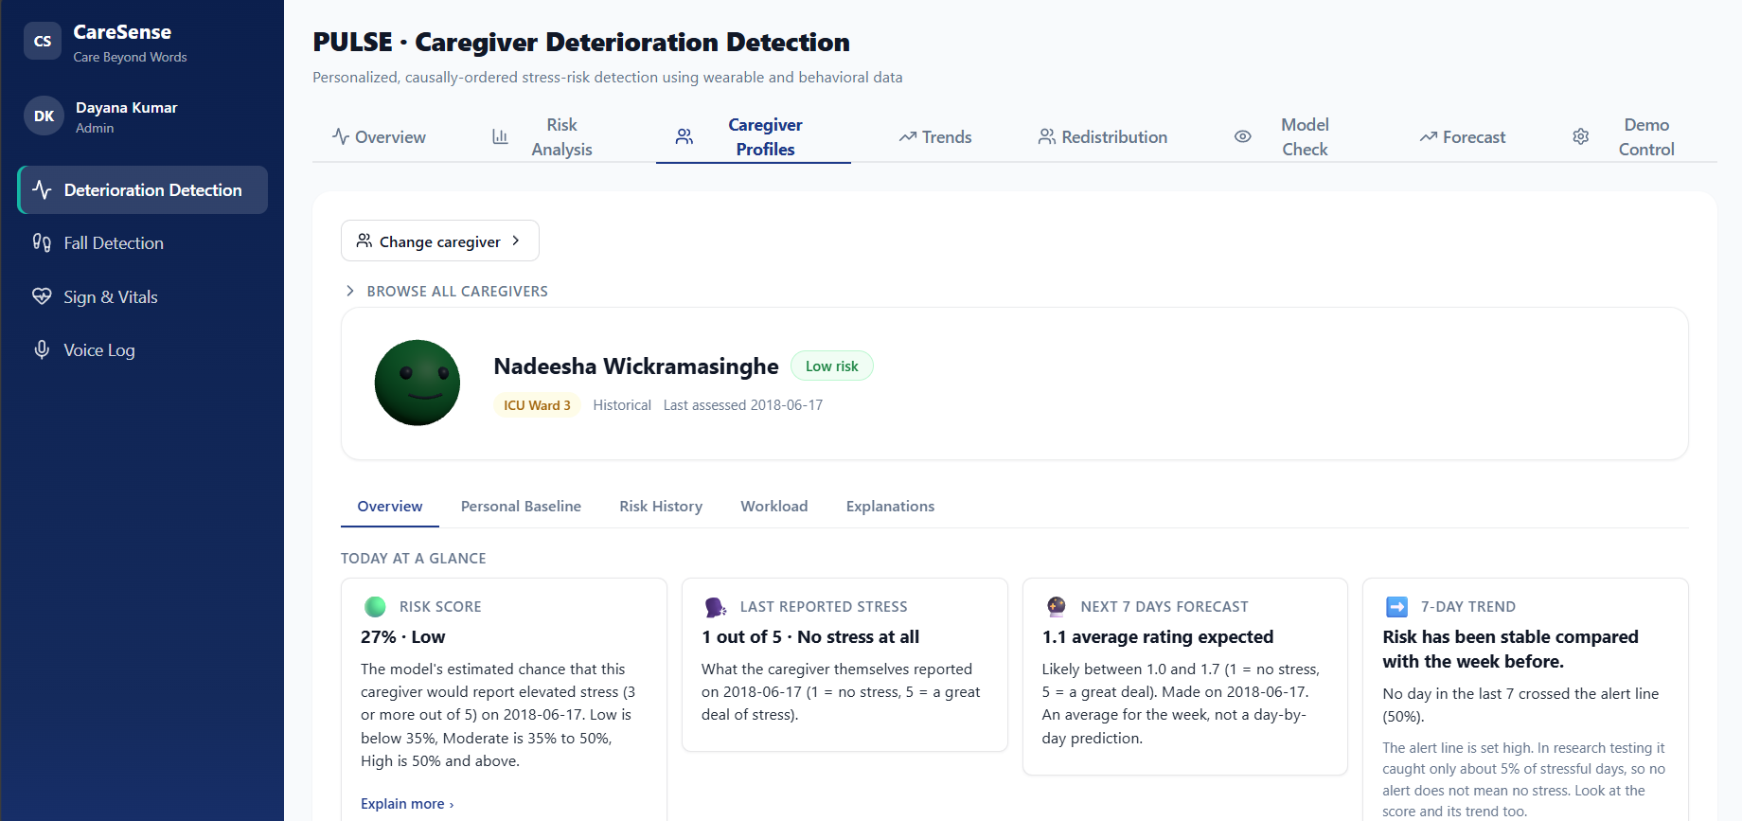

Multimodal Computational Intelligence for Enhancing Caregiver Performance and Care Delivery
FINAL VIVA · BSC (HONS) IT · DATA SCIENCE
PULSE
SENTRY
SCRIBE
GLOSS
Dayana Priyadharshani Kumar · Harishalinee Elangovan · Vithursha Prabagaran · Kaushalya Nagenthraraja
Supervisor: Prof. Samantha Thelijjagoda
Co-supervisor: Mr. Samadhi Rathnayake
4 AI modules · 1 integrated platform
A person always stays in the loop
R26-DS-010
21 October 2026 · 1
Notes:
Opening: introduce the group (R26-DS-010), the CareSense platform and its four components: PULSE (caregiver strain), SENTRY (fall detection), SCRIBE (voice-to-record documentation) and GLOSS (sign-language tutor). One web application, one sign-in, a person in control of every decision.

Slide 2
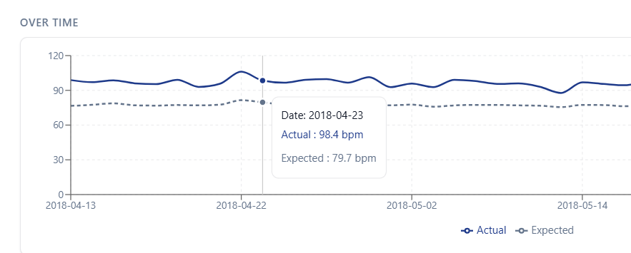

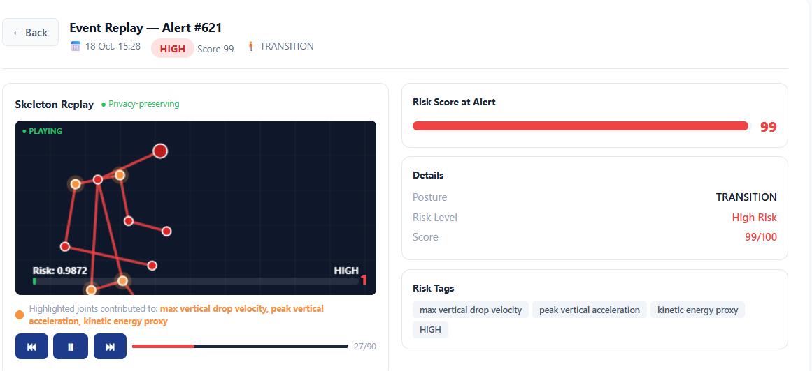

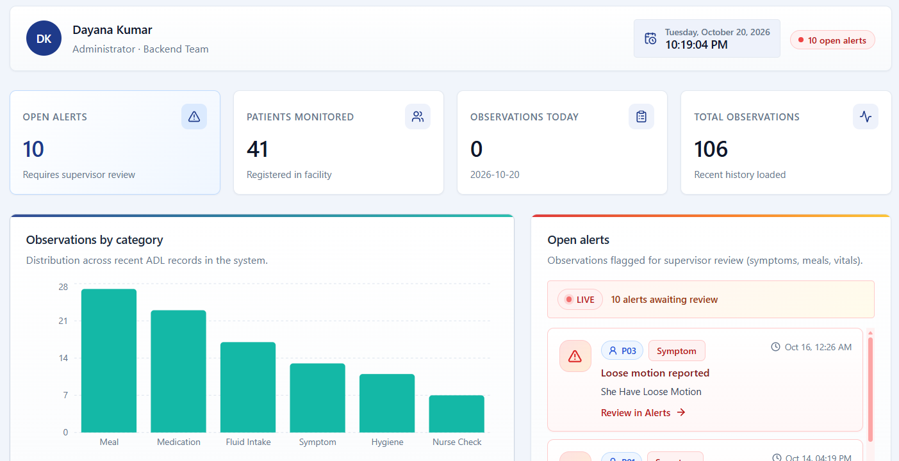

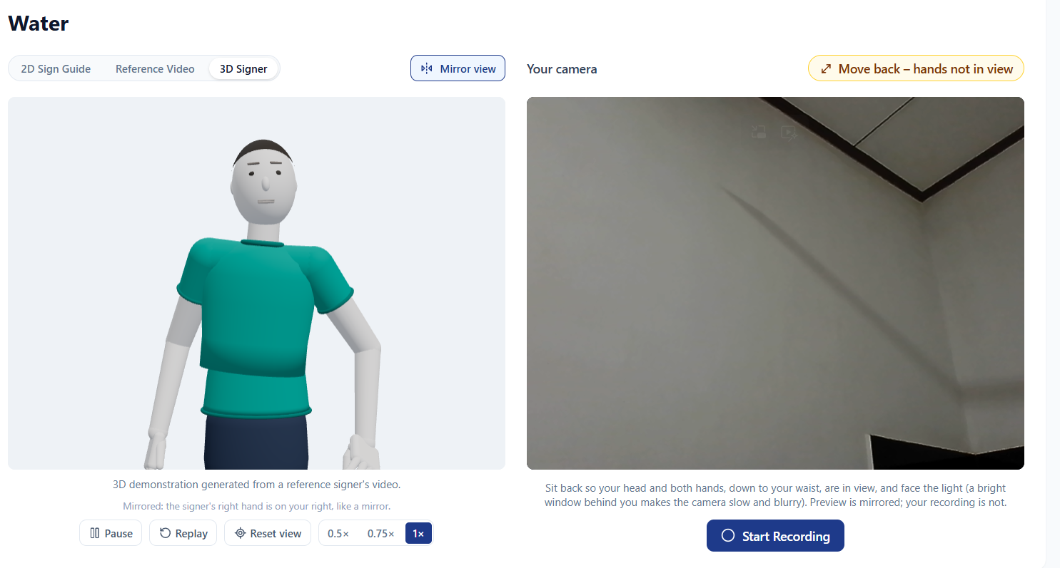

Panel Feedback and Our Solutions
Panel DS-P02
Student ID
Detailed Comments
Our Solution
Solution Space
IT22178640
“When it comes to visualisation, show actual and predicted HR to check model performance.”
Model Check tab plots actual vs predicted heart rate (Stage-1 expected-HR residual)
Held-out check: ROC AUC 0.72 on 27 unseen caregivers
PULSE
Add PULSE screenshot
IT22057488
“Improve model accuracy and prediction when it changes with the environment.”
Fine-tuned on real Hikvision webcam footage — AUC improved from 0.41 → 0.85
5-step augmentation + hip-centerd normalization ensures robustness across environments
SENTRY
Add SENTRY screenshot
IT22294098
“No comments.”
Handles long recordings with more than one observation
SCRIBE
IT22289384
“Evaluate properly whether caregivers remember sign language: (1) ask them to perform a sign for a given word or sentence; (2) show a sign and check they can identify its meaning. Show how personalisation happens from person to person.”
Perform: webcam recognition of 59 care signs plus a DTW execution score
Identify: quiz with a 2D sign guide and reference video
Personalised: mastery per sign, repeat until mastered, next-lesson pick
GLOSS
Add GLOSS screenshot
R26-DS-010
21 October 2026 · 2
Notes:
Each member answers the panel comment given for their component. PULSE: actual vs predicted heart rate to judge model performance. SENTRY: adapt to a changing environment, using a short on-site fine-tune. SCRIBE: no panel comment, so we show the improvements made anyway. GLOSS: evaluate whether caregivers retain signs by perform and identify tasks, with personalisation per person. The dashed boxes are for each member's solution screenshot.

Slide 3
Problem in Brief
Design excellence over existing solutions
Capabilities fully delivered, out of 7
Caregivers carry strain while keeping residents safe, documenting care and communicating, with support split across 4 separate tools.
CareSense
7 / 7
Stress research
0 / 7
86.1%
6.3%
4
12+
Fall systems
0 / 7
Ambient scribes
0 / 7
want to learn sign language
are formally trained
separate logins and dashboards
residents watched per shift
Sign apps
0 / 7
Hatched = partly covered. Only CareSense joins all 4 behind one sign-in, roles, audit log and model registry.
PULSE
Caregiver strain
SENTRY
Fall detection
SCRIBE
Voice-to-record
GLOSS
Sign tutor
0.72
92.3%
15.5%
0.78
ROC AUC on 27 unseen caregivers
sensitivity at 1.28% false alarms
word error rate, down from 26.1%
macro-F1 on 59 care signs
NOVELTY
NOVELTY
NOVELTY
NOVELTY
ST-GCN fused with 18 biomechanical features
3 alert states: NORMAL, MODERATE, HIGH
Skeletons only, no raw video stored
19-field ADL record from spoken notes
Accent-adapted ASR with protected vocabulary
Safety rules lift alert recall to 82%
Care-specific vocabulary, not general signs
Asks for a repeat when unsure
Explained feedback plus Parkinson’s education
Stress score to reviewable workload change
Two-stage model with SHAP reasons
Flags 3 of last 5 days, proposes same-unit cover
R26-DS-010
21 October 2026 · 3
Notes:
Problem: caregivers work under sustained strain while keeping residents safe, keeping records and communicating, but support is split across separate tools. Numbers: 86.1% of health professionals wished to learn sign language and only 6.3% had been formally trained; a caregiver may watch over a dozen residents in one shift. Design excellence (Table 2.3 of the report): CareSense delivers all 7 compared capabilities; stress research, fall systems, ambient scribes and sign apps each deliver none fully and at most two partly. Novelty per component: PULSE turns a score into a reviewable action; SENTRY fuses ST-GCN with 18 biomechanical features and temporal alert states; SCRIBE is a care-home voice-to-record pipeline with a 19-field ADL schema; GLOSS is a care-specific sign tutor with cautious, explained feedback.

Slide 4

IT22178640 | DAYANA PRIYADHARSHANI KUMAR
PULSE · Individual Component
PULSE · CAREGIVER STRESS-RISK DECISION SUPPORT
AI-Assisted Caregiver Workforce Deterioration Detection and Adaptive Workload Redistribution (PULSE)
01
PERSONALIZED MODEL
02
EXPLAINABLE RISK
03
SUPERVISOR REVIEW
Two-stage LightGBM
SHAP-based factors
Workload redistribution
Personalized pipeline using heart rate, physical activity, sleep and previous EMA stress information.
Stress-risk probabilities shown in clear risk tiers with their SHAP-based contributing factors.
Sustained high-risk patterns and supervisor-reviewed workload redistribution suggestions.
0.7211
0.6991
79.30%
+0.0125
Held-out ROC-AUC
Grouped validation ROC-AUC
Test accuracy
Personalized HR modelling
27 caregivers, 1,406 assessments
repeated, participant-grouped mean
vs 78.73% majority baseline
ROC-AUC 0.7086 to 0.7211
Caregiver feedback
Future improvements
Colours and SHAP lists easy to follow
Wants caregiver notes and workload context
Redistribution shown for review only
Retrain on ethical care-home data
Add physiological and workload features
Use skill mix and staffing limits
Decision support for supervisors: every workload change is reviewed by a person.
R26-DS-010
21 October 2026 · 8
Notes:
PULSE: personalized two-stage LightGBM pipeline using heart rate, physical activity, sleep and previous EMA stress, with SHAP explanations and supervisor-reviewed redistribution suggestions. Results: held-out ROC-AUC 0.7211 (27 caregivers, 1,406 assessments); test accuracy 79.30% against a 78.73% majority-class baseline, so ROC-AUC is the headline and accuracy alone should not be claimed as strong performance; repeated participant-grouped validation mean ROC-AUC 0.6991; personalized heart-rate modelling raised test ROC-AUC from 0.7086 to 0.7211. Feedback came from a caregiver walkthrough and is not a formal user acceptance test. Limits: trained and evaluated on hospital-worker data; previous EMA responses contribute substantially; no measured effect of redistribution on stress or care outcomes. Evidence: IT22178640_DRAFT.pdf, Chapters 6, 7 and 9.

Slide 5
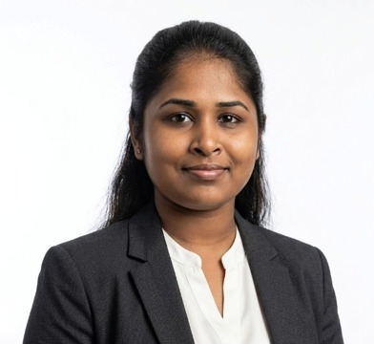
IT22057488 | HARISHALINEE ELANGOVAN
SENTRY · Individual Component
SENTRY · SKELETAL FALL RISK DETECTION
Edge-Enabled Skeletal Movement Analysis System for Real-Time Patient Observable Fall Risk Detection and Prediction
POSE TRACKING
LATE FUSION MODEL
RISK LEVELS
TRAINING DATA
14 body joints
ST-GCN fusion
3 alert levels
3 datasets
MediaPipe Pose tracks the skeleton and analyses 3 seconds of movement per inference.
Skeleton graph combined with 18 biomechanical features into a risk score of 0.0–1.0.
NORMAL, MODERATE or HIGH, with zone-aware modifiers for bed and chair areas.
NTU RGB+D, UR Fall Detection and in-house Hikvision webcam recordings.
AUC
AUC
ACCURACY
LATENCY
0.9926
0.9836
91.4%
5.55 ms
random split
unseen subjects
real-world testing
fully on-device, real-time
R26-DS-010
21 October 2026 · 8

Slide 6
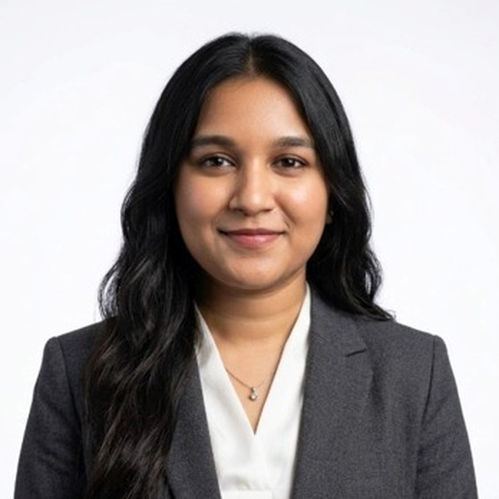
IT22294098 | Vithursha Prabagaran
Individual component
SCRIBE · ADL EXTRACTION AND REALTIME DOCUMENTATION
SCRIBE – Context-Aware Intelligent System for Automated ADL Extraction and Real-Time Documentation from Caregiver Voice Logs
How SCRIBE works
Accuracy and benchmark tests
Caregivers speak their daily care observations instead of writing them by hand. SCRIBE turns each voice log into a structured ADL record and decides whether it needs the supervisor’s attention.
SPEECH RECOGNITION · WHISPER-SMALL + LORA (RANK 16)
WER 26.13% → 15.57%
1
Whisper-small + LoRA
Speech recognition for South Asian-accented English
CER 12.85% → 5.32% (zero-shot → LoRA)
2
BART-base
Removes fillers and spoken self-corrections
DISFLUENCY REMOVAL · BART-BASE, FINE-TUNED
BLEU 0.9530 ROUGE-L 0.9817
3
LanguageTool
Safe grammar fixes; medication and food names protected
Fillers and self-corrections removed
4
T5-small + field rules
Extracts a 19-field ADL record and supervisor alerts
SAFETY EVALUATION · 200 CASES, T5-SMALL
Written report
Shift handover · text + audio
Stored in CareSense
F1 88.49%
OUTPUTS
Recall 82.00% · Precision 96.09%
ADL fields cover medication, meals, hygiene, mobility, fluid intake, symptoms, nurse checks and family visits.
R26-DS-010
21 October 2026 · 7
Notes:
SCRIBE (IT22294098, Vithursha Prabagaran): caregivers record daily care observations by voice. Pipeline: Whisper-small with LoRA (rank 16) for South Asian-accented English, BART-base to remove fillers and self-corrections, LanguageTool with protected medication and food names, then T5-small with field rules to extract a 19-field ADL record and alerts. Outputs: a written report and a shift handover summary in text and spoken audio, stored in the shared CareSense platform. Results: WER 26.13% to 15.57%, CER 12.85% to 5.32%; BLEU 0.9530, ROUGE-L 0.9817; 92.3% exact match on 233 test records; safety set of 200 cases: recall 82.00%, precision 96.09%, F1 88.49%.

Slide 7
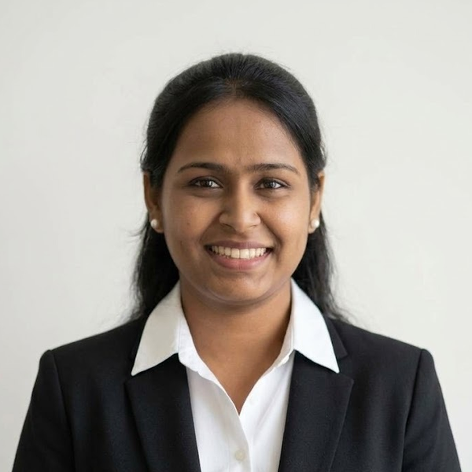
IT22289384 | KAUSHALYA NAGENTHRARAJA
GLOSS · Individual Component
GLOSS · CARE-SIGN TUTORING FOR CAREGIVERS
Personalized Sign Language Tutoring System for Caregivers (GLOSS)
01
SIGN RECOGNITION
02
EXECUTION QUALITY
03
ADAPTIVE LEARNING
TCN + SPOTER-style ensemble
DTW scoring and feedback
Mastery per sign
MediaPipe landmarks from the webcam classify 59 care signs; unsure attempts are asked again.
Compares each attempt with a reference signer and names the hand or body part to fix.
Perform and identify practice; repeat until mastered, then the next lesson is chosen.
0.7752
98.4%
78.59%
+0.039
Test macro-F1
Correct when confident
Test accuracy
Gain over best single model
59 signs, 355 unseen videos
when confidence is ≥ 0.6
95% CI for macro-F1: 0.712–0.802
95% CI +0.008 to +0.072
Caregiver feedback
Future improvements
Practice screens good for testing memory
Localise to Sri Lankan Sign Language
Supervisors also see the progress
Sri Lankan Sign Language version
Signer-independent evaluation
Fully live, real-time recognition
A sign tutor made for caregivers: it checks your sign, tells you what to fix, and asks you to try again when it isn’t sure.
R26-DS-010
21 October 2026 · 7
Notes:
GLOSS (IT22289384, Kaushalya Nagenthraraja): a personalized sign-language tutor that teaches caregivers 59 care-relevant ASL signs. Pipeline: MediaPipe Holistic landmarks from the webcam; an ensemble of an improved TCN and an improved SPOTER-style transformer recognises the sign; DTW against a reference signer grades execution (strong, moderate, weak) and localises the hand or body part to fix; rule-based feedback is reworded by Gemini behind a guard (no LLM below 0.35 confidence, the LLM sees only the rule text, every reply is checked with fallback); mastery is 3 consecutive strong attempts and drives next-lesson selection. Results on 355 test videos: macro-F1 0.7752 (95% CI 0.712 to 0.802), accuracy 78.59%; the ensemble was chosen on validation (0.8116) and beats the best single model by 0.039 (95% CI 0.008 to 0.072). When confidence is 0.6 or above it is right 98.4% of the time. Feedback: Love and Care UAT (18 Oct 2026) and the CCHSS HOD; localise to Sri Lankan Sign Language. Limits: split is by sign, not signer; hurt and pain are weak; test signers are fluent, not novices. Parkinson's content is educational only, with no classifier.

Slide 8
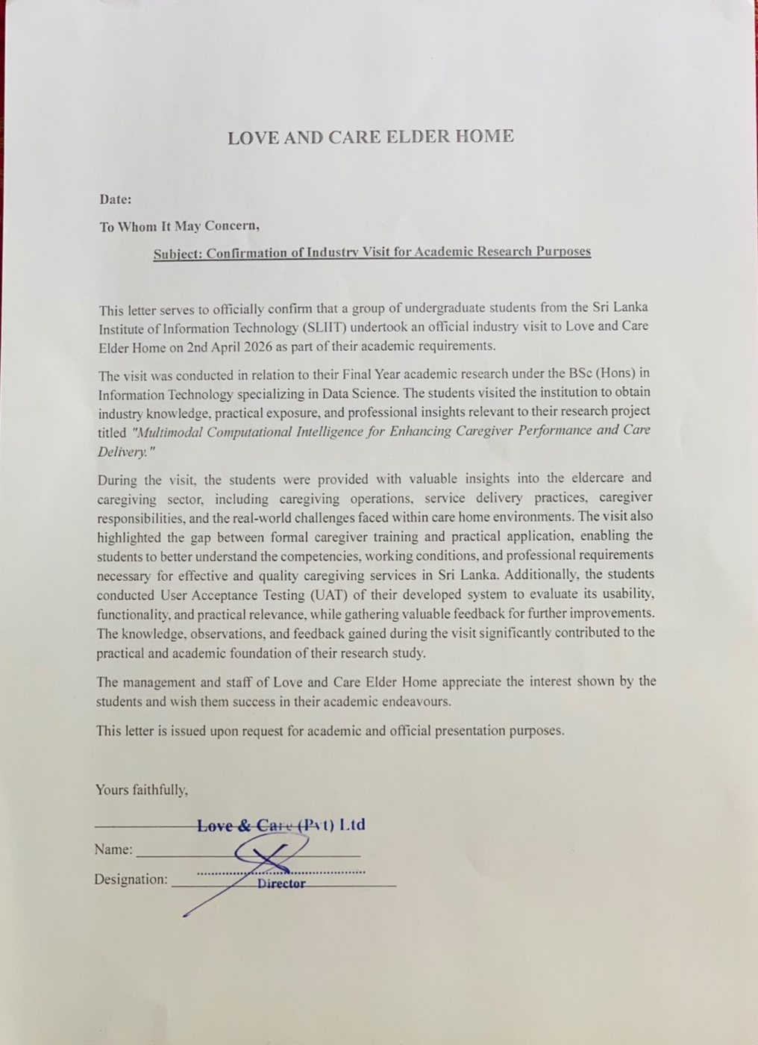
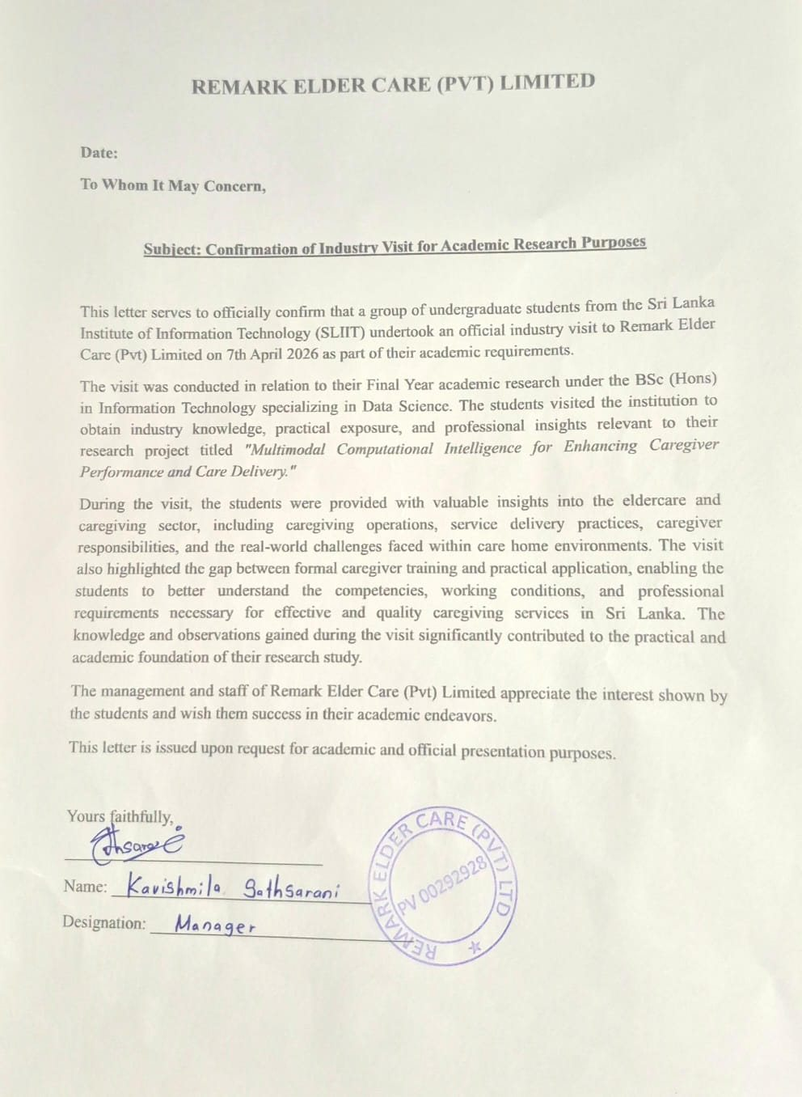
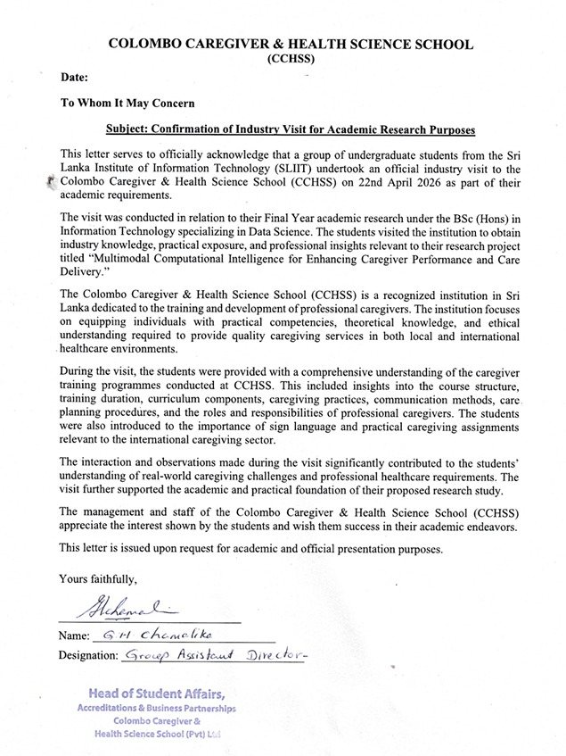
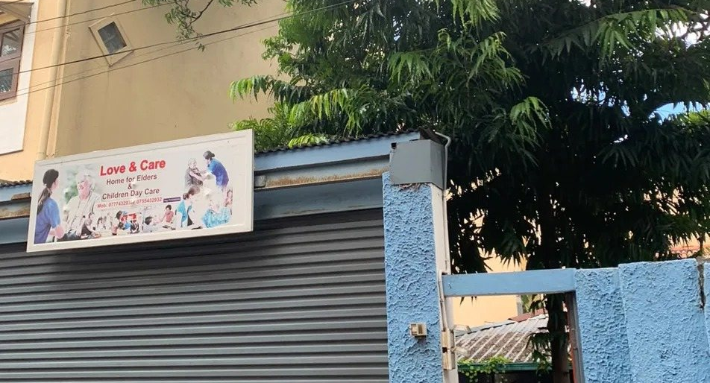
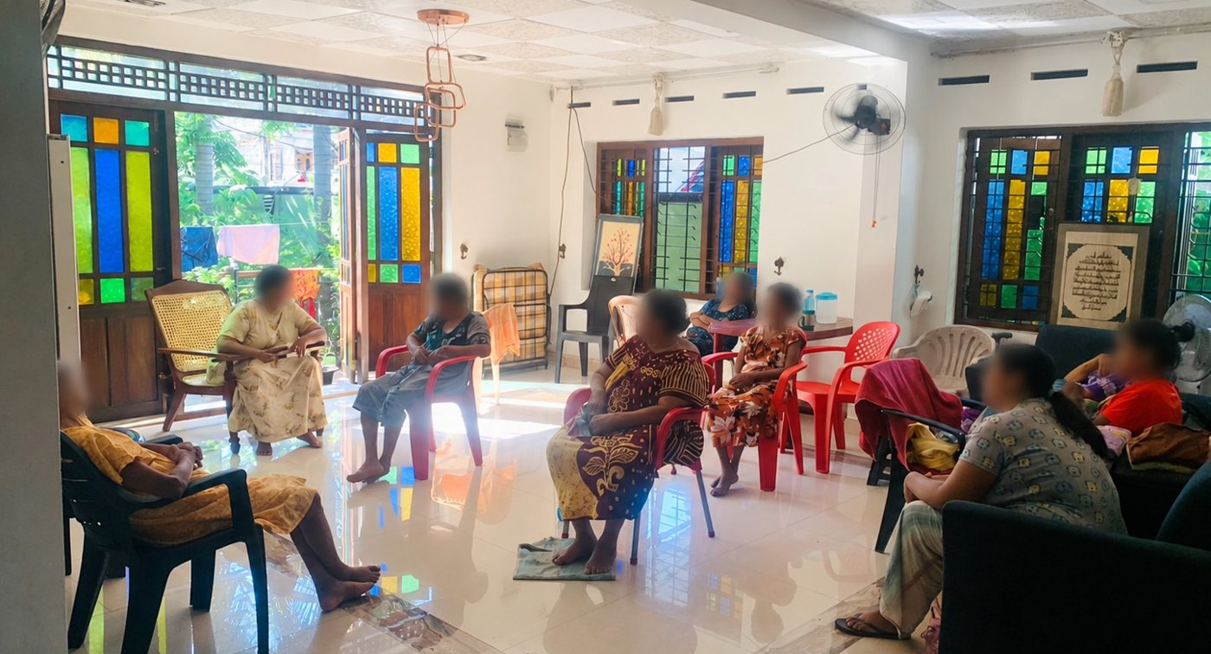
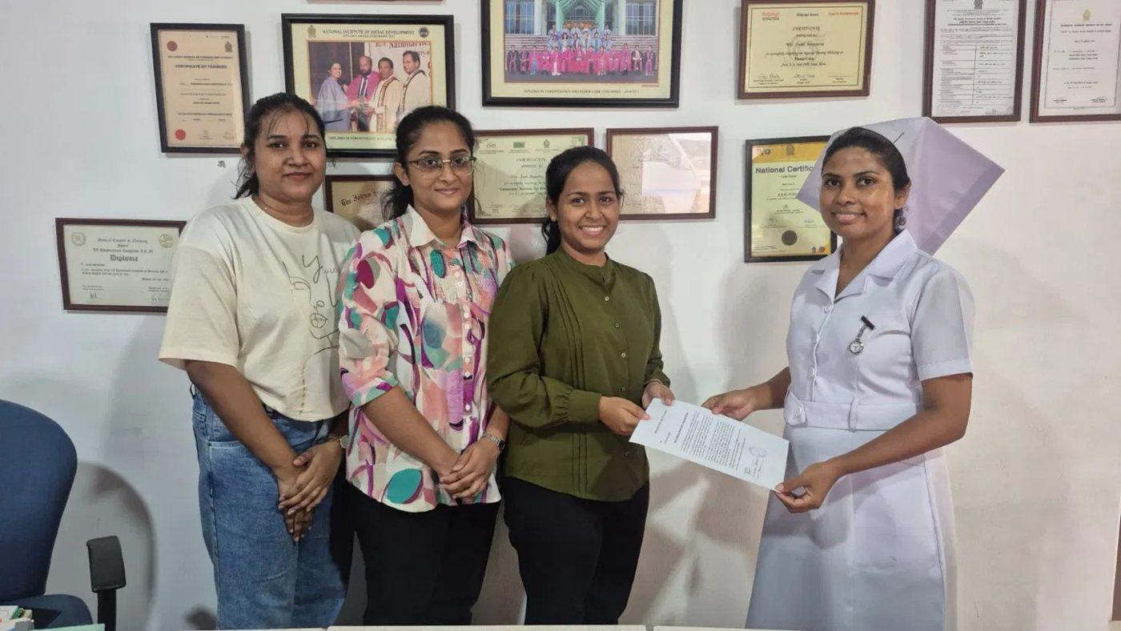
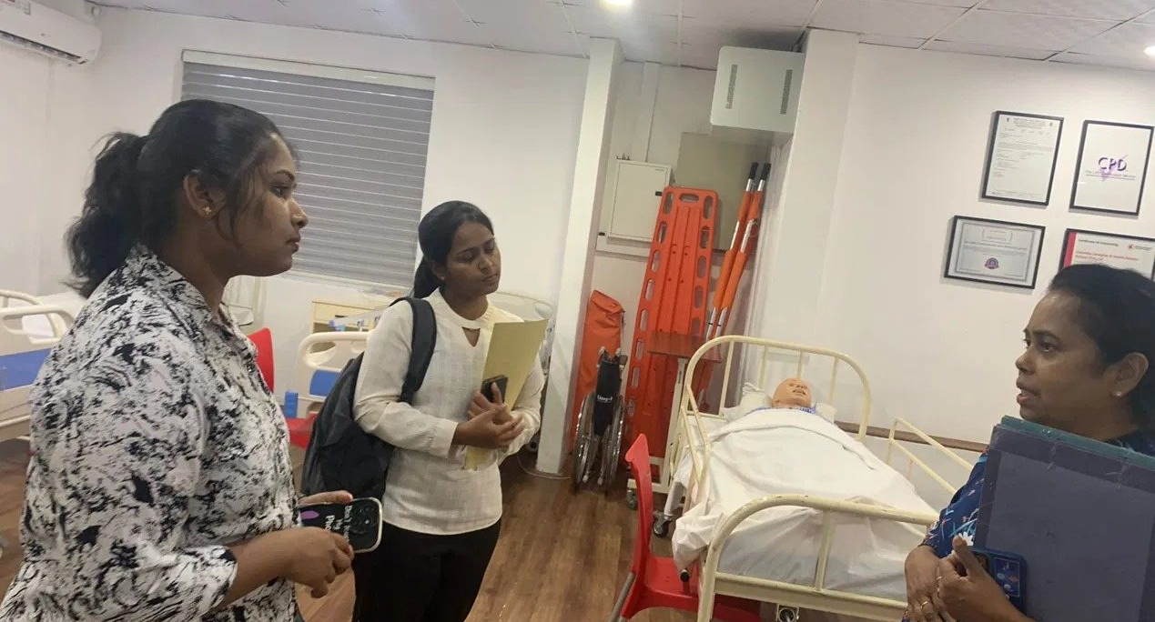
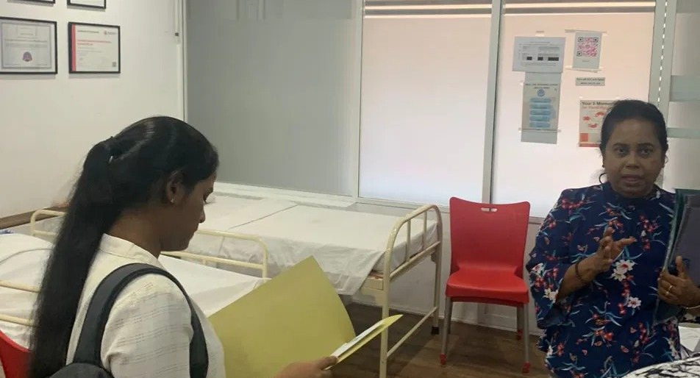
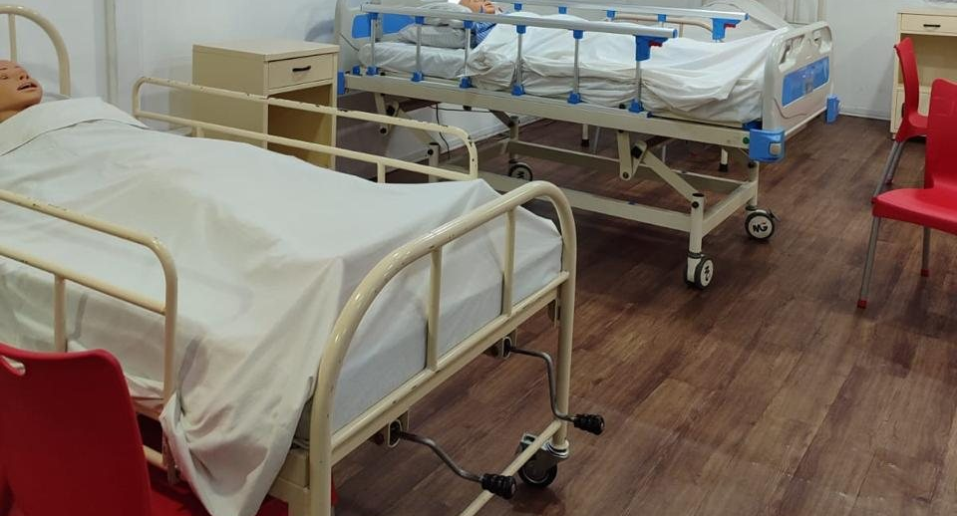
Industry Visits: Learning from the Care Sector
3 organisations · 3 signed letters
27 Nov, 10 Dec 2025
Jan to Feb 2026
Apr to Oct 2026
Sep 2026
Apr and Oct 2026
Supervisor: topic refinement
External supervisor: daily care work
Love and Care Elder Home: visit and UAT
Remark Elder Care: strain interview
CCHSS: how sign language is taught
Love and Care Elder Home
Remark Elder Care
Colombo Caregiver and Health Science School
2 Apr 2026 · repeat visits to Aug
7 Apr 2026 · PULSE walkthrough in Aug
User acceptance testing of CareSense
Handwritten care records reviewed
Staff welcomed prompt, reliable alerts
Group interview with the Chairperson
Caregiver strain and substitute cover
Early signs of Parkinson’s discussed
22 Apr 2026 · CCHSS
Site visit with a sign-language tutor
Course structure and caregiver training
Led to our fixed 59-sign vocabulary
On-site moments
Love and Care entrance
Residents’ lounge, faces blurred
Team receives a visit letter
CCHSS training room briefing
CCHSS practical training area
Mannequin beds for care practice
R26-DS-010
21 October 2026 · 4
Notes:
Our requirements came from the people who do the work. Timeline: supervisor discussions (27 Nov and 10 Dec 2025), external supervisor meetings (Jan to Feb 2026), then three signed industry-visit letters: Love and Care Elder Home (2 Apr 2026), Remark Elder Care (7 Apr 2026) and the Colombo Caregiver and Health Science School (22 Apr 2026). Repeated visits to Love and Care continued from April to August 2026. No audio was recorded and no resident was interviewed.

Slide 9






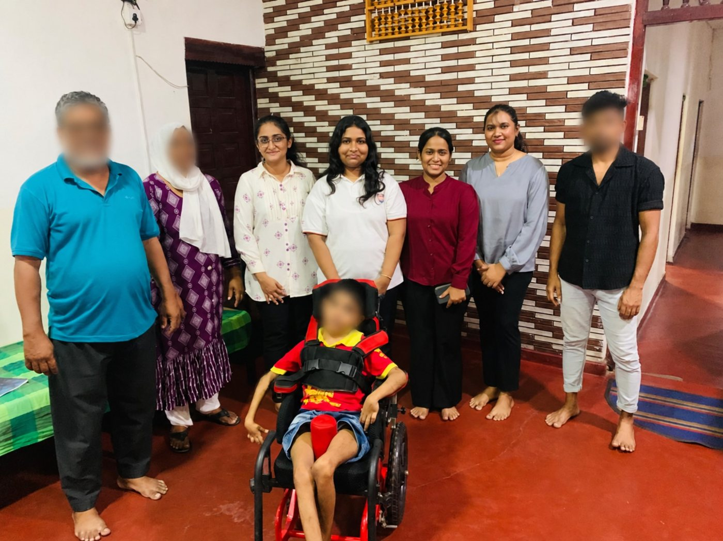
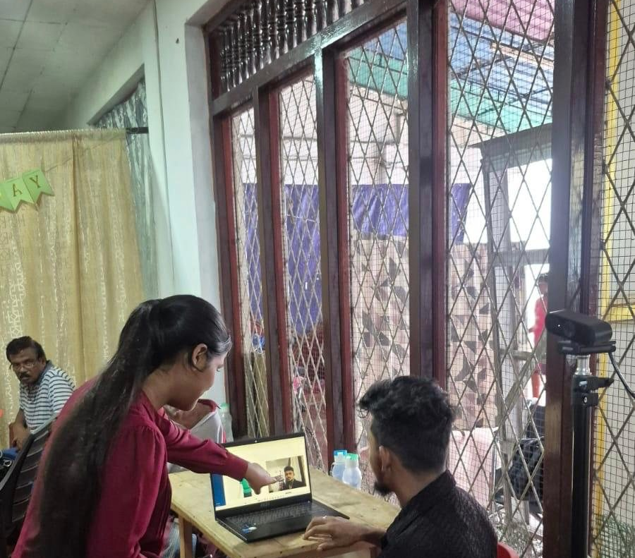
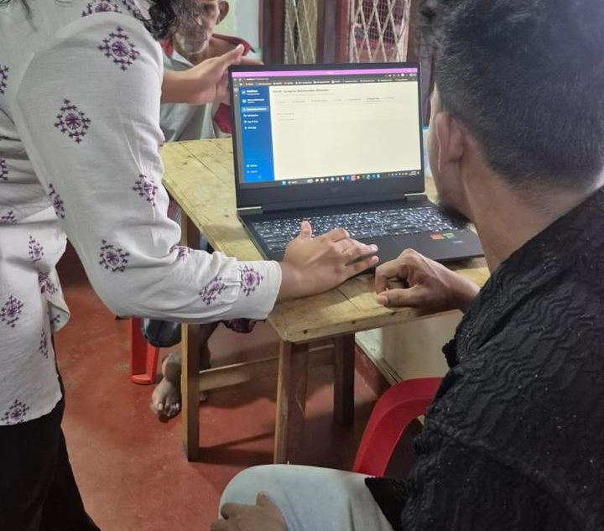
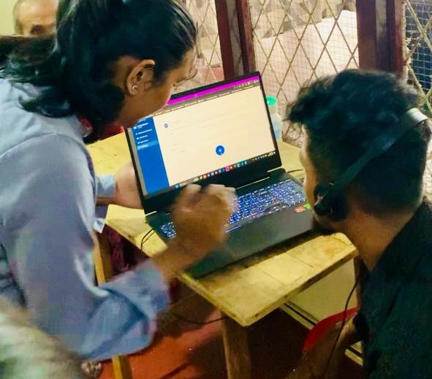
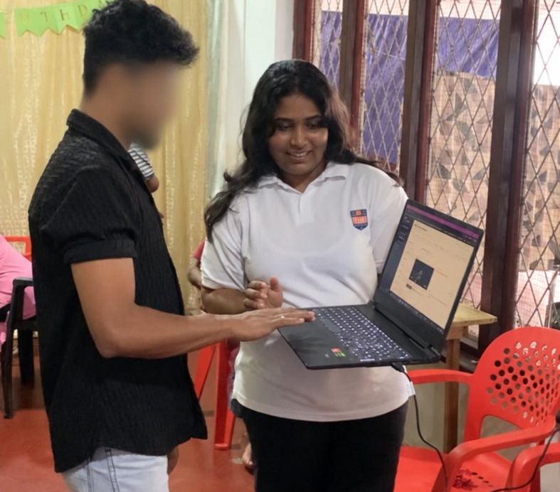
User Testing Journey Map
User acceptance testing with care-home staff
1 · Meet
2 · Demo
3 · Try
4 · Feedback
5 · Refine
Introduced CareSense to staff, caregivers and trainees
Walked through PULSE, SENTRY, SCRIBE and GLOSS screens
Users tried webcam, voice and dashboards hands-on
Heard what felt useful, unclear or missing
Turned each comment into a design change
What users said, what we changed
Cover should reflect skill mix, shifts and minimum staffing; get consent first
PULSE
Change: pilot requirements and module wording
Welcomed prompt, reliable fall alerts
SENTRY
Change: 3 simple alert states and acknowledgement
SCRIBE
Questions about long, multi-sentence recordings
Change: audio chunking and sentence splitting
Hands-on user acceptance testing at the care home: users try CareSense on a laptop with webcam and voice.
Skills fade after training; signing speeds differ
GLOSS
Change: 59 signs, repeat until mastered, DTW scoring
4 / 4
200
3
modules reviewed by stakeholders
safety labels checked by a caregiver
partner organisations gave feedback
R26-DS-010
21 October 2026 · 5
Notes:
User testing journey: Meet (introduce the platform to staff, caregivers and trainees), Demo (walk through the four modules), Try (hands-on use with webcam, voice and dashboards), Feedback (usefulness, clarity, gaps) and Refine (each comment changed the design). The Love and Care letter confirms user acceptance testing of the developed system on 2 April 2026. Feedback and refinements come from Table 6.5 of the report: PULSE (Remark Elder Care walkthrough, Aug 2026), SENTRY (Love and Care and Remark staff), SCRIBE (two care homes plus a caregiver who reviewed the 200-case safety set), GLOSS (caregiver trainees, a CCHSS sign-language tutor and the Remark Chairperson).

Slide 10




Our Research Paper Is Accepted
ACCEPTED
PUBLICATION MILESTONE
PAPER ID · ICSCDS-0291
Multimodal AI Framework for Intelligent Caregiver Support and Patient Safety in Care Facilities
4th International Conference on Sustainable Computing and Data Communication Systems (ICSCDS 2026)
15–17 December 2026, Shree Venkateshwara Hi-tech Engineering College, India
Accepted for presentation and publication in IEEE conference proceedings
Authors: Dayana Priyadharshani Kumar, Harishalinee Elangovan, Vithursha Prabagaran, Kaushalya Nagenthraraja, Samadhi Rathnayake, Samantha Thelijjagoda
R26-DS-010
21 October 2026 · 7
Notes:
Our paper “Multimodal AI Framework for Intelligent Caregiver Support and Patient Safety in Care Facilities” (ICSCDS-0291) was accepted with major revision for presentation and publication at ICSCDS 2026, held 15–17 December 2026 at Shree Venkateshwara Hi-tech Engineering College, India, with proceedings by IEEE. Next step: complete the major revision.

Slide 11
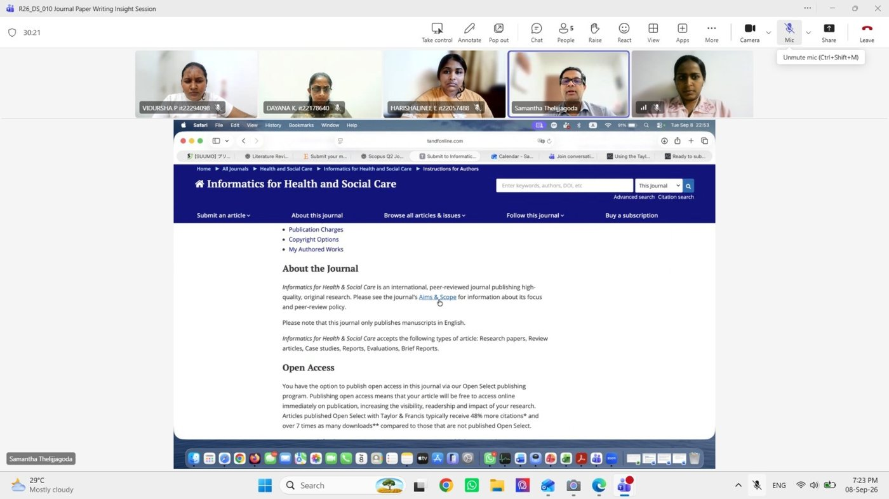
Validated Results and Research Outputs
Tested on data kept apart from development
PULSE
SENTRY
SCRIBE
GLOSS
0.72
92.3%
15.5%
0.78
ROC AUC, 27 unseen caregivers, 1,406 assessments
sensitivity, 1.28% false alarm rate, AUC 0.98
WER 26.13% → 15.57%
(zero-shot → LoRA)
macro-F1; 98.4% of confident calls correct
Research output in progress
Common limitations
1
Public and de-identified data
2
Small samples
Models were trained on existing datasets, so results may shift on new data
Wide confidence intervals; larger samples will narrow them
3
Limited labels and thresholds
4
Advisory use only
Self-reported ratings and small test sets shaped labels and cut-offs
Not a medical device; a person decides every action
Journal paper writing session with our supervisor, 8 Sep 2026
Every output is advice to a person. Next steps: ethics approval and a field pilot.
R26-DS-010
21 October 2026 · 6
Notes:
Principal held-out results (Table 6.4 of the report): PULSE ROC AUC 0.7211 (95% CI 0.6644 to 0.7699) on 27 unseen caregivers; SENTRY sensitivity 92.31%, false alarm rate 1.28%, AUC 0.9836 on unseen NTU subjects, and a short fine-tune on webcam clips restores cross-setting AUC from 0.410 to 0.8527; SCRIBE word error rate 15.57% (26.13% before adaptation) and alert recall 93.3% with rules (82.0% model-only); GLOSS macro-F1 0.7752 on unseen signers with 98.4% of confident predictions correct. Limits: models were trained on data from other settings, so site-level calibration in the pilot is the next step.

