Slide 1
Multimodal Computational Intelligence for Enhancing Caregiver Performance and Care Delivery
R26-DS-010
Main Supervisor : Prof. Samantha Thelijjagoda
Co – Supervisor : Mr. Samadhi Rathnayake
External Supervisor : Mr. Velu Sivakumar
Notes:
Healthcare is under pressure. Caregivers burn out. Patients fall. Documentation fails. And for deaf and hard-of-hearing patients, something as basic as communication breaks down at the bedside. These are not edge cases — they are daily realities in hospitals and care homes across Sri Lanka and globally.

Slide 2

Multimodal Computational Intelligence for Enhancing Caregiver Performance and Care Delivery
1
Problem & Impact
2
Who Benefits
Chronic stress, burnout, high error rates — directly affect patient safety and staff turnover (Shanafelt et al., Mayo Clinic Proc.)
Compounding burden: patient falls, manual documentation overload, and communication breakdowns with deaf / hard-of-hearing patients.
Existing tools are reactive, single-modal, and impersonal — missing early-warning signals before burnout threshold is reached.
Tier | Group | Outcome
PRIMARY | Caregivers — nurses, eldercare & home-care staff, and supervisors | Reduced burnout; better performance
SECONDARY | Patients & healthcare institutions | Improved safety, fewer falls, lower turnover
TERTIARY | Deaf and hard-of-hearing patients | Reliable signed communication
3
Design Excellence of the Solution
Unified Multimodal Platform
Personalization Per Caregiver
Explainability Built In
Early-Warning Focus
Physiological + acoustic stress detection, edge-based fall prediction, voice-driven ADL documentation, and adaptive sign-language tutoring.
Isolation Forest baselines and RL-based adaptive learning tuned to each individual caregiver's patterns.
Transparent reasoning so caregivers and supervisors can trust and act on the system's signals.
Proactive — flags risk signals before burnout threshold is reached, unlike existing reactive tools.
Notes:
THE PROBLEM — 40 seconds
"Shanafelt et al., published in Mayo Clinic Proceedings, showed that over 54% of physicians experience burnout — and the pattern is identical for nurses. But here is what makes this worse: existing tools only detect burnout after it has already occurred. They are reactive, single-modal, and impersonal — applying the same population-level threshold to every caregiver regardless of their individual physiological baseline.
And burnout is only one dimension of the problem. Caregivers also face patient falls that go undetected until it is too late, documentation systems that demand their hands and eyes when their patients need both, and a complete gap in accessible communication for deaf patients. Four connected problems. No unified solution.“
THE SOLUTION — 40 seconds
"Our group project — CareSense — addresses all four dimensions under one platform: Multimodal Computational Intelligence for Enhancing Caregiver Performance and Care Delivery.
The platform has four integrated components. My component — Deterioration Detection — uses physiological wearable signals and acoustic voice analysis to detect caregiver stress before the burnout threshold is reached, with personalised baselines and explainable AI. The second component handles edge-based fall prediction for patients. The third automates clinical documentation through voice, freeing caregiver hands entirely. The fourth provides adaptive sign-language tutoring to bridge the communication gap with deaf and hard-of-hearing patients. Together, these four components form a system that no single team member could build alone.“
WHO BENEFITS — 30 seconds
"The system serves three tiers of beneficiaries. Primary — caregivers themselves: nurses, eldercare staff, and their supervisors — who gain reduced burnout risk, better performance insights, and actionable early warnings. Secondary — patients and healthcare institutions — who benefit from fewer falls, lower error rates, and reduced turnover costs. And tertiary — deaf and hard-of-hearing patients — who gain reliable, technology-assisted signed communication at the point of care."
DESIGN EXCELLENCE — 30 seconds
"What distinguishes CareSense from existing tools comes down to four design principles. First — unified and multimodal: physiological signals, acoustic features, edge sensors, and voice documentation in a single platform. Second — personalised per caregiver: Isolation Forest baseline modelling means the system learns each individual's normal before raising any alert. Third — explainability built in: every risk score comes with a SHAP-based explanation so clinical supervisors can see exactly what is driving the flag, not just a number. And fourth — proactive not reactive: the system flags risk before the burnout threshold is breached, which is the fundamental gap in every existing tool."

Slide 3
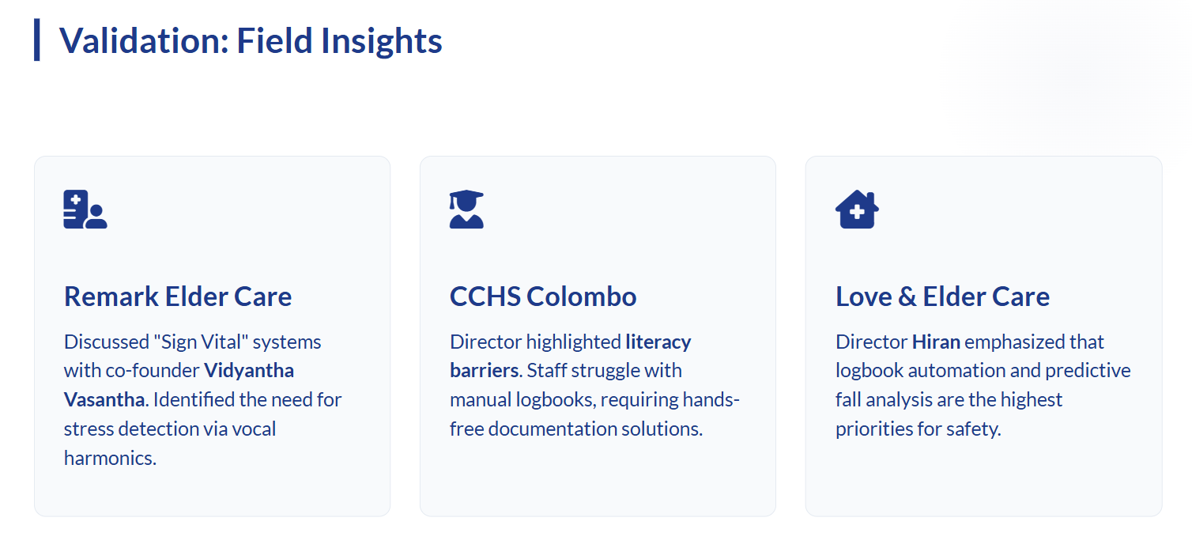
Multimodal Computational Intelligence for Enhancing Caregiver Performance and Care Delivery
Notes:
FIELD VALIDATION — 40 seconds
"This is not a theoretical system. Before a single line of code was written, the team conducted field validation with three real organisations.
At Remark Elder Care, co-founder Vidyantha Vasantha confirmed the need for stress detection through vocal harmonics — caregivers are showing signs of stress in their voice before they report it themselves. At CCHS Colombo, the director highlighted literacy barriers — staff struggle with manual logbooks and urgently need hands-free documentation. And at Love and Elder Care, Director Hiran identified predictive fall analysis and logbook automation as their highest safety priorities.
Three organisations. Three independent confirmations that these four problems are real and unsolved."

Slide 4
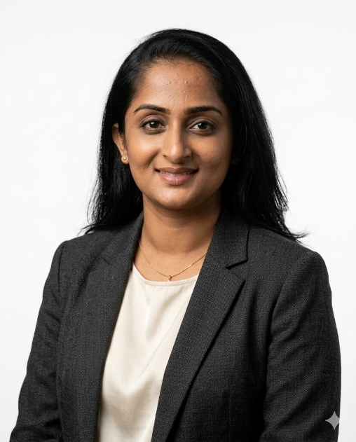
IT22178640 | DAYANA PRIYADHARSHANI KUMAR
Student Must add a professional photo to this cage
Component 01: AI-Assisted Caregiver Workforce Deterioration Detection and Adaptive Workload Redistribution
Specialization : Data Science
IT22178640 | DAYANA PRIYADHARSHANI KUMAR | R26-DS-010
Notes:
My component is AI Assisted Caregiver Workforce Deterioration Detection and Adaptive Workload Redistribution. My component addresses the most invisible problem in healthcare — a caregiver burning out before anyone notices

Slide 5




AI-Assisted Caregiver Workforce Deterioration Detection and Adaptive Workload Redistribution
HOW THE SOLUTION ADDRESSES THE SUB-PROBLEM
USER REQUIREMENTS ADDRESSED BY THE SOLUTION
DETECT
PERSONALISE
PREDICT
Requirement | Type | Status
Detect stress from physiological signals | Functional | DONE
Detect stress from acoustic / voice features | Functional | DONE
Personalise alerts to individual baseline | Functional | DONE
Show trajectory + forecast per nurse | Functional | DONE
Explain model decisions (SHAP per nurse) | Functional | DONE
Relational team network graph | Functional | PARTIAL
Workload redistribution suggestions | Functional | PROTO
Real-time inference backend (FastAPI) | Functional | PP2
Accuracy above majority-class baseline | Non-Functional | DONE
Per-individual SHAP explainability | Non-Functional | DONE
Reduced false positive rate (Isolation Forest) | Non-Functional | DONE
Privacy — de-identified · PhysioNet license | Non-Functional | DONE
Multimodal Stress Detection
Individual Baseline
Burnout Trajectory
XGBoost on EDA + Temperature + HRV
13,287 windows · 15 real nurses
Binary F1 = 0.861 under LOSO CV
Isolation Forest per nurse
7-day calibration · 15 models
Ablation: lowest false positive rate
Daily risk score + slope per nurse
Days-to-threshold computed
Nurse 5C: +2.73/day, already critical
3-Class XGBoost (LOSO) · Macro F1 = 0.305 · Accuracy = 64.1% · 15-fold · No Stress / Medium / High
Binary XGBoost (LOSO) · Binary F1 = 0.816 · Accuracy = 74.7% · RF best at 0.822 → XGBoost selected for exact SHAP
Audio Classical (RAVDESS) · LR best · F1 = 0.780 · AUC = 0.826 · 34 acoustic features · 5-fold actor-independent
Audio 1D CNN (RAVDESS) · F1 = 0.804 · AUC = 0.889 · 130×13 MFCC matrix · selected — best all metrics
Late Fusion · Physio 51.7% + Audio 48.3% · weights derived from validated F1 scores
IT22178640 | DAYANA PRIYADHARSHANI KUMAR | R26-DS-010
Notes:
"The sub-problem I identified: existing systems are reactive, population-level, and unexplainable. CareSense addresses this in three layers.
Detect — XGBoost trained on EDA, temperature, and HRV from 15 real hospital nurses. 13,287 signal windows. Binary F1 of 0.861 under Leave-One-Subject-Out validation — the test nurse was never seen during training.
Personalise — an Isolation Forest model fitted per nurse on their first 7 days. Not compared against the average. Compared against herself. My ablation study — three strategies head to head — proves this reduces false positive rate over both fixed and population thresholds.
Predict — daily risk scores with a slope computed per nurse. Nurse 5C is already critical at slope plus 2.73 per day. Nurse 83 is 8 days from the threshold. The system tells you not just who is stressed — but who is about to be.
On the right you can see all 12 requirements — 9 fully complete, 1 partial, 1 prototype, 1 planned for PP2. The backend inference layer is architected and designed — deployment is the PP2 milestone."

Slide 6
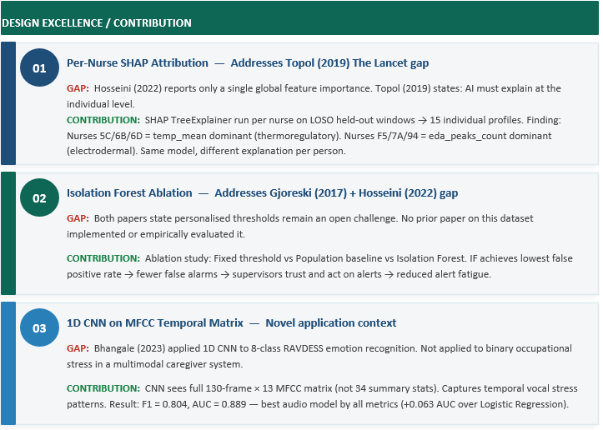
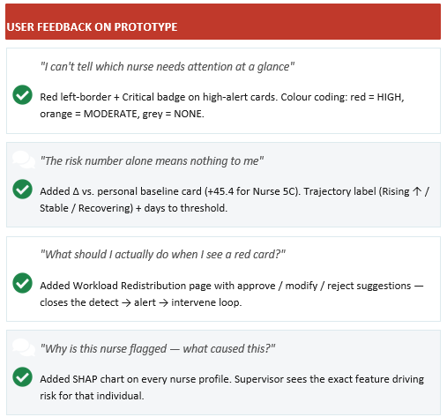
AI-Assisted Caregiver Workforce Deterioration Detection and Adaptive Workload Redistribution
IT22178640 | DAYANA PRIYADHARSHANI KUMAR | R26-DS-010
Notes:
"Three research contributions that go beyond prior work.
First — per-nurse SHAP attribution. Hosseini 2022, the authors of my dataset, report only a global feature importance. Topol 2019 in The Lancet says AI must explain at the individual level. My system does. Nurses 5C and 6B have temperature as their dominant stress biomarker. Nurses F5 and 7A have EDA peaks. Same model — different explanation per person.
Second — Isolation Forest ablation. Gjoreski 2017 and Hosseini 2022 both name personalised thresholds as future work. I implemented and empirically evaluated it.
Third — 1D CNN on temporal MFCC matrix. F1 of 0.804, AUC of 0.889. Bhangale 2023 did this for 8-class emotion recognition. Nobody had applied it to binary occupational stress in a caregiver monitoring system. I did.
User feedback directly shaped the prototype — five specific changes, five direct responses, all visible in the live system."

Slide 7
AI-Assisted Caregiver Workforce Deterioration Detection and Adaptive Workload Redistribution
| Panel Comment Received at Proposal
“Identify how do you going to identify individual behavioural patterns”
| How CareSense Addresses This
Layer 1 – Personal Baseline Modeling: Isolation Forest is trained on each nurse’s initial 7-day physiological data to establish an individualized “normal” behavioral and stress baseline.
Early Detection of Personal Deviations: Instead of comparing against population averages, the system identifies abnormal patterns unique to each individual nurse.
Layer 2 – Explainable Risk Attribution: XGBoost combined with SHAP analysis highlights the specific physiological features contributing most to stress risk for each nurse.
Personalized Stress Signatures: Different nurses exhibit different dominant stress indicators (e.g., EDA peaks, temperature variation), enabling tailored interpretation of risk.
IT22178640 | DAYANA PRIYADHARSHANI KUMAR | R26-DS-010
Notes:
"The panel asked at proposal: how will you identify individual behavioural patterns? Three layers answer this — personal baseline via Isolation Forest, deviation detection against that individual's own norm, and personalised SHAP signatures showing which physiological feature drives each specific nurse's risk. That is the answer — and it is live in the dashboard."

Slide 8
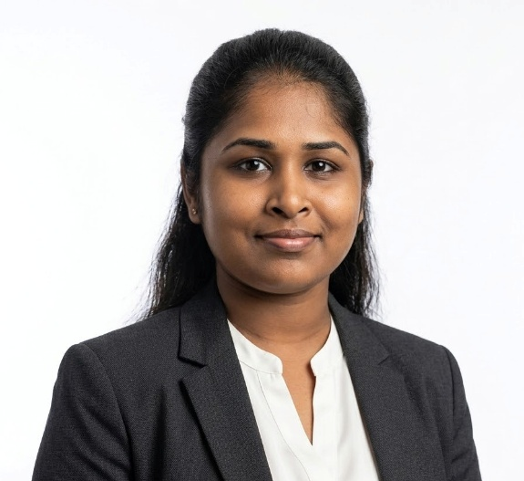
IT22057488 | HARISHALINEE ELANGOVAN
Component 02: Edge-Enabled Skeletal Movement Analysis System for Real-Time Patient Observable Fall Risk Detection and Prediction
Specialization : Data Science
IT22057488 | HARISHALINEE ELANGOVAN | R26-DS-010

Slide 9
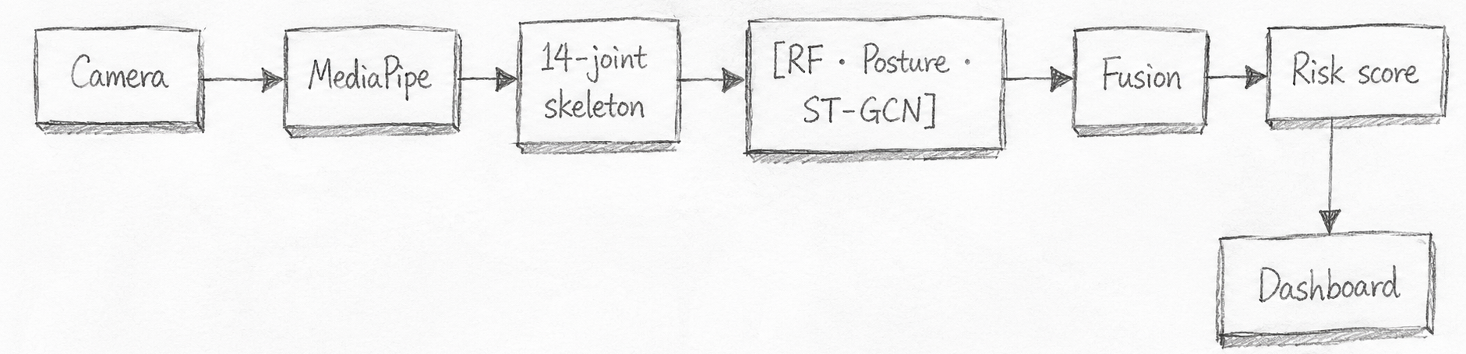
Edge-Enabled Skeletal Movement Analysis System for Real-Time Patient Observable Fall Risk Detection and Prediction
SUB-PROBLEM Existing fall detectors are binary (fall / didn't fall) and trigger after the incident — missing the build-up to instability and producing high false-alarm rates.
1
My Solution
2
User Requirements Addressed
▪ Continuous risk scoring — Low / Moderate / High instead of binary detection
▪ Pipeline: RGB camera → MediaPipe pose → 14-joint skeleton → 4 trained models → real-time verdict on edge device (no cloud)
▪ Four-model ensemble:
• Random Forest baseline (18 hand-crafted motion features)
• 4-class Posture classifier (Lying / Sitting / Standing / Walking)
• Spatio-Temporal Graph CNN (ST-GCN, 14-joint motion)
• Late-Fusion MLP combining all three
▪ RGB discarded at pose extraction — only skeleton processed (privacy-first)
▪ Backend ↔ Frontend: Python pipeline writes JSON manifest → React dashboard reads real model output for every patient card
Requirement | How I address it
Privacy preservation | Skeleton-only data flow; RGB discarded immediately
Real-time on consumer laptop | All processing offline on edge device — no internet needed
Early warning, not post-fall | Moderate Risk class fires before fall escalates
Verifiable, defensible accuracy | 94.24% Fusion test accuracy on 799 held-out subject-disjoint sequences
Explainable predictions | Per-patient "Why?" panel showing dataset action + 8 motion features
Evaluation | 3 protocols — Cross-Subject, Cross-View, Cross-Dataset — to expose generalisation gaps
IT22057488 | HARISHALINEE ELANGOVAN | R26-DS-010

Slide 10
Edge-Enabled Skeletal Movement Analysis System for Real-Time Patient Observable Fall Risk Detection and Prediction
KEY CONTRIBUTION Late-fusion model combining 4 architectures — 94.24% test accuracy on 799 held-out subject-disjoint sequences (+6.8% over RF baseline)
1
Design Excellence / Contribution
2
User Feedback on Prototype
▪ 4 models combined: RF · Posture · ST-GCN · Late-Fusion MLP
▪ Edge-first architecture — inference on Jetson / Coral; only anonymous skeletal vectors leave the camera node
▪ Privacy by design — system never stores or transmits identifiable video
▪ Real-time performance — sub-second end-to-end latency on ward devices
▪ Multi-patient tracking — pose-based identity association handles overlapping subjects in one frame
▪ Modular deployment — swap models (MediaPipe ↔ MoveNet, LSTM ↔ Transformer) without rewriting the system
▪ Explainable & integrated — every prediction shows motion features; backend output drives every dashboard card
3 stakeholders engaged · 4 changes applied
Who | What they said | What I changed
Ward Staff | "No faces leave the room" | Privacy stance validated — no design change needed
Reviewers | "Show which feature drove a high score" | Added explainability layer
Caregivers | "Don't alarm us for every brief wobble only sustained instability" | Added sustained-warning logic Moderate Risk fires only after risk stays in band for 12 seconds (5 ticks); High Risk fires immediately
Advisor | "Widen the model — sit-to-stand & bed-edge" | Added pre-fall behaviors to feature set
IT22057488 | HARISHALINEE ELANGOVAN | R26-DS-010

Slide 11
AI-Assisted Caregiver Workforce Deterioration Detection and Adaptive Workload Redistribution
| Panel Comment Received at Proposal
“When it comes to reasoning, skeletal movement might not be enough”
| How CareSense Addresses This
The system combines deep learning with motion-based reasoning: A spatio-temporal ST-GCN model captures body movement patterns, while 18 handcrafted motion features provide additional information about human movement and instability.
Six reasoning layers improve activity and risk understanding: The framework analyzes movement over time, detects subtle instability, understands posture states such as sitting or standing, and identifies risky transitions like sit-to-stand or sudden drops
Context and pose-quality checks increase reliability: Spatial context helps interpret movements differently based on location, while the pose-quality gate checks for occlusion or unreliable skeleton detection to reduce false alarms
All information is fused into a single final risk score: The deep learning pose stream and motion features are combined using a Late-Fusion MLP to generate a clear low, moderate, or high risk prediction with better reasoning capability.
IT22178640 | DAYANA PRIYADHARSHANI KUMAR | R26-DS-010

Slide 12
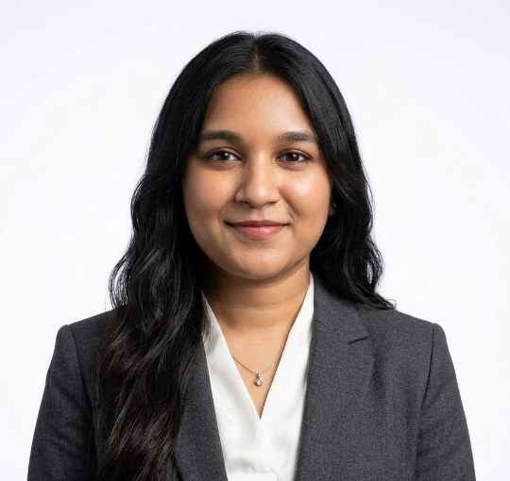
IT22294098 | VIDURSHA PRABAGARAN
Component 03: Context-Aware Intelligent System for Automated ADL Extraction and Real-Time Documentation from Caregiver Voice Logs
Specialization : Data Science
IT22294098 | VIDURSHA PRABAGARAN | R26-DS-010

Slide 13
Context-Aware Intelligent System for Automated ADL Extraction and Real-Time Documentation from Caregiver Voice Logs
1
2
How the Solution Addresses the Sub-Problem
User Requirements Addressed by the Solution
Sub-Problem | Stage | Solution | Result
Background noise degrades ASR accuracy in care home recordings | Stage 1 | noisereduce spectral subtraction 200MB RAM, no GPU required | 54.6% RMS reduction
ASR not optimised for Sri Lankan caregiver speech | Stage 2 | Whisper-small compared across 3 sizes on 23 test recordings | WER 27.22%
Fillers and self-corrections corrupt downstream NLP processing | Stage 3 | BART fine-tuned | BLEU 0.8525
Informal spoken grammar not corrected in ASR output | Stage 4 | Same BART v2 handles grammar jointly | ROUGE-L 0.9400
No structured clinical data extracted from voice logs automatically | Stage 5 | BERT-NER rule-based extraction domain-specific keyword patterns | F1 91.27%
Patient safety alerts not generated automatically | Stage 6 | ClinicalBERT planned | -
Incoming caregivers rely on manual written handover reports | Stage 7 | gTTS spoken handover summary from ADL JSON - planned PP2. | Structured report hint in full dataset
Requirement | How Addressed
Caregiver must speak naturally without learning new words | BART handles fillers, self-corrections, repetitions in natural Sri Lankan English - no constraints on speaking style
System must work in noisy care home rooms | noisereduce removes fan, AC, and TV noise — 54.6% RMS reduction tested on real care home recordings
Patient hygiene must be captured automatically | BERT-NER extracts hygiene field -partial body wash, full body bath, sponge bath - Precision 100%
Medication timing and dose must be recorded accurately | BERT-NER extracts after_breakfast, after_lunch, after_dinner status and tablet dose for all
Fluid intake must be tracked especially for kidney patients | Fluid extraction accuracy 100% on test rows
Supervisor alerted immediately when medication refused | Alert triggered when medicine refused is detected - Alert Recall 86.05% on test rows
Supervisor alerted when abnormal symptoms are observed | Body pain, fever, vomiting, loose motion, crying detected automatically from cleaned text
System must run on standard care home hardware without GPU | noisereduce 200MB no GPU + BERT-NER ~0MB no GPU - full pipeline CPU-ready for care home deployment
IT22294098 | VIDURSHA PRABAGARAN | R26-DS-010

Slide 14
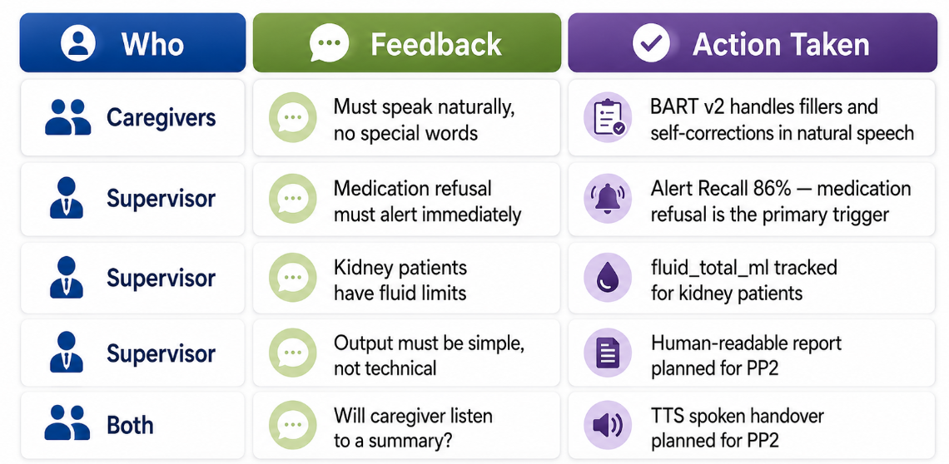
Context-Aware Intelligent System for Automated ADL Extraction and Real-Time Documentation from Caregiver Voice Logs
3
4
Design Excellence and Contributions
User Feedback on the Prototype
1.First Sri Lankan elder care speech dataset :from 39 patients at Love & Elder Care
2. Deployment-aware model selection :Every model chosen for care home hardware - noisereduce (200MB, no GPU) selected over Facebook Denoiser (4GB, GPU required).
3. Self-correction and repetition resolution and grammar correction Resolves "two tablets no sorry three tablets" → "three tablets" automatically BART
4. Rule-based beats neural -novel finding BERT-NER F1 91.27% vs FLAN-T5 F1 47.57% - domain-specific rules outperform general neural models by 43.7%.
5. Kidney patient special handling fluid_limit_ml tracking and dialysis_status extraction .
6. Automatic SNR measurement Replaced manual noise labels with objective SNR measured from audio - reproducible evaluation independent of human annotation.
IT22294098 | VIDURSHA PRABAGARAN | R26-DS-010

Slide 15
AI-Assisted Caregiver Workforce Deterioration Detection and Adaptive Workload Redistribution
| Panel Comment Received at Proposal
“Highlight how the proposed methodology differs from a normal ASR model”
| How CareSense Addresses This
Normal ASR gives only raw text, but my system gives structured ADL records: A normal ASR model only converts speech into a transcript, but my system extracts ADL details such as medication, food intake, fluid intake, hygiene, symptoms, mobility, and time.
Normal ASR keeps speech mistakes, but my system cleans them: It removes fillers, repetitions, hesitations, and self-corrections
Normal ASR does not understand care context, but my system detects risks: My system identifies missed medication, medication refusal, abnormal symptoms, and kidney patient fluid limit issues.
Normal ASR stops at transcription, but my system produces care outputs: My system generates a structured ADL report, sends supervisor alerts, and creates a handover summary for the next caregiver.
IT22178640 | DAYANA PRIYADHARSHANI KUMAR | R26-DS-010

Slide 16
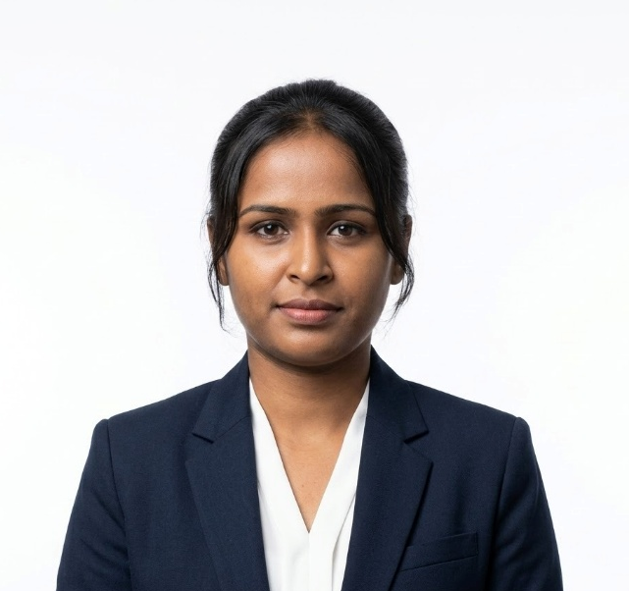
IT22289384 | KAUSHALYA NAGENTHRARAJA
Component 04: Personalized Sign Language Tutoring System for Caregivers
Specialization : Data Science
IT22289384 | KAUSHALYA NAGENTHRARAJA | R26-DS-010

Slide 17
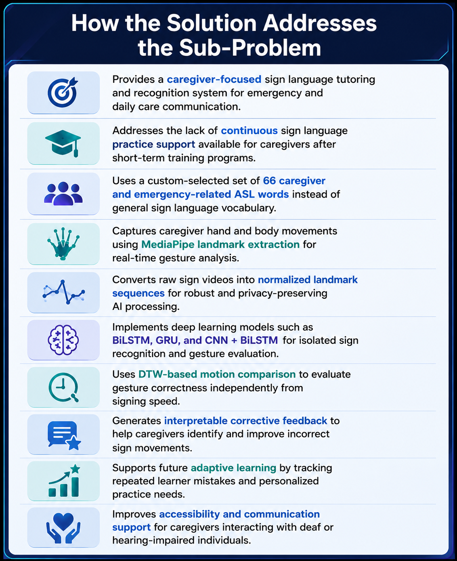
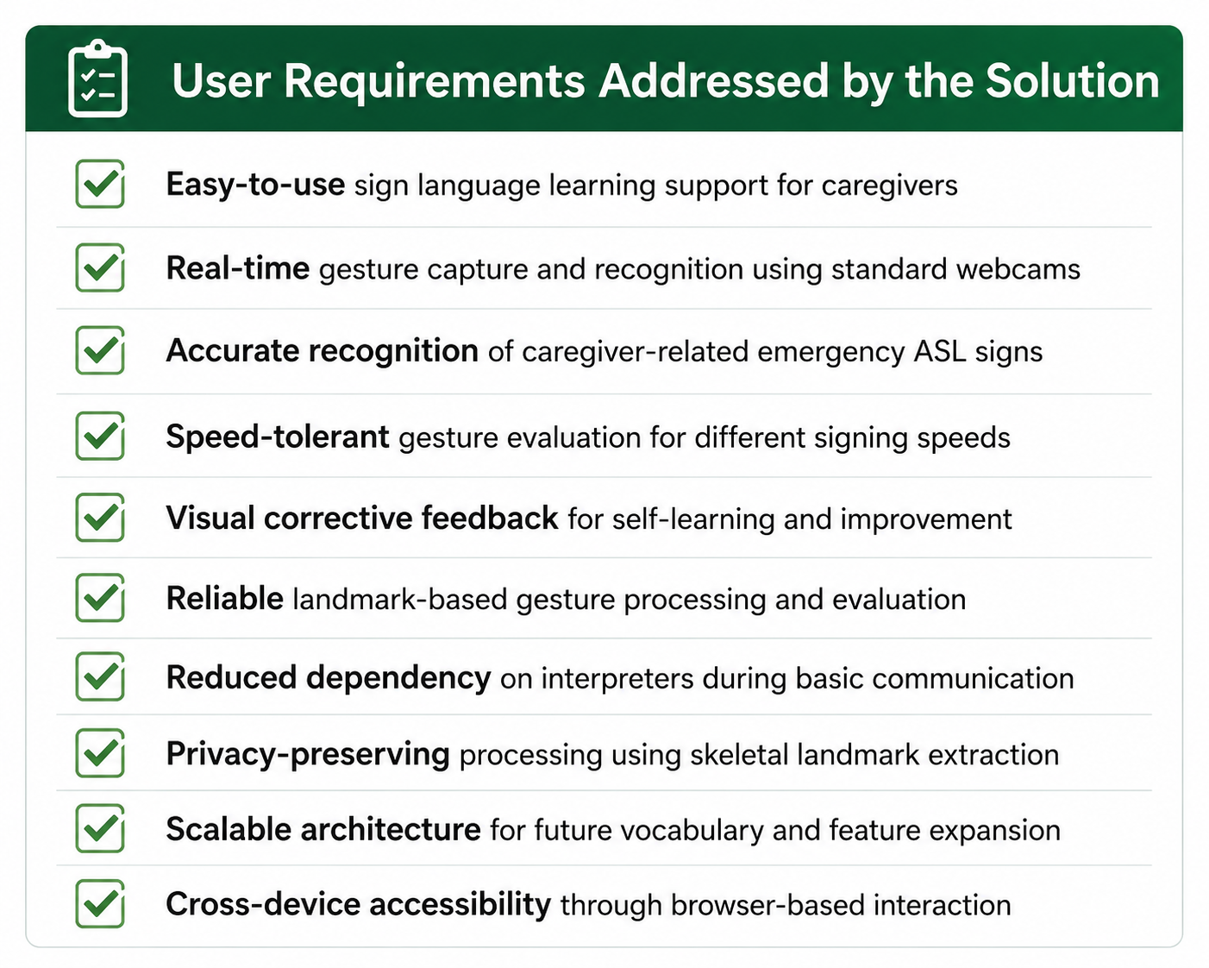
Personalized Sign Language Tutoring System for Caregivers
IT22289384 | KAUSHALYA NAGENTHRARAJA | R26-DS-010

Slide 18
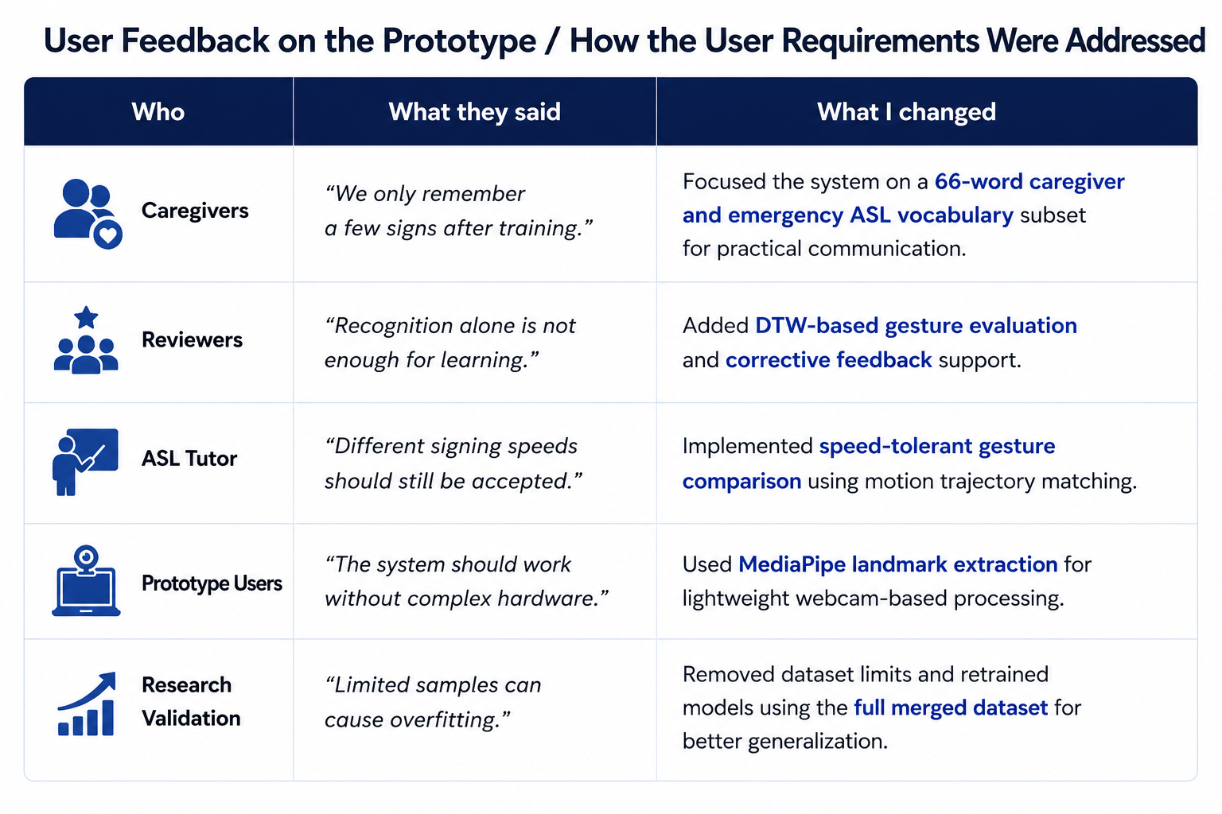
Personalized Sign Language Tutoring System for Caregivers
Design Excellence and Contributions
1. Caregiver-Focused ASL Tutoring
Focused on caregiver and emergency communication needs validated through CCHS instead of general sign recognition.
2. Custom Emergency Vocabulary
Built a custom 66-word caregiver-focused ASL subset using WLASL and ASL-Citizen datasets.
3. Landmark-Based Processing
Used MediaPipe pose and hand landmarks for lightweight and privacy-preserving gesture processing.
4. Robust Preprocessing Pipeline
Applied normalization, temporal standardization, and corrupted-video filtering for improved model learning.
5. Speed-Tolerant Evaluation
Implemented DTW-based motion comparison to evaluate gestures independently from signing speed.
6. Multi-Model Experimentation
Trained and compared BiLSTM, GRU, and CNN + BiLSTM architectures for caregiver-focused ASL recognition.
7. Corrective Feedback Support
Supports gesture correction and self-learning through motion-aware evaluation and interpretable feedback.
User Feedback on Prototype
IT22289384 | KAUSHALYA NAGENTHRARAJA | R26-DS-010

Slide 19
AI-Assisted Caregiver Workforce Deterioration Detection and Adaptive Workload Redistribution
| Panel Comment Received at Proposal
“Emphasise how the proposed methodology differs from a normal sign language tutoring system; what is the proposed sign language type?”
| How CareSense Addresses This
Intelligent Evaluation: Existing systems mainly provide correct or incorrect results with limited feedback. CareSense uses DTW and MediaPipe to support speed-tolerant gesture recognition and provide real-time corrective feedback for better learning.
Personalized Learning: Traditional systems follow the same learning path for all users. CareSense adapts lessons based on user mistakes, tracks progress, and recommends personalized practice activities to improve learning outcomes.
Proposed Sign Language Type: The proposed system focuses on American Sign Language (ASL). The selected ASL gestures are specially designed for caregiving, healthcare, and patient communication situations
IT22178640 | DAYANA PRIYADHARSHANI KUMAR | R26-DS-010

Slide 20
Multimodal Computational Intelligence for Enhancing Caregiver Performance and Care Delivery
COMMON SLIDES FOR THE RP FOLLOWS FROM HERE →

Slide 21
Multimodal Computational Intelligence for Enhancing Caregiver Performance and Care Delivery
MARKET OPPORTUNITY Global healthcare-AI market projected to exceed USD 180 billion by 2030; caregiver-wellness sub-segment growing at >30% CAGR — Sri Lanka / South Asia: rapidly ageing population + rising elderly-care demand
1
Commercialization & Sustainability
3
What is Unique in Our Solution
▪ SaaS subscription model for hospitals & elder-care facilities; tiered pricing by bed count and modules enabled (stress, fall, ADL, sign-language)
▪ Sustained through ongoing licensing, model-update services, and partnerships with caregiver-training institutions for the sign-language module
▪ Only integrated platform addressing four critical pain points — caregiver stress, patient fall risk, automated documentation, and accessibility — in one ecosystem
▪ Personalisation per caregiver: Isolation Forest baselines, RL-based ASL tutoring, and explainability (SHAP) — not a one-size-fits-all black box
▪ Edge-first, privacy-preserving design — raw video never leaves the device; addresses a key adoption barrier in patient-facing AI
2
Customer Persona
▪ Primary buyers: hospital administrators and nursing supervisors managing 50–500 caregiving staff; eldercare home operators; private home-care service providers
▪ Pain points: staff burnout-driven turnover, patient-fall liability, documentation overhead, and communication gaps with deaf / hard-of-hearing patients
4
How Will the Cost Be Recovered
▪ Recurring SaaS fees (monthly / annual per facility) cover model updates and ongoing support
▪ Modular per-component licensing — facilities pay only for modules they enable, lowering the entry barrier
▪ Additional revenue streams: training programmes for the sign-language module, premium analytics dashboards, and research-grade anonymised data partnerships (with consent)
TARGET MARKET Sri Lanka & South Asia — expanding private hospital sector + strong serviceable demand from elderly-care growth
DEFENSIBILITY Four integrated AI modules + edge-first privacy stance create switching costs hard for single-feature competitors to match

Slide 22
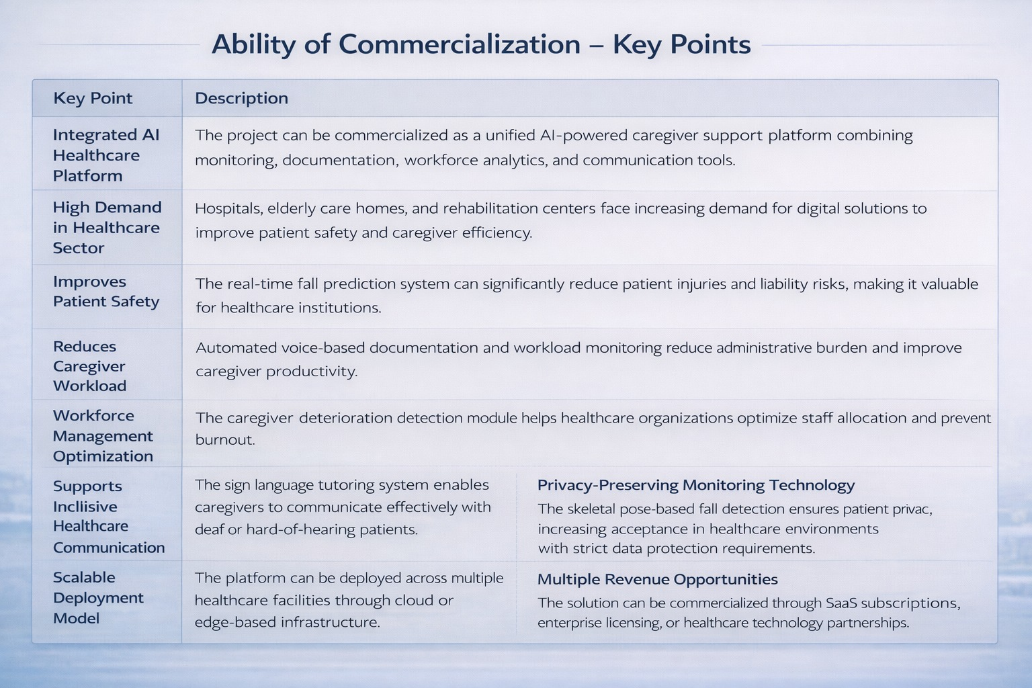
Multimodal Computational Intelligence for Enhancing Caregiver Performance and Care Delivery

Slide 23
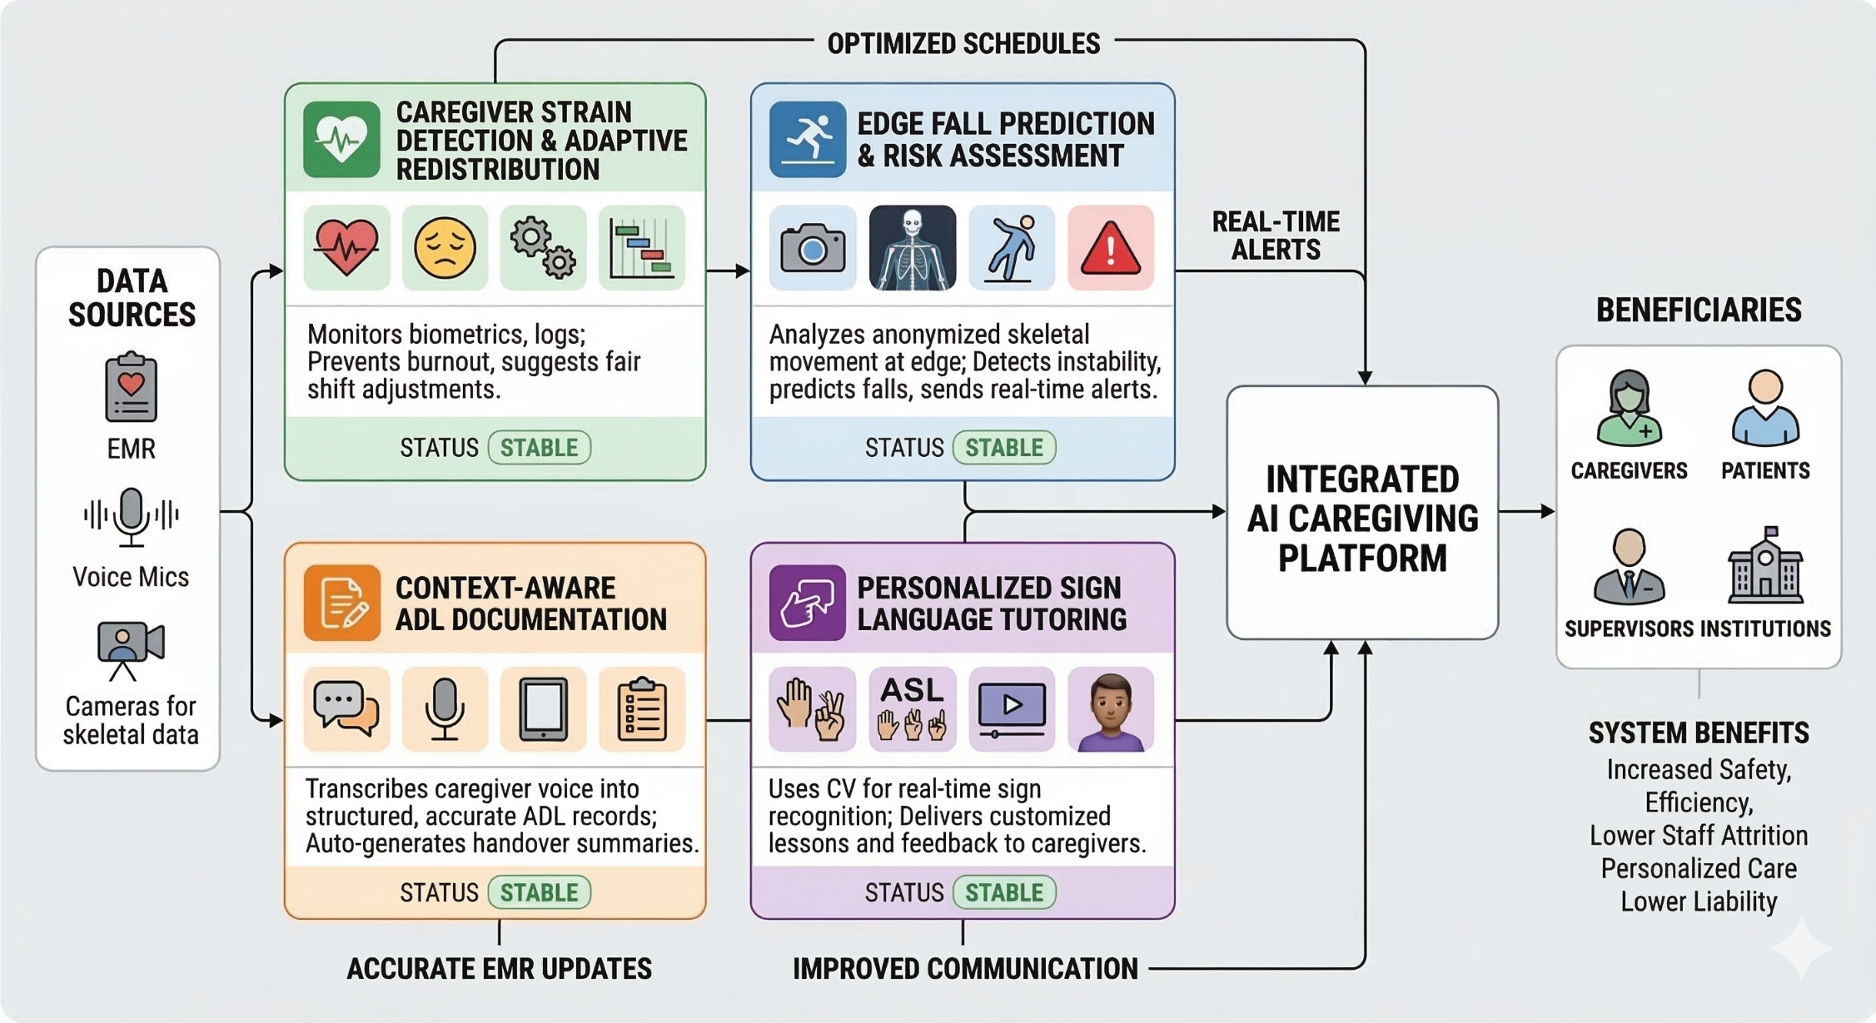
Multimodal Computational Intelligence for Enhancing Caregiver Performance and Care Delivery – System Overview Diagram

Slide 24
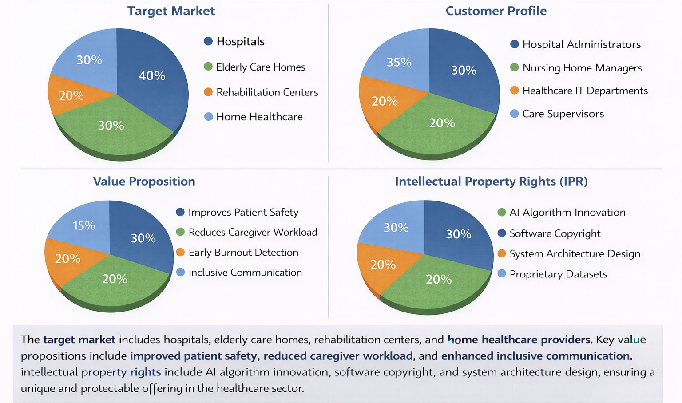
Multimodal Computational Intelligence for Enhancing Caregiver Performance and Care Delivery

Slide 25
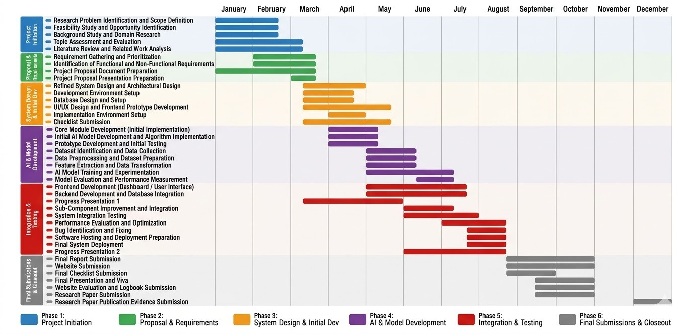
Multimodal Computational Intelligence for Enhancing Caregiver Performance and Care Delivery – Gantt Chart

Slide 26
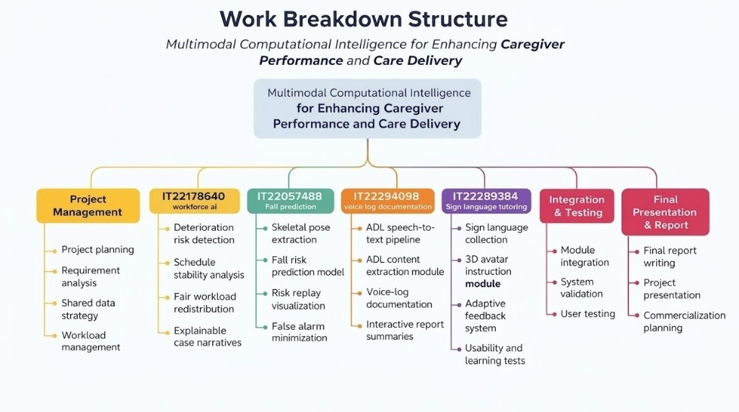

Slide 27


Slide 28


