Slide 1
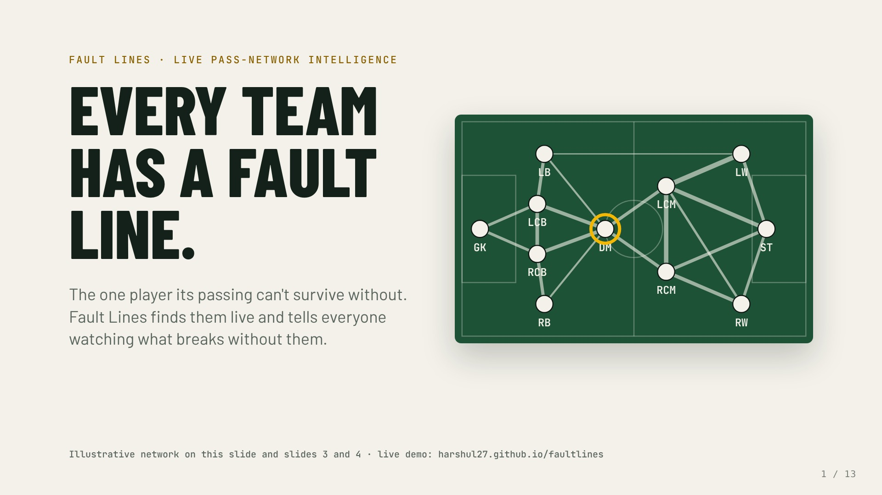
Notes:
Every team has one player its passing depends on more than any other. We call that player the fault line. Fault Lines finds them event by event while the match is on, and explains what breaks without them to whoever is watching.
The network here is illustrative: a typical shape, not a real match.

Slide 2
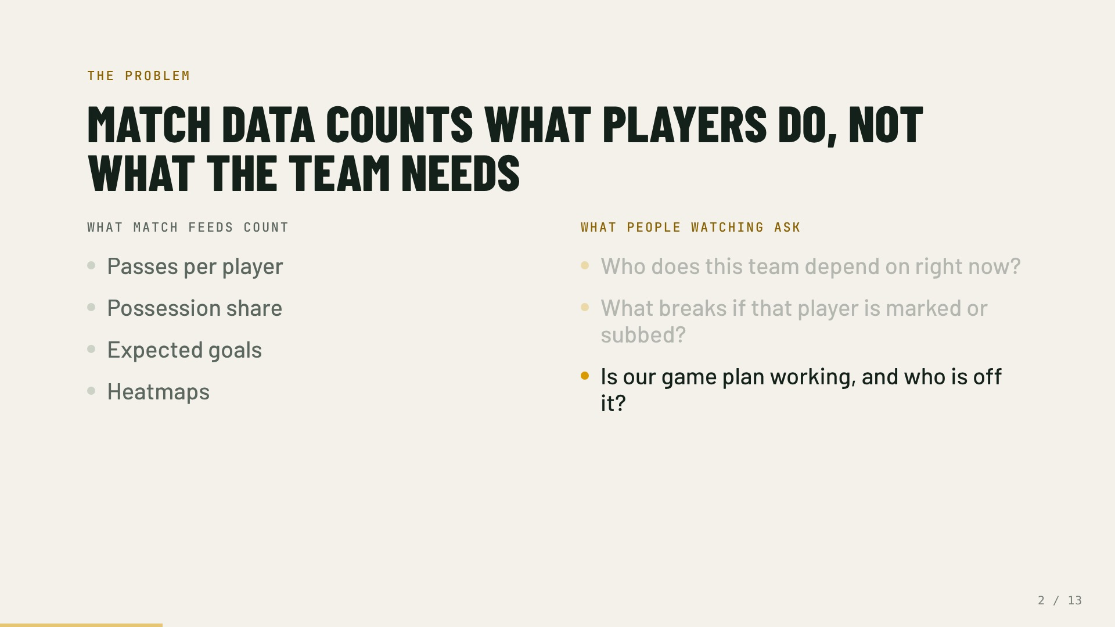
Notes:
Coaches, analysts, broadcasters and fans all ask the same questions. Match feeds answer a different one: how busy each player was.
Who the team depends on right now.
What breaks when that player is marked, tired or substituted.
Whether the plan is working, and who is off it. None of the columns on the left answers these.

Slide 3
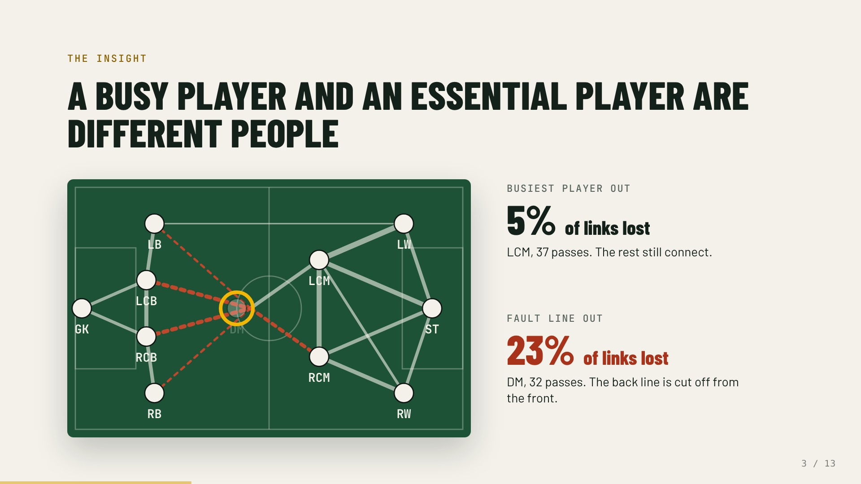
Notes:
The obvious answer is the player with the most passes. Watch what happens when we take them out.
The busiest player goes, and the team barely notices: the others still find each other.
Take out the holding midfielder instead, who made fewer passes, and the back line loses its route to the front. That player is the fault line.

Slide 4
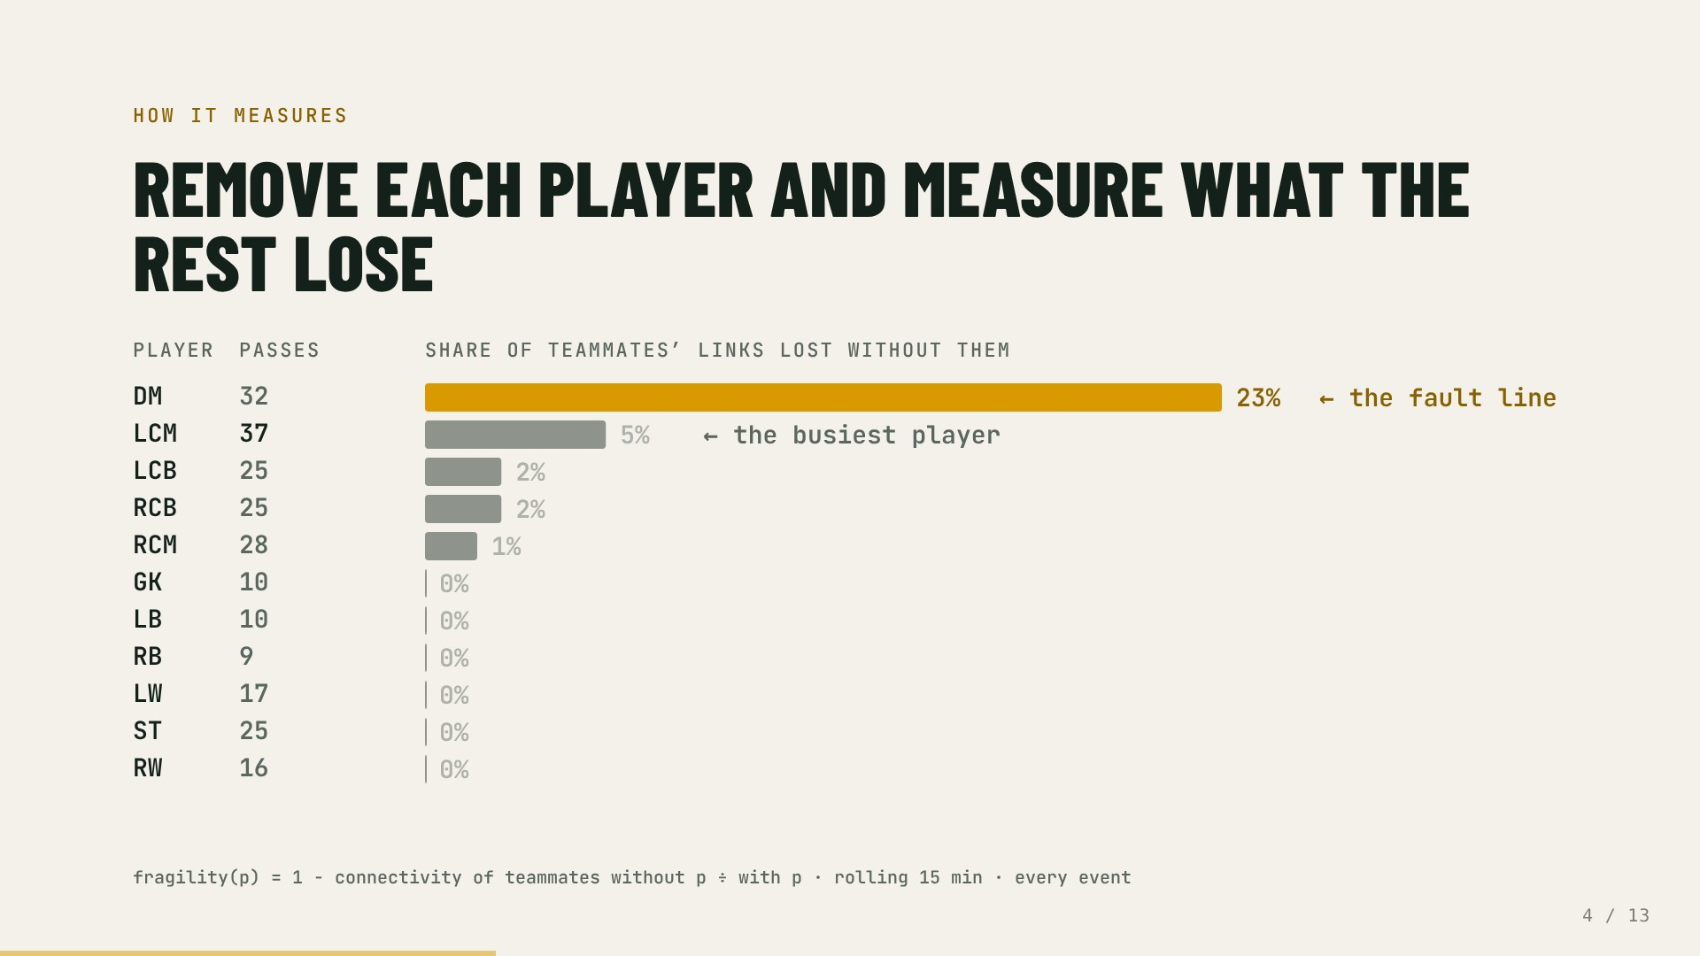
Notes:
For every player, remove them from the last 15 minutes of passing and measure how much of everyone else's connectivity is gone. The bars are computed live in this slide from the illustrative network.
The ranking by passes and the ranking by fragility disagree. The top of this chart is the fault line, and it updates with every event.

Slide 5
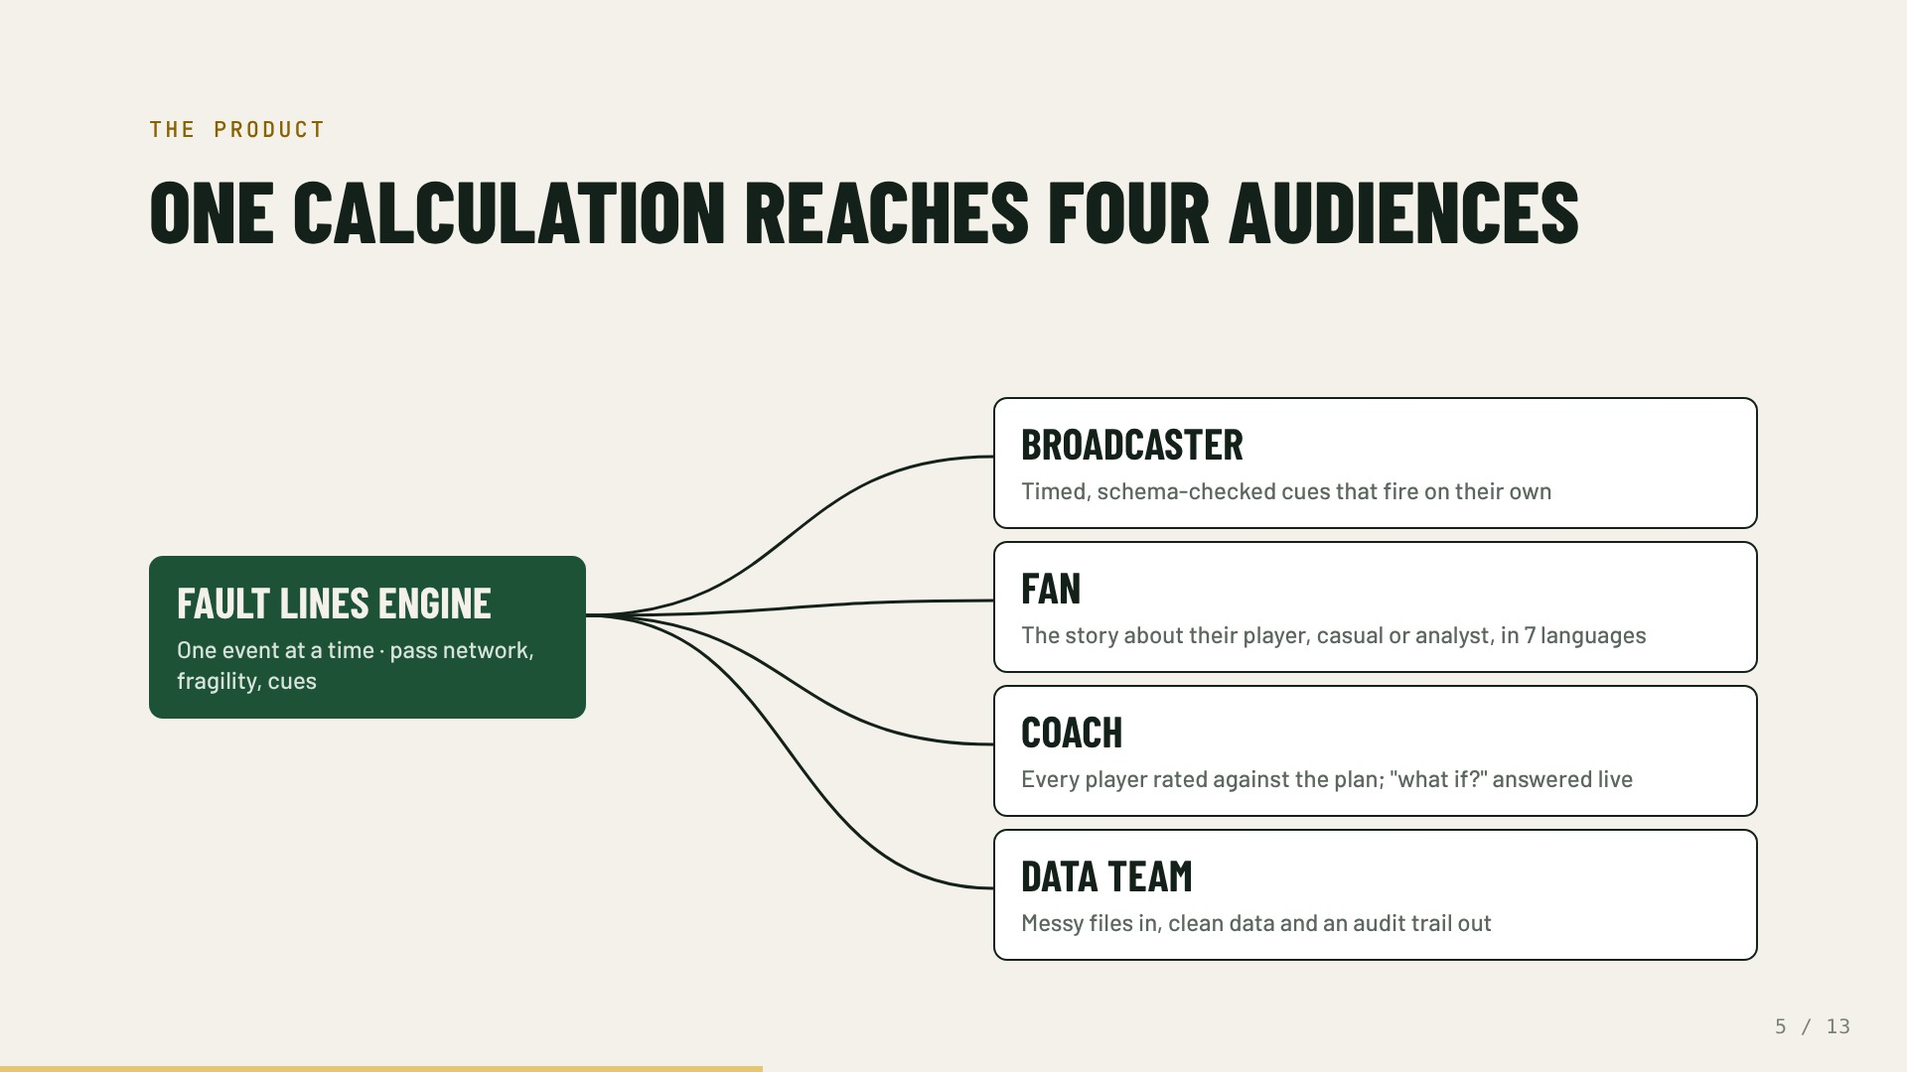
Notes:
The same number serves everyone around a match, each in the form they can use.
Broadcasters get cues with a match clock, priority and display time, validated against a JSON Schema.
Fans get it written for them, about their favourite player, in their language.
Coaches get their own plan as the yardstick and an analyst they can question.
Data teams get a cleaning pipeline they can audit.

Slide 6
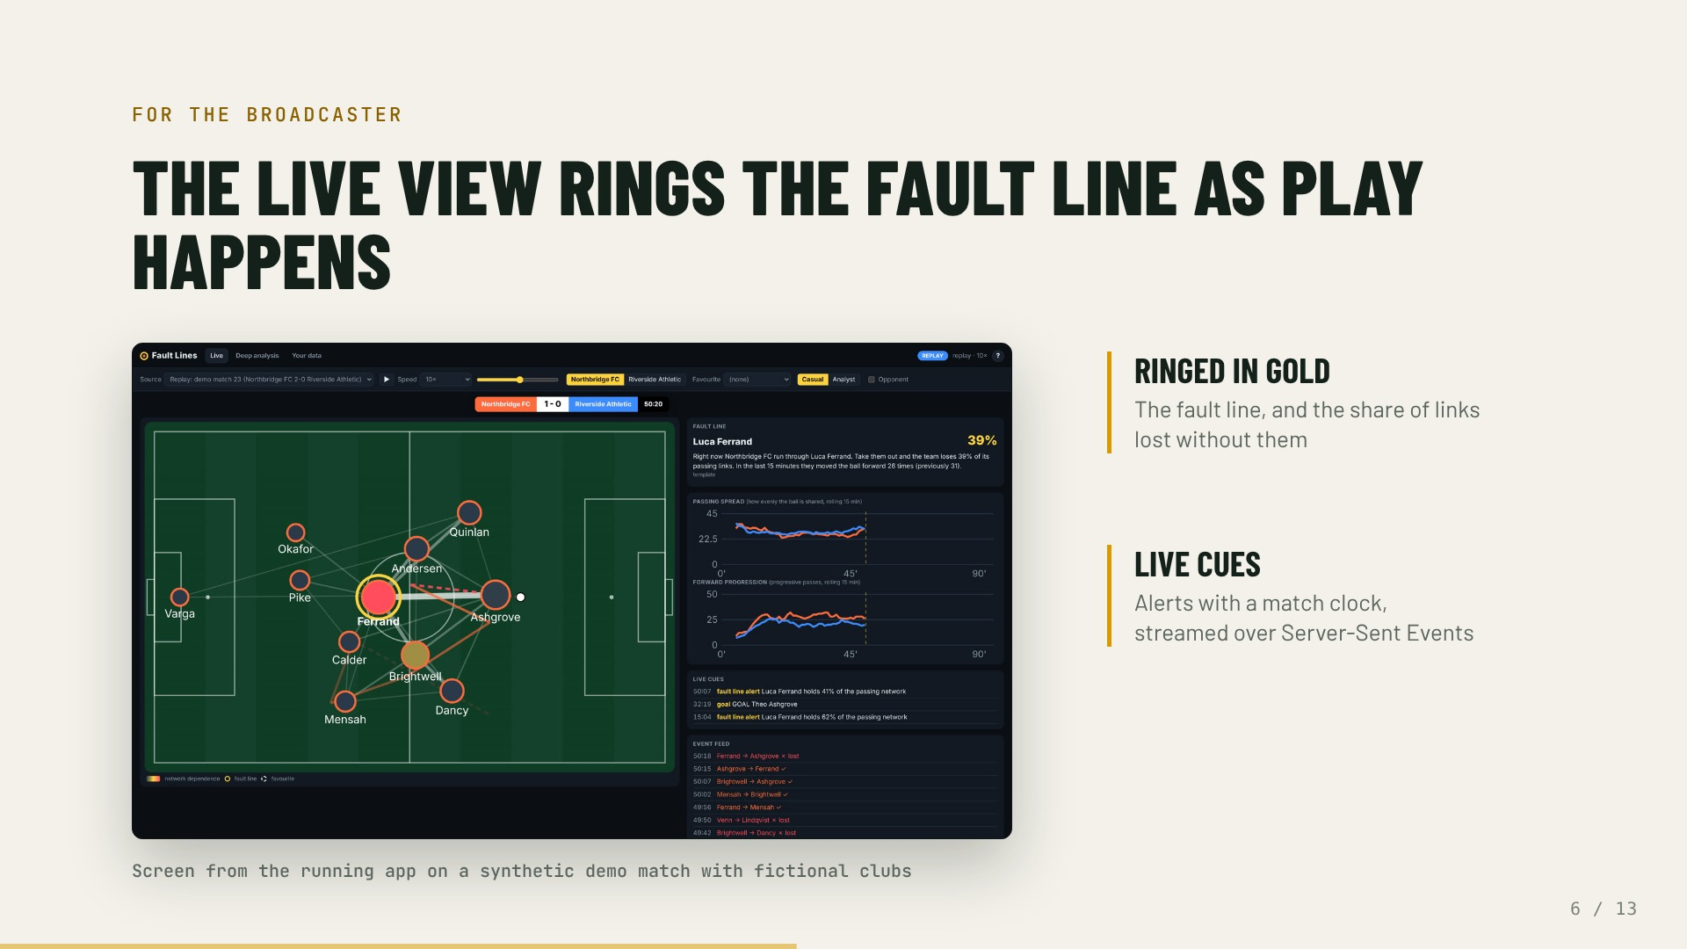
Notes:
This is the real interface. The pass network is drawn on the pitch, line thickness is the share of passes on each link.
The gold ring is the fault line, with the share of links the team would lose.
Cues fire as the network changes, with a clock, a priority and a display time, so a graphics system can use them directly.

Slide 7
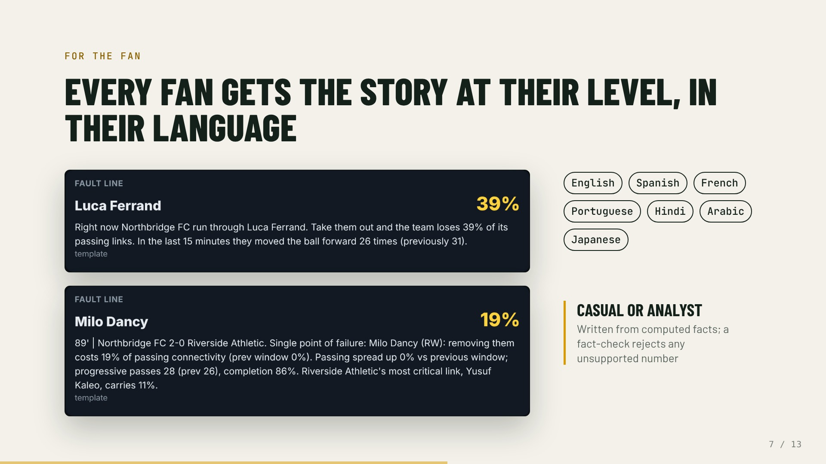
Notes:
Casual mode is one plain sentence. Fans can follow either club and pick a favourite player.
Analyst mode shows the numbers behind it. Both come from the same computed facts, and a fact-check rejects any number the data does not support.

Slide 8
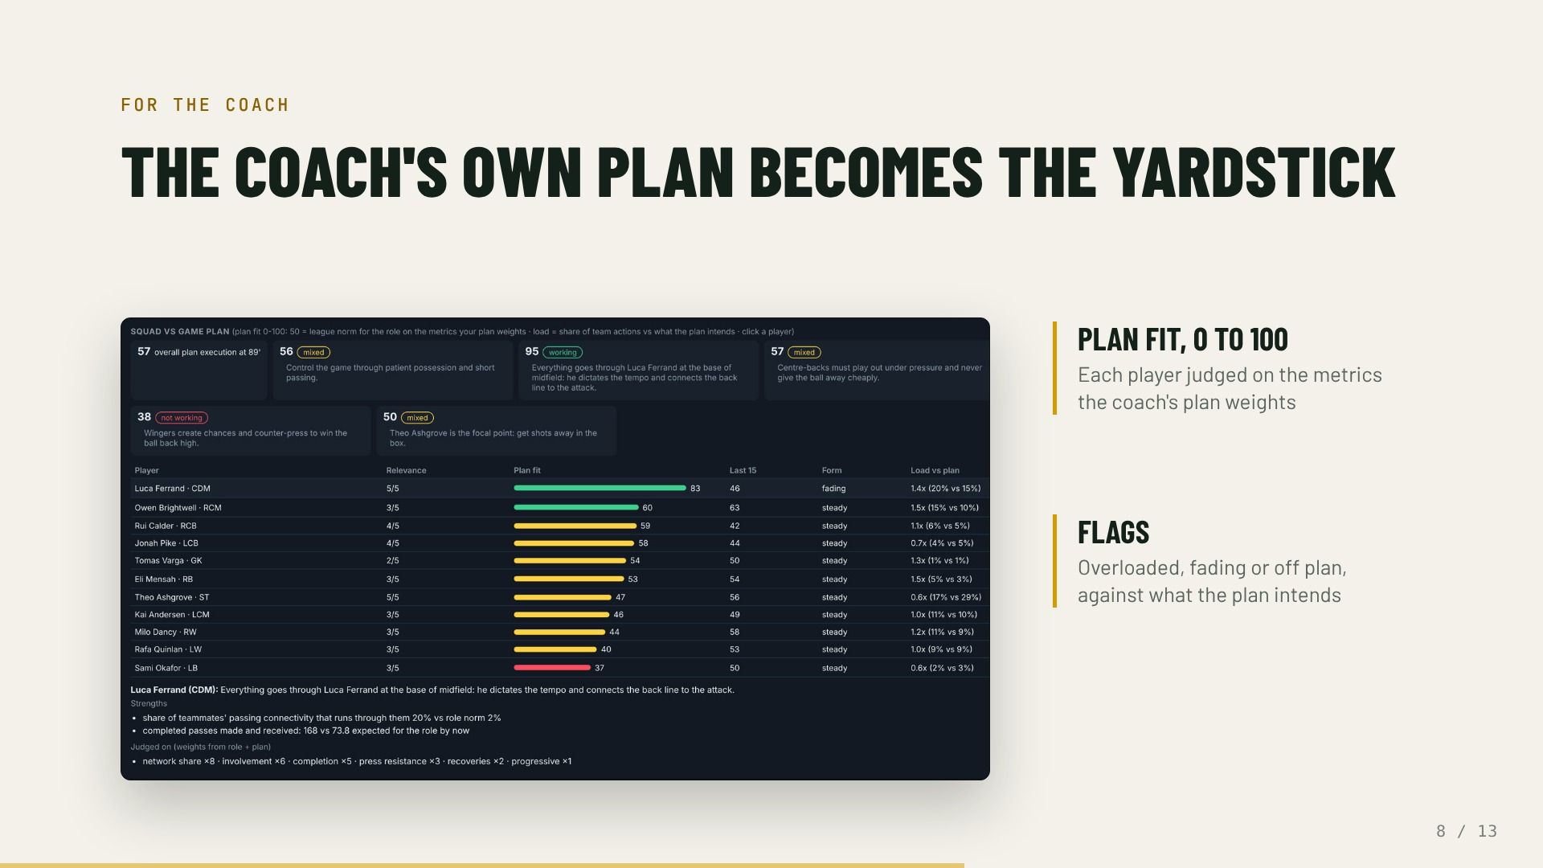
Notes:
The coach pastes the plan in plain words or a sheet. Fault Lines reads it and rates every player against that plan, not a generic rating.
Plan fit, form, load versus what the plan intends, and flags for who is overloaded, fading or off plan.

Slide 9
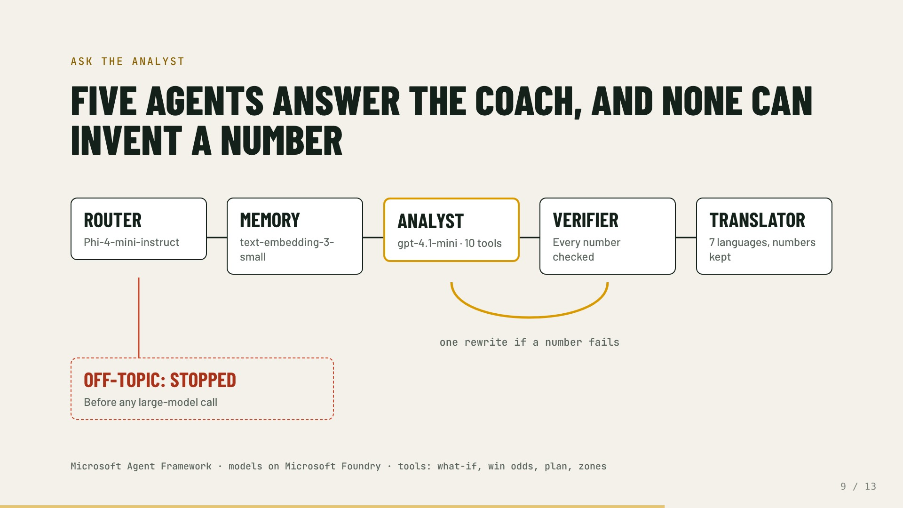
Notes:
A coach types a question. The router, a small fast model, decides what kind of question it is.
Memory keeps only the earlier turns that matter to this question.
The analyst calls match tools: what-if removal, win probability, plan assessment and more.
A deterministic verifier checks every number against the tool outputs; one self-correcting rewrite if something does not match.
The translator keeps every number intact.
Anything off-topic is turned away at the router. A coaching guard also blocks advice to take off a key player unchecked.

Slide 10
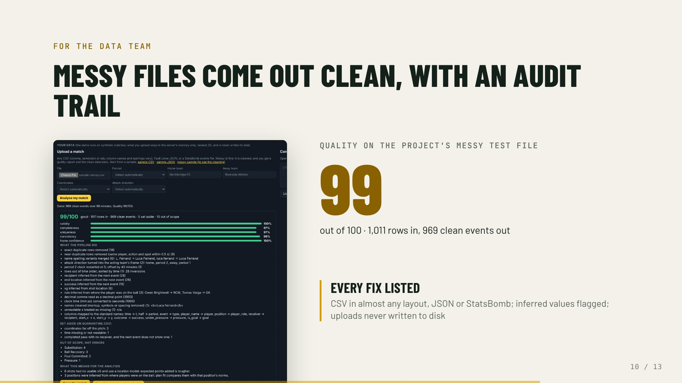
Notes:
Upload a match in almost any CSV layout, JSON or StatsBomb events, or push a live feed. The pipeline maps columns, merges name spellings, removes duplicates, fixes clocks and directions, and quarantines broken rows.
Every fix is listed, every inferred value is flagged, and you get a data package with the clean events and the analysis.

Slide 11
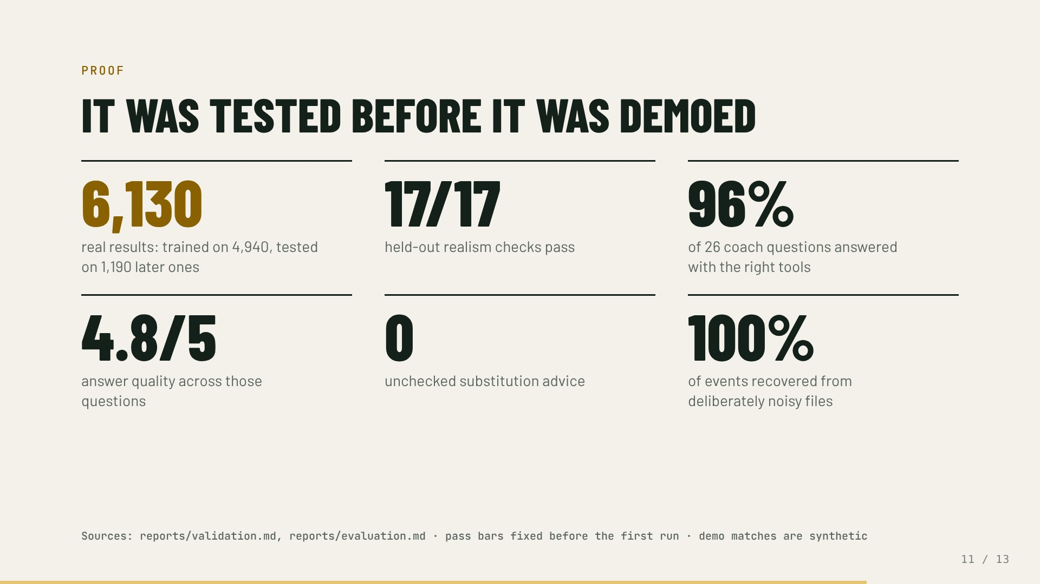
Notes:
The demo runs on synthetic matches. The generator is calibrated on public-domain results and checked against seasons it never saw. The agents were evaluated on 26 coach questions, the pipeline on deliberately noisy files.

Slide 12
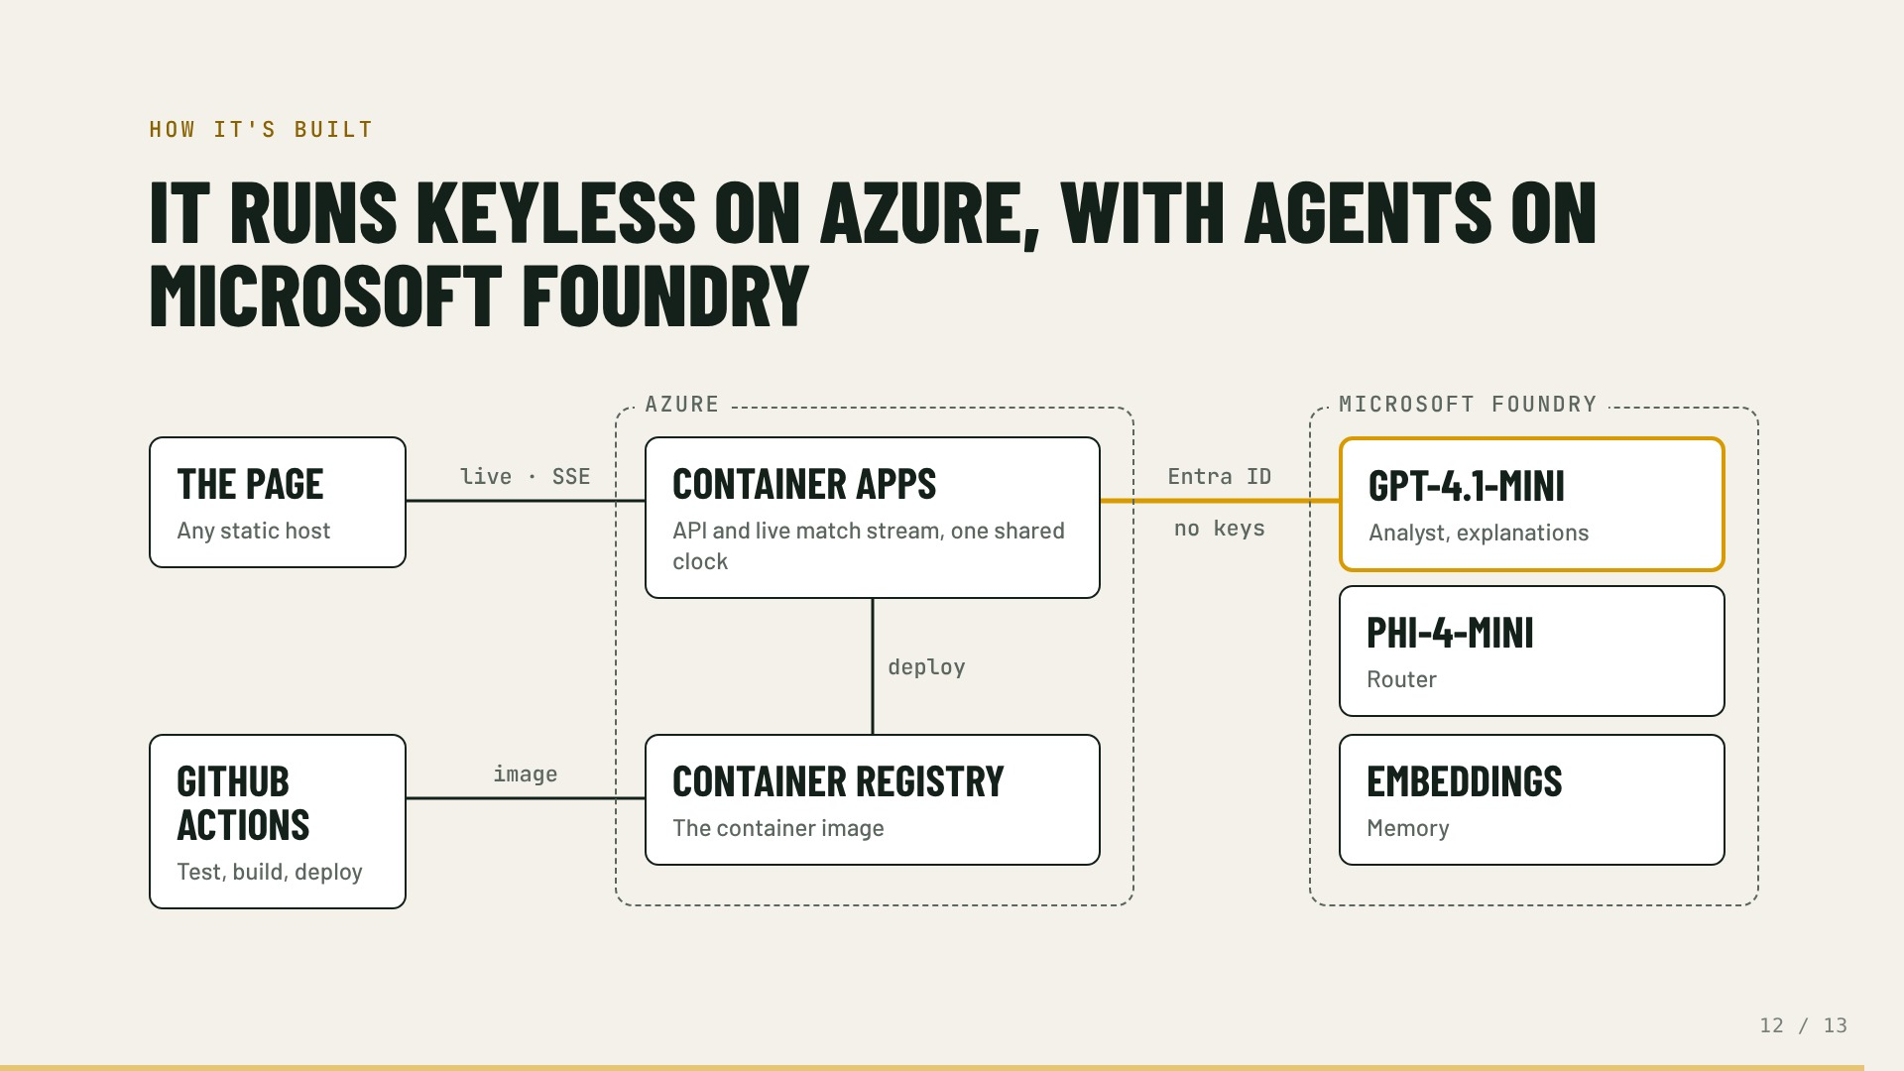
Notes:
The page runs on any static host and connects to the API on Azure Container Apps, which holds one shared match clock and streams events over Server-Sent Events.
Events stream to every viewer at once.
The container reaches Microsoft Foundry through a managed identity in Microsoft Entra ID. There are no API keys anywhere.
GitHub Actions tests every push, builds the image into Azure Container Registry and deploys it.

Slide 13
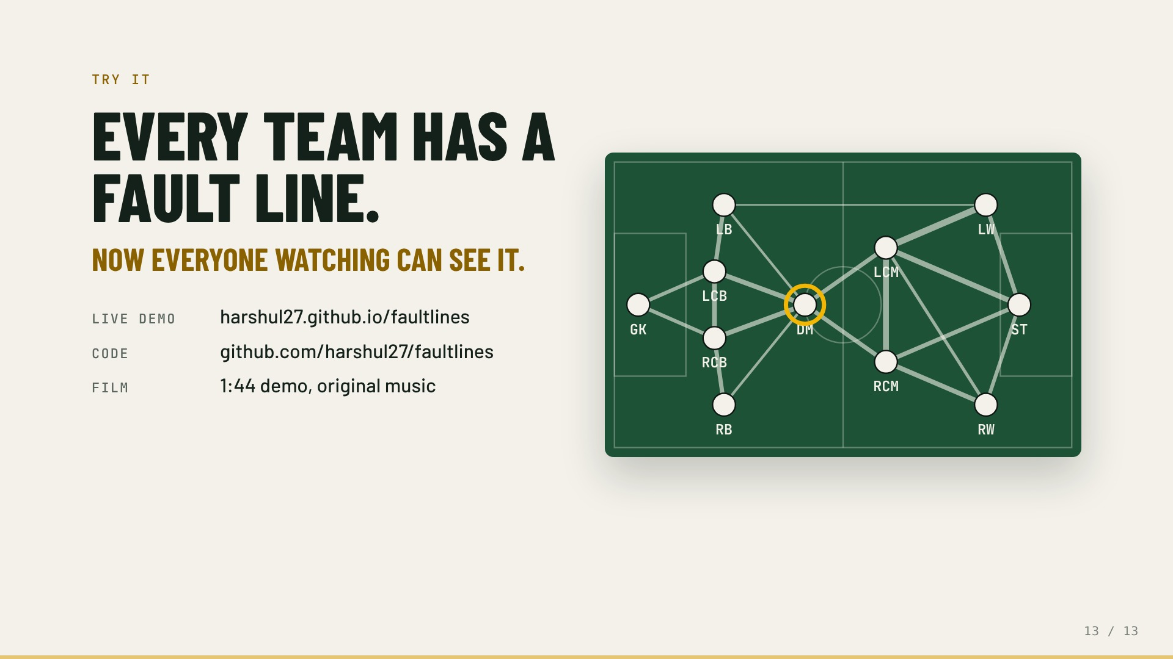
Notes:
Back to where we started: the same network, the same ring. Fault Lines finds the player a team can't lose, live, and explains it to the broadcaster, the fan, the coach and the data team, with every number checked.
Open the live demo, or read the code.

