Slide 1
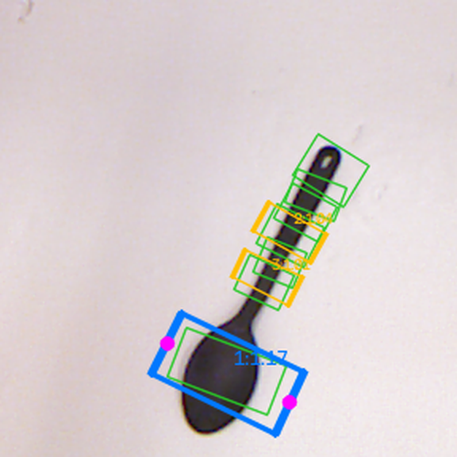
Vision-Based Robotic Grasp Planner
Predicting where a parallel-jaw gripper should grab an object, from a single image
Model output on an unseen test object
Harshul Tyagi · October 2026
Notes:
Goal: given an image of one object, predict a grasp for a two-finger (parallel-jaw) gripper: where to put the centre, how to rotate the gripper, how wide to open, and where the two fingers touch. The picture is a real prediction on a test object the model never saw in training. Blue = chosen grasp, magenta = finger contact points, green = human-labelled good grasps.

Slide 2
A grasp is just a few numbers
Centre (x, y)
where the gripper goes
Angle θ
how it is rotated
Width
how far it opens
Contact points
where fingers touch
885
RGB + depth photos, one object each
5,110
human-labelled good grasps
70 / 15 / 15
train / validation / test split
Cornell Grasping Dataset (Kaggle copy)
Notes:
A grasp for a two-finger gripper seen from above is a rotated rectangle: centre, angle, opening width, plus the two contact points. Dataset: Cornell Grasping Dataset, 885 RGB-D scenes, 5110 positive grasp rectangles; all scenes usable, one malformed rectangle rejected. Kaggle copy: https://www.kaggle.com/datasets/oneoneliu/cornell-grasp

Slide 3





Methodology: from photo to ranked grasps
1. Clean data
2. Prepare
3. Predict
4. Pick
5. Evaluate
Parse and validate all labels; split before training
Crop to 224×224 RGB-D; random rotate, zoom and flip
CNN scores every pixel: quality, angle, width
Find peaks, drop duplicates, rank by score
Overlap > 25% and angle < 30° vs labels
Notes:
1) Every annotation is parsed and checked; bad ones are reported, never silently dropped. Splits are made first so no test image leaks into training. 2) A fixed crop chosen from training data only, resized to 224x224; training images are randomly rotated, zoomed, shifted and mirrored, and the grasp labels are transformed with exactly the same matrix. 3) A fully convolutional network outputs four maps the size of the image: grasp quality, cos 2θ, sin 2θ and width. 4) Local maxima of the quality map become candidates; validity checks and non-maximum suppression remove bad and duplicate ones; the rest are ranked. 5) Standard Cornell metric: the top grasp must overlap a labelled grasp by more than 25% IoU with less than 30° angle difference.

Slide 4





Two models, one fair training recipe
Heavy augmentation + early stopping
only 620 training images, so avoid memorising them
GG-CNN
70K params
Baseline: tiny, fast, 3 conv layers (Morrison et al., 2018)
Angle as cos 2θ and sin 2θ
a grasp turned 180° is the same grasp
Smooth-L1 loss
robust to noisy hand-drawn labels
GR-ConvNet
1.9M params
Adam + cosine LR, mixed precision
stable, about 6 s per epoch on a laptop GPU
Main model: residual encoder–decoder (Kumra et al., 2020)
Pick the model on validation only
the test set was used exactly once
Notes:
Both models were trained with identical data, augmentation, loss (sum of four Smooth-L1 terms), optimiser (Adam, learning rate 1e-3, cosine decay to 1e-5), batch size 8, up to 100 epochs with early stopping (patience 30) and the same decoding, so the comparison isolates the architecture. Why: the dataset is small, so augmentation and early stopping fight overfitting; the doubled-angle encoding removes the jump at ±90°; Smooth-L1 is less sensitive to label noise than squared error; Adam with cosine decay trains reliably without tuning. Checkpoints were chosen on validation accuracy and that choice was committed before the test set was evaluated once. Each full run took about 4-11 minutes on an RTX 4060 laptop GPU.

Slide 5
Right grasp first in ~9 of 10 test scenes
88.6%
top-1 accuracy on 132 held-out test images (95% CI 82.1%–93.0%)
95.5%
correct grasp among the top 5
5.8 ms
per image on a laptop GPU
Gaps between models are not statistically significant (paired McNemar p ≥ 0.33). The block split holds out runs of consecutive scenes, a harder, roughly unseen-object test. Published 97.7% used a different protocol.
Notes:
Final model: GR-ConvNet with RGB-D input, chosen on validation accuracy. On the held-out image-wise test split (132 images, evaluated once) its first-ranked grasp met the Cornell criterion on 88.6% of images, and one of its top five on 95.5%. Network plus decoding takes about 5.8 ms per image. With about 120-130 test images, differences of a few points between models are within noise. The GR-ConvNet paper reports 97.7% under a different protocol (crop centred on the ground-truth grasps, cross-validation), so it is not directly comparable.

Slide 6
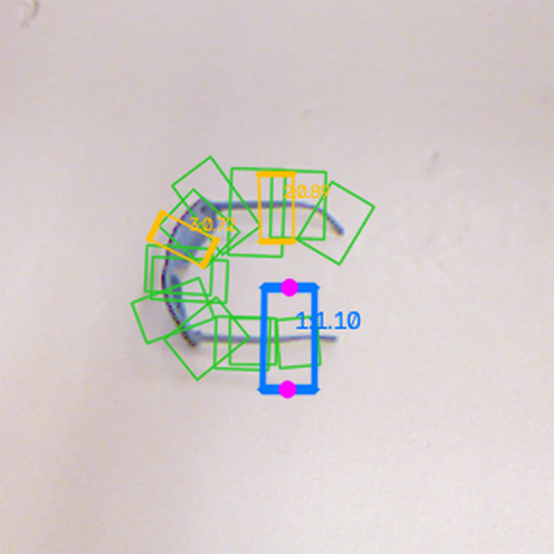
What the model sees and chooses
Chosen grasp
Finger contact points
Next-best options (rank:score)
Human-labelled good grasps
Two test-set objects the model never trained on
Notes:
Real outputs of the final model (scripts/predict.py) on two test-split scenes. The blue rectangle is the selected grasp, magenta dots are where the fingers touch, amber rectangles are the next-best candidates with their scores, green rectangles are the human labels. In both cases the chosen grasp closes across the narrow part of the object. Scores are the network's quality output, not probabilities.

Slide 7



Try it yourself
Live demo
Upload a photo or click an example
huggingface.co/spaces/btechbillu/Vission-Based-grasper
Code and full report
Training, evaluation, tests, 13-chapter report
github.com/harshultyagi/vision_based_gripper
Dataset
Cornell Grasping Dataset (Kaggle copy)
kaggle.com/datasets/oneoneliu/cornell-grasp
Limits: single-object scenes · 2-D image grasps only · not yet tested on a real robot
Notes:
Links: live demo https://huggingface.co/spaces/btechbillu/Vission-Based-grasper (Hugging Face Space, runs on CPU, includes four clickable test scenes); code and report https://github.com/harshultyagi/vision_based_gripper; dataset https://www.kaggle.com/datasets/oneoneliu/cornell-grasp. Limitations: trained only on single-object Cornell scenes from one camera setup; predicts 2-D image grasps (no 3-D pose, calibration or collision checking); not validated on physical hardware.

