Slide 1

Adult Salary Prediction
Key Information and Problem Statement:
The US Census Bureau leads the country's Federal Statistical System
Primary responsibility is to collect demographic and economic data.
Sample dataset provided: 300,000 individuals, 4 files
Task: Identify characteristics associated with making more or less than $50,000/year

Slide 2
The data analysis includes:
Exploratory Data Analysis:
Numerical and/or graphical representations of the data that
may help inform insights and/or tactics for answering the research question of interest.
Data Preparation:
Data cleaning, preprocessing, feature engineering, etc., that may aid
in improving data clarity & model generation.
Data Modelling:
The building of a few competing models to predict the target variable.
Model Assessment:
A selection of the best model based on performance comparisons.
Results:
A concise summary of key findings, recommendations, & future improvements.

Slide 3
Exploratory Data Analysis:
The dataset is majorly divided into training and testing data sets. Headers are stored in separate file.
The training and testing dataset contains 42 columns in which 13 fields belong to the numerical or continuous attributes, 28 categorical attributes excluding target variable- “Income”.
The train data numerical attributes is summarized for example Age:
The mean value is 34 i.e., on an average the value of age attribute is 34.
Age is having the standard deviation 22.33 which indicates the deviation of an observation from the mean.
The value of Age attribute varies from 0 to 90.
The 1st quartile is 16 i.e., 25% of the observations lies below 16.
3rd quartile is 50 which indicates that in 75% of the observations the value of age is less than 50.
The difference between mean & median is not significantly high but the difference between 3rd quartile & maximum made the distribution right skewed.

Slide 4
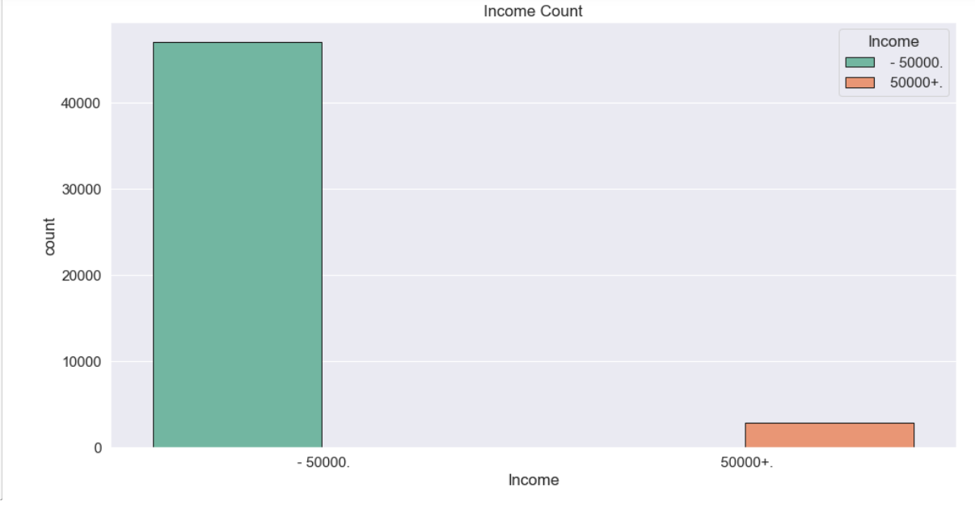
The dataset does not contain any missing value, although ‘?’ present as a corrupt data which was removed, replaced by mode of the particular field.
Some of the count plots are mentioned and explained below:
We can clearly see class imbalance in Income which is the target variable.
.

Slide 5
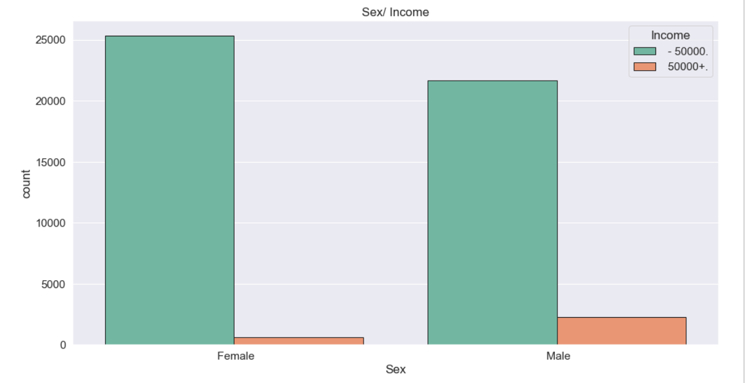
Females with salary less than 50000 are greater than Males with salary less than 50000.
Whereas Males with income more than 50000 are more than females with salary 50000 or above.

Slide 6
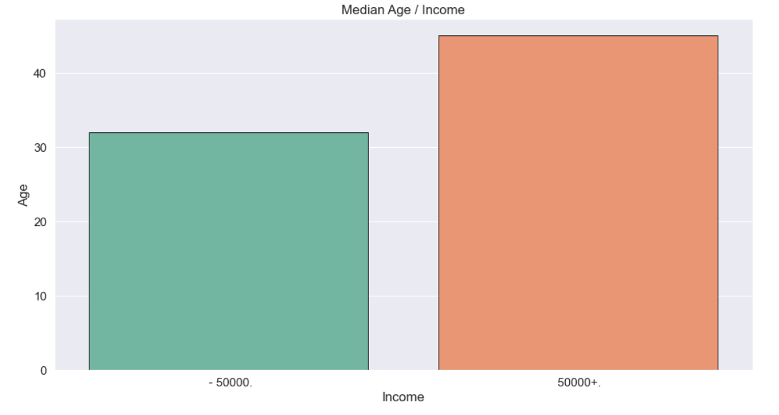
The median age for each Income class is mentioned above.
The median age of salary class below 50000 is 32 and salary class above 50000 is 48.

Slide 7
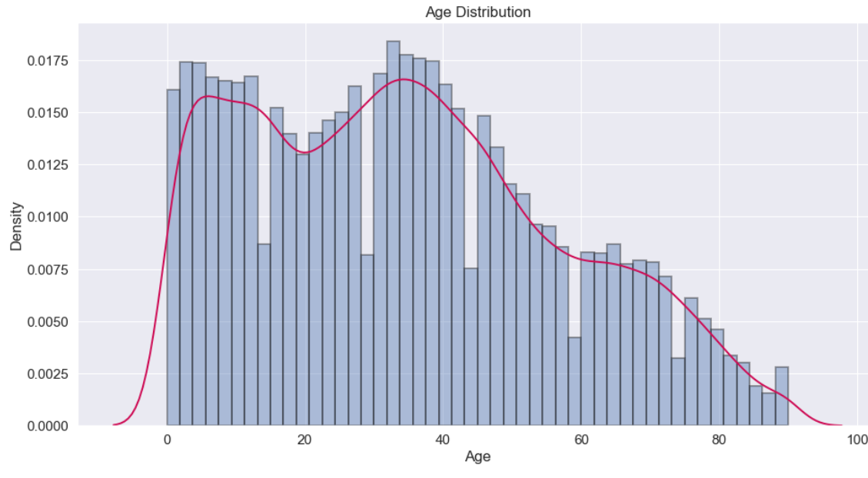
The probably density curve is mentioned above mean around 34 years.

Slide 8
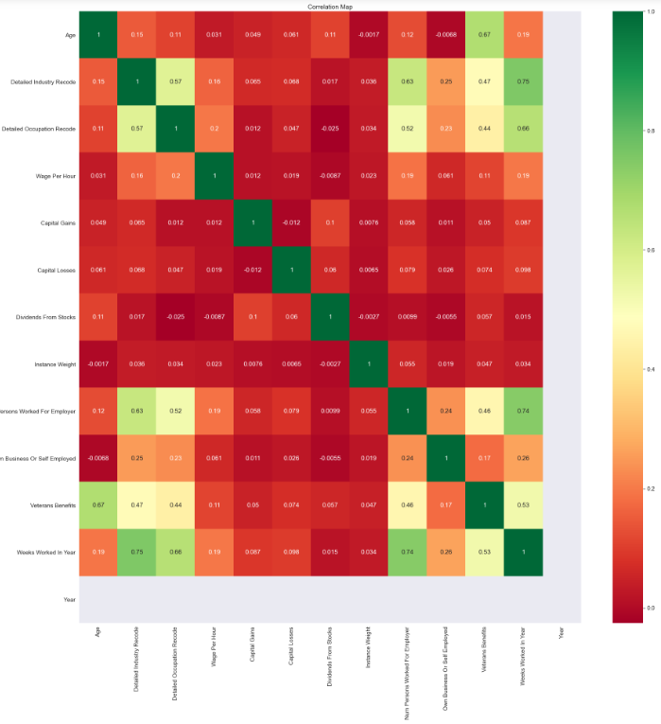
The correlation heatmap is mentioned above.

Slide 9
2) Data Preparation:
The data is prepared by taking below measures:
The target field- Income is transformed into <=50k and >50k and subsequently encoded to 0 and 1.
The Country Of Birth Self field changed to binary, as 1 denotes United-States and 0 denotes others.
Marital stat changed majorly to 4 fields-
Single 21551
Married 21066
Divorced 4491
Widowed 2708
Similarly, all the other categorical fields are encoded using label encoder.
Class imbalance was rectified using undersampling and oversampling.
Feature selection is done using filter method and 11 features are filtered which can contribute more towards predicting Income.

Slide 10
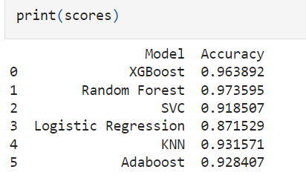
3) Data Modelling and Model Selection
Now we have train and test dataset with reduced features which could contribute more towards predicting salary.
6 machine learning algorithms used to predict the Income, which are-
XGBoost, Random Forest, SVC, Logistic Regression, KNN, AdaBoost.
The scores of these models are mentioned below-

Slide 11
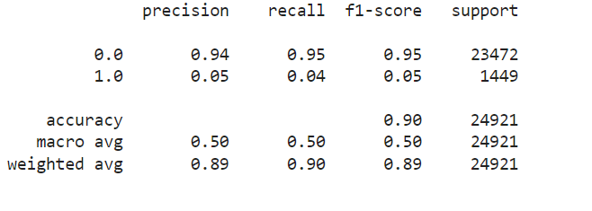
4) Final Model and Result:
The XGBoost model is used as the final model which is explored more.
The classification report is generated to support the model.
As far as the accuracy is concerned the Random forest model can be selected.
Further work can be done- accuracy metrics can be added and hyperparameter tuning could be explored to make the model better.

Slide 12
Questions?

