Slide 1

Einstein Vision
Group 26
Muhammad Sultan
Harsh Verma
Jesdin Raphael
Notes:
Cover for a full photo background

Slide 2
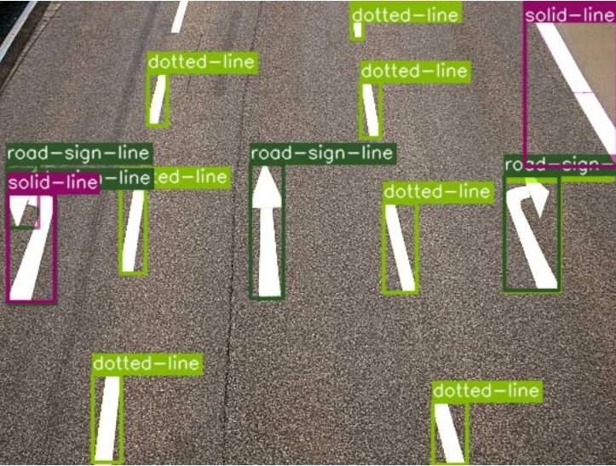
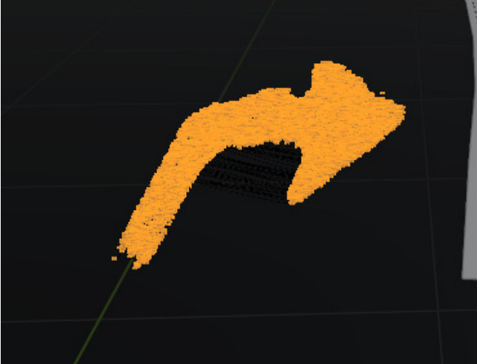
Mask RCNN and Blender Representation

Slide 3
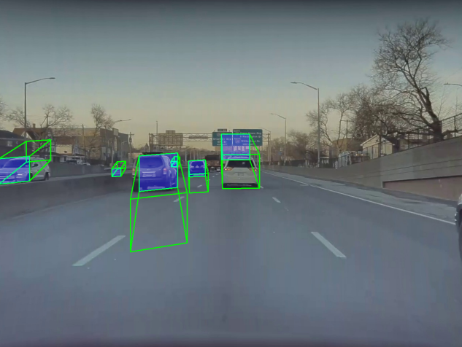
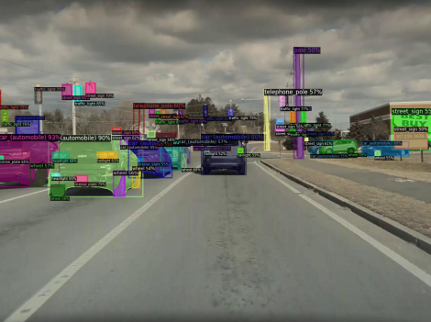
Car position estimation using YOLO3D & DETIC

Slide 4
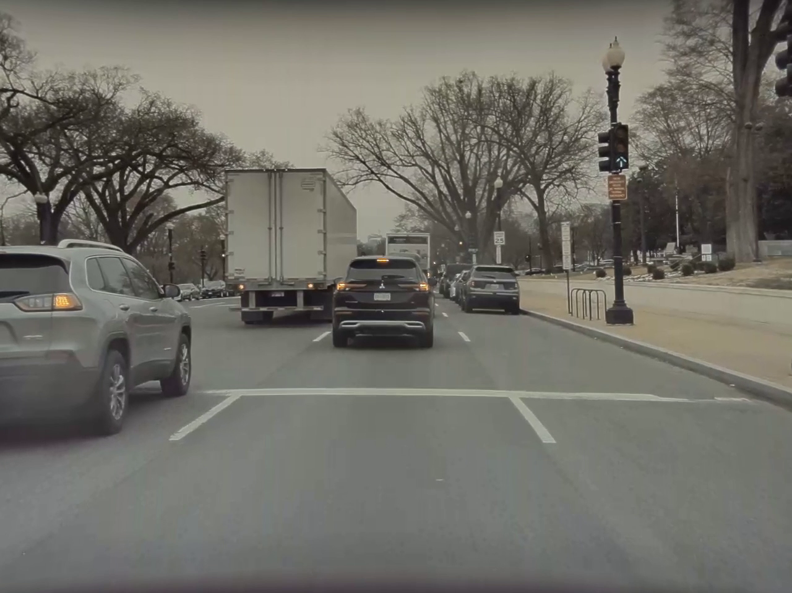
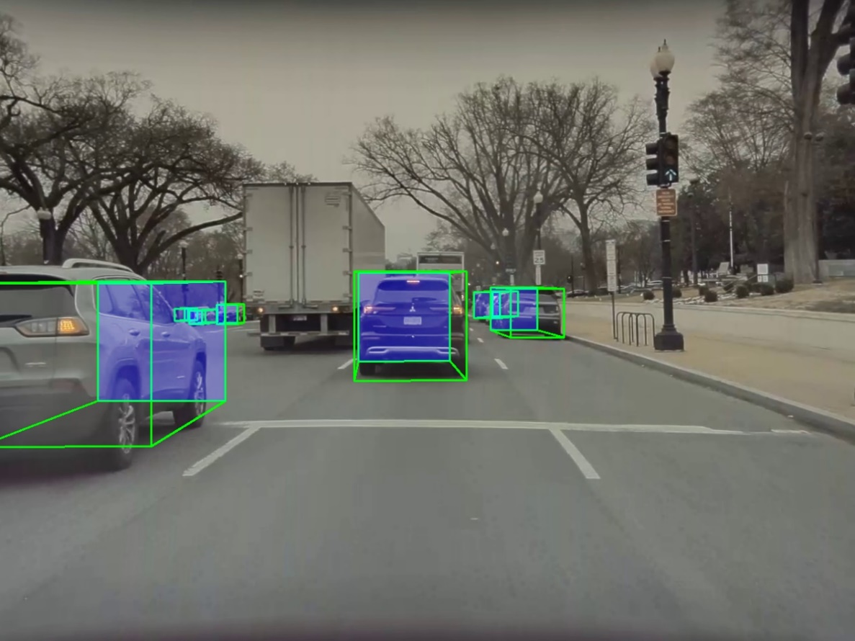
Vehicle Pose Detection using YOLO3D

Slide 5
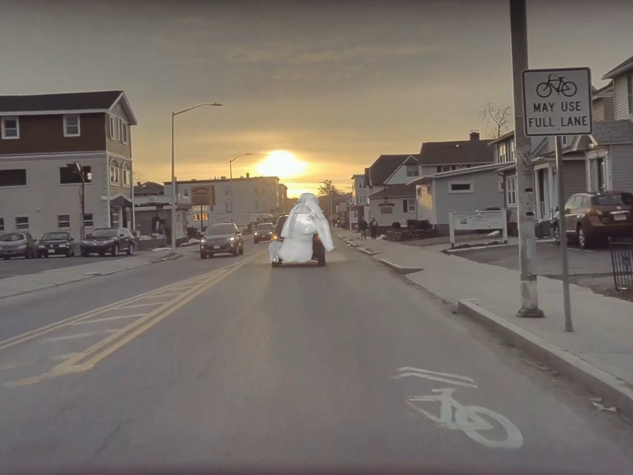
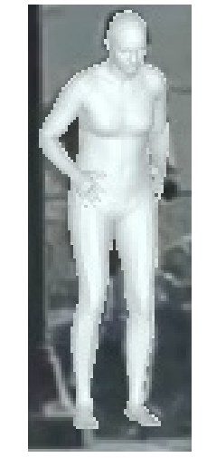
Pose Estimation

Slide 6
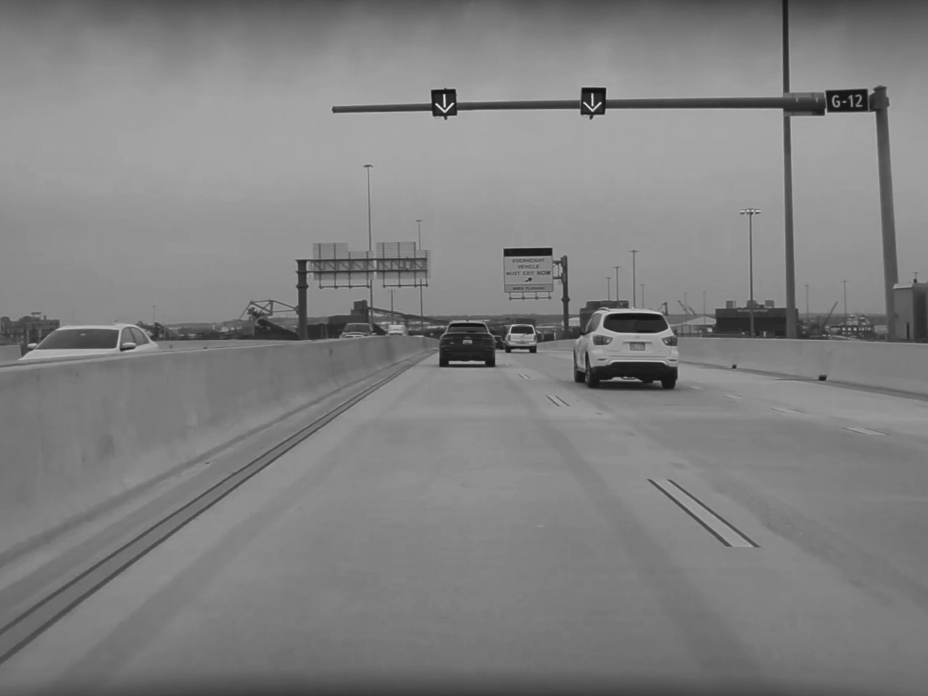
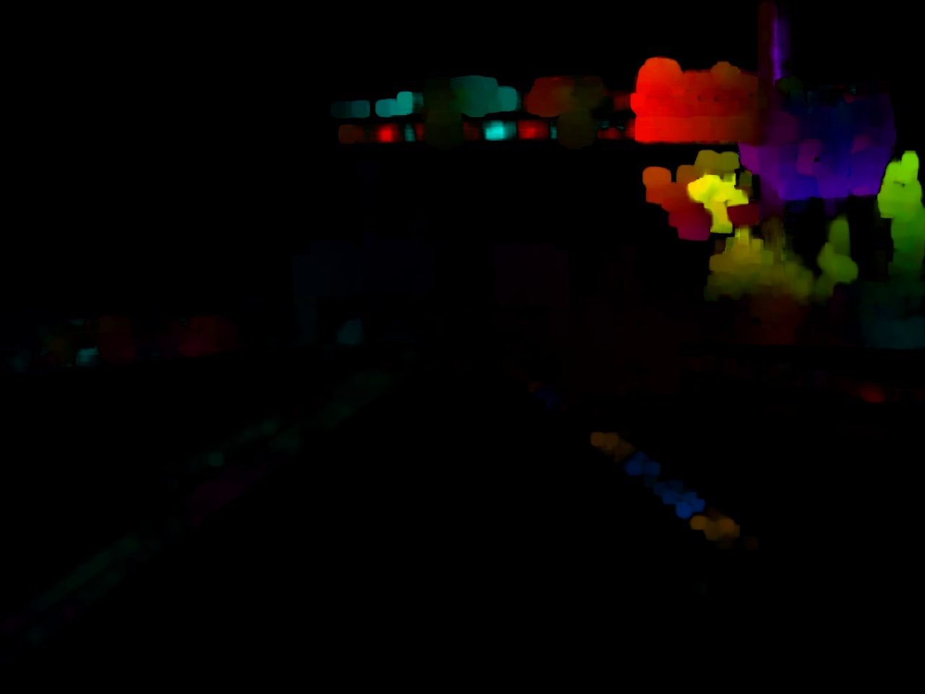
Optical Flow

