Slide 1

HACKOVER_OOZE
PRESENTS
OFFLINE WALLET SYSTEM

Slide 2

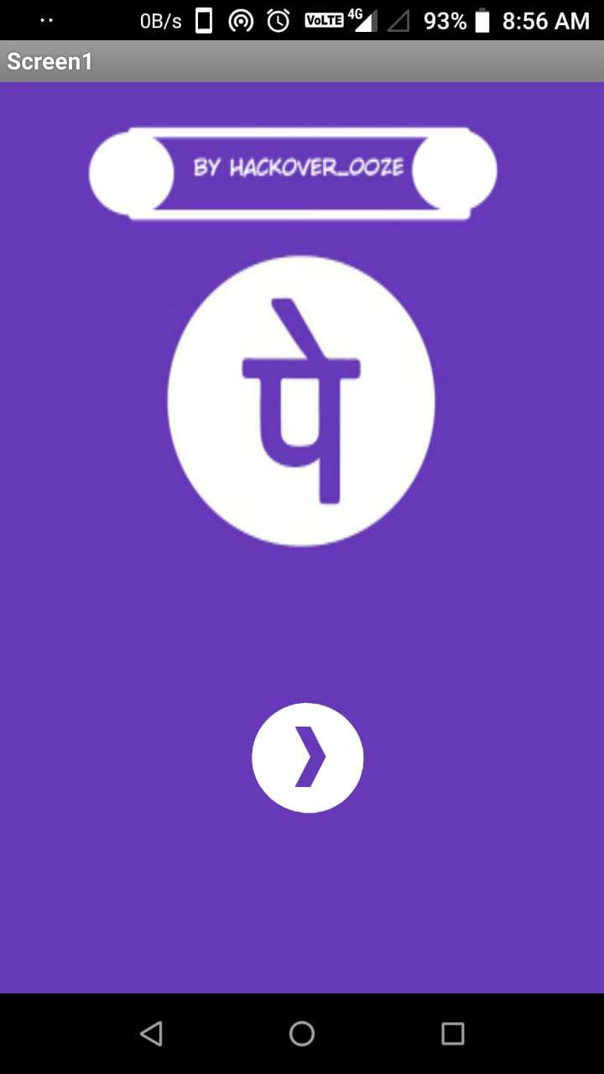
PROGRAMMING LANGUAGE: Java
Kawa
Scheme FRAMEWORK USED: MIT app inventor API SOFTWARE/TOOLS USED:
Android SDK

Slide 3
FEATURES
Send money to someone
Receive money from someone
Transfer money offline
Check account balance
In case there's no availability of normal sms facility, we can take into account offline phonepe wallet from which transactions cannot be done in online mode.Like a normal wallet,the client has to add money to offline wallet where there is good internet connectivity.

Slide 4
START
ADDING MONEY TO PHONEPE WALLET
(WHEN NETWORK IS AVAILABLE)
User requests to add money to the Phonepe Wallet
Phonepe Server
Requested amount<=Balance in the bank
No
Yes
Requested amount deducted from the bank
Error sent to the user for insufficient balance in the bank
Requested amount added to Phonepe Wallet
END

Slide 5
PAYING
AT THE STORE(WHEN NO NETWORK IS PRESENT)
START
Phonepe Server
Requested amount<=Balance in the Wallet
No
Yes
QR code is generated on the Buyer’s Moblie
Receiver scans the QR code
Information from QR is sent to the Phonepe
Error sent to the user for insufficient balance in the Phonepe Wallet
Requested amount deducted from the Phonepe Wallet
Requested amount added to Receiver’s Phonepe Wallet
END

Slide 6
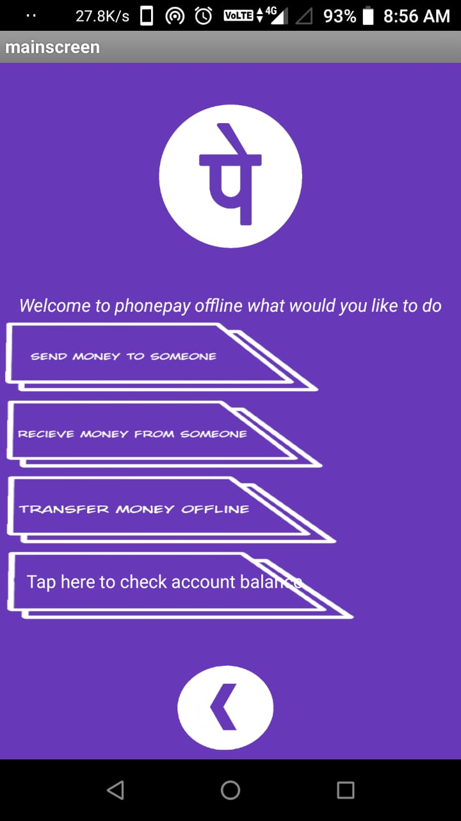
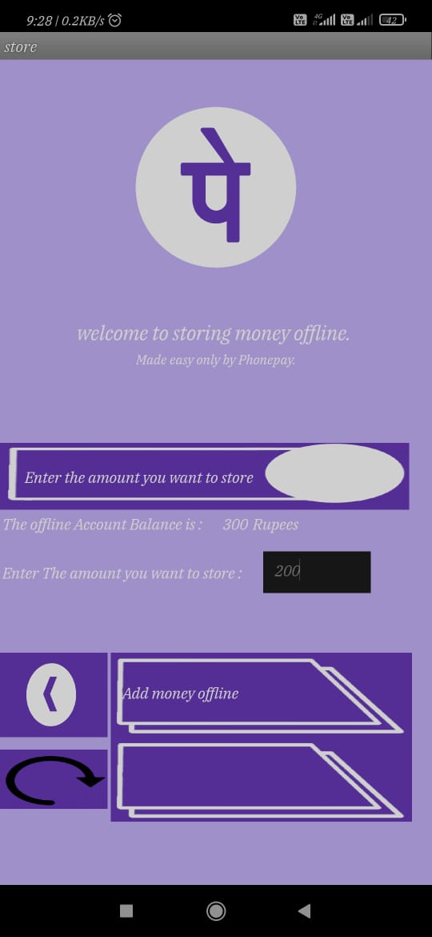
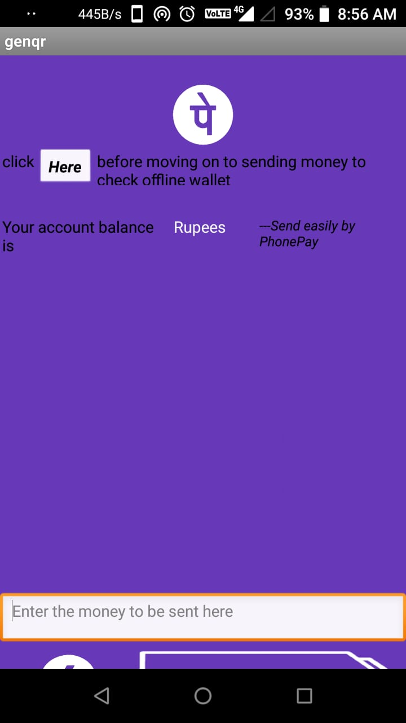
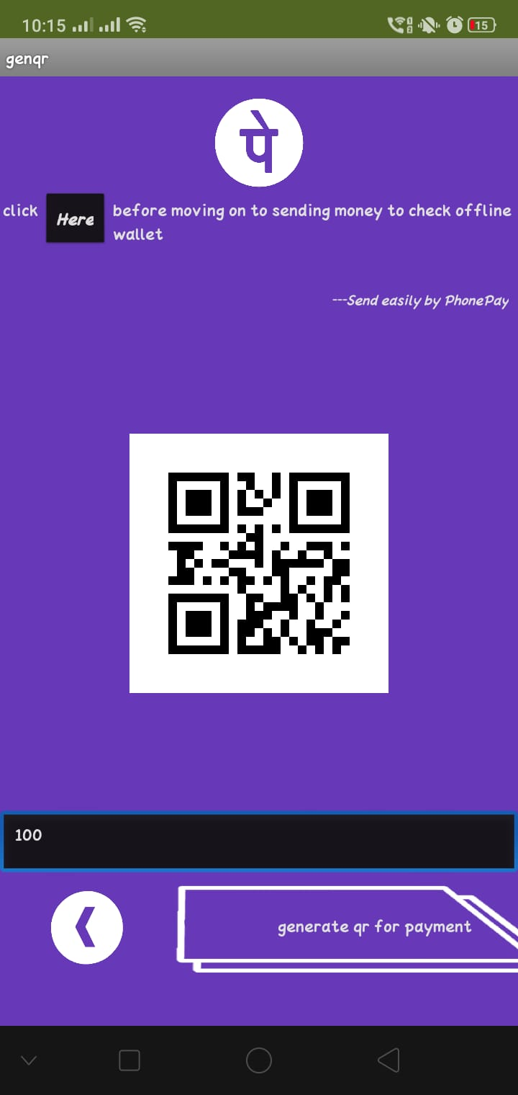
A GLIMPSE TO THE APP
ADDING MONEY TO THE WALLET
PAYING TO THE STORE
MAINSCREEN
QR GENERATION

Slide 7
VIDEO LINK:
You Tube:
https://youtu.be/BHV--yANxZU
APP LINK:
https://drive.google.com/file/d/1N_jm0q0vl_yzbZds0cKyhWJ9PwpZqaKy/view?usp=sharing

