Slide 1
volunteerly
Team Catalyst
Code Innovation Series - Maharaja Agrasen Institute Of Technology
Problem Statement - Education

Slide 2
Team members
Harsh Verma – harshv9988@gmail.com - MAIT
Sagar Garg - sagargupta1417@gmail.com - MAIT

Slide 3
IDEA Overview
The main objective of our hack is to bridge the gap between social services NGO's and volunteers they need for educating underprivilege children or people in rural or backward areas.
On our platform Volunteerly, NGO’s can post different openings for ground volunteers in fields such as education volunteers for underprivilege children, supply chain volunteers strengthening the support etc.
As an user you can search NGO's near you on the platform, can read the description of need and can apply.

Slide 4
What problem does this idea solves?
There has been a gap between NGO's and volunteers those who want to join them. The resources which instructs about joining procedures are either limited or distributed, there is no central information portal for hiring volunteers.
Many NGO's does suffer due to shortage of ground support volunteers those who do main work in areas like teaching underprivilege children education rural area people about health and sanitation processes.

Slide 5
How volunteerly will be solving the issue
NGO’s
As an NGO on platform you can post your openings for volunteers specifying your job description, requirements , location etc;
All your created openings will be saved in your dashboard which also shows applicants and their information on the particular opening
Volunteers
As an volunteer you can search different openings on your dashboard, can explore different NGO profiles.
Can easily apply on a particular opening via dashboard.
Can keep track of your all applications on dashboard.

Slide 6
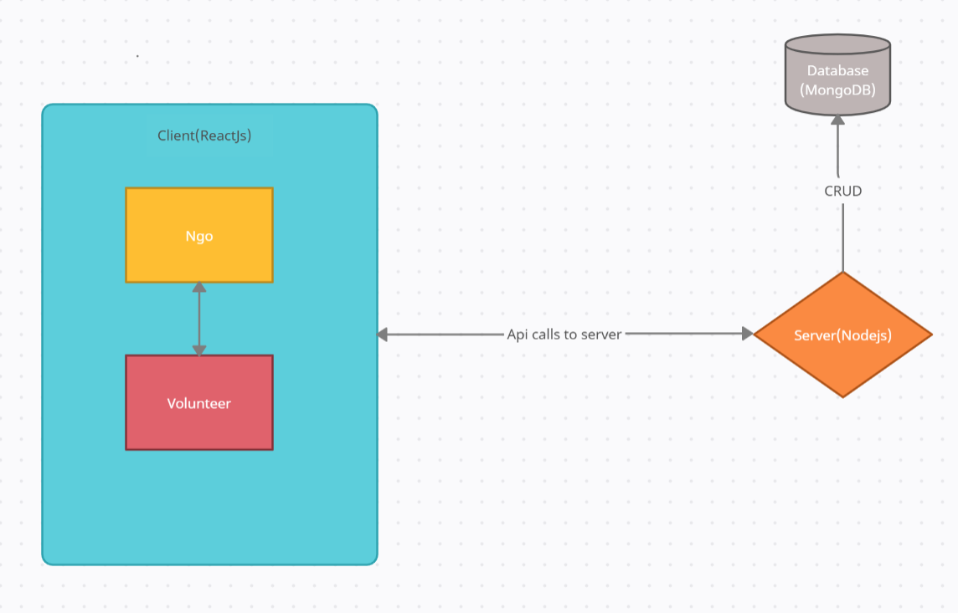
Flow diagram of system/Tech Stack
Client Side – ReactJS, MaterialUI, Bootstrap
Server side – NodeJS, ExpressJS, MongoDB

Slide 7
show stoppers
Apart from code-related bugs designing an aesthetically pleasing background with little design experience will be a challenge.
Integrating two different functionalities for NGO and volunteer dashboard in one site will be a challenge.

Slide 8
Future
Refactoring code for incorporating features such as creating chat channels for volunteers and NGO, showing personalised openings for users.
Adding NGO verification support.
Your Idea?

Slide 9
Thank You

