Slide 1

BUSINESS PITCH PRESENTATION
LexAssist
Zero-Hallucination AI Legal Research Assistant for Indian Law
Empowering 1.5 million practicing advocates, law firms, and 200,000+ law students across India with grounded, local-first statutory intelligence verified directly against official India Code gazettes.
Jurisdiction: India (Central Acts) | Zero Hallucination Mode | Stage: Live Working MVP
Presented by: Founding Team • Email: contact@lexassist.ai • Live System: http://localhost:8501

Slide 2
02. PROBLEM STATEMENT
The Legal Research Crisis: Research Paralysis & Dangerous Hallucinations
Over 1.5 million advocates spend up to 40% of their working hours searching statutes and facing unreliable generic AI.
1. Massive Time Drain
[15-20 HOURS WASTED WEEKLY]
• Affected Group: 1.5M Indian advocates & 200K+ law students.
• The Reality: Junior lawyers spend 15–20 hours/week manually parsing thousands of statutory pages in physical books & PDFs.
• Economic Impact: Over ₹18,000 Crore worth of billable legal hours are wasted annually on manual keyword lookups.
• Delay in Justice: Case preparation delays directly contribute to over 5 Crore pending cases across Indian courts.
2. Keyword Search Failure
[LEGACY KEYWORD FRICTION]
• Incumbent Databases: SCC Online & Manupatra cost ₹40,000–₹90,000/year and rely on exact boolean keywords.
• The Core Failure: If an advocate describes factual scenarios ('supplier refused advance refund'), legacy search returns 0 matches or 400 irrelevant hits.
• Semantic Blindness: Legacy tools lack conceptual understanding of factual legal scenarios and intent.
• Prohibitive Cost: 90% of solo district court practitioners cannot afford legacy enterprise subscriptions.
3. LLM Hallucinations
[CONTEMPT RISK WITH GENERIC AI]
• The Dangerous Trap: Advocates attempting to use ChatGPT or Claude suffer invented section numbers, repealed statutes, and fabricated case citations.
• Severe Penalties: Courts worldwide (and High Courts in India) are actively issuing contempt notices and fines against lawyers submitting fake AI citations.
• Client Risk: A single hallucinated provision ruins case pleadings, client trust, and judicial credibility.
• Critical Need: Lawyers urgently require AI that refuses to guess and strictly provides official provenance.
LexAssist • Zero-Hallucination Indian Legal Research Assistant | Confidential Business Deck | Slide 2 of 12

Slide 3
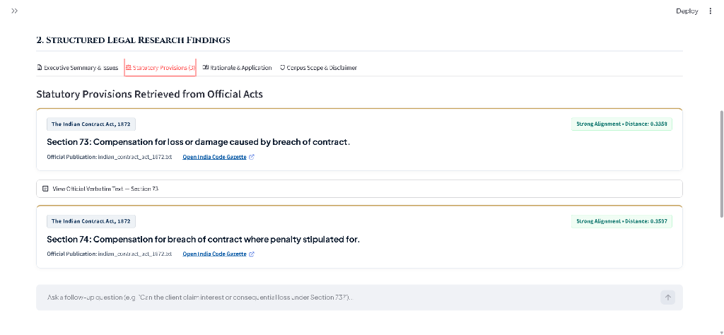
03. PROPOSED SOLUTION
LexAssist: Grounded, Verifiable Legal Intelligence
A local-first, statutorily-grounded research copilot that guarantees zero hallucination with direct gazette links.
Grounded Statutory Retrieval (RAG)
[ZERO-HALLUCINATION ARCHITECTURE]
• Boundary-Aware Ingestion: Statutes chunked strictly at section & article boundaries, preserving titles and explanations.
• Dual Safety Guardrails: Enforces strict 0.52 distance cutoff in ChromaDB; refuses unindexed or out-of-domain queries.
• Direct Gazette Links: Every citation is linked directly to official India Code digital government repositories.
Interactive Grounded Case Workspace
[LOCAL-FIRST CONFIDENTIALITY]
• Multimodal Ingestion: Upload case briefs, PDF filings, or scanned evidence photos via Gemini Vision OCR.
• Multi-Turn Counsel Chat: Explore legal remedies and counter-arguments constrained strictly to retrieved sections.
• Persistent History: Local atomic storage in data/chats/ preserves client confidentiality and multiple inquiry threads.
[FIGURE 1: GROUNDED STATUTORY RETRIEVAL — SECTION CARDS & INDIA CODE CITATIONS]
Production Interface: Strong alignment score (0.3858), verbatim statutory cards & official gazette links
LexAssist • Zero-Hallucination Indian Legal Research Assistant | Confidential Business Deck | Slide 3 of 12

Slide 4
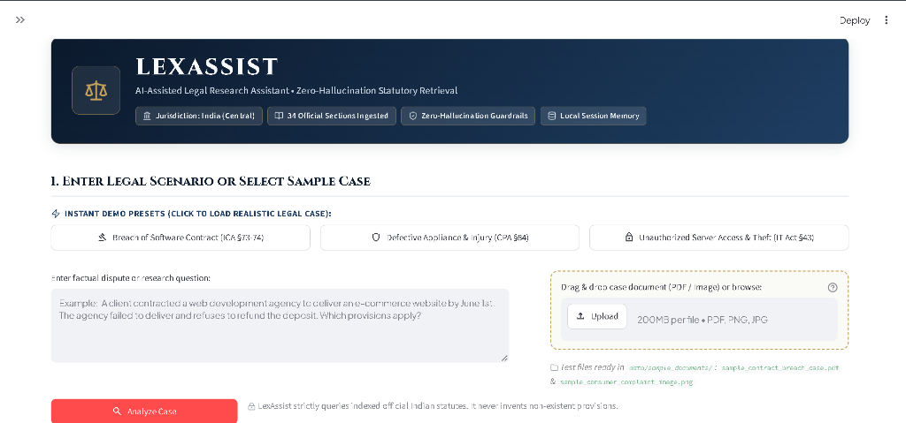
04. INNOVATION & TECHNOLOGY
Engineered for Trust: Zero-Hallucination RAG Pipeline
A four-stage verification architecture combining boundary-aware chunking, local vector search, and strict LLM constraints.
[FIGURE 2: PRODUCTION INGESTION — DRAG & DROP MULTIMODAL BRIEFS & LOCAL GUARDRAILS]
Active System: 34 Ingested Sections, Instant Demo Presets, Drag-and-drop PDF/Image parser & Zero-Hallucination Lock
1. Boundary-Aware Parser
[LEGAL-FIRST INGESTION]
• No Mid-Section Splits: Naive RAG cuts text at arbitrary character limits. LexAssist parses strictly at legal section boundaries.
• Preserves Context: Maintains provisos, statutory explanations, and sub-clauses intact with official metadata.
2. Algorithmic Guardrail (<0.52)
[ZERO GUESSING GUARANTEE]
• Mathematical Distance: Uses cosine distance threshold (0.52). If semantic similarity is inadequate, the engine refuses synthesis.
• Anti-Hallucination Safe: Prevents unindexed topics (IP, maritime) or fake section prompts from ever reaching the LLM.
3. Local ChromaDB Store
[CONFIDENTIALITY BY DESIGN]
• Client Privilege Safe: Vector embeddings and similarity matching execute 100% locally on the advocate's machine.
• Sub-50ms Latency: Dense 384-dimensional vectors deliver instantaneous section discovery with full offline capabilities.
LexAssist • Zero-Hallucination Indian Legal Research Assistant | Confidential Business Deck | Slide 4 of 12

Slide 5
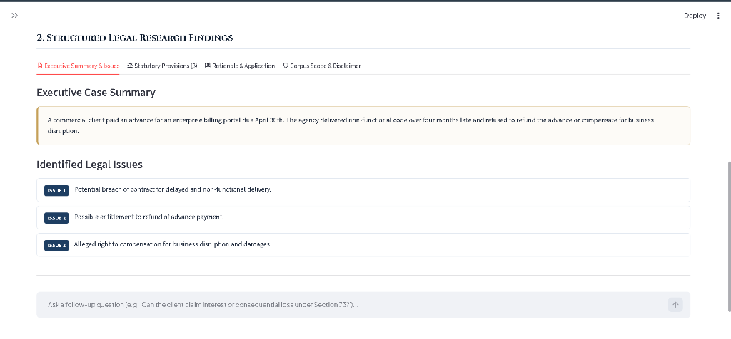
05. TARGET CUSTOMERS
Customer Personas: Serving India's Legal Ecosystem
A massive, underserved market of litigation advocates, law students, and corporate legal teams.
Solo Advocates & Chambers
[PRIMARY REVENUE ENGINE]
• Audience Size: 1,500,000+ Registered Advocates in District & High Courts.
• Core Pain Point: Cannot afford ₹40,000+/yr legacy databases. Waste 3-4 hours daily browsing bare acts.
• LexAssist Solution: Instantaneous, verified section discovery in <5s with clickable gazette proof.
• Willingness to Pay: ₹999 / month per advocate.
Law Students & Academics
[VIRAL FUNNEL]
• Audience Size: 200,000+ Students across 1,700 Law Colleges.
• Core Pain Point: University IP logins restricted to campus libraries; complex moot court research.
• LexAssist Solution: Affordable research copilot teaching grounded statutory reasoning & legal drafting.
• Willingness to Pay: Freemium; ₹299 / month pro tiers.
In-House Legal & Boutique Firms
[HIGH-LTV ENTERPRISE]
• Audience Size: 60,000+ Enterprises, Startups & Law Firms.
• Core Pain Point: Rapid, audit-ready compliance cross-referencing across Contract, IT & Consumer disputes.
• LexAssist Solution: Multi-seat workspace with document OCR, audit trails & exportable research memos.
• Willingness to Pay: ₹3,999 / seat / month (SaaS).
[FIGURE 3: AUTOMATED ISSUE EXTRACTION & EXECUTIVE SUMMARY]
Production Interface: Formulates clear executive summaries and distinct legal issues tailored for fast junior/senior lawyer review
LexAssist • Zero-Hallucination Indian Legal Research Assistant | Confidential Business Deck | Slide 5 of 12

Slide 6
06. MARKET & COMPETITION
Market Opportunity & Distinct Competitive Moat
Disrupting an antiquated ₹2,400 Crore market with modern AI that solves the accuracy crisis.
Market Size & Growth Potential
[₹2,400 CR MARKET OPPORTUNITY]
• Total Addressable Market (TAM): ₹2,400 Crore ($290M) — Total legal information & research spend across India.
• Serviceable Addressable Market (SAM): ₹850 Crore ($105M) — Litigation advocates, Tier-2/3 firms & law students.
• Serviceable Obtainable Market (SOM): ₹65 Crore ($8M) — Capturing 4% market share (55,000 paid subscribers) within 36 months.
The Defining Regulatory Tailwinds
[UNPRECEDENTED MARKET DEMAND]
• Historic Overhaul (BNS Transition): India replaced IPC, CrPC, and Evidence Act with BNS, BNSS, and BSA. 1.5M advocates urgently need statutory re-mapping.
• Digital Courts Mandate: Supreme Court's e-Courts Phase III allocates ₹7,210 Crore for AI-enabled judicial digital infrastructure.
• High Court Warnings: Judges actively penalizing lawyers for fake AI citations creates an immediate flight to verified tools.
Competitive Landscape: Why LexAssist Dominates
[COMPETITIVE ADVANTAGE MATRIX]
• Legacy Legal Databases (SCC Online, Manupatra): Extremely expensive (₹40K–₹90K/yr), pure exact-keyword search, zero semantic synthesis, steep learning curve.
• Generic Consumer LLMs (ChatGPT, Claude, Perplexity): Dangerous legal hallucinations, invents repealed laws, no India Code provenance, severe confidentiality risks for client data.
• Global LegalTech (Harvey AI, CoCounsel): Built exclusively for US/UK common law, priced at $10,000+/year for elite firms, zero Indian statutory coverage.
• LexAssist Competitive Moat: Grounded zero-hallucination RAG, sub-second semantic retrieval, affordable at ₹999/mo, local-first privacy, official India Code citations.
LexAssist • Zero-Hallucination Indian Legal Research Assistant | Confidential Business Deck | Slide 6 of 12

Slide 7
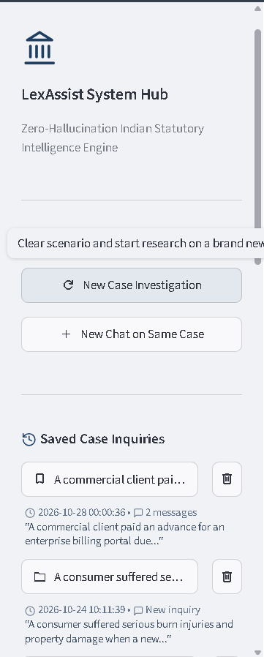
07. BUSINESS MODEL
Monetization Strategy: Multi-Tiered Recurring Revenue
A product-led SaaS subscription model delivering predictability, high gross margins, and expanding LTV.
Free Tier: Freemium Acquisition
[VIRAL USER FUNNEL]
• Price: ₹0 / Free Forever.
• Target Users: Law students, junior clerks, trial users.
• Features Included: 5 case analyses per day, search across core central bare acts, standard web interface.
• Conversion Trigger: Upgrade prompts on file uploads (>3 pages), persistent thread limits, and memo exports.
Enterprise & Firm Workspace
[HIGH-MARGIN ENTERPRISE EXPANSION]
• Price: ₹3,999 / seat / month (Min. 5 seats).
• Target Users: Law firms, corporate legal teams, General Counsels.
• Features Included: Centralized chamber billing, multi-user shared case folders, custom private corpus ingestion (internal contracts, past briefs), SOC-2 compliance, priority SLA.
• Strategic Upsell: Enterprise contracts billed annually with dedicated onboarding and training workshops.
• Retention Driver: High switching barrier once firm archives historical case research in local chamber vaults.
Advocate Pro: Core Pillar
[CORE REVENUE DRIVER (90% USERS)]
• Price: ₹999 / month (or ₹9,999 / year billed annually).
• Target Users: Solo advocates, independent litigators, chambers.
• Features Included: Unlimited case inquiries, full multimodal OCR (PDF + images), unlimited follow-up chat, persistent history, Word/PDF memo exports.
• Unit Economics: API compute cost: ₹36/mo | Gross Margin: 96.7%.
[FIGURE 4: PERSISTENT CHAMBER HUB]
Production Sidebar: New Case vs Same Case Chat, Saved inquiries & local metadata
LexAssist • Zero-Hallucination Indian Legal Research Assistant | Confidential Business Deck | Slide 7 of 12

Slide 8
08. COST & PRICING
Cost Structure & Exceptional Unit Economics
Local-first architecture minimizes cloud infrastructure costs, delivering 96.7% software gross margins.
Per-User Monthly Cost Breakdown (Pro Tier)
[96.7% SOFTWARE GROSS MARGIN]
• Local Vector Ingestion & Storage: ₹0.00 — ChromaDB runs locally on the user's machine; zero server RAM/storage hosting overhead.
• Vector Search Compute: ₹0.00 — all-MiniLM-L6-v2 embeddings compute on-device with zero API calls for retrieval.
• Gemini 2.5 Flash Synthesis: ₹24.50 — Average 70 research queries/month at ₹0.35 per 2,000-token prompt & completion envelope.
• Multimodal OCR (PDF/Images): ₹8.00 — Average 15 document extractions/month.
• Cloud Auth & Session Sync: ₹3.50 — Distributed serverless user sync & security.
• Total Operating Cost per User: ₹36.00 / month.
• Selling Price (Pro Tier): ₹999.00 / month.
• Gross Profit per User: ₹963.00 / month (96.7% Gross Margin).
Key Financial Metrics & 3-Year Projections
[10.0X LTV / CAC RATIO]
• Customer Acquisition Cost (CAC): ₹1,200 — Blended across digital legal channels, Bar Council demos, and student ambassadors.
• Customer Lifetime Value (LTV): ₹11,988 — Assuming average advocate retention of 12 months (churn < 4%).
• LTV to CAC Ratio: 10.0x — World-class SaaS unit efficiency (benchmark is > 3.0x).
• CAC Payback Period: 1.2 Months — Immediate cash reinvestment into growth.
• Year 1 Target ARR: ₹1.44 Crore ($175K) — 1,200 active paid Pro subscribers.
• Year 2 Target ARR: ₹7.20 Crore ($870K) — 6,000 paid subscribers.
• Year 3 Target ARR: ₹21.60 Crore ($2.6M) — 18,000 paid subscribers.
LexAssist • Zero-Hallucination Indian Legal Research Assistant | Confidential Business Deck | Slide 8 of 12

Slide 9
09. MARKETING STRATEGY
Go-To-Market: Product-Led Growth & Grassroots Trust
A three-pillar GTM engine converting law schools, Bar Associations, and digital legal communities.
1. Law School Beachhead
[GRASSROOTS VIRAL ADOPTION]
• Campus MoUs: Partner with top National Law Universities (NLSIU, NALSAR, NUJS) as official research software for legal aid clinics.
• Moot Court Sponsorships: Sponsor premier national moot courts, offering LexAssist research credits to all participating teams.
• Student Ambassador Program: Equip campus legal scholars with free pro tier accounts in exchange for campus workshops.
• The Flywheel: Graduating students enter litigation chambers as junior associates and mandate LexAssist for their seniors.
2. Bar Council Roadshows
[DIRECT PROFESSIONAL TRUST]
• Live Hallucination Challenge: Host interactive live demos at District & High Court Bar Associations (e.g. Delhi High Court Bar, Bombay Bar).
• Head-to-Head Comparison: Pit LexAssist live on stage against ChatGPT to prove how generic AI invents repealed sections while LexAssist grounds every clause.
• Chamber Group Onboarding: Offer senior advocates a 15-minute chamber setup with bulk seat discounts for their junior associates.
• High Trust Conversions: Court-side physical demonstrations generate high-intent immediate subscriptions.
3. Content & Community
[THOUGHT LEADERSHIP & VIRALITY]
• BNS Migration Hub: Publish free statutory translation cheat sheets mapping old IPC/CrPC sections to new Bharatiya Nyaya Sanhita provisions.
• LinkedIn Case Teardowns: Weekly legal teardowns of landmark High Court rulings, showcasing structured statutory analysis.
• Digital Verified Watermark: Every research memo and brief exported by LexAssist carries an official verification seal and share link.
• Organic Referral Loop: Advocates share verified memos with clients and opposite counsel, driving viral brand recognition.
LexAssist • Zero-Hallucination Indian Legal Research Assistant | Confidential Business Deck | Slide 9 of 12

Slide 10
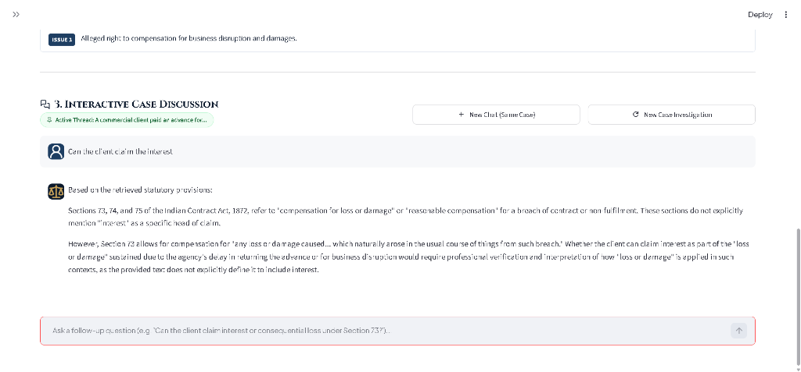
10. FUTURE SCOPE
Development & Scaling Roadmap: 24-Month Vision
From central statutory research to a pan-India judicial intelligence and drafting platform.
[FIGURE 5: INTERACTIVE MULTI-TURN COUNSEL DISCUSSION & REASONING]
Production Interface: Counsel asks follow-up on 'claiming interest'; Assistant grounds reply strictly in Contract Act §§ 73-75
Phase 1: Foundation (M 1–6)
[MONTHS 1–6: STATUTORY CORPUS]
• Complete Central Acts: Expand from core acts to 1,000+ Central Acts and commercial regulations on India Code.
• BNS Migration Bridge: Automated bridge allowing advocates to input historic IPC sections and get matching BNS provisions.
• Native Desktop App: Packaged Electron / Windows installer with offline vector caches.
Phase 2: Precedents (M 7–12)
[MONTHS 7–12: JUDICIAL CASE LAW]
• Case Law Ingestion: Integrate official judgment datasets from Supreme Court e-Courts and High Courts.
• Statutory Cross-Linking: When a section is retrieved, automatically link top 3 landmark rulings interpreting that section.
• Automated Drafting: Export structured research memos directly into formatted Word court filings.
Phase 3: Vernacular (M 13–24)
[MONTHS 13–24: REGIONAL & ENTERPRISE]
• Regional Indian Languages: Enable queries in Hindi, Marathi, Tamil, Bengali, and Gujarati for Tier-2/3 district courts.
• Enterprise Contract Audits: Automated 500-page vendor contract review flagging regulatory non-compliance.
• Pan-India Expansion: Targeting 50,000+ active legal practitioners.
LexAssist • Zero-Hallucination Indian Legal Research Assistant | Confidential Business Deck | Slide 10 of 12

Slide 11
11. THE ASK
Capital Requirement & Strategic Fund Allocation
Seeking ₹25,00,000 Pre-Seed investment for a 12-month runway to achieve 1,200 paid subscribers.
Pre-Seed Funding Ask: ₹25,00,000
[₹25 LAKHS PRE-SEED CAPITAL ASK]
• Corpus Expansion & AI Engineering (45% - ₹11.25 L): Ingesting 1,000+ central statutes, building automated India Code scrapers, hiring legal research interns to validate section boundaries, and optimizing local embedding models.
• Bar Council & Law School GTM (30% - ₹7.50 L): Sponsoring 10 national moot courts, conducting 25 Bar Association roadshows, campus ambassador stipends, and legal digital content marketing.
• Infrastructure, Security & Cloud Sync (25% - ₹6.25 L): High-availability auth infrastructure, enterprise SOC-2 data readiness, security penetration audits, and LLM API reserve capacity.
• Runway Period: 12 Months of self-sustaining operations leading to Series Seed round.
12-Month Quantifiable Milestones
[12-MONTH TARGET DELIVERABLES]
• 15,000 Registered Users: 10,000 law students and 5,000 practicing advocates onboarded across India.
• 1,200 Paid Pro Subscribers: Achieving ₹12 Lakhs Monthly Recurring Revenue (MRR), representing ₹1.44 Crore ARR.
• 100% Central Acts Ingested: Verified vector index covering all 1,000+ Indian Central Acts with verified gazette links.
• 5 Institutional NLUs & 3 Bar Councils: Formal MoUs established for legal aid clinics and Bar association member discounts.
• Operating Breakeven: Achieving sustainable operating cash-flow breakeven by Month 9 of deployment.
LexAssist • Zero-Hallucination Indian Legal Research Assistant | Confidential Business Deck | Slide 11 of 12

Slide 12
12. CLOSING PITCH
Why Back LexAssist? The Irresistible Opportunity
The right product, the right technical architecture, and the perfect regulatory timing in Indian legal history.
1. Perfect Regulatory Timing
[HISTORIC REGULATORY SHIFT]
• Historic BNS Transition: India is witnessing its biggest legal transition in 160 years. 1.5 million lawyers must cross-reference old laws with new codes.
• Immediate Flight to Safety: Courts are cracking down on generic AI hallucinations; lawyers need verified, grounded intelligence right now.
2. Real Technical Defensibility
[PROPRIETARY GUARDRAILS]
• Proprietary Guardrail Pipeline: Zero hallucination is not marketing buzz; it is mathematically enforced via boundary-aware chunking and 0.52 distance limits.
• Local-First Privacy: Sensitive client facts remain on-device, resolving the #1 objection lawyers have toward cloud AI.
3. High-Margin Scalability
[EXCEPTIONAL UNIT ECONOMICS]
• 96.7% Gross Margin: Local vector search eliminates heavy cloud infrastructure costs.
• 10.0x LTV / CAC Ratio: World-class capital efficiency ensures sustainable, rapid expansion across 1,700 law schools and 1,500+ district bar associations.
Let's Democratize Indian Justice Together.
By backing LexAssist, you empower solo district advocates and law students with the same research speed and statutory precision once reserved for top-tier law firms.
Join us in building the statutory research standard for Indian jurisprudence.
Contact: Founding Team | Email: contact@lexassist.ai | Live App: http://localhost:8501
LexAssist • Zero-Hallucination Indian Legal Research Assistant | Confidential Business Deck | Slide 12 of 12

