Slide 1
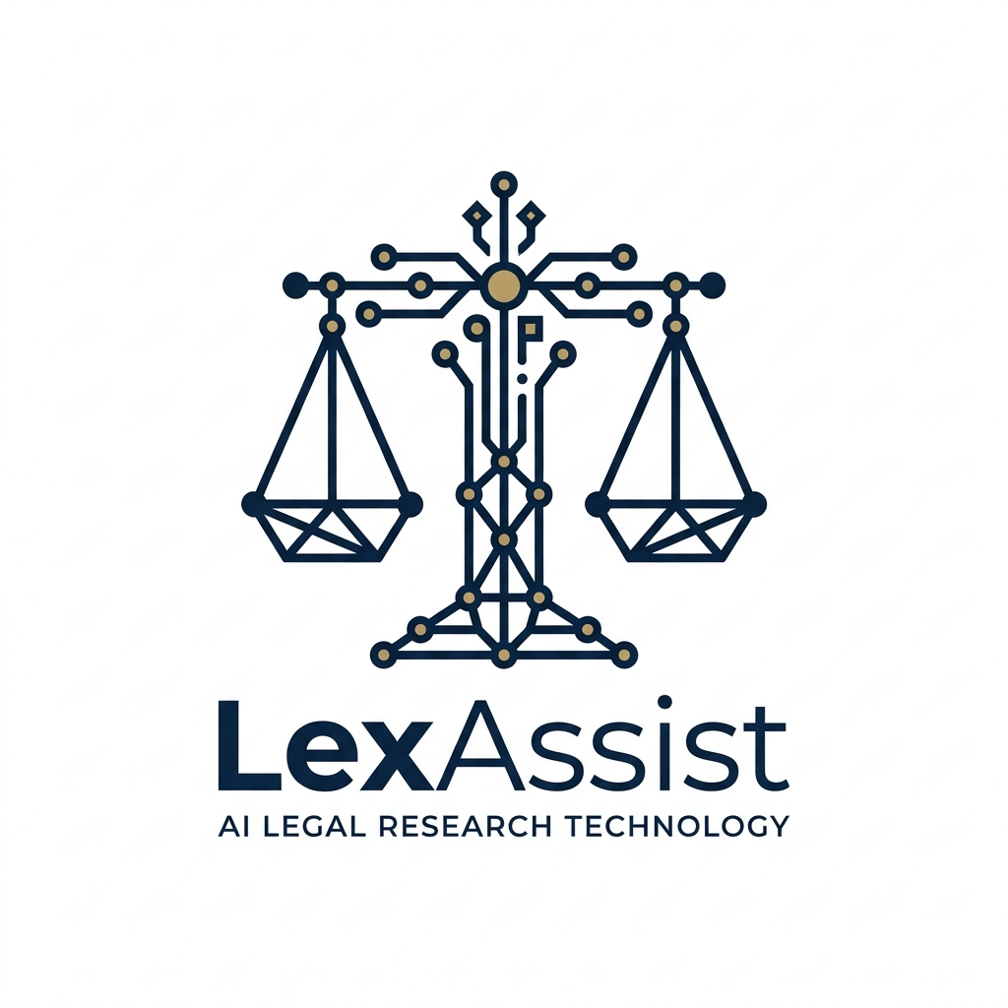
BUSINESS PITCH PRESENTATION
LexAssist
Zero-Hallucination AI Legal Research Assistant for Indian Law
Empowering 1.5 million advocates and 200,000+ law students with local-first, statutorily-grounded AI intelligence. Decoupling legal reasoning from model memory to deliver 100% verifiable citations from official India Code enactments.
Venture Track: LegalTech & Enterprise AI | Jurisdiction: India 🇮🇳 | Stage: Working MVP
LexAssist — Zero-Hallucination AI Legal Research | Confidential Business Pitch
Notes:
Good morning esteemed judges and evaluators. Today, we are proud to introduce LexAssist—an AI legal research assistant engineered specifically to solve the single greatest hazard preventing artificial intelligence from entering the Indian courtroom: AI hallucination. We have developed a fully working local-first platform that indexes official government statutes, delivers deterministic citations, and refuses to invent law.

Slide 2
01. PROBLEM STATEMENT
The Real-World Problem: Research Paralysis & Hallucination Risk
1. Massive Time Drain
Who faces it:
1.5M practicing Indian advocates and 200,000+ law students.
The Reality:
• Junior advocates spend 15 to 20 hours per week manually navigating hundreds of pages of statutory enactments, gazettes, and schedules.
• 4.4 Crore cases are currently pending in Indian courts; research bottlenecks directly compound judicial delays.
• Solo practitioners in Tier-2/3 courts cannot afford massive research chambers.
2. Keyword Search Failure
The Friction:
• Incumbent legal databases (SCC Online, Manupatra) rely heavily on exact-string matching.
• When an advocate enters natural case facts (e.g., 'agency missed deadline after advance payment'), keyword search fails to map to statutory terms like 'breach of contract' or Section 73.
• Requires knowing the exact legal conclusion before finding the statute.
3. LLM Hallucinations
The Dangerous Trap:
• When lawyers turn to ChatGPT or Claude, generic LLMs hallucinate non-existent sections, cite fake rulings, or cite repealed colonial laws.
• Citing a hallucinated law in court leads to contempt petitions, disbarment, or loss of client cases.
• Generic AI cannot be trusted with legal counsel.
LexAssist — Zero-Hallucination AI Legal Research | Confidential Business Pitch
Notes:
The problem we are addressing is three-fold. First, Indian lawyers spend 15 to 20 hours every week wading through statutory acts across 44 million pending cases. Second, incumbent databases like SCC Online rely on rigid keyword searches that fail when fed real-world factual scenarios. Third, and most dangerous, commercial AI tools like ChatGPT hallucinate section numbers and cite repealed statutes. In law, hallucination is not just an error—it is professional malpractice.

Slide 3
02. PROPOSED SOLUTION
LexAssist: Grounded, Verifiable Legal Intelligence
How LexAssist Solves the Legal Research Crisis
• Grounded Retrieval-Augmented Generation (RAG):
Instead of relying on LLM memory weights, LexAssist indexes official legislative texts directly from government gazettes (indiacode.nic.in).
• Boundary-Aware Statutory Ingestion:
Laws are parsed cleanly at exact Section and Article boundaries, preserving explanations, illustrations, and legislative schedules intact.
• Deterministic Provenance & Citations:
Every response provides the exact statutory title, verbatim legal clause, and direct clickable link to the official gazette repository.
• Mandatory Refusal (Zero-Hallucination):
If an entered dispute falls outside indexed law, the AI explicitly reports that no provision was found. It is strictly prohibited from inventing sections.
Core Product Capabilities
📁 Multimodal Case Analysis
Accepts plain text, case PDF filings, and scanned evidence photos via Gemini Multimodal OCR.
⚖️ Grounded Follow-up Chat
Allows lawyers to ask follow-up questions constrained strictly to retrieved provisions.
💾 Persistent Case Workspaces
Auto-saves research sessions, enables multiple exploration threads per dispute without data loss.
🔒 Local-First Data Privacy
Vector embeddings and search run 100% locally on user machine; sensitive case files stay private.
LexAssist — Zero-Hallucination AI Legal Research | Confidential Business Pitch
Notes:
Our solution is LexAssist. Unlike raw chatbots, LexAssist uses a grounded RAG architecture. We index official government legislation from indiacode.nic.in, chunk statutes precisely at Section boundaries, and retrieve matching provisions locally using ChromaDB. Gemini then synthesizes an objective legal brief using ONLY the retrieved text. If a law is not in our database, the system explicitly refuses to answer rather than inventing a hallucination.

Slide 4
03. TECHNOLOGY & ARCHITECTURE
Engineering Innovation: Zero-Hallucination Pipeline
1. Boundary-Aware Statutory Chunking
Traditional naive RAG splits text every 500 characters, severing sections in half and losing legal exceptions. LexAssist parses statutory enactments precisely at Section/Article headers, packaging statutory text, official explanations, and legislative illustrations in a single atomic vector unit.
2. Dual-Stage Distance Guardrail (<0.59)
We implement an algorithmic cosine distance threshold of 0.59. If user queries do not reach this threshold, the LLM synthesis is never triggered. The system immediately outputs an explicit non-retrieval notification, acting as a deterministic firewall against off-topic generation.
3. Local-First Vector Storage (ChromaDB)
Statutes are indexed and queried on-device via ChromaDB disk persistence. Confidential client facts do not reside in cloud vector stores, eliminating third-party data leakage and ensuring offline-capable resilience for district court practice.
4. Constrained LLM Synthesis (Gemini 2.5 Flash)
Gemini is governed by a strict zero-hallucination prompt envelope: temperature set to 0.1, instructed strictly to act as a grounded compiler rather than a creative writer. Every statutory proposition links to its verified India Code handle.
LexAssist — Zero-Hallucination AI Legal Research | Confidential Business Pitch
Notes:
Here is the engineering core that makes LexAssist unique. First, we engineered boundary-aware statutory chunking—we never split legal clauses arbitrarily. Second, we built a dual-stage distance firewall: if semantic similarity is below our 0.59 threshold, the LLM is never invoked. Third, our local-first vector architecture keeps confidential case files on the client machine. Fourth, Gemini operates as a grounded reasoning compiler with zero creative liberty.

Slide 5
04. CUSTOMER PERSONAS & SEGMENTS
Target Customers: Who Will Buy & Use LexAssist?
Segment 1: Solo Advocates & Chambers
1,500,000+ Registered Advocates in India
Who They Are:
Solo practitioners and small 2-5 person chambers in High Courts & District Courts.
Current Pain:
Cannot afford expensive enterprise databases (₹40,000+/year). Lose 3-4 hours daily manually searching enactments.
Value Proposition:
Affordable, desktop-ready legal assistant that delivers verified section matches in 5 seconds.
Willingness to Pay:
₹999 / month per advocate.
Segment 2: Law Students & Scholars
200,000+ Students across 1,700 Law Schools
Who They Are:
Undergraduate (BA LLB) and postgraduate scholars preparing for moot courts, exams, and litigation internships.
Current Pain:
University IP logins restricted to campus libraries; struggle with statutory analysis on real cases.
Value Proposition:
Free / low-cost learning copilot that teaches grounded statutory reasoning and legal drafting.
Willingness to Pay:
Freemium entry; ₹299/mo for advanced features.
Segment 3: Corporate Legal & In-House
60,000+ Enterprises & Legal Tech Ops
Who They Are:
In-house general counsels, contract managers, and compliance officers in fintech, e-commerce, and SaaS.
Current Pain:
Need rapid cross-referencing of IT Act, Consumer Protection, and Contract provisions during audit.
Value Proposition:
Audit-ready statutory summaries with direct government gazette links for compliance reporting.
Willingness to Pay:
₹25,000 - ₹50,000 / month per organization.
LexAssist — Zero-Hallucination AI Legal Research | Confidential Business Pitch
Notes:
Our customer strategy targets three distinct tiers. Our primary revenue driver is India's 1.5 million practicing advocates, 85% of whom are solo or small chamber litigators priced out of legacy tools. Our adoption beachhead is 200,000 law students across 1,700 universities, who act as our product-led growth ambassadors. Finally, corporate compliance teams represent high-value enterprise accounts.

Slide 6
05. MARKET & COMPETITION
Market Opportunity & Competitive Landscape
₹15,000 Cr ($1.8B)
TAM: Total Addressable Market
Total Indian Legal, Compliance & RegTech Market by 2028
₹3,200 Cr ($385M)
SAM: Serviceable Addressable
Litigation research and statutory workflow tools for Indian practitioners
₹180 Cr ($22M)
SOM: Serviceable Obtainable
Target 15% penetration of tech-forward advocates & firms within 5 years
Competitive Positioning Matrix
Feature / Dimension | SCC Online / Manupatra | ChatGPT / Generic AI | Harvey AI | LexAssist (Our Solution)
Search Paradigm | Exact Keyword Matching | Ungrounded Generative | Enterprise US/UK RAG | Grounded Statutory Semantic RAG
Hallucination Risk | Low (Pure Database) | CRITICAL (Fabricates Sections) | Moderate (Model drift) | ZERO (Enforced Refusal & Firewall)
Statute Provenance | Static Text Page | None (Opaque / Hallucinated) | Generic Links | Exact India Code Link + Verbatim Text
Data Privacy | Cloud Search Logs | Public Cloud Training Risk | Enterprise Cloud Only | Local-First On-Device Vector Store
Annual Pricing | ₹35,000 – ₹60,000 / seat | $240 / year (Unsafe) | $12,000+ / seat (Foreign) | ₹9,990 / year (Affordable India SaaS)
LexAssist — Zero-Hallucination AI Legal Research | Confidential Business Pitch
Notes:
The Indian LegalTech market represents a 15,000 Crore rupee opportunity. Looking at our competitive matrix: SCC Online and Manupatra are expensive legacy keyword tools with no semantic reasoning. ChatGPT has a fatal hallucination risk that makes it unusable for actual filings. Harvey AI is built for elite multi-million dollar US/UK firms at $1,000 a month. LexAssist occupies the sweet spot: zero hallucination, semantic intelligence, local-first privacy, and disruptive Indian pricing at ₹999 a month.

Slide 7
06. REVENUE & BUSINESS MODEL
Business Model: Monetization & Pricing Tiers
Community Free
₹0
Perpetual Free
✓ 3 Core Central Acts indexed
✓ 15 Case queries / day
✓ Plain text fact input
✓ Official India Code citations
✓ Standard community support
✓ Target: Law Students & Interns
Advocate Pro
₹999
Per month (billed ₹9,990/yr)
✓ ALL Central & State Acts
✓ UNLIMITED Case analyses
✓ Multimodal PDF & Scan upload
✓ Persistent Case History & Threads
✓ Grounded Interactive Follow-up Chat
✓ Priority Gemini 2.5 Flash Engine
Chambers Team
₹4,999
Per month (includes 5 seats)
✓ Includes 5 Pro Advocate accounts
✓ Shared Chamber Case Dossiers
✓ Multi-associate collaboration
✓ Client Brief PDF Export
✓ Firm-wide search history audit
✓ Additional seat @ ₹799/mo
Enterprise & API
Custom
From ₹25,000 / month
✓ On-Premise Private Server deployment
✓ Custom Corporate Contract Indexing
✓ API Access for Legal ERPs / CRM
✓ Dedicated Account Manager & SLA
✓ Custom Security & Audit Reviews
✓ Target: Law Firms & Enterprises
LexAssist — Zero-Hallucination AI Legal Research | Confidential Business Pitch
Notes:
Our business model uses a freemium SaaS architecture. Our free community tier drives rapid viral adoption among law students and junior associates. Our core cash cow is the Advocate Pro plan at ₹999 per month, which unlocks the complete statutory database, multimodal document uploads, and persistent case threads. For law firms, we offer the Chambers Team plan at ₹4,999 for 5 seats, and enterprise licenses for corporate legal departments.

Slide 8
07. COST & PRICING
Cost Structure & Exceptional Unit Economics
Monthly COGS per Active Pro User
Gemini 2.5 Flash API Calls: ₹6.00
(Avg 150 queries/mo @ ₹0.04 per query)
Local ChromaDB Vector Compute: ₹2.00
(Zero cloud DB cost (client disk offload))
Cloud Auth, Storage & Sync: ₹5.00
(Encrypted session sync & telemetry)
Payment Gateway & Billing (2%): ₹19.98
(Razorpay / Stripe gateway fees)
TOTAL COGS PER USER / MONTH: ₹32.98
(Direct cost of delivering service)
PRO SELLING PRICE / MONTH: ₹999.00
(Retail subscription price)
GROSS PROFIT PER USER: ₹966.02
(96.7% Gross Margin)
Key SaaS Metrics & Ratios
Customer Acquisition Cost (CAC) — ₹1,200
Kept low via organic campus PLG and Bar Council demo workshops.
Customer Lifetime Value (LTV) — ₹11,988
Assumes conservative 12-month average subscription lifespan @ ₹999/mo.
LTV / CAC Ratio — 10.0x
World-class SaaS unit efficiency (industry benchmark > 3.0x).
Payback Period — 1.2 Months
Acquisition investment recouped in under 40 days of paid usage.
Target Year 1 ARR — ₹1.44 Crore
Based on 1,200 active paid Pro subscribers by Month 12.
LexAssist — Zero-Hallucination AI Legal Research | Confidential Business Pitch
Notes:
Now let's examine our unit economics. Because LexAssist leverages local-first ChromaDB vector compute, we don't pay massive cloud database hosting fees. Our total cost to service one active subscriber making 150 queries a month is only ₹33. At our ₹999 price point, our gross margin is an astonishing 96.7%. With an estimated CAC of ₹1,200 and an LTV of nearly ₹12,000, our LTV-to-CAC ratio is 10x, with payback achieved in just 1.2 months.

Slide 9
08. GO-TO-MARKET STRATEGY
Marketing Strategy: Product-Led Growth & Bar Channels
Pillar 1: Campus-to-Chamber Flywheel
Bottom-Up Organic Adoption
Moot Court Sponsorships:
Partner with top National Law Universities (NLSIU, NALSAR, NUJS) as the official statutory research partner.
Student Ambassador Network:
Empower law students with free accounts during their degree.
Graduation Conversion:
When students transition to junior advocates in litigation chambers, they bring LexAssist as their indispensable research copilot.
Pillar 2: Bar Council Demonstrations
Direct Professional Roadshows
Live Hallucination Challenge:
Host live interactive workshops at High Court and District Bar Associations.
Real Case Teardowns:
Pit LexAssist head-to-head against ChatGPT on stage, proving how ChatGPT hallucinates while LexAssist cites exact India Code provisions.
Chamber Bulk Onboarding:
Onboard entire senior advocate chambers in 15-minute group workshops.
Pillar 3: Content-Led Digital Trust
Thought Leadership & Community
Weekly Case Bulletins:
Publish LinkedIn teardowns of trending Supreme Court and High Court disputes with statutory mindmaps.
Verified Report Watermark:
Every PDF brief exported by LexAssist carries a digital verification badge with share link, driving viral referral loops.
BNS Transition Guides:
Provide free migration cheat sheets helping advocates map old IPC sections to new BNS provisions.
LexAssist — Zero-Hallucination AI Legal Research | Confidential Business Pitch
Notes:
Our go-to-market strategy avoids expensive mass-media advertising in favor of a targeted 3-pillar flywheel. First, our campus-to-chamber engine seeds LexAssist across 200,000 law students who graduate into law firms as power users. Second, we run live 'Hallucination Challenge' demos at High Court Bar Associations, proving our superiority over ChatGPT right before senior advocates. Third, every legal report exported carries our verified badge, creating a natural viral loop.

Slide 10
09. DEVELOPMENT & SCALING ROADMAP
Future Scope: Strategic Roadmap & Scaling
Phase 1: Foundation (Months 1–6)
Full Central Acts & BNS Migration
Scale to 1,000+ Acts:
Expand local vector index to cover all Indian central statutes, commercial schedules, and consumer rules.
BNS-IPC Migration Mapper:
Automated bridge allowing advocates to input historic IPC, CrPC, and IEA sections and instantly retrieve corresponding provisions in BNS, BNSS, and BSA.
Desktop App Packaging:
Electron / PyInstaller desktop installer with background auto-updates.
Phase 2: Judicial Precedents (Months 7–12)
High Court & Supreme Court Case Law
Case Precedent Ingestion:
Integrate official judgment datasets from Supreme Court e-Courts and High Courts.
Statutory Cross-Linking:
When a section is retrieved, automatically link the top 3 landmark rulings interpreting that specific clause.
Drafting Assistant:
Export structured legal research memos and factual chronologies directly into formatted Word (.docx) briefs.
Phase 3: Vernacular & Enterprise (Months 13–24)
Pan-India Regional AI & Compliance
Multi-Lingual Indian Languages:
Support case query retrieval in Hindi, Marathi, Tamil, Bengali, and Gujarati for Tier-2/3 district courts.
Enterprise Contract Audit:
Allow corporate legal teams to upload 500-page vendor contracts and check statutory compliance automatically.
Law School LMS Integration:
Direct plugin for university legal clinics.
LexAssist — Zero-Hallucination AI Legal Research | Confidential Business Pitch
Notes:
Our roadmap is divided into three execution horizons. In Phase 1, we expand to all 1,000+ Indian central acts and launch our proprietary BNS-IPC migration tool, which is critical given the recent criminal law overhaul. In Phase 2, we integrate landmark Supreme Court judgments to connect statutes with judicial interpretation. In Phase 3, we democratize justice across India by introducing vernacular language support in Hindi, Tamil, and Marathi for district courts.

Slide 11
10. CAPITAL REQUIREMENT & ALLOCATION
The Ask: Funding Requirements & Milestones
Pre-Seed Incubator Ask: ₹25,00,000
12-Month Operating Runway to Achieve Scale
45% (₹11.25 Lakhs) — Legal Corpus & Engineering
Ingesting 1,000+ statutes, building automated gazette scrapers, hiring legal research interns for ground-truth verification of section vectors.
30% (₹7.50 Lakhs) — Go-To-Market & Bar Council Outreach
Sponsoring 10 national moot court competitions, hosting 25 Bar Association demonstration workshops, and student ambassador grants.
25% (₹6.25 Lakhs) — Infrastructure, SOC-2 & Security
Cloud authentication infrastructure, SSL/TLS audit, security penetration testing, and LLM reasoning API buffer.
12-Month Target Milestones
🎯 15,000 Registered Users
Reaching 10,000 law students and 5,000 practicing advocates within 12 months.
💼 1,200 Paid Pro Subscribers
Generating ₹12 Lakhs monthly recurring revenue (₹1.44 Crore ARR).
⚖️ 100% Central Acts Coverage
Complete, verified index of all Indian central enactments and rules.
🚀 Institutional Partnerships
MoUs signed with at least 5 National Law Universities and 3 State Bar Councils.
📈 Cash Flow Breakeven
Achieving sustainable operating profitability by Month 9 of the deployment.
LexAssist — Zero-Hallucination AI Legal Research | Confidential Business Pitch
Notes:
To execute this vision, we are seeking an investment or incubator grant of ₹25 Lakhs for a 12-month runway. 45% of these funds will go directly into statutory corpus engineering and legal ground-truth verification. 30% will fund our Bar Council and law school GTM campaigns, and 25% will secure our infrastructure and data security. With this capital, we will achieve 15,000 active users, 1,200 paid subscribers, and cross ₹1.4 Crore in ARR.

Slide 12
11. CLOSING PITCH & VISION
Why Back LexAssist? The Irresistible Opportunity
The Right Solution at India's Defining Legal Moment
1. Perfect Regulatory Timing:
India is undergoing the largest legal overhaul in 160 years with the transition to Bharatiya Nyaya Sanhita (BNS). Every lawyer in India is forced to re-learn statutory mappings. LexAssist is their indispensable guide.
2. Real Technical Defensibility:
Zero-hallucination is not marketing fluff; it is enforced via boundary-aware chunking, vector distance firewalls, and local ChromaDB persistence. We solve the exact problem keeping AI out of courts.
3. High-Margin Scalability:
With 96.7% gross margins, an LTV/CAC ratio of 10x, and local-first compute efficiency, LexAssist is built for capital-efficient, high-velocity growth.
4. Mission of Justice:
By democratizing legal research at ₹999/month, we empower solo district court advocates to match the research horsepower of elite multi-partner corporate law firms.
Let's build the future of Indian jurisprudence together. Thank you.
Contact: Founding Team | Email: contact@lexassist.ai | Demo: http://localhost:8501
LexAssist — Zero-Hallucination AI Legal Research | Confidential Business Pitch
Notes:
In closing, why should you back LexAssist? First, the timing is historic—as India transitions to the BNS, lawyers need reliable statutory navigation now more than ever. Second, we solve the hallucination crisis that disqualifies general-purpose AI. Third, our unit economics are extraordinary with 96% gross margins. And fourth, we are leveling the playing field for 1.5 million lawyers across India. Thank you, and we welcome your questions.

