Slide 1
(SY SEM – 1)
AI POWERDED PREDICTIVE MAINTAINANCE SYSTEM
Instructor
Prof. Manisha Mhetre
Sr No. | Name | PRN | Roll No.
1 | Harshvardhan Vitthal Shinde | 12413756 | 10
2 | Sandesh Gaykwad
3 | Varun Nilesh Lolage | 12415221 | 68

Slide 2
Problem Statement
An AI-Powered Predictive Maintenance System is a smart industrial solution that uses Artificial Intelligence (AI), Machine Learning (ML), and IoT sensors to monitor the condition of machines in real-time.
Instead of waiting for equipment to fail or performing unnecessary routine checks, this system predicts failures in advance and schedules maintenance only when needed.
This innovation helps industries to:
Minimize unplanned downtime
Reduce maintenance costs
Extend machine lifespan
Improve safety and efficiency
By transforming traditional maintenance into intelligent, data-driven decision making, AI-powered predictive maintenance is revolutionizing the future of industries.

Slide 3
To monitor machine health in real-time using IoT sensors.
To predict failures in advance using AI and Machine Learning models.
To reduce unplanned downtime and improve overall equipment efficiency (OEE).
To minimize maintenance costs by performing servicing only when required.
To increase machine lifespan through timely and accurate maintenance.
To enhance safety by preventing sudden breakdowns or accidents.
To provide a dashboard and alerts system for easy decision-making by maintenance teams.
Objective

Slide 4
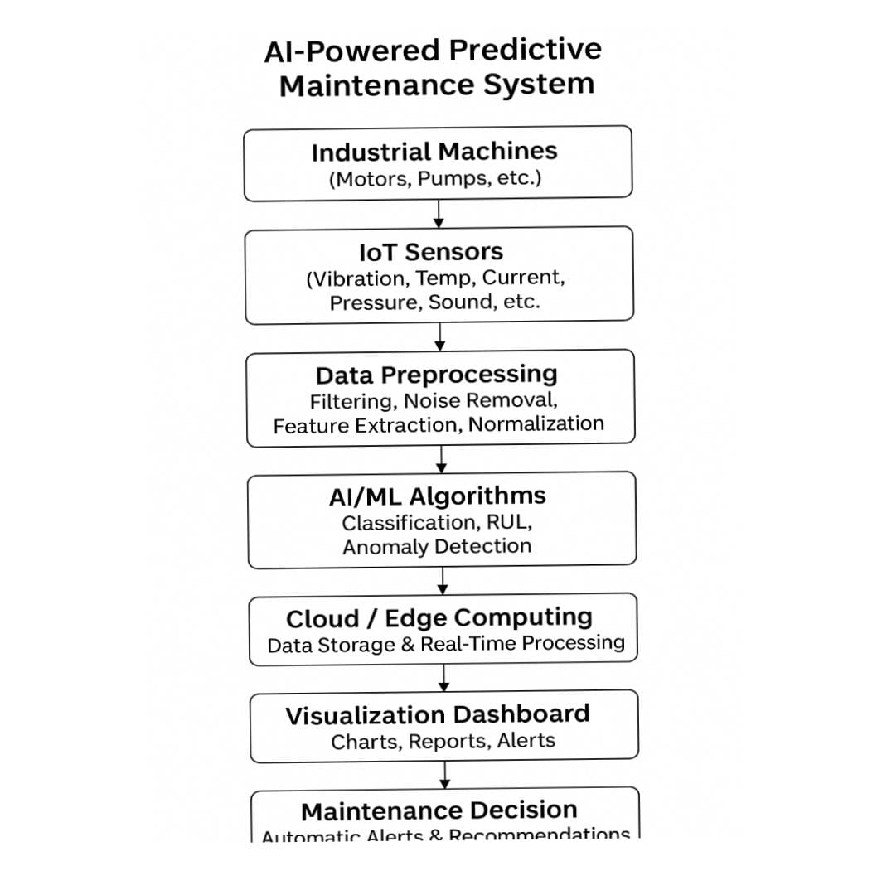
Block Diagram

Slide 5
Particular techniques
IoT Sensors → Vibration, temperature, current, pressure data.
Data Preprocessing → Filtering, feature extraction, normalization.
Machine Learning → Classification, regression, anomaly detection.
Time-Series Analysis → ARIMA, LSTM for sequential data.
Cloud & Edge Computing → Data storage, real-time processing.
Visualization & Alerts → Dashboards, notifications.

Slide 6
ESP32 Devkit :The microcontroller, to read the from all sensors,process data.
ADS1115: High resolution anolog to digital converter.
ADXL345 module: For Vibration/Shock moitoring.measures acceleration along X,Y,Z axes
RTCDS3231:High accuracy Real-time.
Current sensor ACS712:Measures the AC or DC current flowing through monitored machine.
MAX9814: Microphone used to detect internal sound of the machine.
LED:To provide visual alerts.
Buzzer:To provide audio alerts.
MicroSD card:Used for data logging and send data to cloud.
Components used

Slide 7
Hardware integration :Install IoT sensors to continuously stream real-time data.
Data collection: Acquire raw sensor data and securely transfer it to cloud.
Analomy detection: Run lightweight models to detect sudden ,critical failures in real time.
Model training: Use historical data stored in cloud to train advanced predictive models.
Visualization:Present the model outputs (health ststus,predicted fault type) on visualization dashboards.
Maintenance decision:Generate actionable alerts and recommendations.
Methodology

Slide 8
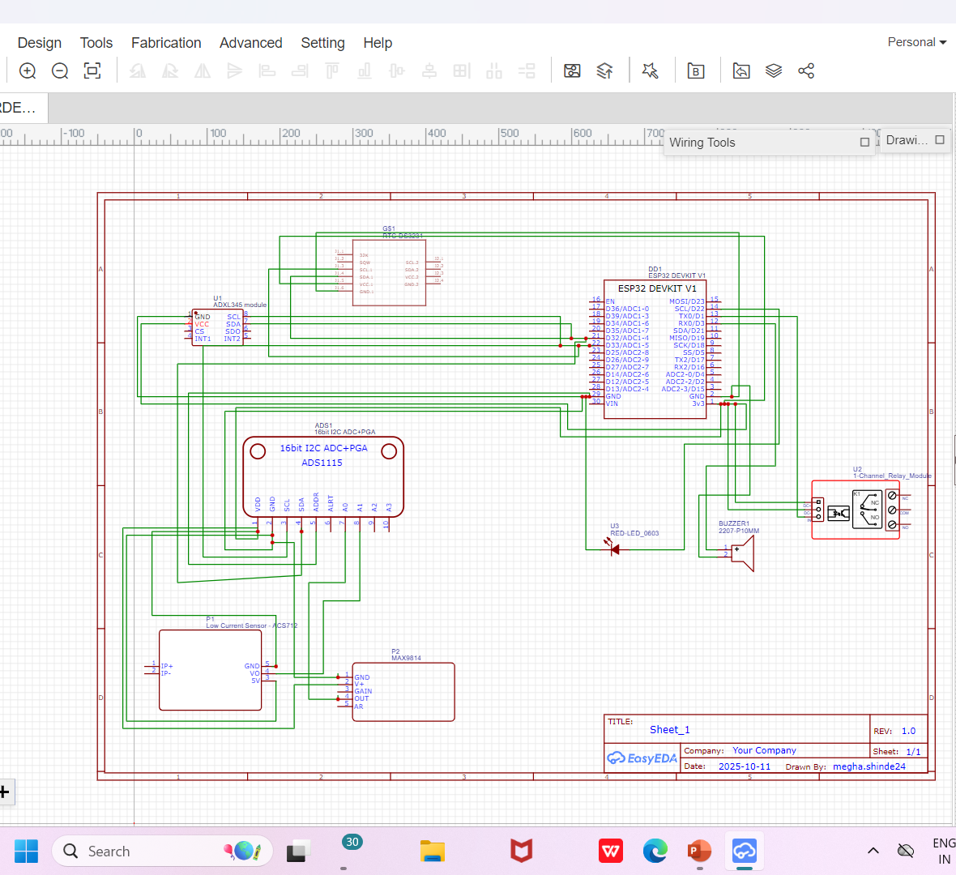
Circuit diagram

Slide 9
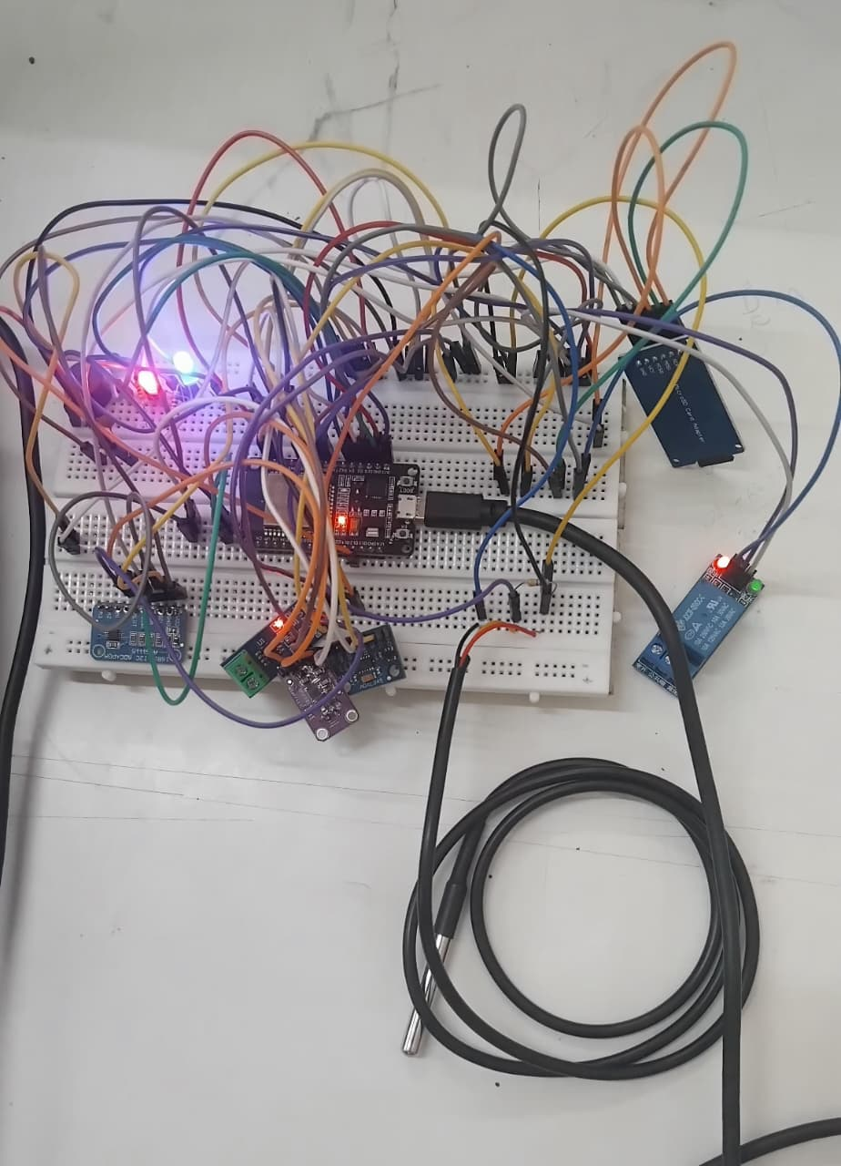
Implementation on breadboard

Slide 10
Thank You

