Slide 1
MID-SEM REVIEW
Single Cycle
RISC-V Processor
RV32I Implementation in Verilog HDL
PRESENTED BY
Tarun Sayal
Snehal Sagar
Megha Shindhe
Harshvardhan Shinde
Vishwakarma Institute of Technology, Pune
github.com/Tarunsayal/rv32i

Slide 2
AGENDA
01
Introduction
05
Modules Built
RISC-V & project motivation
All 8 core modules complete
02
Architecture Overview
06
Supported Instructions
RV32I ISA & single-cycle concept
37 RV32I instructions
03
Processor Architecture
07
Work Done & Next Steps
Datapath & block diagram
Progress status & pending tasks
04
Datapath Diagram
08
Conclusion
RV32I single-cycle circuit
GitHub & future scope

Slide 3
INTRODUCTION
Why RISC-V?
What is RISC-V?
Modern processors use x86 & ARM — complex, patented architectures. RISC-V is open-source and freely available.
An open Instruction Set Architecture developed at UC Berkeley. Follows Reduced Instruction Set Computing (RISC) principles.
RV32I Subset
Why Single-Cycle?
The base integer ISA — 32-bit instructions, 32 general-purpose registers. Covers arithmetic, memory, and branch operations.
Each instruction completes in one clock cycle. Ideal for learning processor internals — clean, simple datapath with no pipeline hazards.

Slide 4
RISC-V ARCHITECTURE OVERVIEW
Open-Source ISA
RV32I Instruction Format Fields
No licensing fees. Fully modular — base + optional extensions.
R-type
funct7[7]
rs2[5]
rs1[5]
fn3[3]
rd[5]
op[7]
32 Registers
I-type
imm[12]
rs1[5]
fn3[3]
rd[5]
op[7]
x0–x31, each 32-bit wide. x0 is hardwired to zero.
RISC Principles
S-type
imm[7]
rs2[5]
rs1[5]
fn3[3]
imm[5]
op[7]
Fixed 32-bit instruction width. Load-store architecture. Simple, orthogonal encoding.
B-type
imm[7]
rs2[5]
rs1[5]
fn3[3]
imm[5]
op[7]
Instruction Formats
R-type, I-type, S-type, B-type (and more). Each format has fixed field positions for rs1, rs2, rd, funct3, funct7.
32-bit fixed-width instructions | 32 registers (x0–x31) | Load-Store architecture

Slide 5
PROCESSOR ARCHITECTURE
PC
Program Counter — holds address of current instruction
Fetch
Decode
Execute
Memory
Write
Back
IMEM
Instruction Memory — stores 32-bit instructions
RegFile
PC → IMEM
Control
ImmGen
RegFile
ALU Ctrl
+ ALU
DMEM
R/W
RegFile
Write
32×32 register file with 2 read ports, 1 write port
ImmGen
Immediate Generator — sign-extends fields by instruction type
Single-Cycle Datapath — all stages resolve in one clock cycle
Control
Decoder + Control Unit — generates all control signals from opcode
Key Control Signals
ALU
10-operation ALU — ADD, SUB, AND, OR, XOR, SLL, SRL, SRA, SLT, SLTU
Signal | Purpose
ALUSrc | Reg vs Immediate to ALU
MemWrite / MemRead | Data memory control
RegWrite | Write-back enable
PCSrc = Branch & Zero | Branch mux select
DMEM
Data Memory — read/write for LW/SW
ALU Ctrl
Maps ALUOp + funct3 + funct7 → 4-bit ALU select

Slide 6
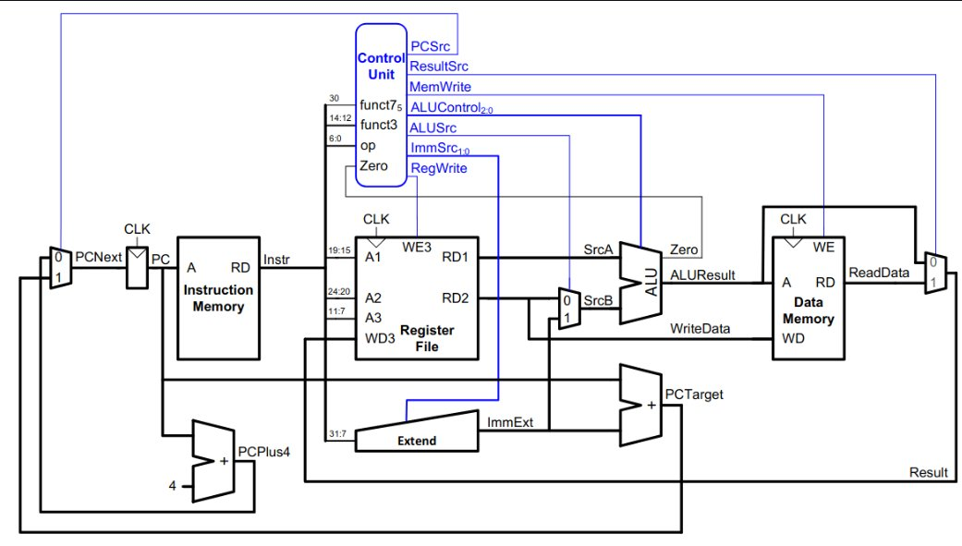
DATAPATH
RV32I Single-Cycle
PCSrc
ALUControl
ALUSrc
MemWrite
RegWrite
ImmSrc

Slide 7
MODULES BUILT — 8 / 8 Complete
pc_counter.v
DONE
instr_mem.v
DONE
32-bit PC register. Updates to PC+4 (sequential) or branch target on PCSrc.
Read-only instruction memory. Outputs 32-bit instruction at PC address.
imm_gen.v
DONE
decoder.v + control_unit.v
DONE
Sign-extends immediates for I, S, B types from instruction fields.
Decodes opcode → control signals: ALUSrc, ALUOp[1:0], MemWrite, MemRead, RegWrite, Branch.
alu.v
DONE
reg_file.v
DONE
10 operations: ADD, SUB, AND, OR, XOR, SLL, SRL, SRA, SLT, SLTU. Produces zero flag.
32×32 register file. Two async read ports, one sync write port. x0 hardwired to 0.
data_mem.v
DONE
alu_control.v
DONE
Byte-addressable data memory for LW (load) and SW (store) instructions.
Maps ALUOp[1:0] + funct3[2:0] + funct7[5] → 4-bit ALU_sel. Handles R-type, I-type, LW/SW, BEQ.

Slide 8
SUPPORTED INSTRUCTIONS — 37 of 47 RV32I
R-Type
I-Type
Register-register arithmetic & logic — 10 instructions
Immediate arithmetic, loads, JALR — 15 instructions
ADD
SUB
AND
OR
ADDI
ANDI
ORI
XORI
XOR
SLL
SRL
SRA
SLTI
SLTIU
SLLI
SRLI
SLT
SLTU
SRAI
LW
LH
LB
LHU
LBU
JALR
S-Type
B-Type
Store — 3 instructions
Conditional branches — 6 instructions
SW
SH
SB
BEQ
BNE
BLT
BGE
BLTU
BGEU

Slide 9
WORK DONE & NEXT STEPS
Module Completion
8 / 8 Modules
100% — All modules written & testbenched
COMPLETED
PENDING
pc_counter.v — PC register
riscv_top.v — Top-Level Integration
instr_mem.v — 32-bit instruction ROM
Wire all 8 modules together
PCSrc = Branch & Zero (AND gate)
37 RV32I instructions functional
Full system testbench
imm_gen.v — sign-extended immediate (I/S/B)
decoder.v + control_unit.v — control signals
alu.v — 10 operations + zero flag
reg_file.v — 32×32, x0 hardwired zero
Instruction Coverage
data_mem.v — LW/SW, testbenched
37 of 47 RV32I base instructions targeted
(excludes FENCE, ECALL, EBREAK, CSR class)
alu_control.v — ALUOp+funct3+funct7 → sel
github.com/Tarunsayal/rv32i

Slide 10
CONCLUSION
All 8 Modules Written & Testbenched
All core modules of the RV32I single-cycle processor implemented in Verilog HDL — each individually verified with a testbench.
Supports Full Instruction Classes
37 of 47 RV32I base instructions targeted across R, I, S, and B types. 10-operation ALU with zero flag.
Clean Architecture
Strictly follows the RV32I single-cycle datapath — separate control and datapath, pure register PC, proper ImmGen.
One Step from Completion
Only top-level integration (riscv_top.v) remains — wiring all 8 modules together and running the full system testbench.

Slide 11
Thank You
RV32I Single-Cycle Processor | Mid-Semester Review
Team
Tarun Sayal | Snehal Sagar | Megha Shindhe | Harshvardhan Shinde
GitHub
github.com/Tarunsayal/rv32i

