Slide 1


Marathwada Mitra Mandal’s
College of Engineering
Karvenagar, Pune An Autonomous Institute affiliated to SPPU
Accredited with “A++” Grade by NAAC
Recipient of Best College Award in AY 2018-19 from SPPU
Internship Review 2
Department of Information Technology
Web Design and Development
Presented By: Harshwardhan Uttam Sawant Internal Mentor: Mrs. Preeti Joshi
Name of Company: Techno Hacks pvt ltd External Mentor: Mr. Sandip Gavit
Date: 12/02/2025

Slide 2
Contents
Introduction
Motivation & Objective
Problem Statement
Nature of Work
Final Work
Conclusion
References

Slide 3
Introduction
TechnoHacks Solutions
Create High Quality Product that make your life easier
They provide top-notch IT training and Projects to help businesses and individuals stay ahead in the ever-evolving tech landscape. Their team of experts is dedicated to helping you achieve your goals and reach your full potential.
Mentor : Sandip Gavit
Domain : Web Design And Development.

Slide 4
Motivation & Objective
Motivation
Frontend development merges creativity, coding, and user experience design to craft intuitive and visually appealing web interfaces.
The demand for skilled frontend developers is growing rapidly as businesses prioritize engaging digital experiences.
Building practical experience is essential to mastering frameworks, responsive design, and best practices in this fast-evolving field.
Objective
Gain hands-on experience with real-world web development projects under expert guidance.
Develop skills to create responsive, accessible, and dynamic user interfaces while ensuring seamless functionality across platforms.

Slide 5
Problem Statement : Designing a scalable, intuitive, and performance-optimized web platform for seamless interaction between clients and freelancers presents both technical and architectural challenges. The application must efficiently manage authentication, role-based navigation, real-time job listings, portfolio handling, and an integrated testing system—while maintaining a consistent user experience across all components. Detailed Description: In today’s digital era, freelancers struggle to find a professional and effective way to showcase their skills, projects, and achievements. Traditional methods, such as resumes and LinkedIn profiles, lack interactivity and fail to provide a comprehensive portfolio presentation. A dedicated freelancer website is essential for professionals to highlight their expertise, connect with clients, and secure job opportunities.
Problem Statement

Slide 6
Nature of Work
UI Design and Implementation: Build responsive, visually appealing, and accessible user interfaces using modern frameworks.
Cross-Platform Compatibility: Ensure consistent performance across devices and browsers using responsive design.
UX Optimization: Enhance usability and navigation through user feedback and performance improvements.
Code Optimization and Maintenance: Write clean, reusable code and fix bugs to maintain website quality.
Tools and Technology Usage: Utilize design tools and version control systems for efficient development.

Slide 7
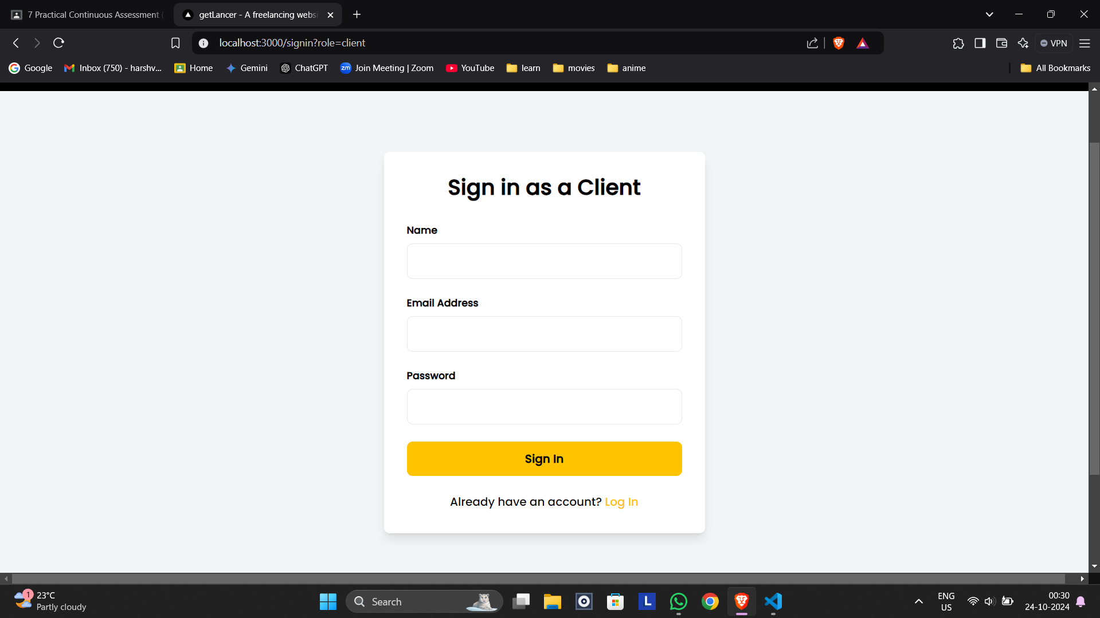
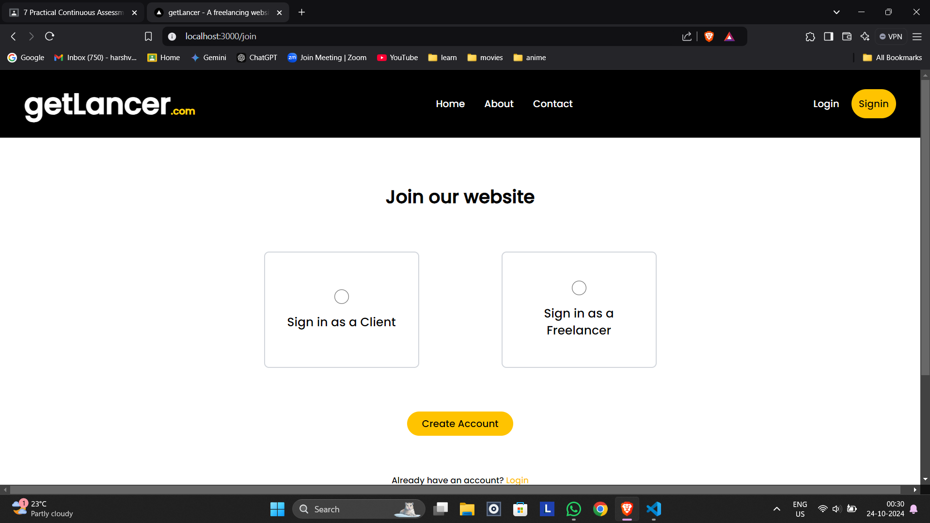
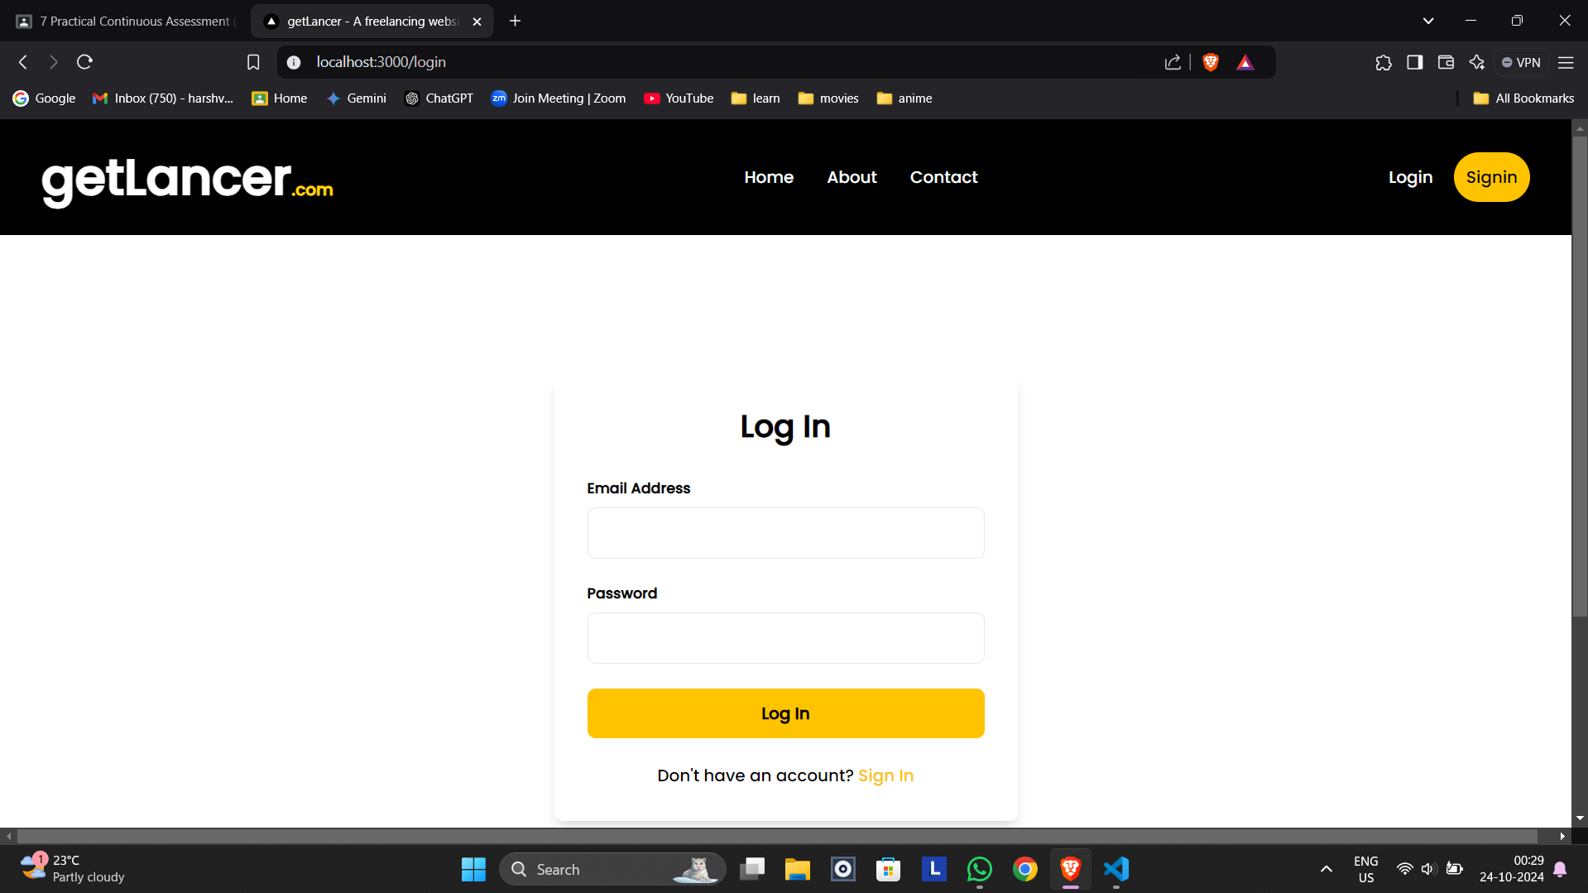
Final Work
Week 1:

Slide 8
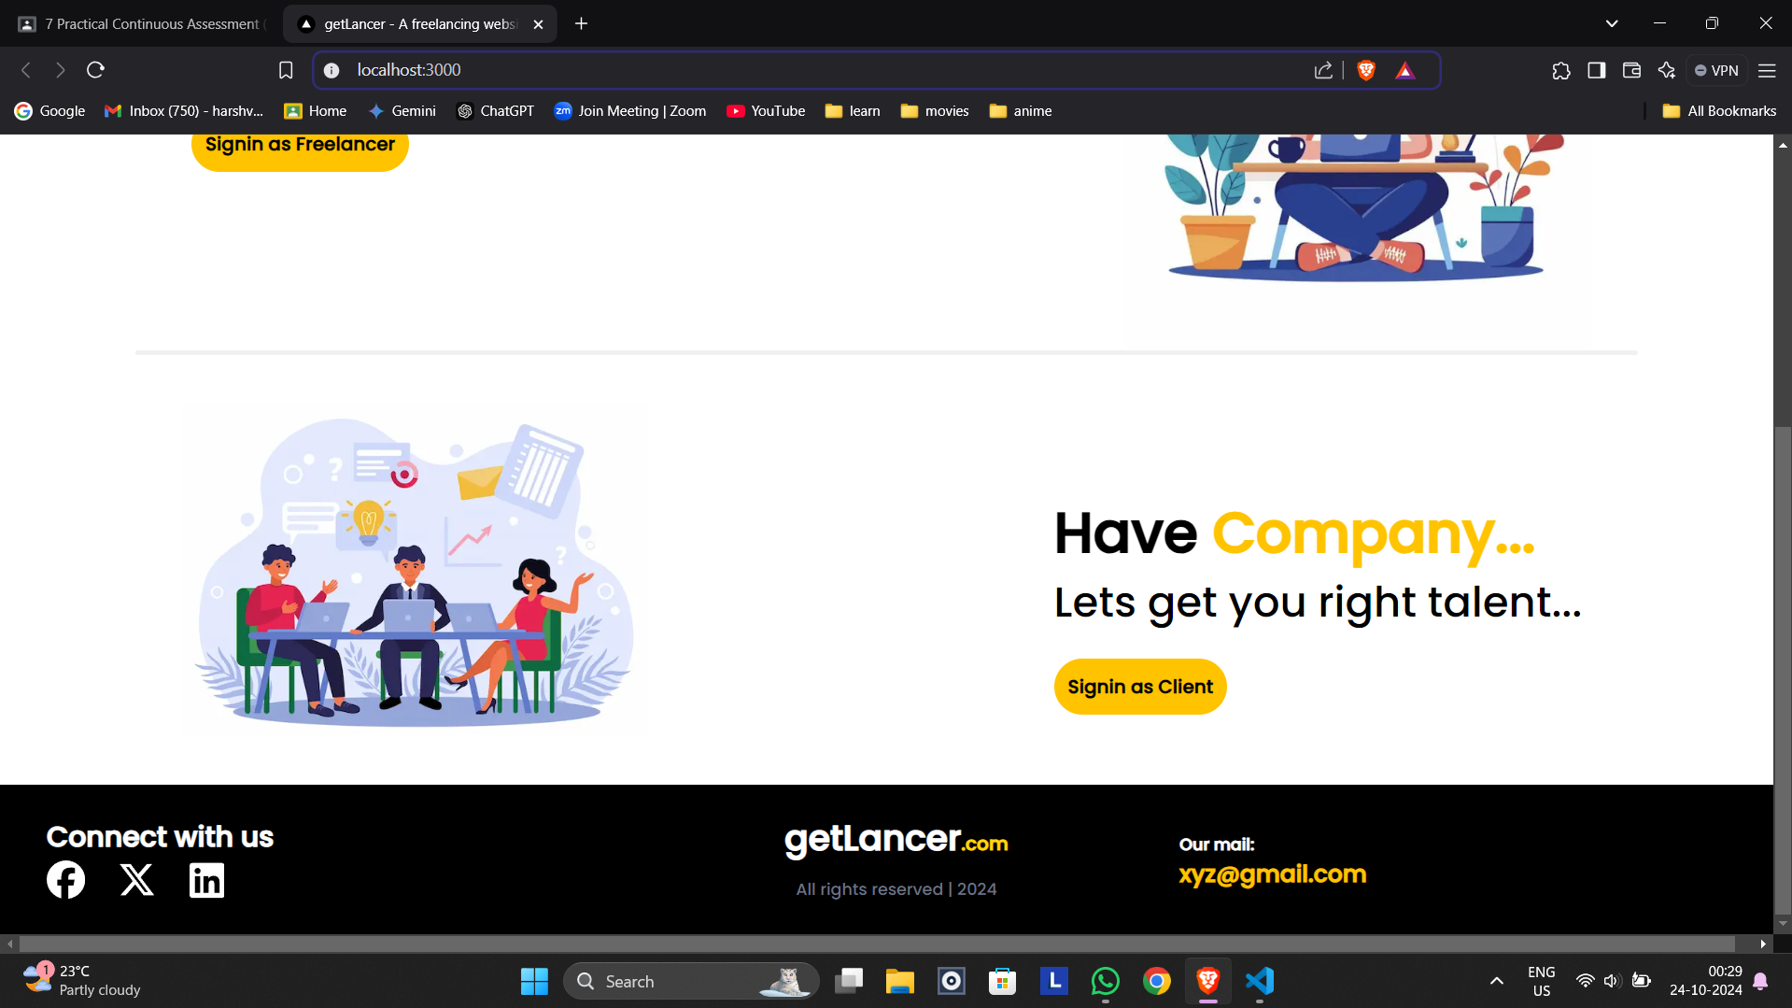
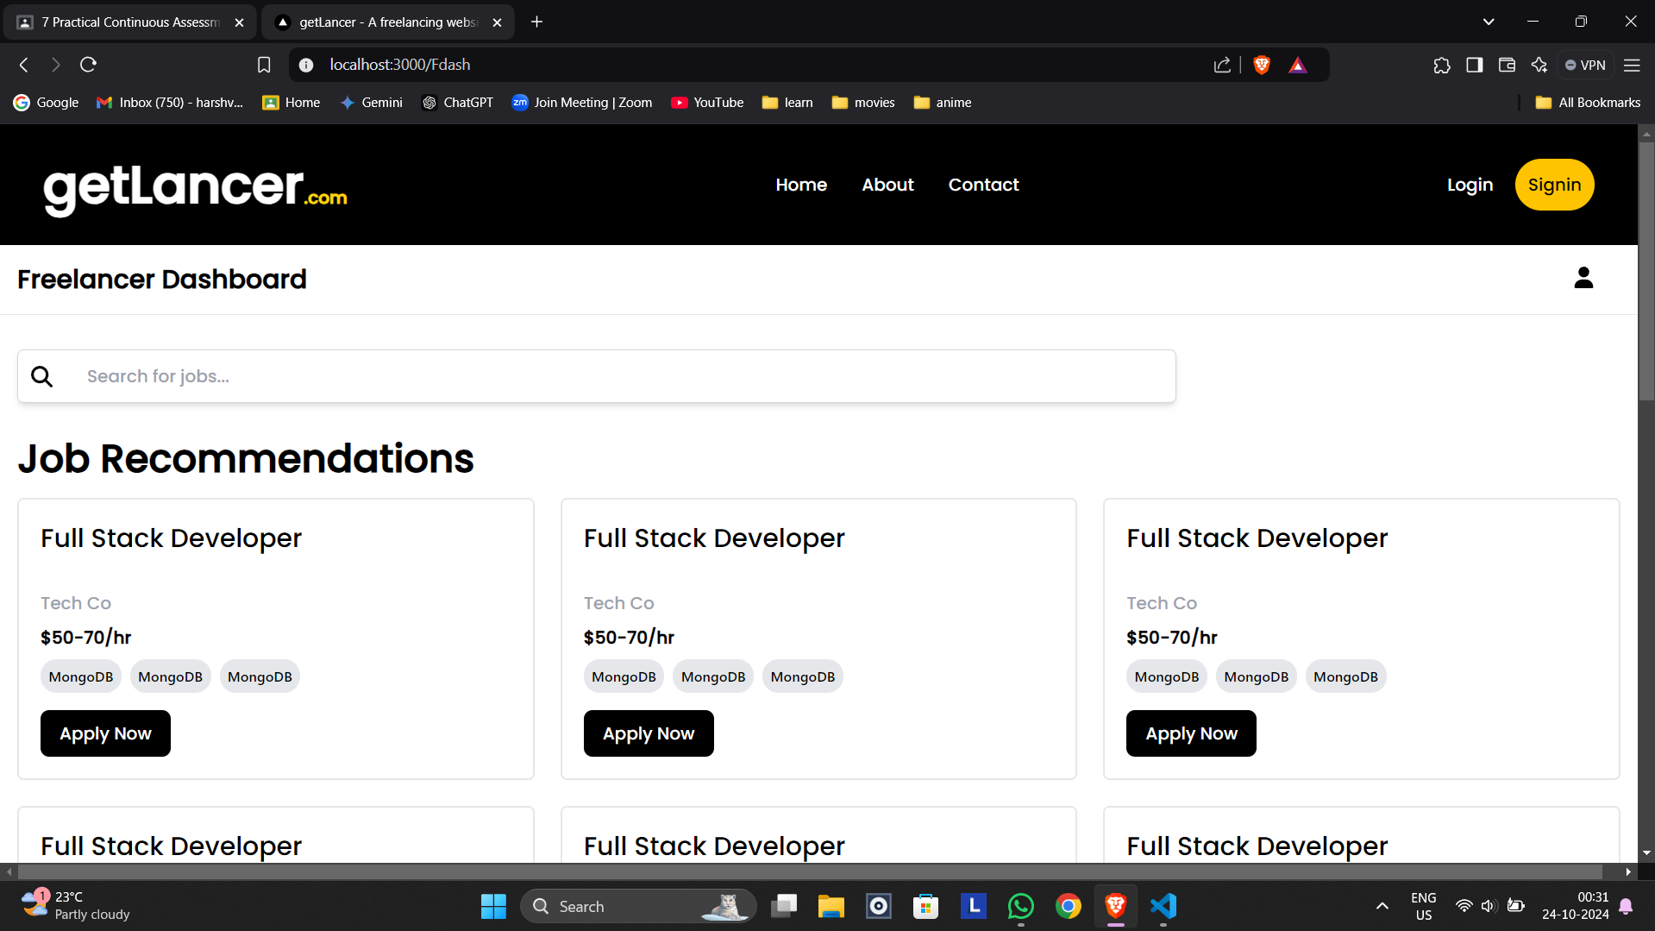
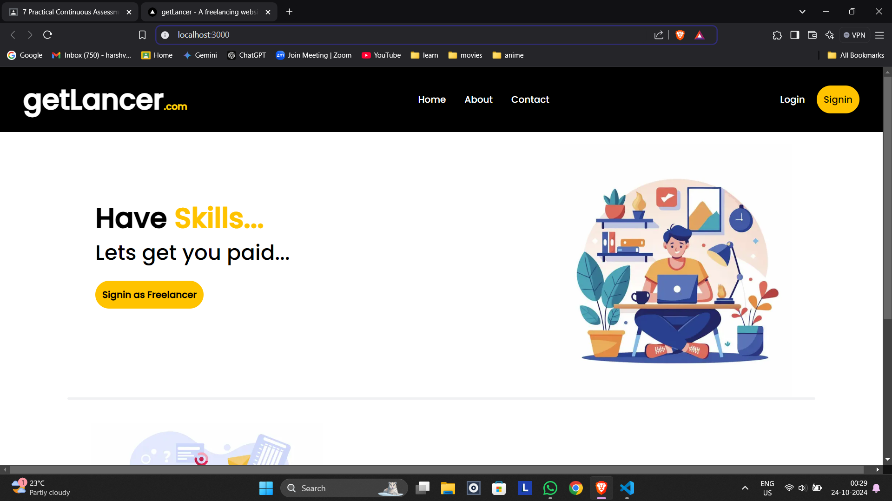
Final Work

Slide 9
Conclusion
Throughout the internship, the development of the Client-Freelancer platform focused on delivering a user-centric, functional, and secure web experience. From conceptualization to execution, each component was built with attention to detail, performance, and scalability.
Interactive elements like card-based dashboards, portfolio uploads, and client reviews enrich the user experience, while the implementation of a quiz-based assessment system adds a practical layer to evaluate freelancer skills before job application. The integration of MongoDB for backend data handling ensured efficiency and real-time responsiveness throughout the application.

Slide 10
References
M. Singh, K. Kumar, & S. Gupta. (2019). Enhancing Job Recommendations for Freelancers Using Machine Learning. IEEE Transactions on Intelligent Systems, 29(4), 500-512.
T. Brown, L. Williams, & H. Thompson. (2021). Gamification and Engagement in Freelancing Platforms. Journal of Human-Computer Interaction, 38(1), 112-127.
J. Lee & P. Walker. (2018). Talent Matching in the Gig Economy: Challenges and Solutions. Harvard Business Review, 96(3), 150-164.
H. Zhang, Y. Lin, & Q. Wang. (2020). A Review of Next.js for Scalable Web Applications. Journal of Web Technologies, 42(2), 67-85.
B. Smith, L. Johnson, & K. Patel. (2021). React.js and Performance Optimization for Large-Scale Applications. International Conference on Web Development and UX Design, 315-328.
D. Thompson & R. Williams. (2018). Predictive Analytics for Freelancer Skill Growth. Springer Journal of Computational Intelligence, 28(5), 144-159.

Slide 11


