Slide 1
Topic Modeling
Using Latent Dirichlet Allocation (LDA)

Slide 2
Outline
Topic Modeling Overview
The Latent Dirichlet Allocation (LDA) Model
Fitting LDA in genism
Interpreting the Results: Labeling the Topics by Top Keywords
Parameter Tuning: How many topics?

Slide 3
What is Topic Modeling
Topic modeling aim at extracting meaningful dimensions in textual data
Technically, it aims for dimension reduction; but we do want to have interpretable dimensions

Slide 4
A Toy Dataset
Example: A Toy Dataset
toy_corpus = ["The fox jumps over the dog", "The fox is very clever and quick", "The dog is slow and lazy", "The cat is smarter than the fox and the dog", "Python is an excellent programming language", "Java and Ruby are other programming languages", "Python and Java are very popular programming languages", "Python programs are smaller than Java programs"]
How do you describe this dataset?
What are possible topics?

Slide 5
Example: Text Preprocessing
from normalization import normalize_corpus norm_tokenized_corpus = normalize_corpus(toy_corpus, tokenize=True) norm_tokenized_corpus
[['fox', 'jump', 'dog'], ['fox', 'clever', 'quick'], ['dog', 'slow', 'lazy'], ['cat', 'smarter', 'fox', 'dog'], ['python', 'excellent', 'programming', 'language'], ['java', 'ruby', 'programming', 'language'], ['python', 'java', 'popular', 'programming', 'language'], ['python', 'program', 'small', 'java', 'program']]
Perform basic preprocessing:
drop to lower case,
remove punctuation,
drop stopwords,
etc.

Slide 6
Example 1A: Build A Corpus in Gensim
from gensim import corpora # build the dictionary dictionary = corpora.Dictionary(norm_tokenized_corpus) print(dictionary.token2id) # view the dictionary mappings
{'program': 17, 'lazy': 5, 'clever': 4, 'java': 13, 'programming': 10, 'language': 11, 'python': 9, 'smarter': 7, 'fox': 1, 'dog': 2, 'cat': 8, 'jump': 0, 'popular': 15, 'slow': 6, 'excellent': 12, 'quick': 3, 'small': 16, 'ruby': 14}
# convert tokenized documents into bag of words vectors mapped_corpus = [dictionary.doc2bow(text) for text in norm_tokenized_corpus] mapped_corpus # view the converted vectorized corpus
[[(0, 1), (1, 1), (2, 1)], [(1, 1), (3, 1), (4, 1)], [(2, 1), (5, 1), (6, 1)], [(1, 1), (2, 1), (7, 1), (8, 1)], [(9, 1), (10, 1), (11, 1), (12, 1)], [(10, 1), (11, 1), (13, 1), (14, 1)], [(9, 1), (10, 1), (11, 1), (13, 1), (15, 1)], [(9, 1), (13, 1), (16, 1), (17, 2)]]
from gensim import models # build tf-idf feature vectors tfidf = models.TfidfModel(mapped_corpus) corpus_tfidf = tfidf[mapped_corpus]

Slide 7
Latent Dirichlet Allocation (LDA)
What is LDA? Mathematic Foundations

Slide 8
A Generative Perspective
We assume a generative process of documents:
documents are mixtures of topics
a topic is a probability distribution over words
a topic model is a generative model for documents
Bayesian modeling: try to maximize the likelihood of observed data given assumptions of model setup

Slide 10



Generative Process for LDA
Each document is generated by the following sampling process:
Choose a distribution over topics:
Then, for each token in that document, take two steps to determine which term to use:
Step 1: choose a topic at random according to the document’s topic distribution
Step 2: draws a word from that topic

Slide 11
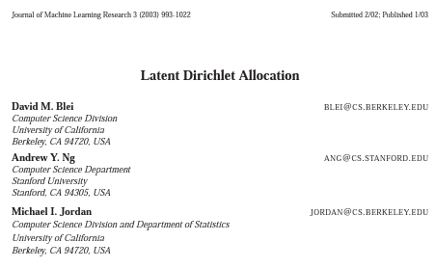
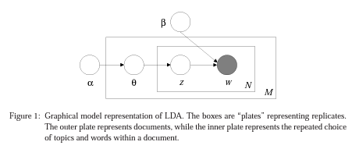

Slide 12
Fitting LDA in genism

Slide 13
LDA Implementation in Gensim
Example: Running LDA in gensim's ldamodel module
lda_gensim = models.LdaModel(corpus_tfidf, id2word=dictionary, iterations=1000, num_topics=total_topics) # use the function to generate topics on toy corpus print_topics_gensim(topic_model=lda_gensim, total_topics=2, num_terms=5, display_weights=True)
Topic #1 with weights [('fox', 0.08), ('dog', 0.08), ('jump', 0.07), ('clever', 0.07), ('quick', 0.07)] Topic #2 with weights [('programming', 0.08), ('language', 0.08), ('java', 0.07), ('python', 0.07), ('ruby', 0.07)]
See documentation: https://radimrehurek.com/gensim/models/ldamodel.html

Slide 14
Example: Obtaining Topic Keywords Using print_topics()
lda_model = gensim.models.ldamodel.LdaModel( corpus=corpus, id2word=id2word, num_topics=20, random_state=100, update_every=1, chunksize=100, passes=10, alpha='auto', per_word_topics=True ) # print keywords (for interpretation and qualitative assessment) from pprint import pprint pprint(lda_model.print_topics())
Output exceeds the size limit. Open the full output data in a text editor [(0, '0.033*"new" + 0.024*"power" + 0.022*"buy" + 0.018*"price" + 0.017*"high" + ' '0.017*"sell" + 0.017*"sale" + 0.015*"player" + 0.015*"cost" + ' '0.015*"accept"'), (1, '0.161*"gun" + 0.110*"physical" + 0.040*"direct" + 0.035*"objective" + ' '0.031*"safety" + 0.027*"apparently" + 0.022*"automatic" + 0.022*"ban" + ' '0.020*"manage" + 0.019*"being"'), (2, '0.170*"space" + 0.052*"earth" + 0.049*"orbit" + 0.046*"launch" + ' '0.040*"moon" + 0.037*"mission" + 0.031*"shuttle" + 0.030*"satellite" + ' '0.022*"saturn" + 0.021*"lunar“’), ...

Slide 15
LDAvis for interactive Visuals
Example: LDAVis
import pyLDAvis import pyLDAvis.gensim_models as gensimvis pyLDAvis.enable_notebook() vis = gensimvis.prepare(lda_model, corpus, id2word) vis

Slide 16
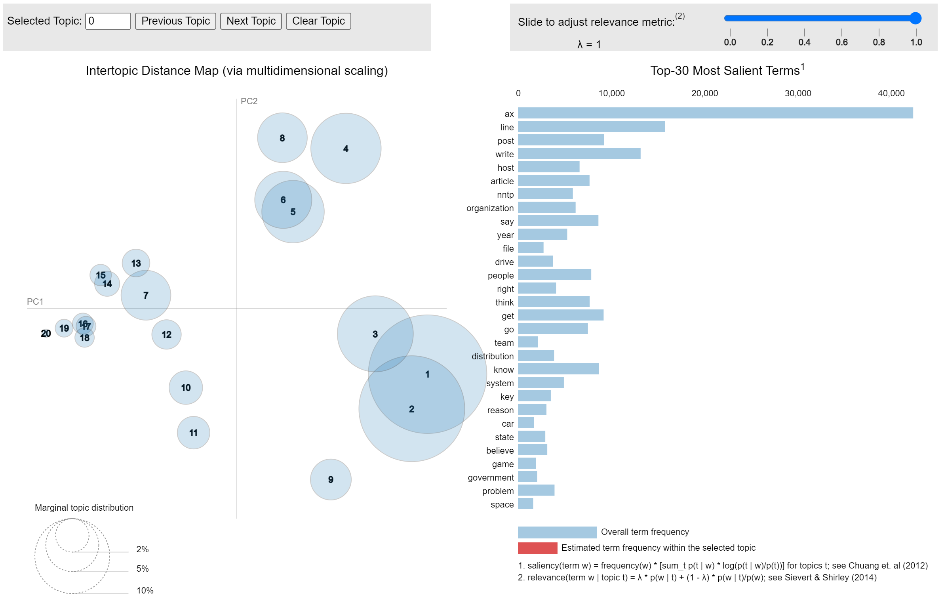

Slide 17
How Many Topics?
Question: "How well did my data fit the model (with the given parameters)?"

Slide 18
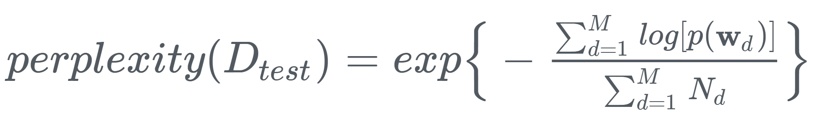

Perplexity
The perplexity of a discrete probability distribution p is defined as
$$2^{H\left(p\right)}=2^{−\sum_{x}{p\left(x\right)\log_{2}{p\left(x\right)}}}$$
where H(p) is the entropy of the distribution and x ranges over events.
The perplexity, used by convention in language modeling, is monotonically decreasing in the likelihood of the test data, and is algebraically equivalent to the inverse of the geometric mean per-word likelihood.
Therefore, in LDA, a lower perplexity score indicates better generalization performance.

Slide 19
How Good Are the Topics?

Slide 20

Intra-topic Coherence
Topic coherence captures the relatedness of a topic’s keywords, which could be measured based on their co-occurrences.
One would consider pairwise keyword relations and average these relationship pairs at the topic level to calculate each topic’s coherence score.
Specifically, suppose that we are considering a topic $T$ identified by the following top K keywords: $w_{1}$, $w_{2}$, …, $w_{K}$. The overall coherence measure would be
$$Coherence\left(T\right)=\frac{2}{K(K−1)}\sum_{\begin{aligned}i,j=1 \\ i<j\end{aligned}}^{K}{Assoc(w_{i},w_{j})}$$
where $Assoc(w_{i},w_{j})$ represents the association between keywords $w_{i}$ and $w_{j}$. (Pointwise mutual information (PMI) is a commonly used measure. See next slide.)
Larger scores of coherence are desired.
See also: Mimno et al. "Optimizing semantic coherence in topic models." EMNLP 2011

Slide 21
Recap
Topic modeling with text aims for meaningful dimension extraction
Topic modeling is generally unsupervised – there is no ground truth – so we could resort to the data/fit property for evaluation.
Probabilistic model (e.g., LDA): report perplexity (a concept related to the log likelihood) and ask the question: "How good do my data fit the modeling assumptions?"
Ultimately, what parameter makes things easier to interpret? (Philosophically sound, but hard to implement, especially for automation.) We may ask the question: "Is there a way to quantitatively assess topic quality?“
Topic coherence can be calculated

Slide 22
Suggested Readings
Text Analytics with Python (TAP) by Dipanjan Sarkar
Topic Modeling – Overview (pp. 234-235)
Latent Dirichlet Allocation (pp. 241-245)
Extracting Topics from Product Reviews (pp. 246-250)

