Slide 1

Linear Regression
Harshvardhan
University of Tennessee
Teaching Demo at UMass Amherst | December 2, 2024
Notes:
https://www.kaggle.com/datasets/mirichoi0218/insurance

Slide 2

Table of Contents
What is Linear Regression?
Mathematics of Linear Regression
Interpreting Results and RSquared
Assumptions and Model Diagnostics
Conclusion
Case Study:
Health Insurance Premiums

Slide 3
Linear Regression
Going from correlation to regression

Slide 4
What is Linear Regression?
Linear regression is a model that estimates linear relationship between a dependent variable and one or more independent variable(s)
It is an attempt to find the best fit line between independent and dependent variables
Strengths:
Explainability and interpretability in understanding decisions
Strong statistical basis for usage and interpretation
Weaknesses:
Assumes linear relationship — simple model is too simple
Sensitive to outliers
Assumptions — we will talk about them
No causation implied, only a sophisticated form of correlation

Slide 5
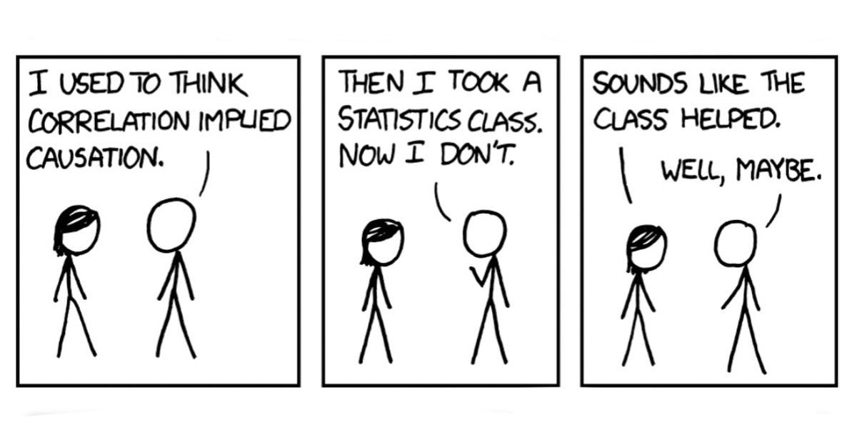
Source: XKCD

Slide 6
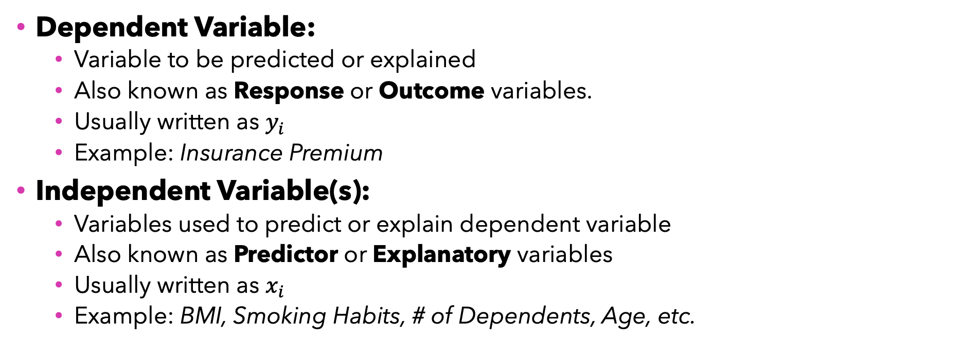
Key Components
Predictor / Explanatory / Independent Variable
Dependent Variable:
Variable to be predicted or explained
Also known as Response or Outcome variables.
Usually written as $y_{i}$
Example: Insurance Premium
Independent Variable(s):
Variables used to predict or explain dependent variable
Also known as Predictor or Explanatory variables
Usually written as $x_{i}$
Example: BMI, Smoking Habits, # of Dependents, Age, etc.
Predicted / Response / Outcome / Dependent Variable

Slide 7

Case Study
What drives Health Insurance Premiums?
Kindly download slides, data and R code.

Slide 8



Health Insurance Data
We will use data from Kaggle for a fictional case study.
Download files from Github:
github.com/harshvardhaniimi/linear-regression

Slide 9
Health Insurance Premiums in Massachusetts: What Drives Costs?
In 2022, per capita health care spending was $10,264, which was a 5.8% increase from 2021.
The average cost of an individual health insurance plan in Massachusetts is $721.19 per person.
What lifestyle factors drive insurance premium in general?
1.
2.
3.

Slide 10
Massachusetts Department of Public Health (MDPH)
Goals
Identify actionable Policy Insights for MDPH
Empower insurers to structure premiums based on evidence rather than assumptions
Variables
Sex, Smoking Habits, Region
Age, BMI, Dependents
Insurance Charges
Identifying key factors driving health insurance charges.
NOTE: Fictional Case Study

Slide 11
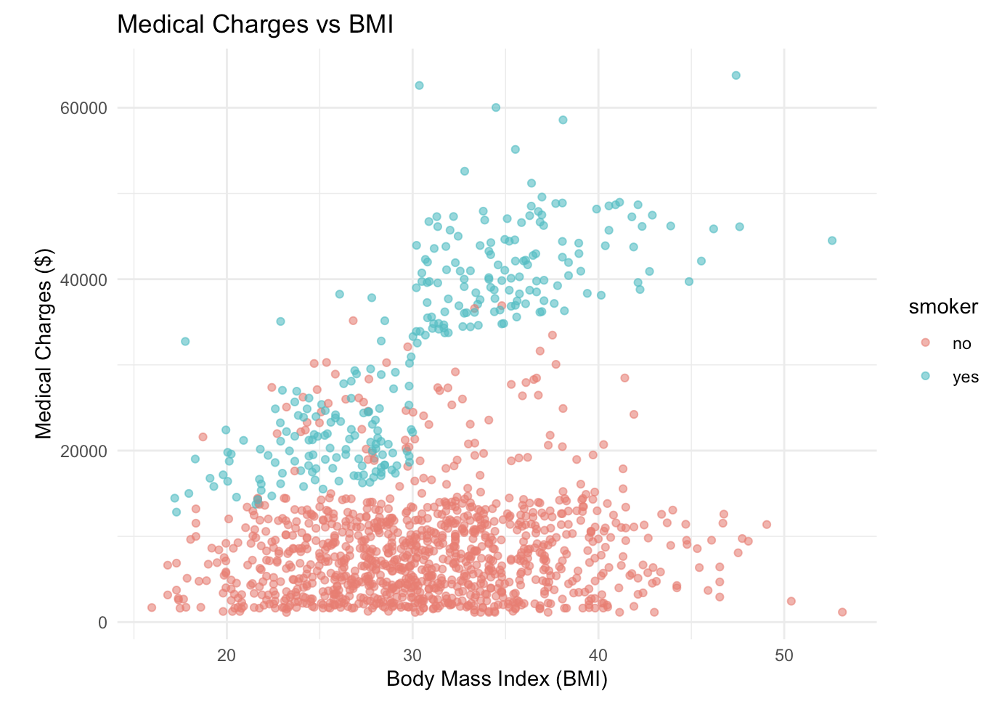
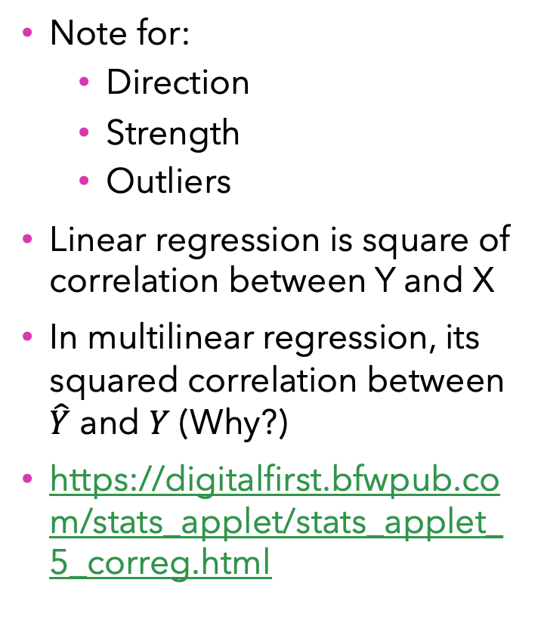
Scatterplot and Correlation
Note for:
Direction
Strength
Outliers
Linear regression is square of correlation between Y and X
In multilinear regression, its squared correlation between $\hat{Y}$ and $Y$ (Why?)
https://digitalfirst.bfwpub.com/stats_applet/stats_applet_5_correg.html

Slide 12
Linear Regression Mathematics
Linear Model, Coefficients and Predicted Responses

Slide 13
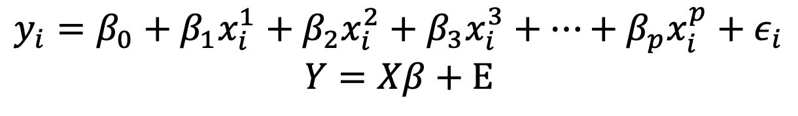

Mathematics of Linear Regression
Simple Linear Regression (single predictor)
Multiple Linear Regression (p predictors)
$$y_{i}=β_{0}+β_{1}x_{i}+ε_{i}$$
$$y_{i}=β_{0}+β_{1}x_{i}^{1}+β_{2}x_{i}^{2}+β_{3}x_{i}^{3}+…+β_{p}x_{i}^{p}+ε_{i}$$
$$Y=Xβ+Ε$$

Slide 14
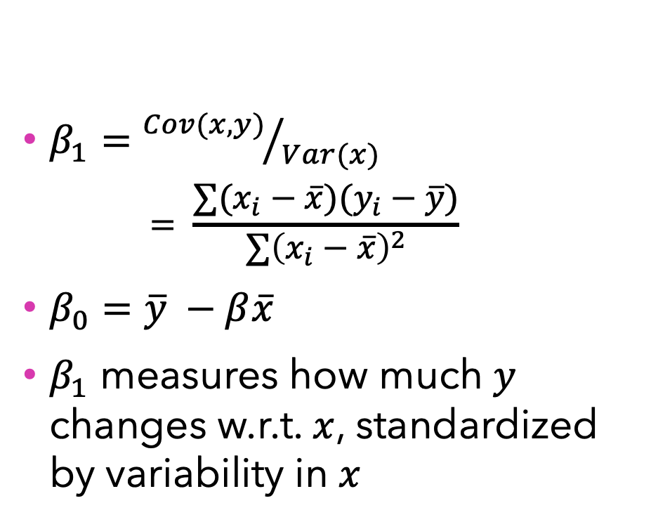
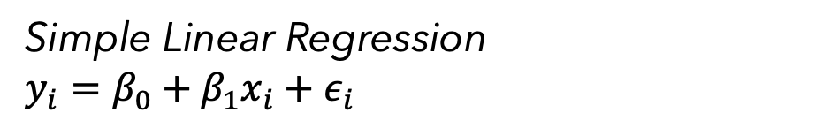

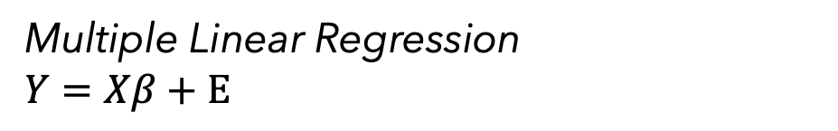
Calculating Coefficients
Simple Linear Regression
$$y_{i}=β_{0}+β_{1}x_{i}+ε_{i}$$
Multiple Linear Regression
$$Y=Xβ+Ε$$
$β_{1}={Cov(x,y)}/{Var(x)}$
$$= \frac{∑(x_{i}−\overline{x})(y_{i}−\overline{y})}{∑{\left(x_{i}−\overline{x}\right)}^{2}}$$
$β_{0}=\overline{y} −β\overline{x}$
$β_{1}$ measures how much $y$ changes w.r.t. $x$, standardized by variability in $x$
$β={\left(X^{′}X\right)}^{−1}X^{′}Y$
where $X$ is data matrix, $Y$ is response vector

Slide 15
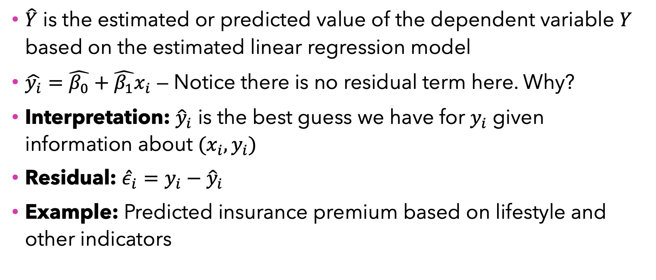

Predicted Response: $\hat{Y}$
$\hat{Y}$ is the estimated or predicted value of the dependent variable $Y$ based on the estimated linear regression model
$\hat{y_{i}}=\hat{β_{0}}+\hat{β_{1}}x_{i}$ — Notice there is no residual term here. Why?
Interpretation: ${\hat{y}}_{i}$ is the best guess we have for $y_{i}$ given information about $(x_{i}, y_{i})$
Residual: ${\hat{ε}}_{i}=y_{i}−{\hat{y}}_{i}$
Example: Predicted insurance premium based on lifestyle and other indicators

Slide 16
Interpretation, Assumptions and Diagnostics
How reliable are our conclusions?

Slide 17
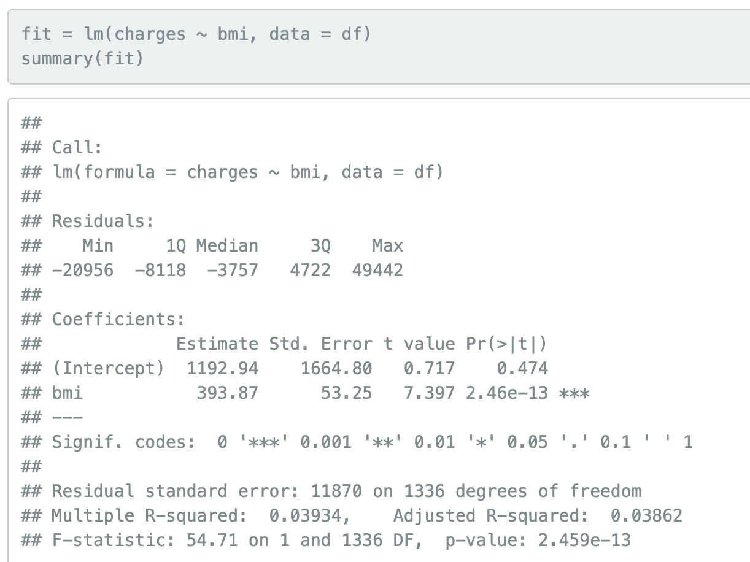
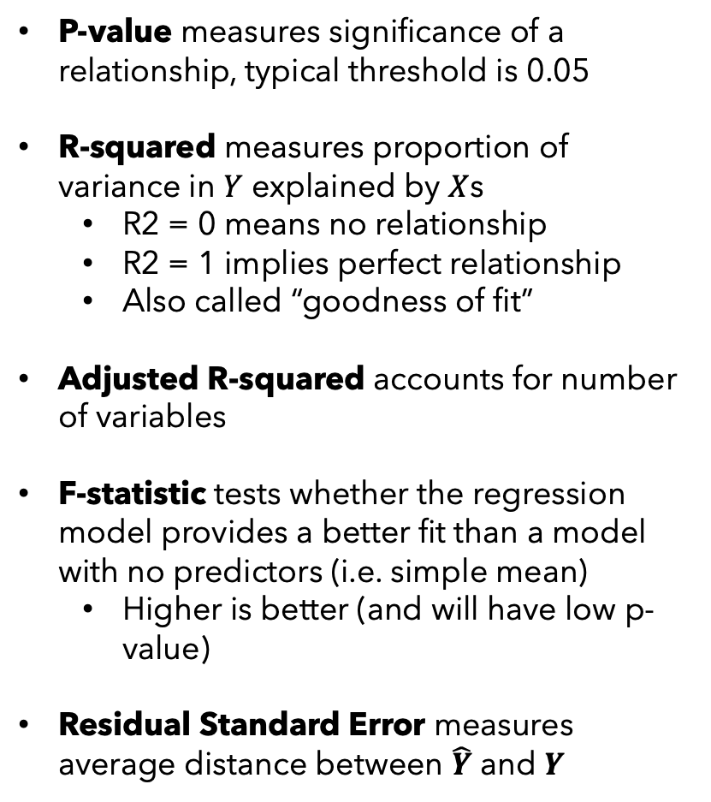
Significance and Strength of Relationship
P-value measures significance of a relationship, typical threshold is 0.05
R-squared measures proportion of variance in $Y$ explained by $X$s
R2 = 0 means no relationship
R2 = 1 implies perfect relationship
Also called “goodness of fit”
Adjusted R-squared accounts for number of variables
F-statistic tests whether the regression model provides a better fit than a model with no predictors (i.e. simple mean)
Higher is better (and will have low p-value)
Residual Standard Error measures average distance between $\hat{Y}$ and $Y$

Slide 18
R-Squared: Goodness of Fit
R2 measures the proportion of variance in dependent variable Y explained by independent variables X in a linear regression model
R2 = 0.75 means 75% of variance in Y is explained by X
R lies between 0 (nothing can be explained) and 1 (everything explained)
Higher R2 generally implies better model
How high? Depends on field — economics or psychology (0.3 is okay), physics (even 0.9 may not be enough)
Limitations:
R2 doesn’t indicate if the model is appropriate
Doesn’t measure predictive performance for out of sample (“test”) data
Doesn’t imply causality
Will increase if # of independent variables increase
Adjusted RSquared

Slide 19
Interpretation
Based on the results:
Dependent variable (Y) = _______________
Independent variable (X) = ______________
Linear model, mathematically:

Slide 20
Interpretation
Is regression model significant?
F-statistic =
R2 =
Adj R2 =
R2 Interpretation:
Is the relationship between BMI and insurance premium significant?
P-value =
Slope Interpretation:
Intercept Interpretation:

Slide 21
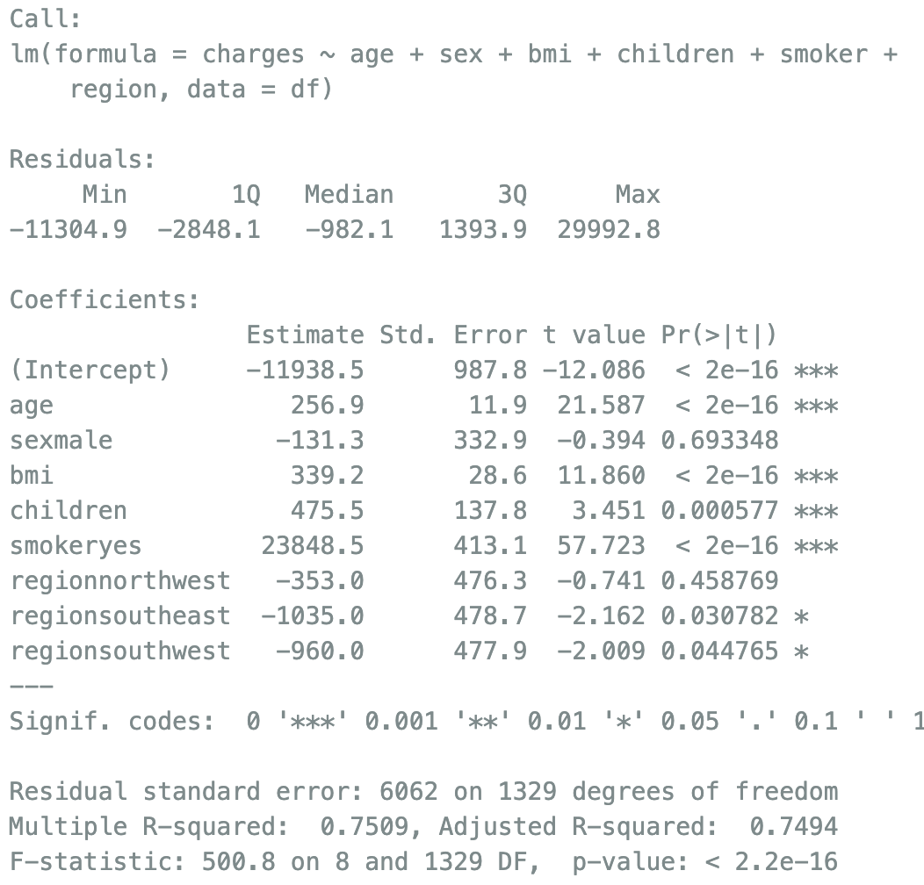
Multiple Linear Regression
We can choose to include more than one variables in regression. Let’s see an example.
Interpret R2:
Estimate effect of ‘age’:
Estimate effect of ‘smoking’:

Slide 22
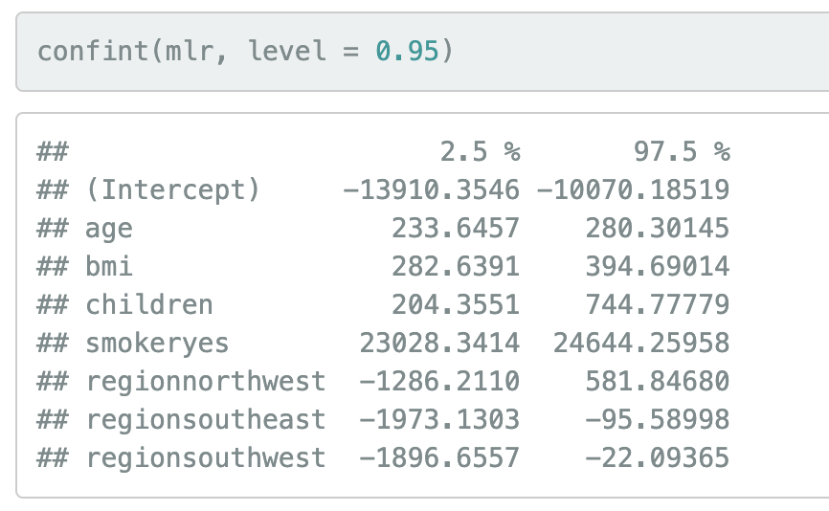
Confidence Intervals of Estimated Coefficients
confint (model) function in R can give us 95% confidence intervals for all intercepts

Slide 23
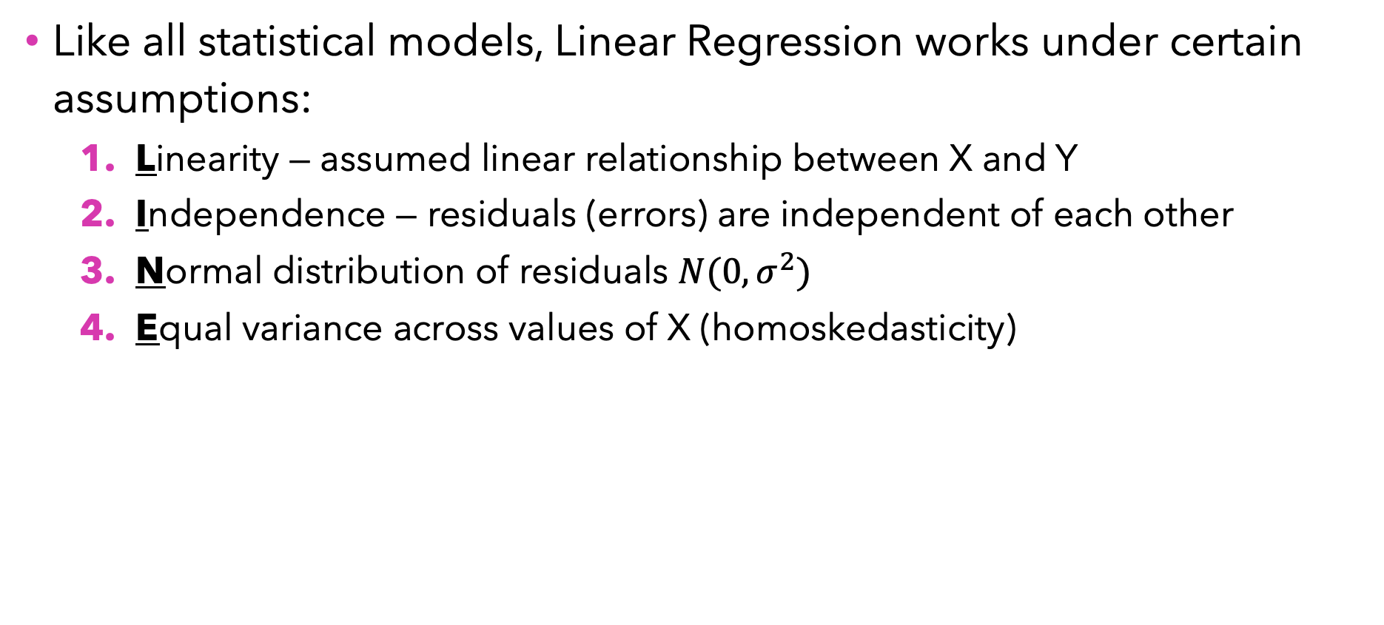
Assumptions in Linear Regression (LINE)
Like all statistical models, Linear Regression works under certain assumptions:
Linearity — assumed linear relationship between X and Y
Independence — residuals (errors) are independent of each other
Normal distribution of residuals $N(0,σ^{2})$
Equal variance across values of X (homoskedasticity)

Slide 24
Model Diagnostics
R provides four diagnostic plots:
Residual vs Fitted plot (Linearity assumption)
Good if horizontal line shows with no distinct patterns
plot(model, which = 1)
Normal Q-Q plot (Normality assumption)
Good if residuals follow diagonal dotted line
plot(model, which = 2)
Scale-Location plot (Equal variance or Homoskedasticity assumption)
Good if horizontal line with equally spread points
plot(model, which = 3)
Residuals vs Leverage (Detecting outliers)
Good if few points stand out
plot(model, which = 4)

Slide 25
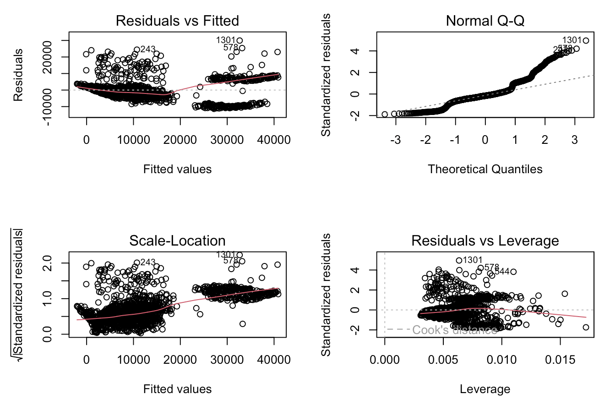
Model Diagnostics Case

Slide 26
In-class Quiz
Let’s see how much we understood from today’s class so far
Visit https://play.blooket.com/ and enter code XXXXXX

Slide 27
Business Insights
Real-World Implications and Actionable Insights

Slide 28



Impact of Smoking Habits, BMI and Others
Impact of Smoking on Charges From our MLR results, we found that being a smoker is associated with an increase of approximately $23,836 in annual medical charges, holding other variables constant.
Effect of BMI on Costs For every one-unit increase in BMI, medical charges increase by around $338.66, controlling for other factors like age and smoking.
Explaining Variability in Medical Charges Smoking habits, BMI, age, number of dependents, and regional differences together explain 75% of the variability in health insurance premiums.

Slide 29



Recommended Policy Interventions
Expand the Massachusetts Tobacco Cessation and Prevention Program (MTCP) with targeted campaigns for high-risk populations — regions, incentives like tax benefits, or disincentives like higher taxes on cigarettes, etc.
Higher BMI leads to higher charges! Consider subsidizing gym memberships, nutritional counseling, active transit like biking and walking particularly for lower-income groups that face barriers to access
Extra premium for children’s insurance causes higher childcare costs for parents. Consider subsidizing children’s insurance!

Slide 30
Concluding Remarks
What we learned today?
Linear regression helps us identify relationship and patterns between independent and dependent variables
Smoking and BMI have high impact!
Model coefficients tell us the impact of an individual variable
RSquared tells us “goodness of fit” of a model
Assumptions of LR should be verified before interpretation
Residuals analysis can tell us more about the data than we think
What to remember?
Regression’s strength is interpretability
Regression coefficient being significant doesn’t imply causality
Assumption of “linear model” might be too simplistic for pure prediction
LINE Assumptions: Linearity, Independence, Normality, Equal Variance
There is more to regression! We will cover additional topics in coming classes

Slide 31
Next Up…
Interaction between Variables
Identifying relationships that have combined/conditional effects, not additive effects
Effect of exercise on weight might depend on diet type
Ranking Importance of Independent Variables
Scaling X by its mean and standard deviation
Linear regression for optimization
https://blog.harsh17.in/using-linear-regression-to-find-optimal-value/
Variable selection: Lasso and ridge regressions

Slide 32

Questions?

