Slide 1

Linear Regression
Harshvardhan
University of Tennessee
Teaching Demo at UMass Amherst | December 2, 2024

Slide 2

Table of Contents
What is Linear Regression?
Mathematics of Linear Regression
Interpreting Results and RSquared
Assumptions and Model Diagnostics
Hands-on: Example in R/RStudio
Conclusion
Case Study:
Number of Golf Courses in USA

Slide 3

Golf Courses by State: How Many Are There?
In 2023, more than 45 million people played golf in US
What determines how popular is golf in any state?
Location
Population / Population Density
Population Growth
Etc.
Fun fact: Florida has the highest number of golf courses in USA, currently 1000+

Slide 4



golf.png

Slide 5


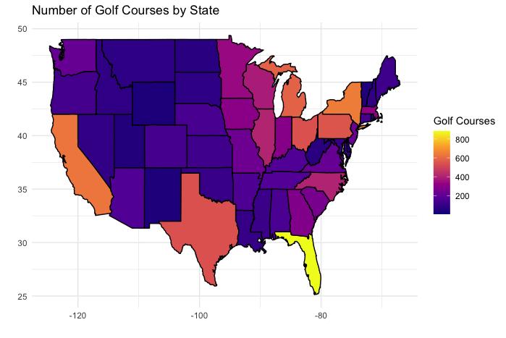
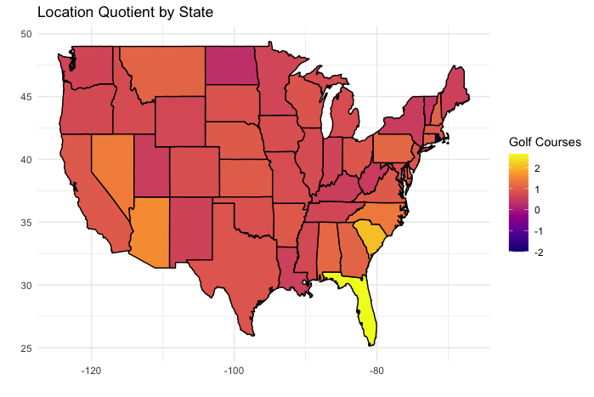
Golf Courses by Location
Location Quotient: A numerical index indicating location’s favorability to have golf courses

Slide 6
What is Linear Regression?
Linear regression is a model that estimates linear relationship between a dependent variable and one or more independent variable(s)
It is an attempt to find the best fit line between independent and dependent variables
Strengths:
Explainability and interpretability
Simple, quick and easy
Statistical basis for usage and interpretation
Weaknesses:
Assumes linear relationship — simple model is too simple
Sensitive to outliers
Assumptions — we will talk about them
No causation implied, only a sophisticated form of correlation

Slide 7
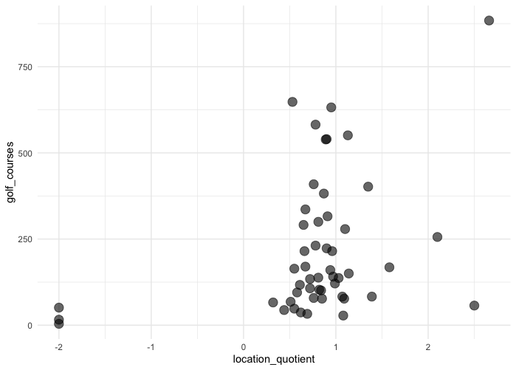
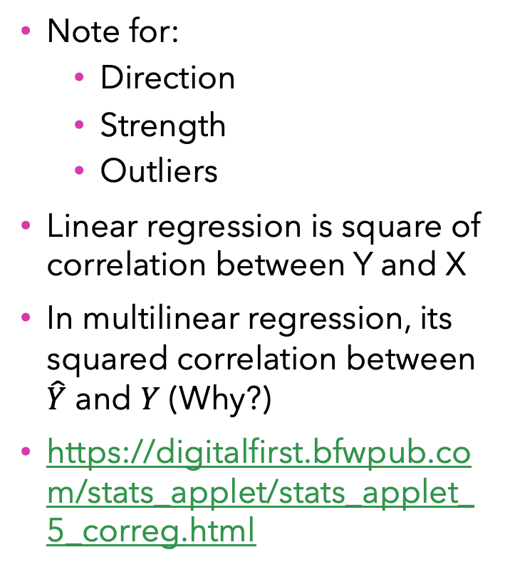
Scatterplot and Correlation
Note for:
Direction
Strength
Outliers
Linear regression is square of correlation between Y and X
In multilinear regression, its squared correlation between $\hat{Y}$ and $Y$ (Why?)
https://digitalfirst.bfwpub.com/stats_applet/stats_applet_5_correg.html

Slide 8
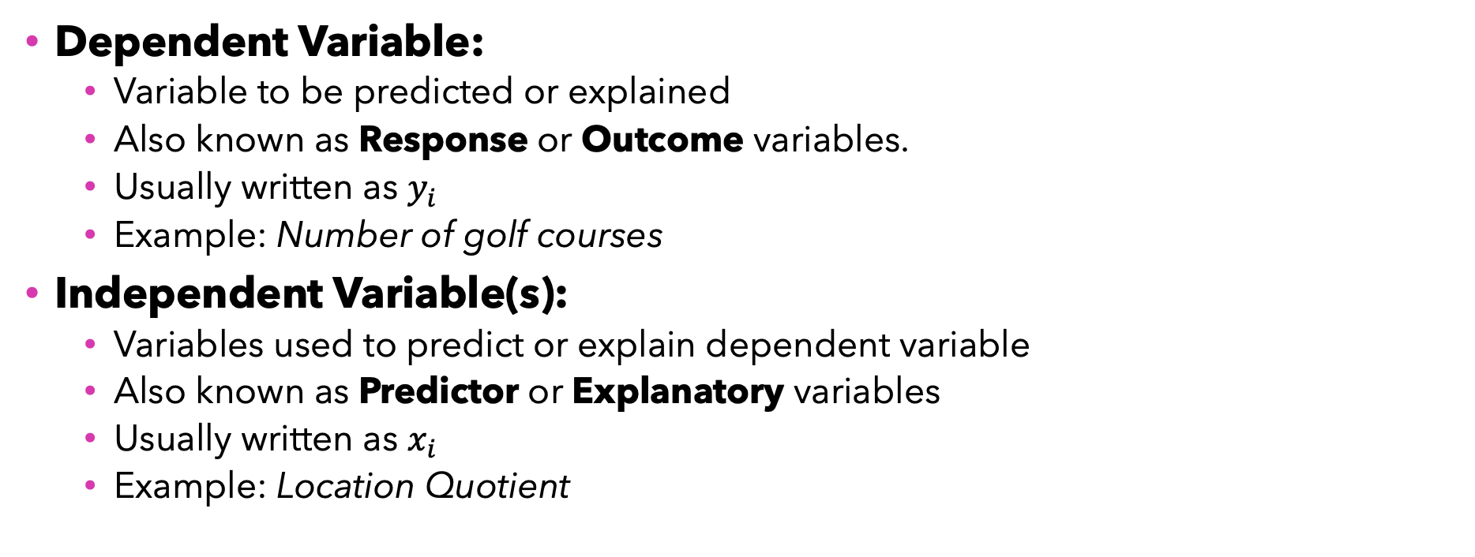
Key Components
Predictor / Explanatory / Independent Variable
Dependent Variable:
Variable to be predicted or explained
Also known as Response or Outcome variables.
Usually written as $y_{i}$
Example: Number of golf courses
Independent Variable(s):
Variables used to predict or explain dependent variable
Also known as Predictor or Explanatory variables
Usually written as $x_{i}$
Example: Location Quotient
Predicted / Response / Outcome / Dependent Variable

Slide 9
Linear Regression Mathematics
Linear Model, Coefficients and Predicted Responses

Slide 10
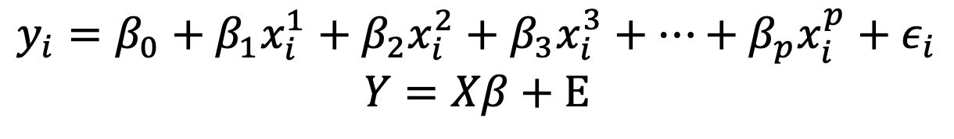

Mathematics of Linear Regression
Simple Linear Regression (single predictor)
Multiple Linear Regression (p predictors)
$$y_{i}=β_{0}+β_{1}x_{i}+ε_{i}$$
$$y_{i}=β_{0}+β_{1}x_{i}^{1}+β_{2}x_{i}^{2}+β_{3}x_{i}^{3}+…+β_{p}x_{i}^{p}+ε_{i}$$
$$Y=Xβ+Ε$$

Slide 11
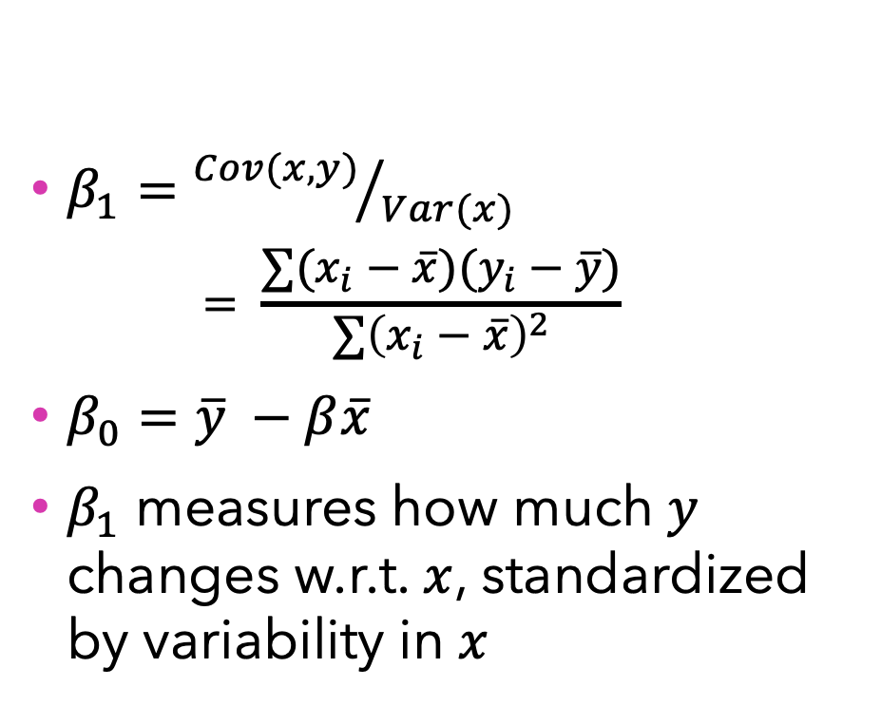
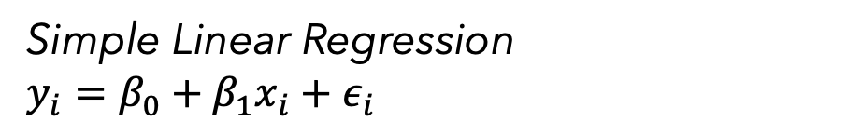

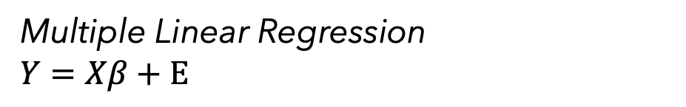
Calculating Coefficients
Simple Linear Regression
$$y_{i}=β_{0}+β_{1}x_{i}+ε_{i}$$
Multiple Linear Regression
$$Y=Xβ+Ε$$
$β_{1}={Cov(x,y)}/{Var(x)}$
$$= \frac{∑(x_{i}−\overline{x})(y_{i}−\overline{y})}{∑{\left(x_{i}−\overline{x}\right)}^{2}}$$
$β_{0}=\overline{y} −β\overline{x}$
$β_{1}$ measures how much $y$ changes w.r.t. $x$, standardized by variability in $x$
$β={\left(X^{′}X\right)}^{−1}X^{′}Y$
where $X$ is data matrix, $Y$ is response vector

Slide 12
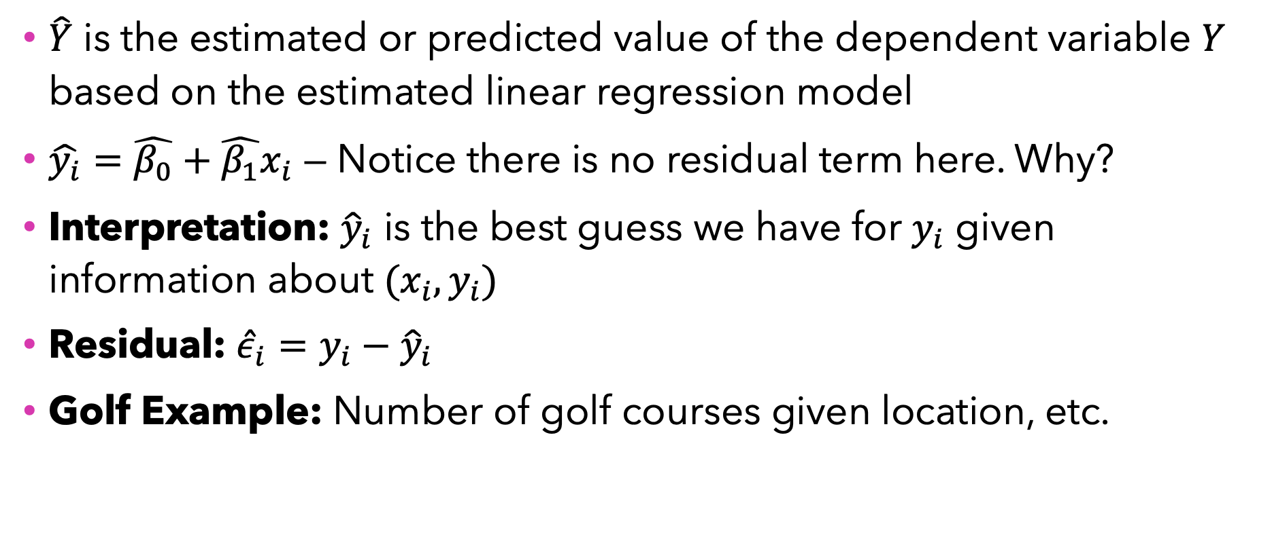
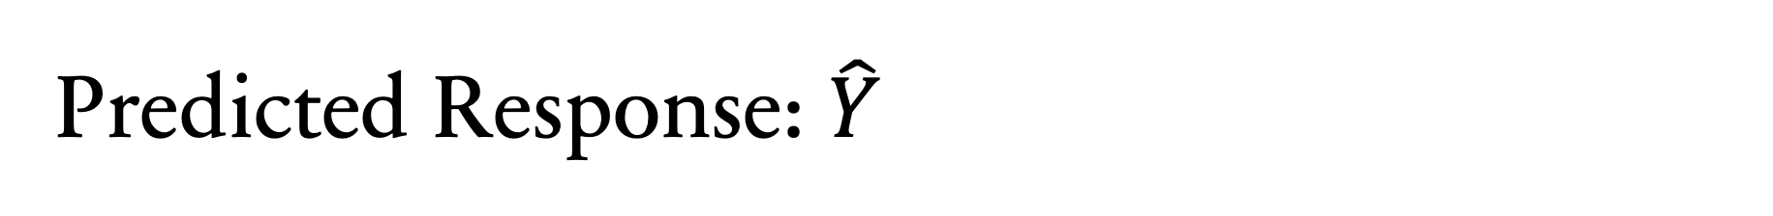
Predicted Response: $\hat{Y}$
$\hat{Y}$ is the estimated or predicted value of the dependent variable $Y$ based on the estimated linear regression model
$\hat{y_{i}}=\hat{β_{0}}+\hat{β_{1}}x_{i}$ — Notice there is no residual term here. Why?
Interpretation: ${\hat{y}}_{i}$ is the best guess we have for $y_{i}$ given information about $(x_{i}, y_{i})$
Residual: ${\hat{ε}}_{i}=y_{i}−{\hat{y}}_{i}$
Golf Example: Number of golf courses given location, etc.

Slide 13
Interpretation, Assumptions and Diagnostics
How reliable are our conclusions?

Slide 14
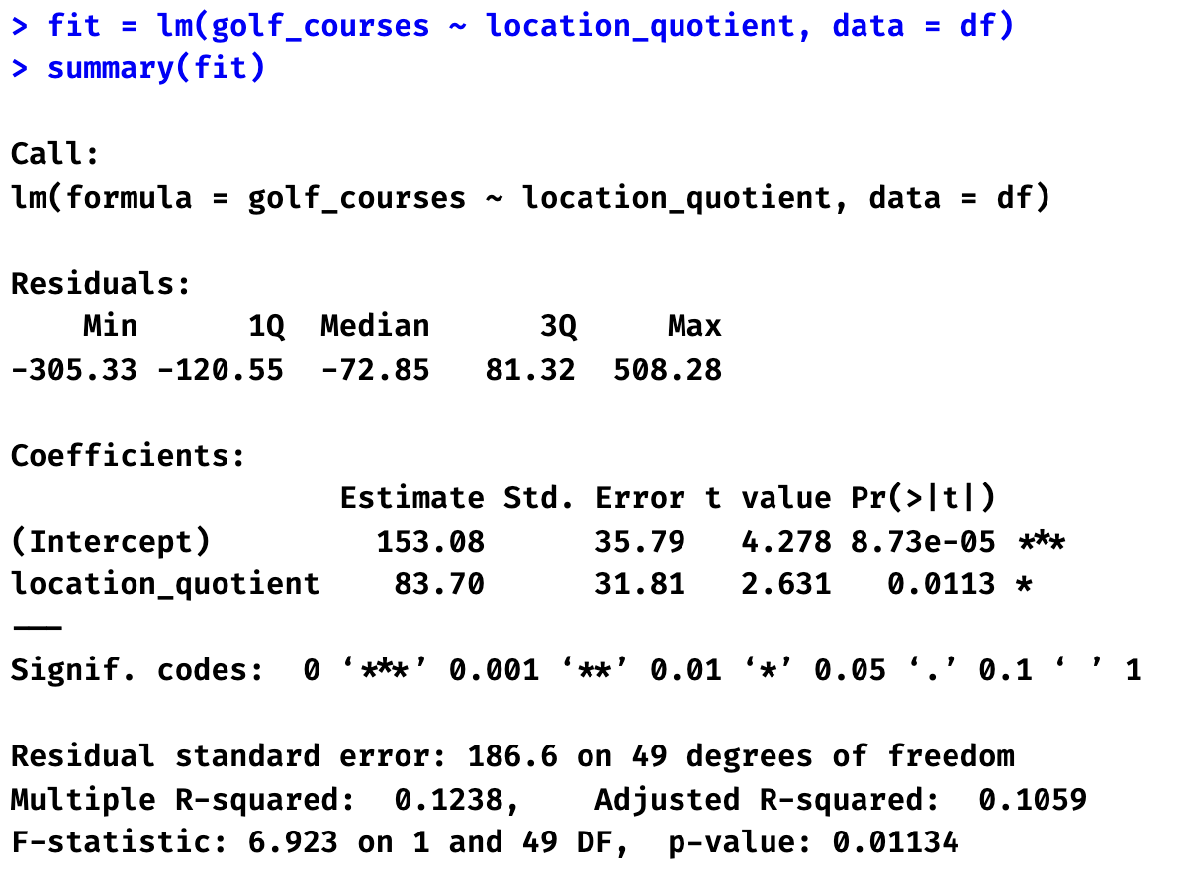
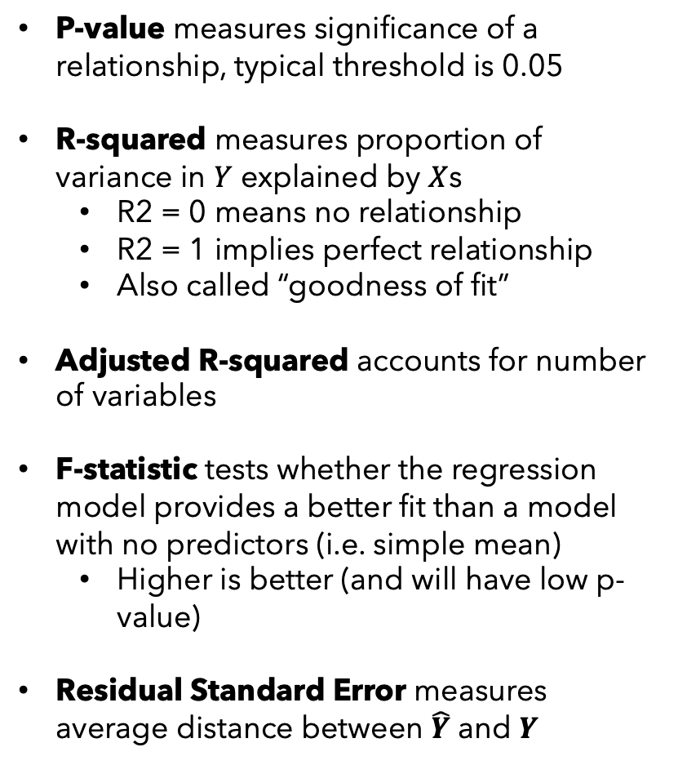
Significance and Strength of Relationship
P-value measures significance of a relationship, typical threshold is 0.05
R-squared measures proportion of variance in $Y$ explained by $X$s
R2 = 0 means no relationship
R2 = 1 implies perfect relationship
Also called “goodness of fit”
Adjusted R-squared accounts for number of variables
F-statistic tests whether the regression model provides a better fit than a model with no predictors (i.e. simple mean)
Higher is better (and will have low p-value)
Residual Standard Error measures average distance between $\hat{Y}$ and $Y$

Slide 15
Interpretation
Based on the results:
Dependent variable (Y) = _______________
Independent variable (X) = ______________
Linear model, mathematically:

Slide 16
Interpretation
Is regression model significant?
F-statistic =
R2 =
Adj R2 =
R2 Interpretation:
Is the relationship between location and number of golf courses significant?
P-value =
Slope Interpretation:
Intercept Interpretation:

Slide 17
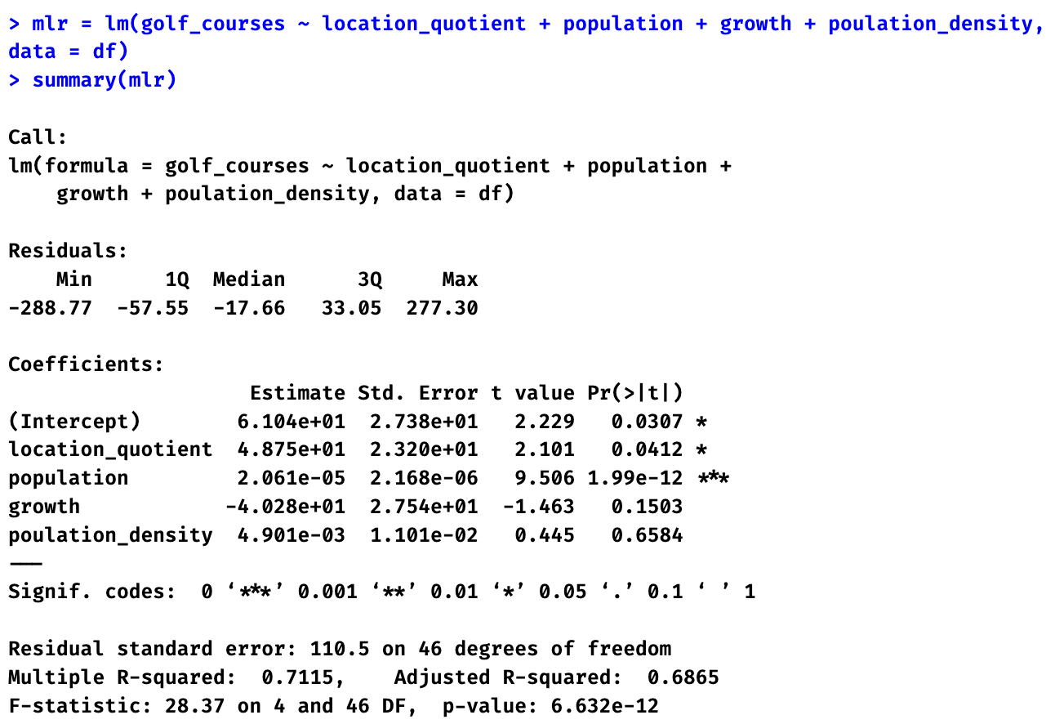
Multiple Linear Regression
We can choose to include more than one variables in regression. Let’s see an example.
Interpret R2:
Estimate effect of ‘population’:

Slide 18
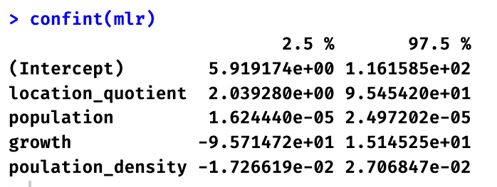
Confidence Intervals of Estimated Coefficients
confint (model) function in R can give us 95% confidence intervals for all intercepts

Slide 19
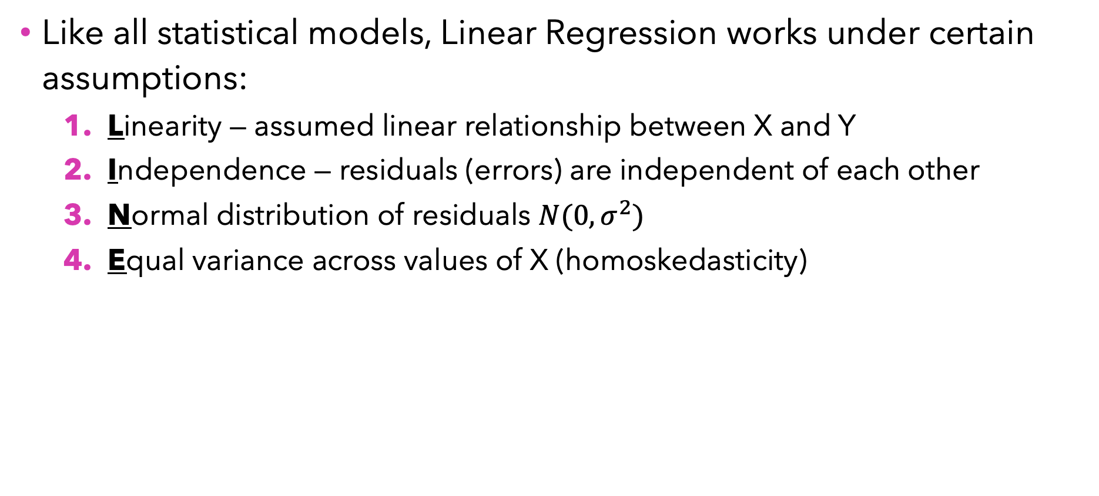
Assumptions in Linear Regression (LINE)
Like all statistical models, Linear Regression works under certain assumptions:
Linearity — assumed linear relationship between X and Y
Independence — residuals (errors) are independent of each other
Normal distribution of residuals $N(0,σ^{2})$
Equal variance across values of X (homoskedasticity)

Slide 20
Model Diagnostics
R provides four diagnostic plots:
Residual vs Fitted plot (Linearity assumption)
Good if horizontal line shows with no distinct patterns
plot(model, which = 1)
Normal Q-Q plot (Normality assumption)
Good if residuals follow diagonal dotted line
plot(model, which = 2)
Scale-Location plot (Equal variance or Homoskedasticity assumption)
Good if horizontal line with equally spread points
plot(model, which = 3)
Residuals vs Leverage (Detecting outliers)
Good if few points stand out
plot(model, which = 4)

Slide 21
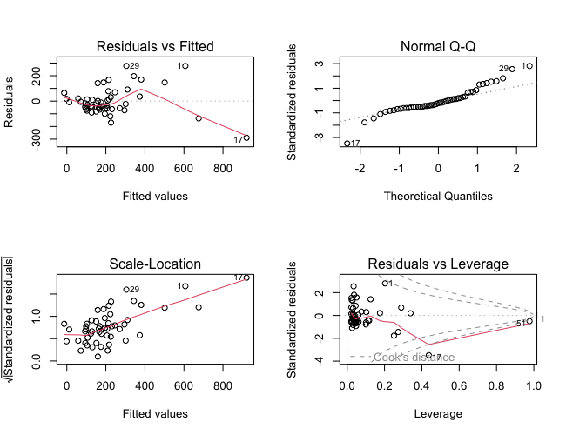
Model Diagnostics Case

Slide 22
Mid-class Quiz
Let’s see how much we understood from today’s class so far
Visit https://play.blooket.com/ and enter code XXXXXX

Slide 23
Business Insights
Real-World Implications and Actionable Insights

Slide 24
Impact of Location, Population, and Value of Linear Model
From our MLR results, we found that a one-unit increase in location quotient is associated with ~49 additional golf courses, holding other variables constant.
For every additional 100,000 people in a state's population, the number of golf courses increases by ~2.
Location, Population, Population Growth, and Population Density together explain 71% of variability in the number of golf courses by state.

Slide 25
Multiple Linear Regression

Slide 26
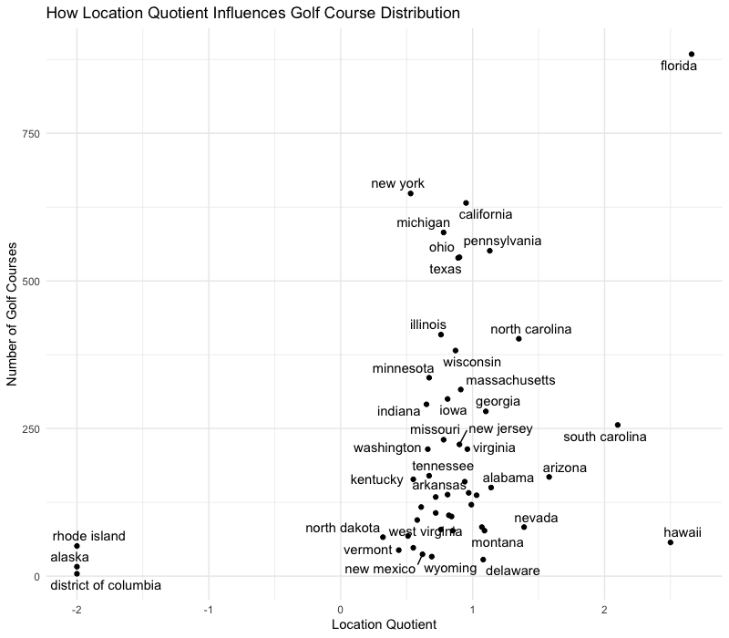
Location Matters! Strategic Golf Course Development
Insight:
Location matters! (location_quotient is significant.)
States with a higher Location Quotient (e.g., Florida, Hawaii):
More favorable for golf courses due to climate and topography.
Strong existing presence of golf courses.
Action:
Target high-Location Quotient regions for:
Premium golf-related tourism?
Leverage natural advantage to attract domestic and international clientele at those locations

Slide 27
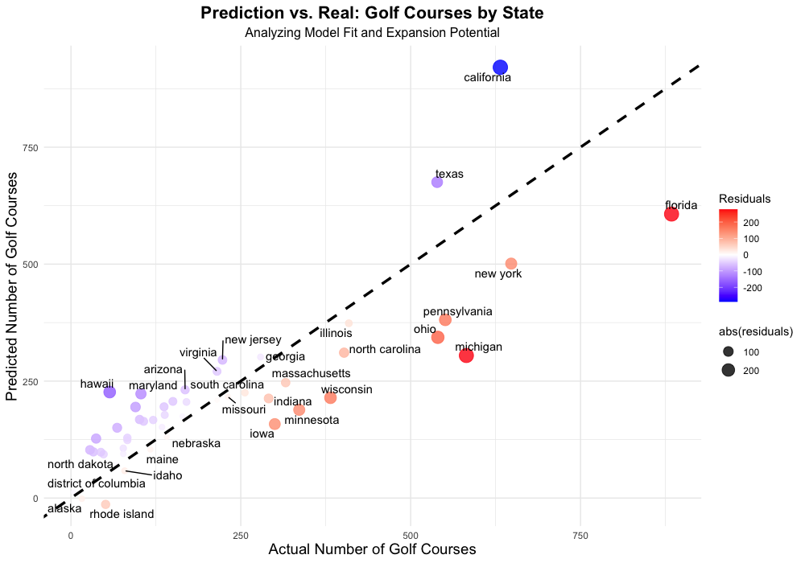
Market Potential
We can see market potential by visualizing the residuals.
Underestimated States (Red Points)
More favourable than expected
Overestimated States (Blue Points)
Less favourable than expected
Well-Fitted States (White Points)
As favourable as expected

Slide 28
Concluding Remarks
What we learned today?
Linear regression helps us identify relationship and patterns between independent and dependent variables
Location quotient and population matter in predicting the number of golf courses in a state
Model coefficients tell us the impact of an individual variable
RSquared tells us “goodness of fit” of a model
Assumptions of LR should be verified before interpretation
Residuals analysis can tell us more about the data than we think
What to remember?
Regression’s strength is interpretability
Regression coefficient being significant doesn’t imply causality
Assumption of “linear model” might be too simplistic for pure prediction
LINE Assumptions: Linearity, Independence, Normality, Equal Variance
There is more to regression! We will cover additional topics in coming classes

Slide 29
Next Up…
Interaction between Variables
Identifying relationships that have combined/conditional effects, not additive effects
Effect of exercise on weight might depend on diet type
Ranking Importance of Independent Variables
Scaling X by its mean and standard deviation
Linear regression for optimization
https://blog.harsh17.in/using-linear-regression-to-find-optimal-value/
Variable selection: Lasso and ridge regressions

Slide 30

Questions?

