Slide 1
Summary of MEMEX paper
MEMEX is the problem that the researchers are trying to combat. Meme-evidence Detection is the problem where the model is given a meme image and a document that contains the context of the meme. The model should correctly highlight the paragraph/lines which match with the context of the meme.
MCC (Meme Context Corpus) is the dataset that the researchers have come up with. It contains 3403 memes and the train,validation,test split is 80:10:10. It includes History (38.59%), Entertainment(15.44%), Joe Biden (12.17%), Barack Obama (9.29%), Coronavirus (7.80%), Donald Trump (6.61%), Hillary Clinton (6.33%), US Elections (1.78%), Elon Musk (1.05%) and Brexit (0.95%). Most of the memes were sourced from subreddits like ‘r/CoronavirusMemes’, ‘r/PoliticalHumor’, ‘r/PresidentialRace’ subreddits.
To combat the problem, the researchers have proposed MIME (MultImodal Meme Explainer) , a multimodal neural framework that uses common sense enriched meme representation and a layered approach to capture the cross-modal semantic dependencies between the meme and the context

Slide 2
MIME
MIME takes 2 inputs. A document and an image. The document is directly processed through BERT, a deep learning model, which helps to understand the context of each line in the document.
The image is processed through a multimodal bitransformer model (MMBT) which uses BERT and Resnet (An image processing model that outputs the objects in the image) and then sent to the Knowledge enriched meme encoder (KME). KME takes the text and the caption of the meme from the MMBT and using ConceptNet (A source of external commonsense knowledge) outputs the knowledge enriched multimodal meme representation.
The data from KME and BERT is then inputted into Meme aware transformer whose outputs are then inputted into a Meme aware LSTM which also inputs from KME to generate the desired output.

Slide 3
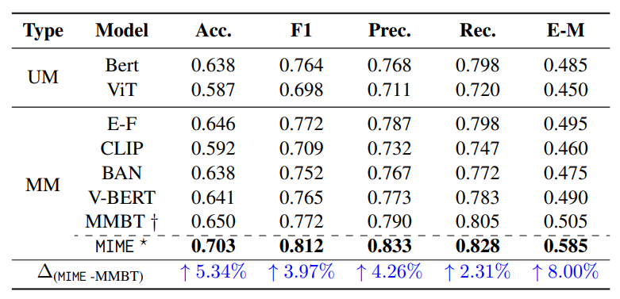
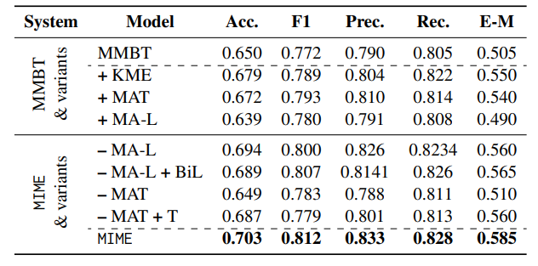
Results
MIME performed the best out of all the models for MEMEX.
Out of all multimodal models other than MIME, MMBT fares the most optimally.
KME and MAT together are the most important components of the MIME while MA-L increases the accuracy of MIME marginally.

Slide 4
Strengths of the paper
The paper is one of the first papers to combat meme contextualization in such detail.
They provided an open source dataset that other researchers could use. This increases their credibility.
They included empirical evidence to show the superiority of their model over other models. It was really cool how they showed the accuracy of MIME without some features of it and the accuracy of MMBT with just some features of MIME.

Slide 5
Weaknesses of the paper
MCC mostly includes historical or political memes while most of the memes on the web are related to recent trends or everyday life.
The paper doesn’t talk about how well the model scales with respect to the document’s size. The end goal here is to be able to get the context of the meme anywhere from the internet without providing any document.
The paper doesn’t talk elaborate about how this model helps in other areas. This makes the paper seem really niche and makes it less relevant.

Slide 6
Some improvements to the paper
The scope of MCC should be increased to incorporate memes of other kind like memes related to recent trends.
The researchers should elaborate upon the applications of MIME which they mentioned. They should have given some example images in the paper.
Performance with bigger documents should have been shown in the research paper.

