Slide 1
YuvaIntern
JanSeva Digital Service Platform (JSDSP)
4-Week Internship Completion Presentation
From project planning → responsive prototype → QA strategy → performance, accessibility & security audit
Junior Web Developer E-Governance & Digital Services
01
02
03
04
PLAN
PROTOTYPE
QA
AUDIT
Harshvardhan Singh
BTech CSE • Session 2024–28
Internship period: 07 Aug 2026 – 04 Sep 2026 • Remote • 4 weeks

Slide 2
Internship at a Glance
02
A four-week progression from an e-governance blueprint to an evidence-based prototype audit
ORGANIZATION
ROLE
YuvaIntern
Junior Web Developer – E-Governance & Digital Services
DURATION
PROJECT
07 Aug 2026 – 04 Sep 2026 • 4 weeks
JanSeva Digital Service Platform (JSDSP)
PRIMARY DELIVERABLE
REPRESENTATIVE JOURNEY
Citizen-facing digital service prototype + QA/audit documentation
Income Certificate • prototype / demonstration content
Verified internship details are stated in the offer letter, including the four-week duration and dates.
YuvaIntern • Junior Web Developer – E-Governance & Digital Services

Slide 3
The Project Vision
03
What JanSeva is designed to make easier for citizens and departments
A single digital front door for routine public services
Citizen journey
• Citizens discover services, understand eligibility, apply, upload documents, track requests, receive notifications and raise grievances.
• Departments get reusable building blocks for workflow, case management, dashboards, audit trails and integrations.
• Design priorities: simplicity, inclusion, transparency, interoperability, trust & security, and continuous improvement.
Discover → Understand → Sign in → Apply → Attach → Submit → Process → Notify → Decide → Complete → Feedback
Planning foundation
Week 1 establishes the full service model; later weeks narrow into the demonstrable prototype and then validate its quality posture.
14 functional requirements • 11 non-functional quality attributes • 6 personas • 11-step citizen journey • roadmap • risk register
YuvaIntern • Junior Web Developer – E-Governance & Digital Services

Slide 4
Four-Week Journey
04
The internship progressed as one traceable engineering story
WEEK 1
WEEK 2
WEEK 3
WEEK 4
PLAN
PROTOTYPE
QA
AUDIT
Vision, research, requirements, personas, architecture, roadmap and risks
→
Information architecture, wireframes, high-fidelity screens and responsive behaviour
→
Test levels, traceability, 10 test cases, automation, defect process and exit criteria
→
Performance, WCAG 2.2, OWASP-aligned security review and prioritized remediation
Traceability mattered throughout: each later week explicitly carries forward scope, terminology, evidence and limitations from the earlier week.
YuvaIntern • Junior Web Developer – E-Governance & Digital Services

Slide 5
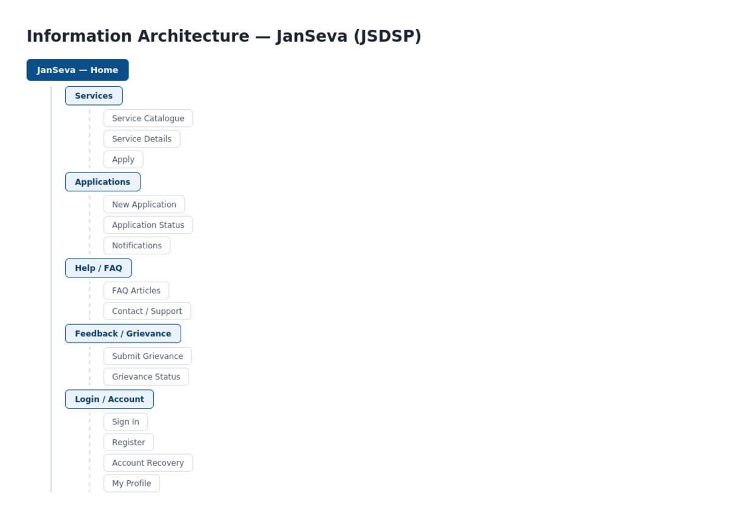
Week 1 — Planning & Technical Blueprint
05
The foundation for a reusable e-governance platform
What was defined
• Citizen-centered vision: make routine services understandable, accessible, trackable and secure from one digital front door.
• Functional requirements across discovery, identity, applications, documents, workflow, status, payments, notifications, grievance, admin, reporting, integration, audit and assisted service.
• Non-functional targets for performance, availability, security, privacy, accessibility, usability, scalability, interoperability, observability, maintainability and resilience.
• Proposed architecture: responsive web app, modular APIs, identity integration, database/object storage, workflow, observability and CI/CD.
• Delivery roadmap from discovery to Alpha, Beta, Pilot and Scale, with governance and risk controls.
Key planning outputs
14 FRs • 11 NFRs • 6 personas • 11-step journey • 10 risks • MVP acceptance criteria
YuvaIntern • Junior Web Developer – E-Governance & Digital Services

Slide 6
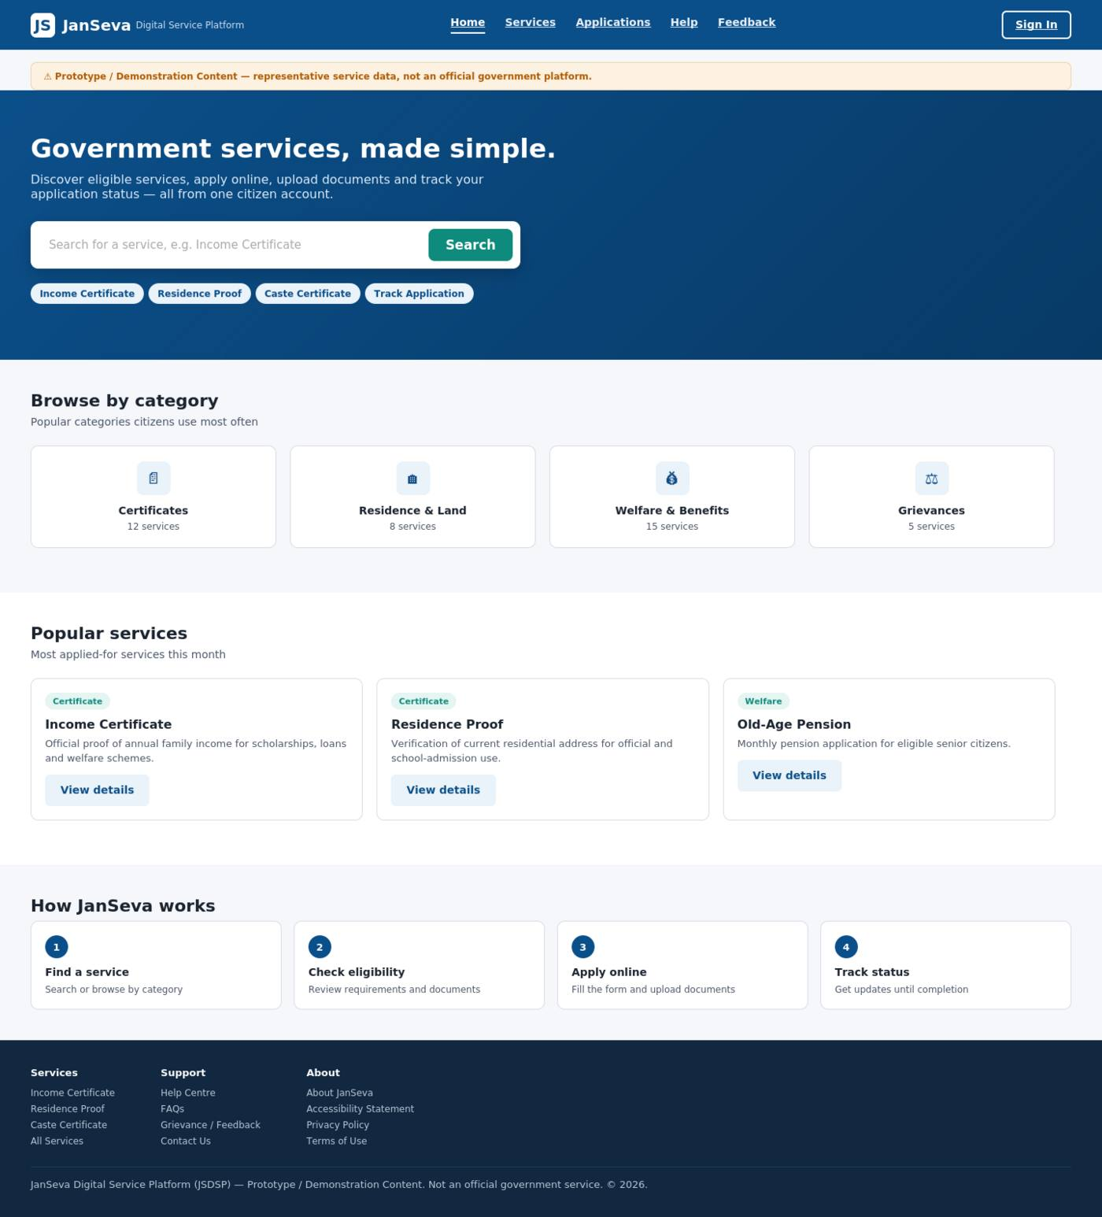
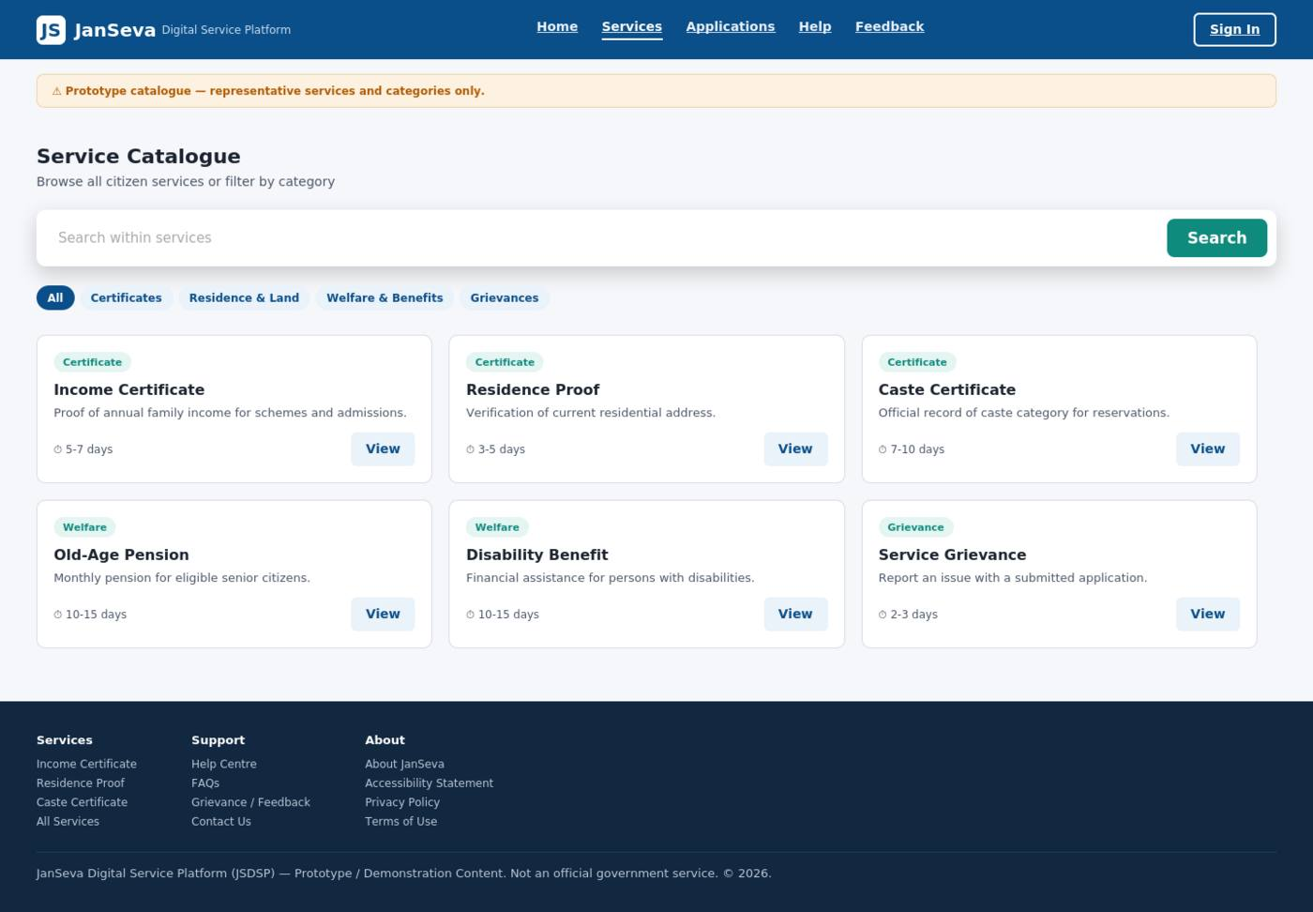
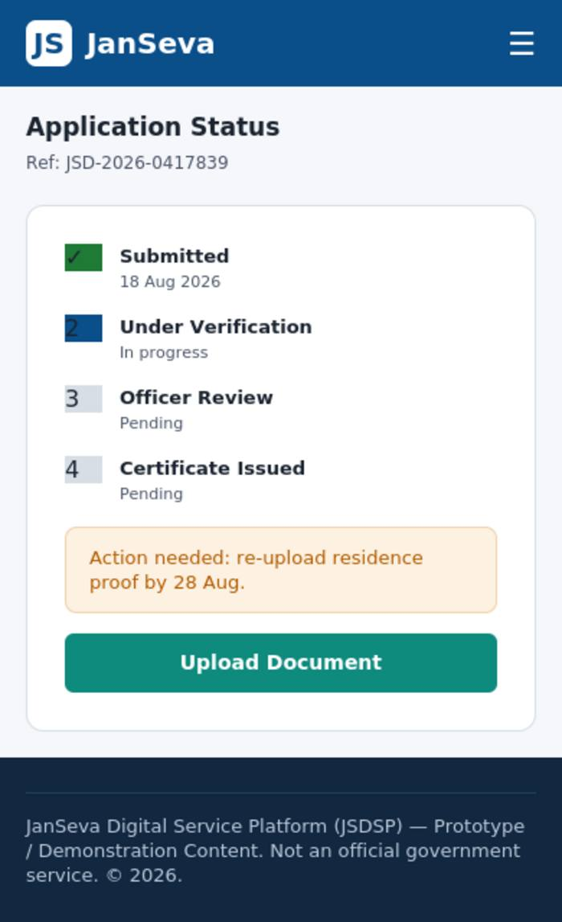
Week 2 — Responsive Citizen Service Prototype
06
Turning the plan into a concrete interface for one complete journey
Prototype scope
Responsive behaviour
Ten screens across discovery, authentication, application, review, confirmation, status and support, plus an optional officer dashboard.
Desktop 1440px • Tablet 768px • Mobile 390px 4→2→1 column grids • single-column mobile forms • compact navigation
Prototype boundary: mock/static data; no production backend, identity provider, payment gateway or database.
YuvaIntern • Junior Web Developer – E-Governance & Digital Services

Slide 7
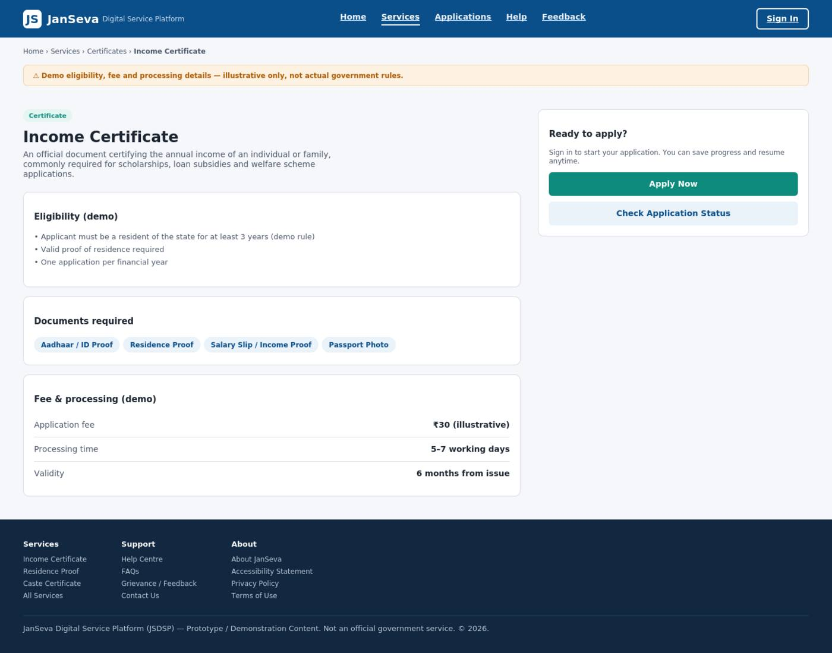
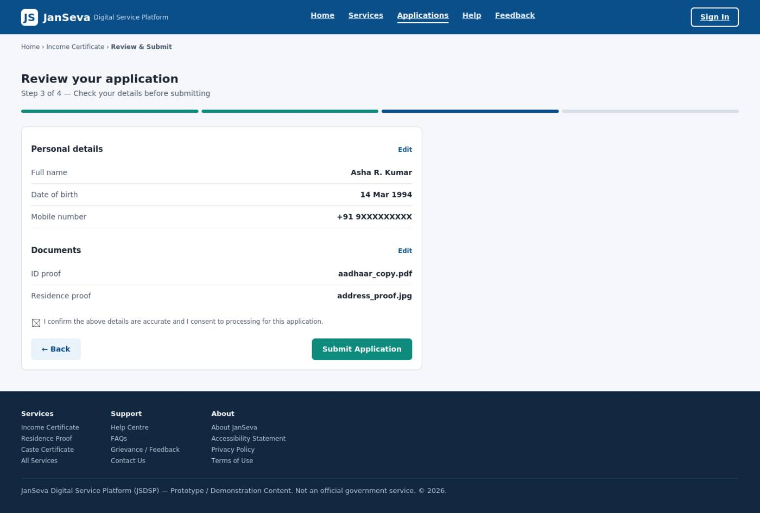
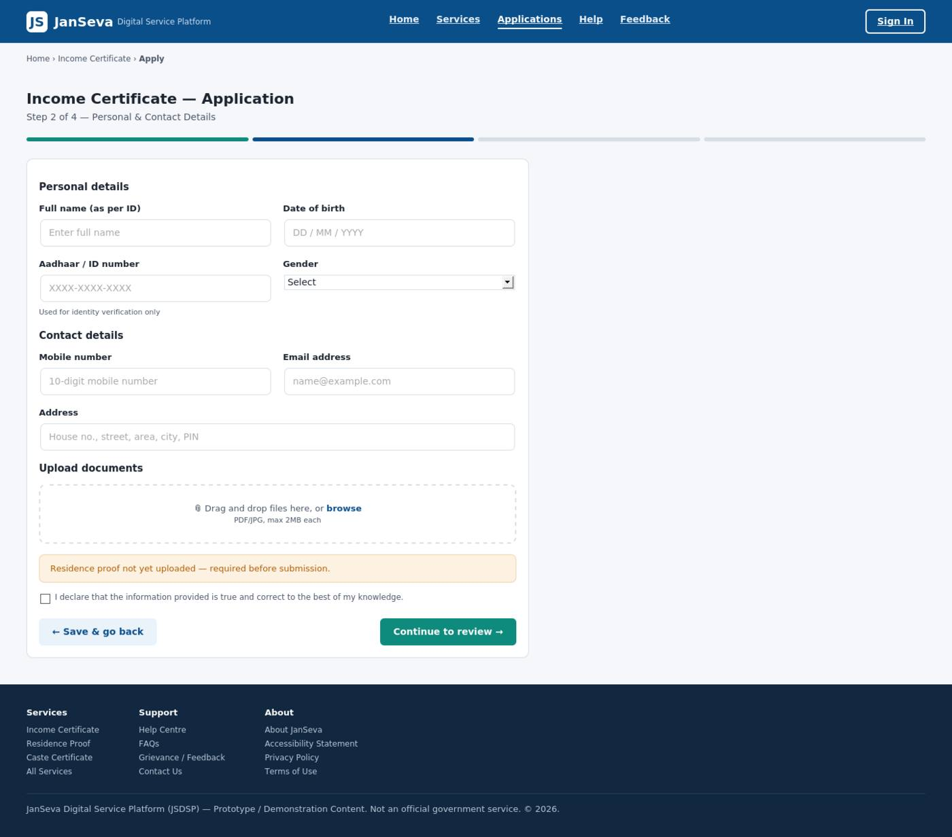
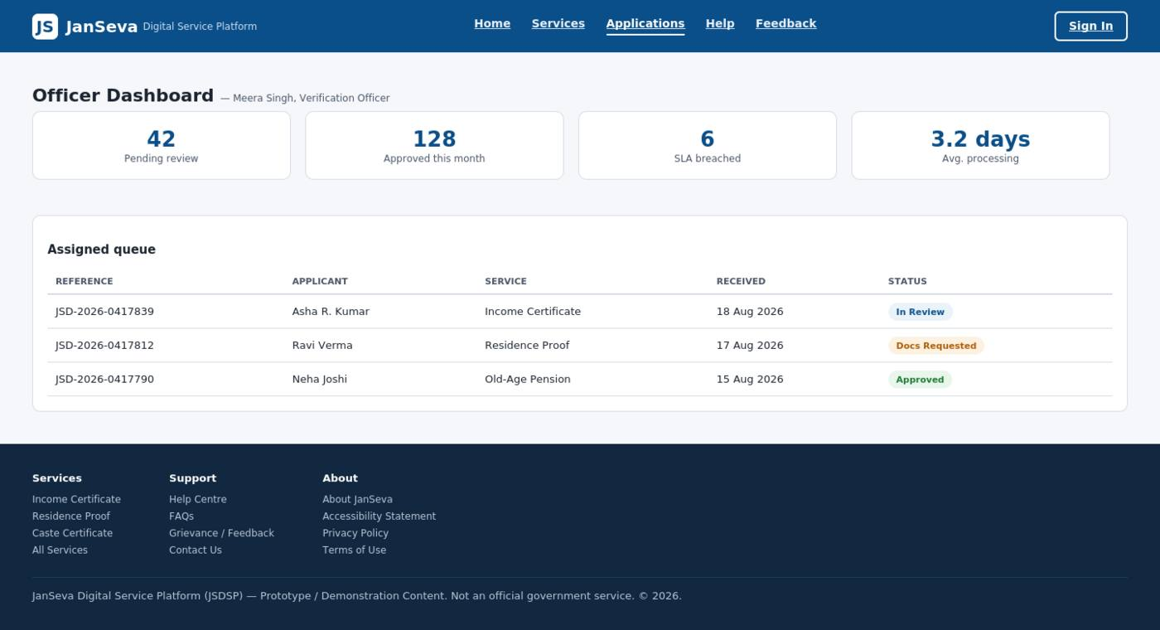
Week 2 — Key UI/UX Work
07
A reusable, service-first interface system
Service details
Application form
Review & submit
Officer dashboard
Design system
Deep public-sector blue + teal action accent • reusable header/search/cards/forms/upload/timeline/alerts • one clear primary action per screen
YuvaIntern • Junior Web Developer – E-Governance & Digital Services

Slide 8
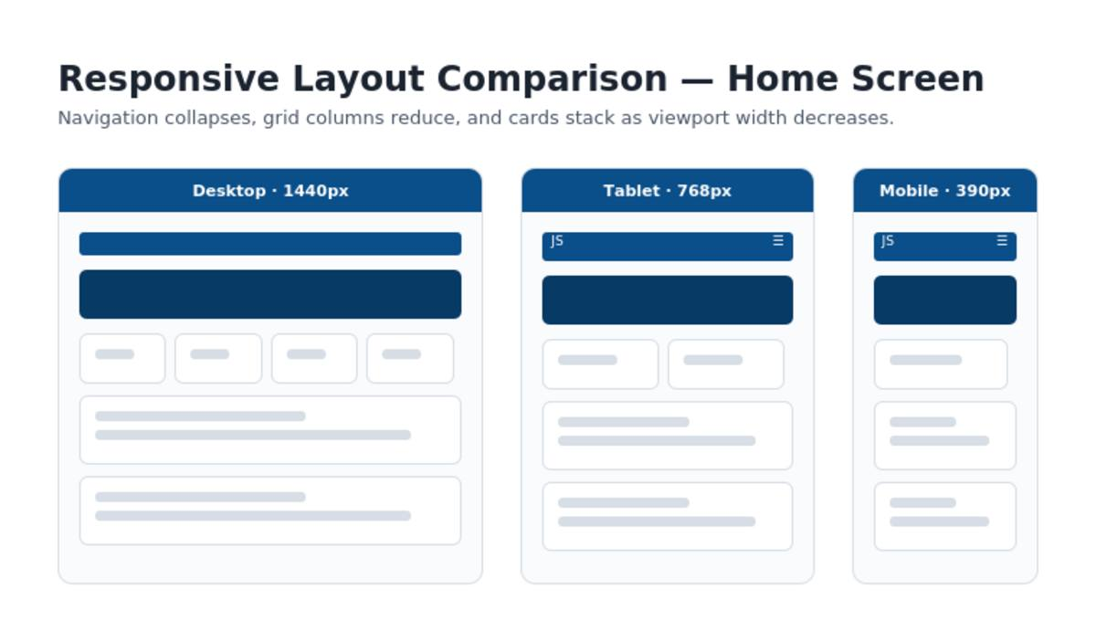
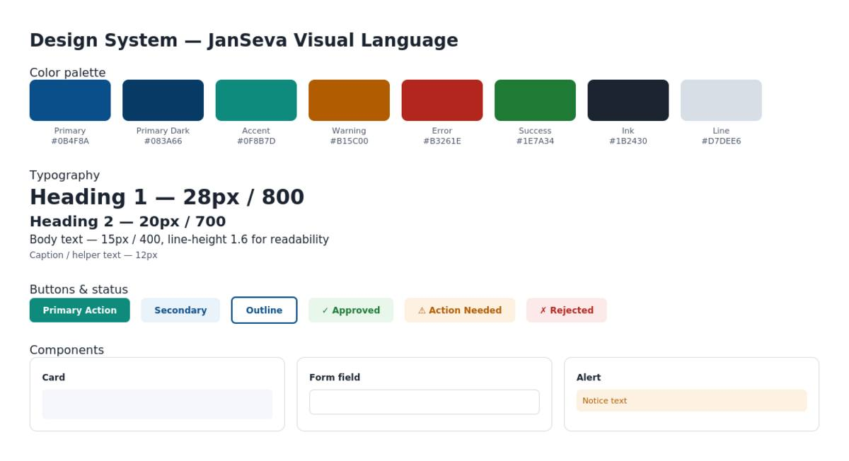
Week 2 — Responsive Design & Accessibility
08
Built mobile-first, with the target of WCAG 2.2 AA
Accessibility foundations
• Semantic structure and logical heading hierarchy
• Visible, associated form labels + contextual helper/error text
• Predictable focus styling and descriptive actions
• Contrast-aware status, alert and navigation states
• Touch-friendly mobile controls and flexible layout
• Representative manual checks recorded; full interactive audit left for later stages
Important accuracy note
The reports explicitly avoid claiming full WCAG compliance before interactive and assistive-technology validation.
YuvaIntern • Junior Web Developer – E-Governance & Digital Services

Slide 9
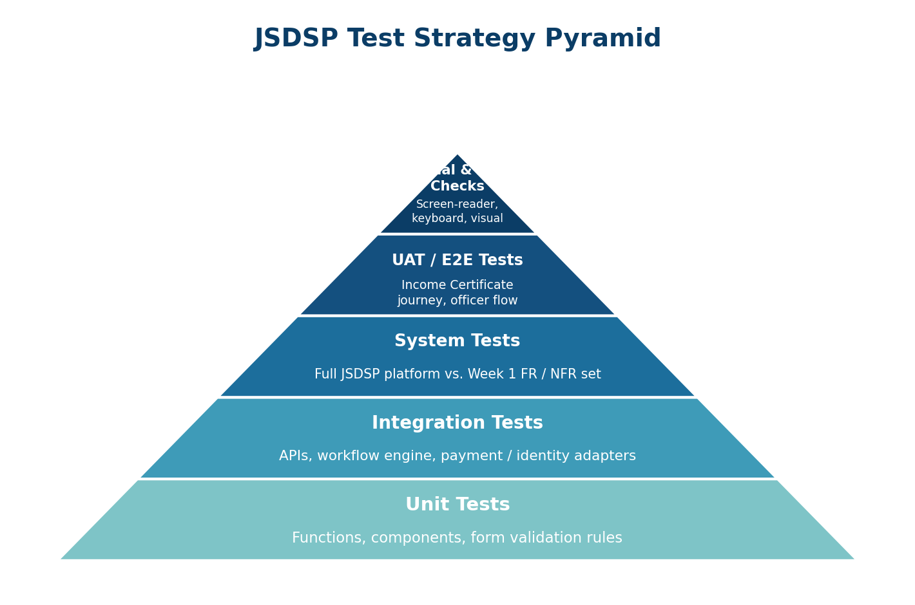
Week 3 — QA & Testing Strategy
09
Moving from design quality to repeatable verification
QA framework
• Five levels: Unit → Integration → System → UAT / End-to-End → Manual & Accessibility
• Requirement-to-test traceability across functional requirements and NFRs
• Ten detailed scenarios covering sign-in, discovery, forms, uploads, submission, officer workflow, status/notifications, payments, RBAC/audit and accessibility
• Automation strategy with Jest/RTL, Postman/Newman, Playwright/Cypress, k6/JMeter, SAST/dependency scans and axe/WAVE + NVDA/VoiceOver
• Clear defect lifecycle and release exit criteria: zero open Critical defects; High defects fixed or formally accepted
Evidence rule
Prototype/UI observations are separated from execution that requires a live backend or staging environment.
YuvaIntern • Junior Web Developer – E-Governance & Digital Services

Slide 10
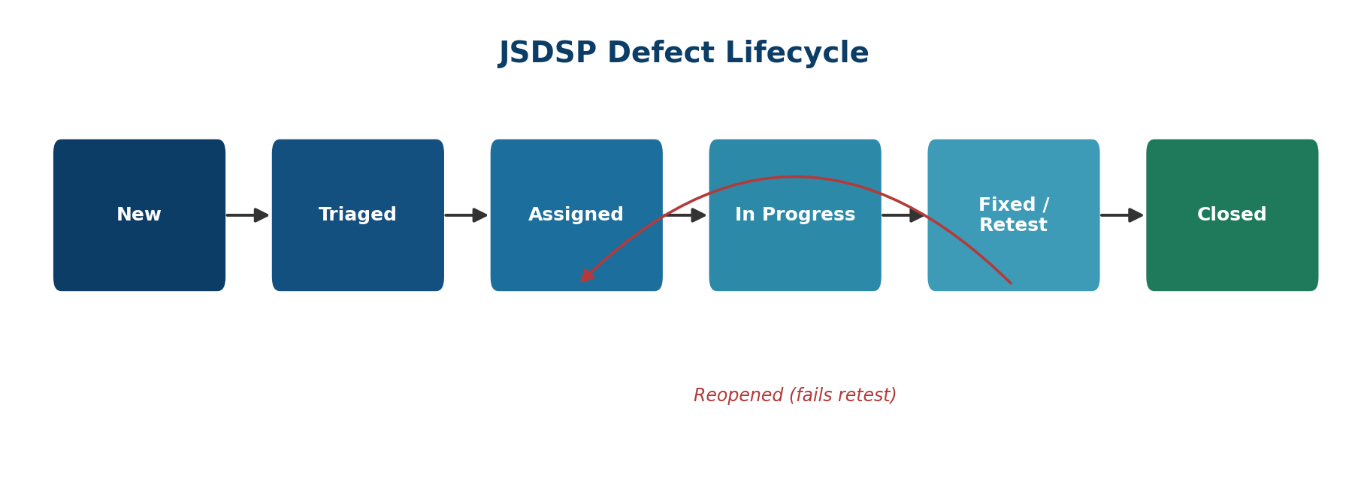
Week 3 — Test Coverage & Defect Thinking
10
A practical QA package, not just a checklist
Coverage highlights
detailed test cases
10
core citizen + officer scenarios
test levels
5
unit through manual/accessibility
traceability intent
100%
each in-scope requirement mapped
priority tiers
P0–P3
immediate → future remediation
Example lifecycle
New → Triaged → Assigned → In Progress → Fixed / Retest → Closed
Defect management
Every defect records the test case, reproduction steps, severity/priority, affected requirement or screen, and evidence. Critical/High issues block release under the stated exit criteria.
YuvaIntern • Junior Web Developer – E-Governance & Digital Services

Slide 11
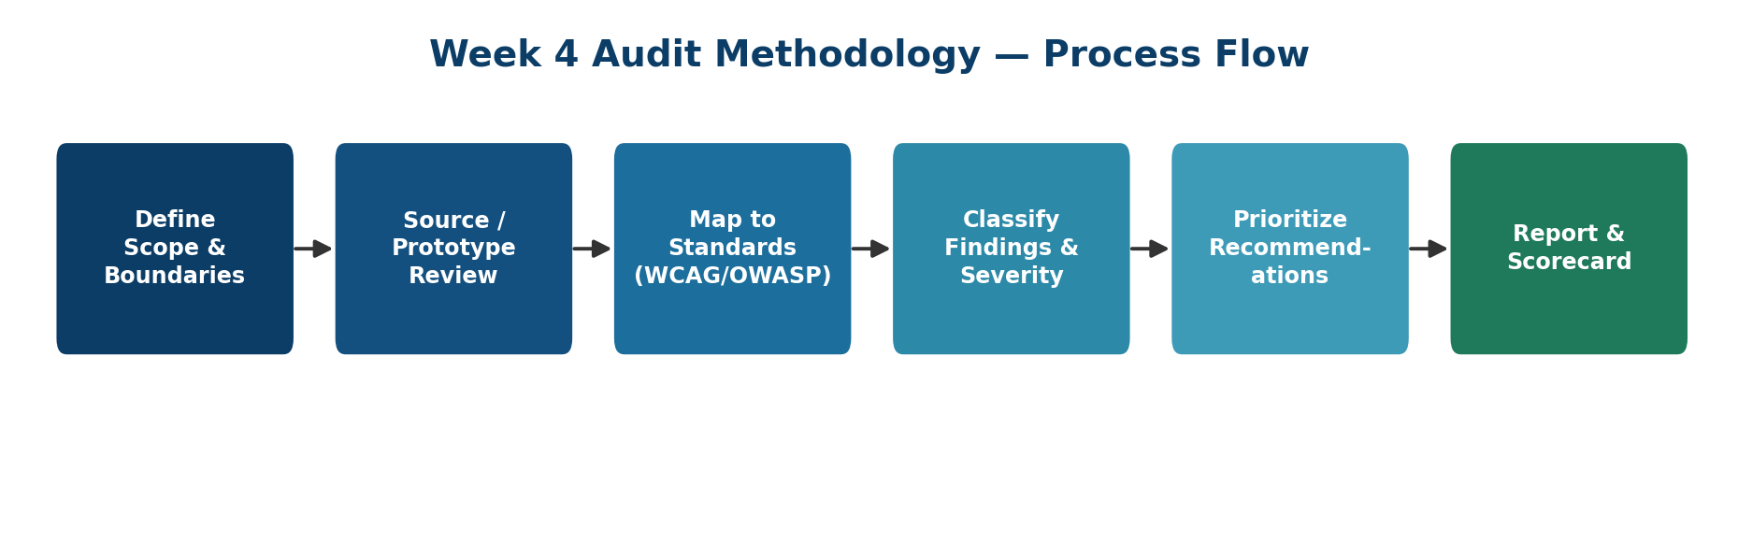
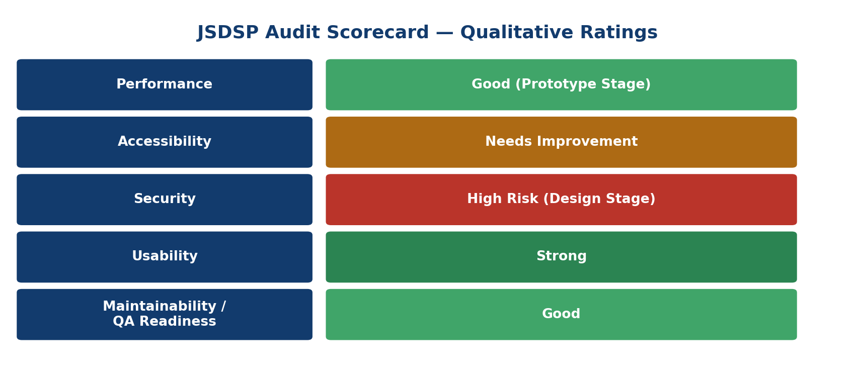
Week 4 — Performance, Accessibility & Security Audit
11
An evidence-based final review of the shipped prototype
Audit approach
• Performance: source architecture review + production measurement framework (Core Web Vitals targets)
• Accessibility: WCAG 2.2-oriented source/UI review, including reproducible contrast calculations
• Security: OWASP Top 10:2025-aligned source review across authentication, authorization, input handling, uploads, headers and logging
• Cross-check against Week 1–3 artifacts and the live project repository
• Anything requiring infrastructure that did not exist was recorded as Planned / Not Verified — never claimed as passed
YuvaIntern • Junior Web Developer – E-Governance & Digital Services

Slide 12
Week 4 — Performance Findings
12
Strong prototype architecture, but production tooling is still ahead
What was genuinely strong
Key improvements
• Zero third-party network dependencies in the shipped prototype
• No external fonts, analytics or trackers in the reviewed build
• No image elements to create current image-loading overhead
• Flexible CSS breakpoints at 900px and 640px support responsive reflow
• No measured Lighthouse/PageSpeed score was claimed because no production-representative environment existed
• Migrate toward the planned React + TypeScript production stack
• Introduce a build pipeline with minification and dead-code elimination
• Add long-lived caching / CDN rules once hosted
• Enforce a performance budget in CI
• Collect real-user LCP / INP / CLS after deployment
Bottom line
Production targets defined
Good prototype architecture ≠ measured production performance.
LCP ≤ 2.5s • INP ≤ 200ms • CLS ≤ 0.1 • TTFB ≤ 0.8s • <500 KB/view target
YuvaIntern • Junior Web Developer – E-Governance & Digital Services

Slide 13
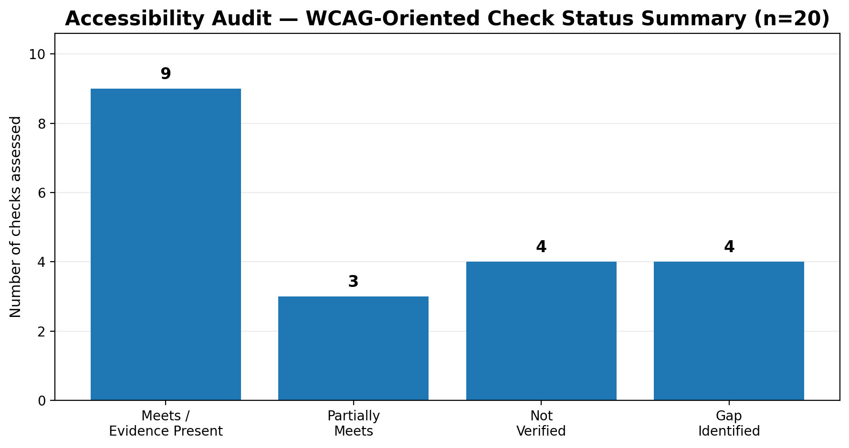
Week 4 — Accessibility Findings
13
A strong semantic/contrast base with concrete fixes identified
Audit summary
20 WCAG-oriented checks
9 Meets / evidence present 3 Partially meets 4 Not verified 4 Gaps identified
Main gaps
• required-field indication
• aria-live / role=alert for errors
• focus management on route change
• skip link and complete keyboard/screen-reader validation
Contrast evidence
All 8 checked high-use colour pairs passed WCAG AA thresholds in the source calculation.
Critical honesty point: the audit concludes the prototype is not WCAG 2.2 AA conformant today.
YuvaIntern • Junior Web Developer – E-Governance & Digital Services

Slide 14
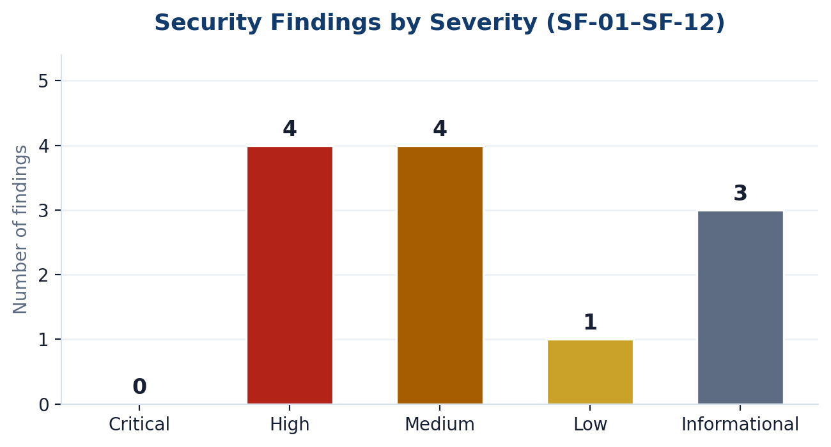
Week 4 — Security Findings
14
Low current exploitability, high production-readiness risk if shipped unchanged
Most important findings
• No real authentication logic — simulated login only
• No role-based access control (RBAC) enforcement
• User-typed search text reflected through innerHTML without escaping (SF-02)
• No production security headers / CSP evidence
• No real upload validation / storage controls yet
• No audit logging implementation yet
Positive evidence
Priority framing
No hardcoded secrets, keys or credentials were found in the reviewed source.
P0: quick accessibility fixes • P1: auth/RBAC/headers/input safety • P2: robustness • P3: infrastructure-dependent items
YuvaIntern • Junior Web Developer – E-Governance & Digital Services

Slide 15
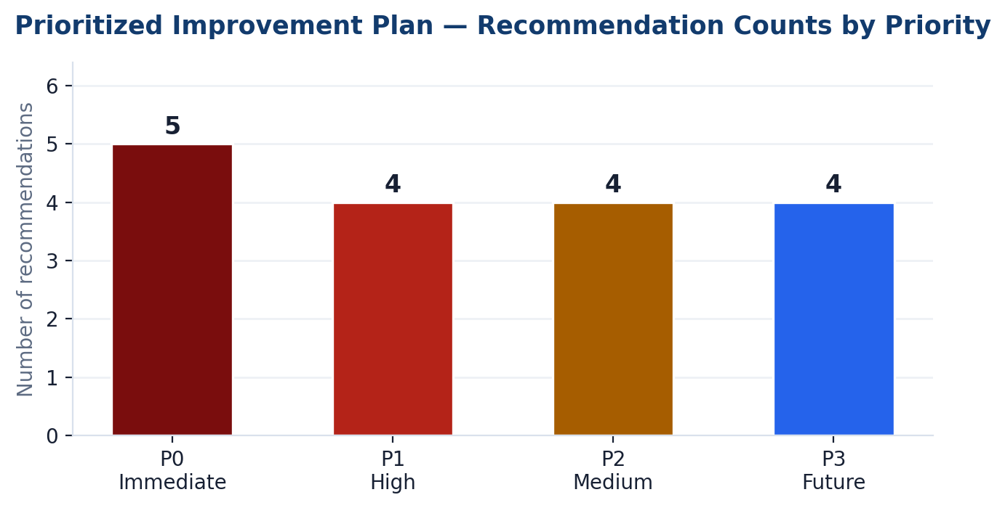
Cross-Dimension Findings & Improvement Plan
15
The audit connected performance, accessibility and security into one engineering backlog
Why the findings interact
• Missing focus management hurts both accessibility and perceived usability.
• Unsafe innerHTML interpolation is both a security and maintainability risk.
• A future build pipeline can serve performance, SAST and dependency scanning together.
• Upload validation affects both performance and security.
Recommended sequence
P0 → fix cheap accessibility issues now | P1 → lock authentication, RBAC, security headers and input handling before Alpha | P2/P3 → harden build, dependency scanning, observability and infrastructure
YuvaIntern • Junior Web Developer – E-Governance & Digital Services

Slide 16
Technology, Process & Skills Gained
16
The internship strengthened both implementation thinking and engineering discipline
Technology exposure
Engineering habits
Project outcomes
• HTML5
• Trace requirements to design and tests
• Separate verified evidence from planned work
• Design mobile-first and accessibility-first
• Treat security and performance as product requirements
• Document limitations instead of overstating readiness
• Reusable e-governance blueprint
• Complete representative citizen journey
• High-fidelity responsive prototype
• Executable QA strategy and test suite design
• Evidence-based performance/accessibility/security audit
• Prioritized roadmap toward production readiness
• CSS3
• JavaScript
• Flexbox / Grid
• Git & GitHub
• Responsive UI
• Reusable UI patterns
• QA / test planning
• WCAG 2.2
• OWASP-aligned review
Core lesson
A polished prototype becomes valuable when every claim is traceable to evidence.
YuvaIntern • Junior Web Developer – E-Governance & Digital Services

Slide 17
Final Internship Outcome
17
A complete, honest engineering progression — ready for the next implementation phase
What I completed across four weeks
01
Blueprint
Requirements, personas, architecture, roadmap and risks
02
Prototype
Responsive UI, reusable components, 10-screen citizen journey
03
QA
Test strategy, traceability, scenarios, defect lifecycle and release criteria
04
Audit
Performance framework, WCAG-oriented review, OWASP-aligned security findings
Production-readiness statement
The project is a credible prototype-stage foundation, not a production-ready government service. The final audit gives a concrete path to Alpha.
YuvaIntern • Junior Web Developer – E-Governance & Digital Services

Slide 18
Thank You
Certificate
Harshvardhan Singh
Junior Web Developer – E-Governance & Digital Services
Junior Web Developer – E-Governance & Digital Services
YuvaIntern • 07 Aug 2026 – 04 Sep 2026
Certificate No. YI/2026/184736/410723
Issued: 04 Sep 2026
JanSeva Digital Service Platform (JSDSP)
4-Week Internship Completion Presentation

