Slide 1

Railway Passenger & Revenue Analysis
By Harsh Varma

Slide 2
Problem Statement
Currently I am showing project on railway passenger & revenue analysis
Railway data is available in large amounts, but it is difficult to understand train performance, passenger flow, revenue, routes, and delays by looking at raw data. There is no single view to track overall railway operations and identify delay issues. This project aims to convert railway data into an interactive Power BI dashboard to easily monitor performance and support better decision-making.

Slide 3
About this Project?
This project is created using Power BI to analyze railway data.
The dashboard helps to understand:
- How many trains are running
- How many passengers are traveling
- How much revenue is generated
- Which trains and routes are delayed
- Overall railway performance
This Project is about analyzing railway data to understand train performance ,passenger details , revenue, routes and delays using Power BI dashboards. It helps to see overall railway operations and take better decisions.

Slide 4
Who will use this Dashboard
Railway Management
To check overall performance
To track revenue and passenger growth
To take strategic decisions
⏱️ 2️⃣ Operations Team
To identify delayed trains
To analyze on-time performance
To improve train scheduling
🛤️ 3️⃣ Route & Planning Team
To see high-traffic routes
To plan better routes and timings
💰 4️⃣ Finance Team
To monitor ticket revenue
To analyze revenue by route and train type
📊 5️⃣ Analysts / Students
To perform data analysis
To prepare reports, assignments, and presentations

Slide 5
Data Overview
🔹 Dataset Details
Data Source: Railway operational dataset (Excel file)
Number of Records: 500+ train records
Type of Data: Structured tabular data
Time-Based Data: Scheduled and actual departure & arrival times
Data Taken: I have taken data through online platform

Slide 6
Dataset Size & Key Fields
Key Fields
Train-Related Fields
Train_ID – Uniquely identifies each train
Train_Name – Name of the train
Train_Type – Type of train (Express, Passenger, Superfast)
Route-Related Fields
Route – Railway zone (North, South, East, West)
Source – Starting station
Destination – Ending station
Distance_KM – Distance travelled by train
Time & Delay Fields
Scheduled_Departure – Planned departure time
Scheduled_Arrival – Planned arrival time
Actual_Departure – Actual departure time
Actual_Arrival – Actual arrival time
Delay_Minutes – Delay in minutes
Passenger & Revenue Fields
Passengers – Number of passengers travelling
Ticket_Revenue – Revenue generated from tickets
Dataset size
Number of rows – 500
Number of columns – 14
Data Format – Excel (.xlsx)
Data Type – Structured tabular data

Slide 7
How power query is used
In Power Query, we cleaned and prepared the railway data by renaming columns, changing data types, handling missing values, creating delay columns and groups, and then loading the cleaned data for analysis.”
Power Query Used in This Project
Renamed columns for better understanding
Changed data types (Date/Time, Number)
Removed blank and error values
Created delay column and delay groups
Extracted date and time from datetime fields
Sorted and filtered data
Loaded cleaned data into Power BI

Slide 8
Key Measures Explanation (DAX)
Key Measures are calculations created using DAX.
Important Key Measures used:
- Total Trains: DISTINCTCOUNT(Railway_Data[Train_ID])
- Total Passengers: SUM(Railway_Data[Passengers])
- Total Revenue: SUM(Railway_Data[Ticket_Revenue])
- Average Delay: AVERAGE(Railway_Data[Delay_Minutes])
- On-Time Trains: CALCULATE(COUNT(Railway_Data[Train_ID]),Railway_Data[Delay_Minutes] = 0)
- Delayed Trains: CALCULATE(COUNT(Railway_Data[Train_ID]),Railway_Data[Delay_Minutes] > 0)
- On-Time Percentage: DIVIDE([On-Time Trains],[Total Trains])*100
- Maximum Delay: MAX(Railway_Data[Delay_Minutes])
Avg Passengers Per Train = AVERAGE(Railway_Data[Passengers])
Revenue per Passenger = DIVIDE([Total Revenue],[Total Passengers])
Trains Delay > 30 = CALCULATE(COUNT(Railway_Data[Train_ID]),Railway_Data[Delay_Minutes] > 30)
Key Measures are hidden to keep the dashboard clean and professional.

Slide 9
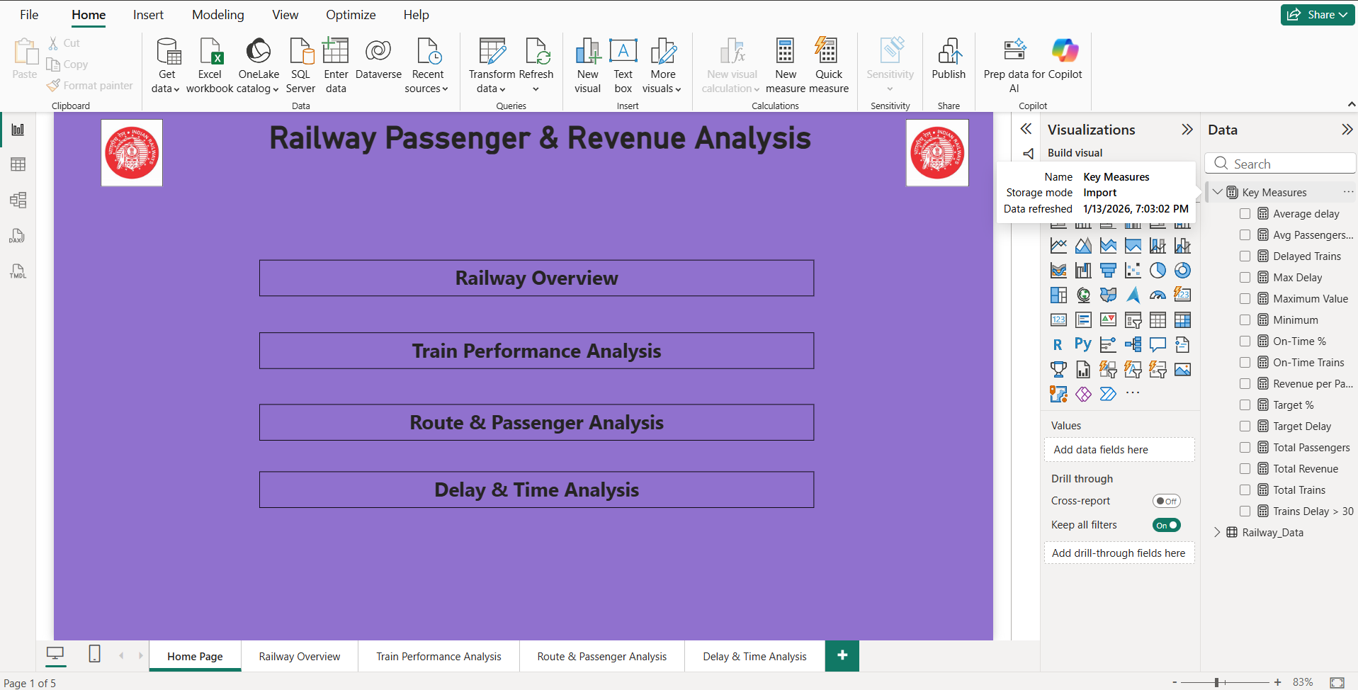
Home Page – Navigation Dashboard
This is the Home Page of the dashboard.
It is used only for navigation.
Buttons are provided to move to:
- Railway Overview
- Train Performance Analysis
- Route & Passenger Analysis
- Delay & Time Analysis
This makes the dashboard easy to use.

Slide 10
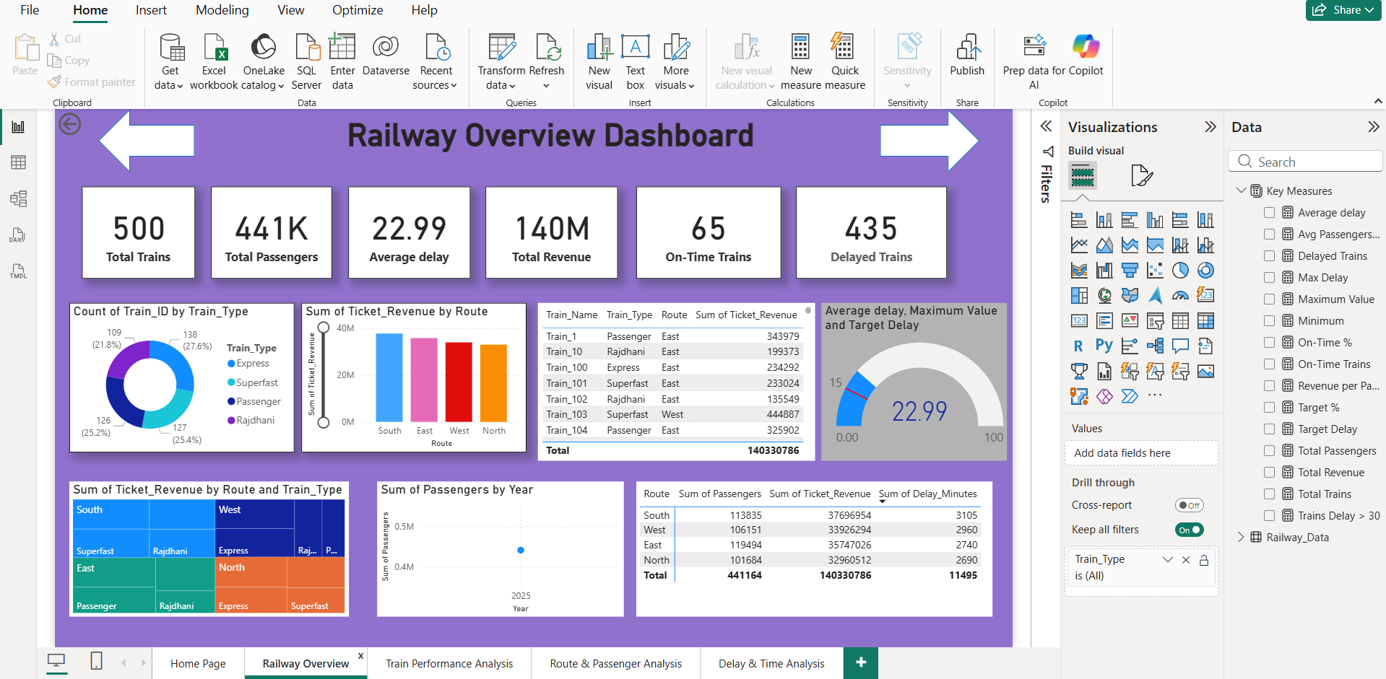
Railway Overview Dashboard
KEY MEASURES (CARDS):
- Total Trains: Total number of trains
- Total Passengers: Total passengers traveled
- Average Delay: Average delay time in minutes
- Total Revenue: Total ticket revenue
- On-Time Trains: Trains running on time
- Delayed Trains: Trains that are delayed
These cards give a quick summary of railway performance.

Slide 11
Railway Overview – Charts Explanation
1. Donut Chart: Shows number of trains by Train Type (Express, Passenger, Superfast, Rajdhani).
2. Bar Chart: Shows Ticket Revenue by Route (North, South, East, West).
3. Table: Shows Train Name, Train Type, Route, and Revenue.
4. Gauge Chart: Shows Average Delay compared with Target Delay.
5. Treemap: Shows contribution of Revenue by Route and Train Type.
6. Line Chart: Shows trend of Passengers by Year.

Slide 12
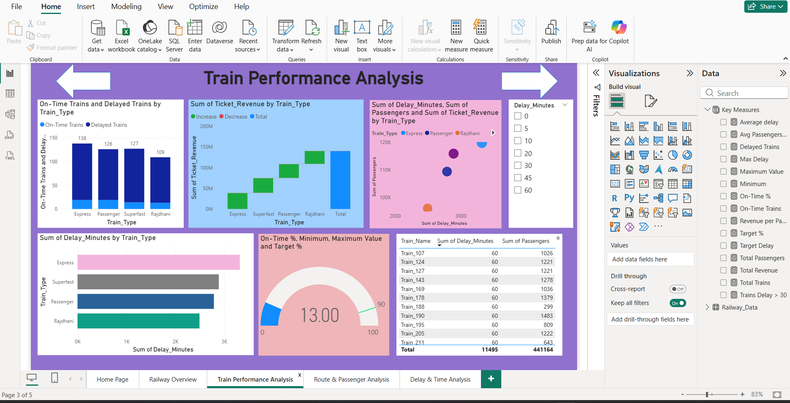
Train Performance Analysis Dashboard
This page focuses on train performance.
Charts Explanation:
- Stacked Column Chart: Compares On-Time and Delayed trains by Train Type.
- Waterfall Chart: Shows Ticket Revenue contribution by each Train Type.
- Scatter Chart: Shows relationship between Delay Minutes, Passengers, and Revenue.
- Bar Chart: Shows total Delay Minutes by Train Type.
- Gauge Chart: Shows On-Time Percentage with Target.
- Table: Shows Train-wise Delay Minutes and Passengers.

Slide 13
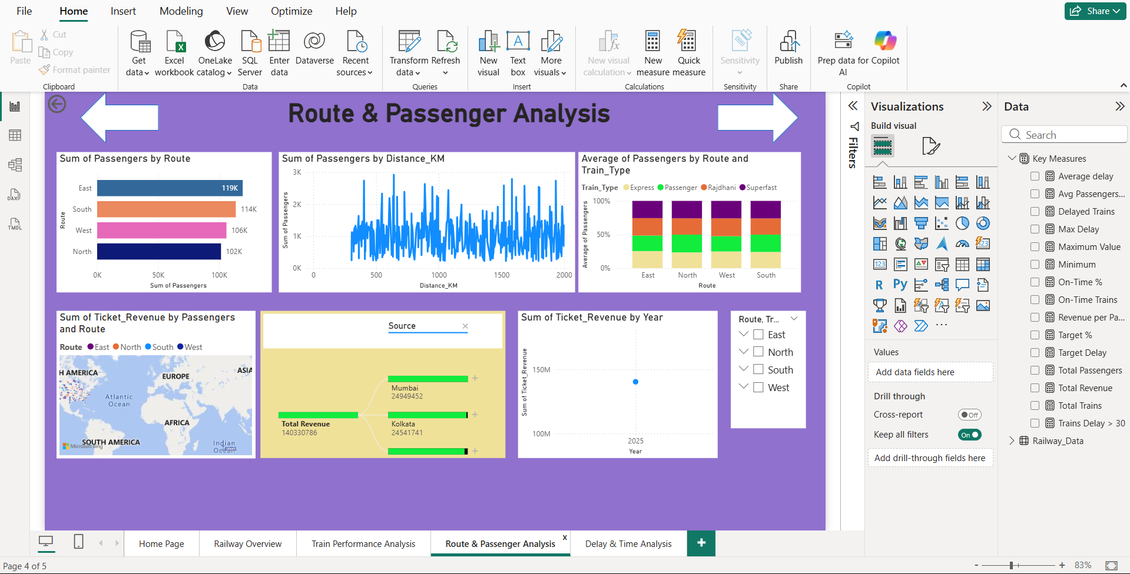
Route & Passenger Analysis Dashboard
This page analyzes routes and passengers.
Charts Explanation:
- Bar Chart: Shows total Passengers by Route.
- Line Chart: Shows Passengers by Distance (KM).
- 100% Stacked Column Chart: Shows average passengers by Route and Train Type.
- Map Chart: Shows Ticket Revenue by Route.
- Decomposition Tree: Shows how Total Revenue is divided by Source.
- Line Chart: Shows Ticket Revenue trend by Year.
- Slicers: Used to filter Route and Train Type.

Slide 14
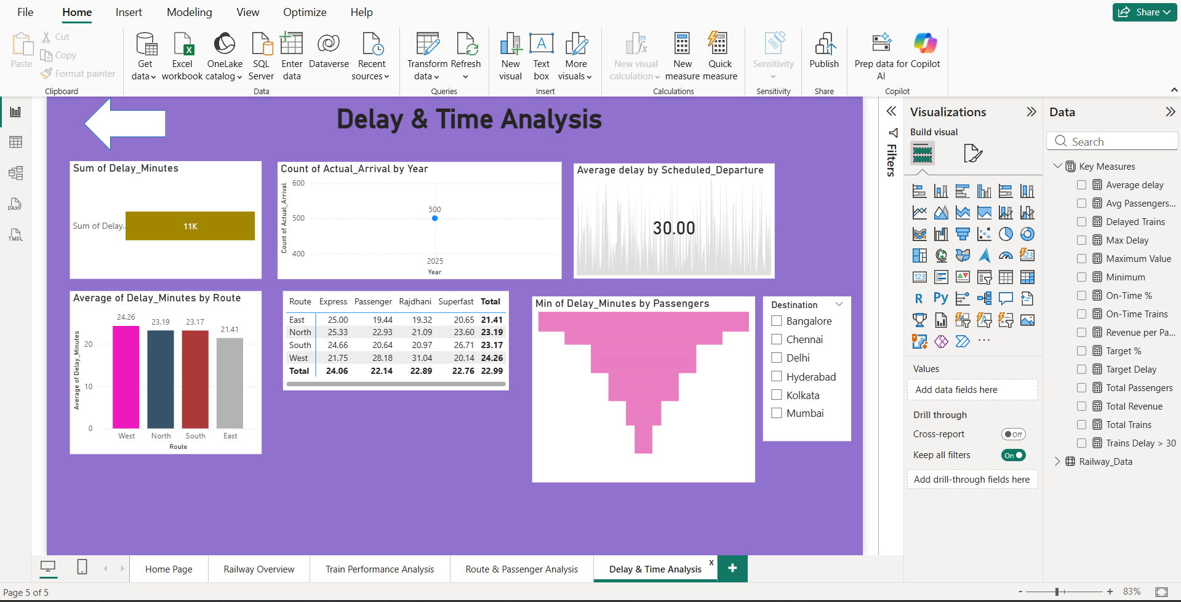
Delay & Time Analysis Dashboard
This page focuses on delay analysis.
Charts Explanation:
- Card: Shows total Delay Minutes.
- Line Chart: Shows count of arrivals by Year.
- KPI Visual: Shows Average Delay.
- Column Chart: Shows Average Delay by Route.
- Matrix: Shows Delay by Route and Train Type.
- Funnel Chart: Shows minimum delay based on Passengers.
- Destination Slicer: Filters data by city.

Slide 15
How Key Measures Are Added
Steps to create a Key Measure:
Go to Modeling → New Measure
Write DAX formula Example:
Total Passengers = SUM(Railway[Passengers])

Slide 16
Key Insights
1️⃣ Train Operations Overview
The dashboard shows the overall number of trains, passengers, routes, and total revenue.
It gives a quick snapshot of railway performance using KPI cards.
2️⃣ Revenue Performance
Superfast and Express trains generate higher revenue compared to Passenger trains.
Some routes contribute more revenue, indicating high-demand corridors.
3️⃣ Passenger Analysis
Routes with longer distance generally carry more passengers.
Average passengers per train helps identify trains with high and low occupancy.

Slide 17
4️⃣ Delay Analysis
A large percentage of trains run on time, but some experience delays.
Delays above 30 minutes are fewer but have a high operational impact.
Certain routes show higher average delays, indicating areas for improvement.
5️⃣ Train Performance
On-time performance varies by train type.
Rajdhani and Superfast trains show better punctuality compared to others.
6️⃣ Route Efficiency
Some routes have high passenger volume but lower revenue, suggesting lower ticket pricing.
Routes with high revenue per train indicate better efficiency.
7️⃣ Decision-Making Support
The dashboard helps management to:
Improve punctuality
Optimize routes and schedules
Increase revenue and passenger satisfaction

Slide 18
Conclusion
This Railway Power BI project helps us understand railway operations in a simple and visual way. By using charts, key measures, and filters, we can easily analyze train performance, passengers, revenue, and delays.
The dashboard gives:
A clear overview of overall railway performance
Easy comparison between routes, train types, and time periods
Quick insights using key measures like total passengers, revenue, and average delay
Filters and slicers make the dashboard interactive and user-friendly. This project shows how Power BI can turn raw data into meaningful information and help management take better decisions.
Overall, this project demonstrates good understanding of Power BI, DAX measures, and data visualization.

Slide 19
Thank You for your precious time..

