Slide 1
Streamlit

Slide 2
What is Streamlit?
Streamlit is an open-source Python framework used to create interactive web applications for Data Science, Machine Learning, AI, dashboards, and data visualization using only Python code.
You do not need:
HTML
CSS
JavaScript
React
With Streamlit, you can convert a Python script into a web app very quickly.

Slide 3
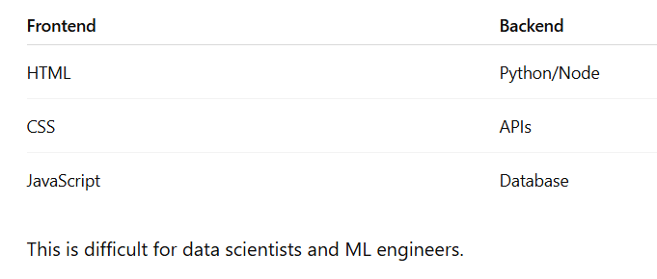
Why Streamlit is Popular
Traditional Web Development
Normally, creating a web app requires:

Slide 4
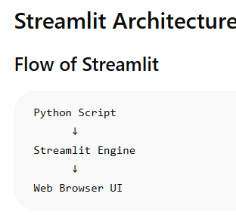
Installation
pip install streamlit
To run use
streamlit run app.py

Slide 5
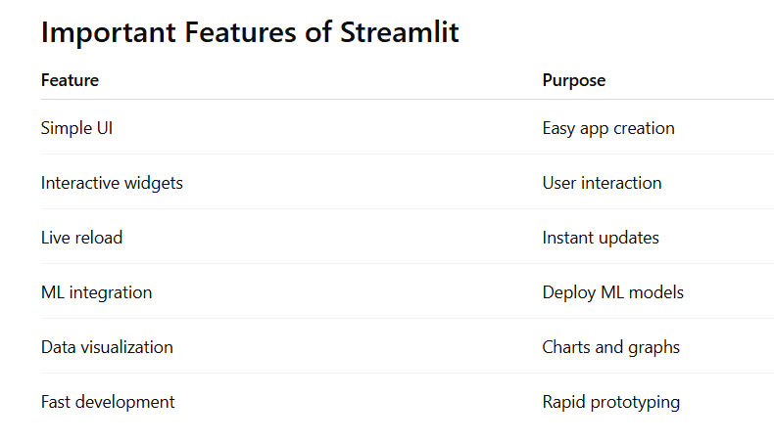

Slide 6
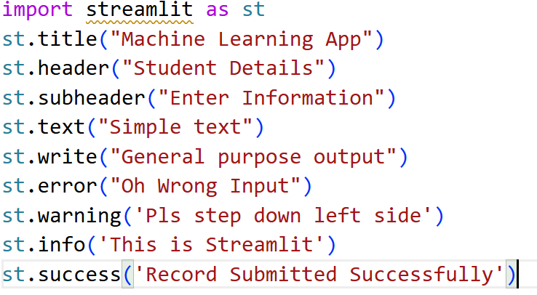
Basic Components

Slide 7
Markdown
st.markdown("# Welcome to Streamlit")
st.markdown("# Heading 1") st.markdown("## Heading 2") st.markdown("### Heading 3")
st.markdown("**Bold Text**") st.markdown("*Italic Text*")
List
st.markdown(""" - Python - Streamlit - Machine Learning """)
st.markdown(""" 1. Install Streamlit 2. Create App 3. Run App """)
st.markdown( "<h1 style='color:red'>Hello</h1>", unsafe_allow_html=True )

Slide 8
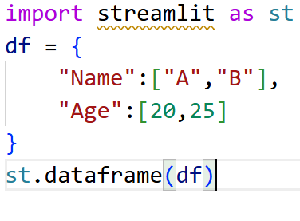
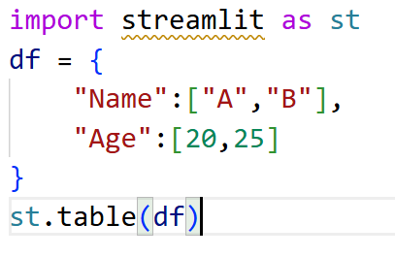
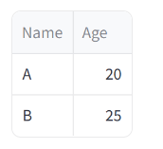
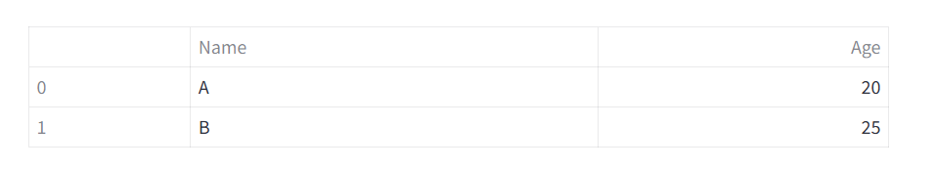
Dataframe & Table

Slide 9
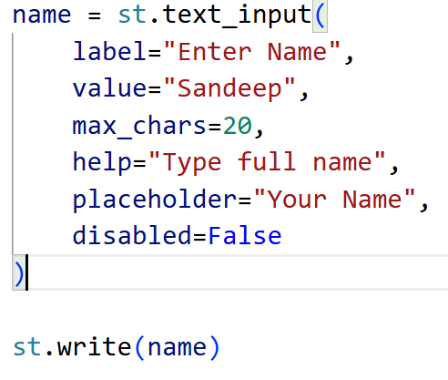
text_input
Syntax
st.text_input(
label,
value="",
max_chars=None,
key=None,
type="default/password",
help=None,
autocomplete=None/email/name/password,
on_change=None,
args=None,
kwargs=None,
placeholder=None,
disabled=False,
label_visibility="visible/hidden"
)

Slide 10
st.number_input( label, min_value=None, max_value=None, value="min", step=None, format=None, key=None, help=None, on_change=None, args=None, kwargs=None, placeholder=None, disabled=False, label_visibility="visible" )

Slide 11
TextArea
st.text_area(
label,
value="",
height=None,
max_chars=None,
key=None,
help=None,
on_change=None,
args=None,
kwargs=None,
placeholder=None,
disabled=False,
label_visibility="visible"
)

Slide 12
Button
st.button( label, key=None, help=None, on_click=None, args=None, kwargs=None, type=“primary/secondary", disabled=False, use_container_width=False )

Slide 13
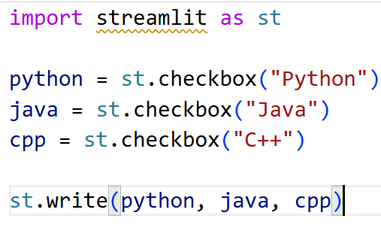
CheckBox
st.checkbox(
label,
value=False,
key=None,
help=None,
on_change=None,
args=None,
kwargs=None,
disabled=False,
label_visibility="visible"
)

Slide 14
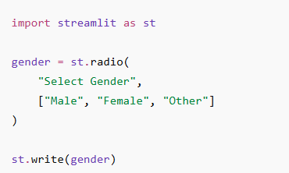
RadioButton
st.radio(
label,
options,
index=0,
format_func=str,
key=None,
help=None,
on_change=None,
args=None,
kwargs=None,
disabled=False,
horizontal=False,
captions=None,
label_visibility="visible"
)

Slide 15
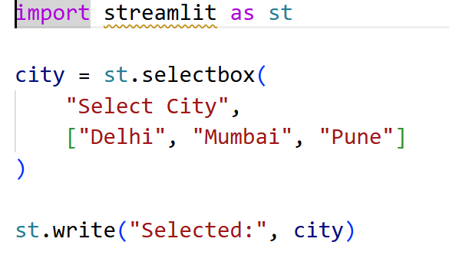
SelectBox
st.selectbox(
label,
options,
index=0,
format_func=str,
key=None,
help=None,
on_change=None,
args=None,
kwargs=None,
placeholder=None,
disabled=False,
label_visibility="visible"
)

Slide 16
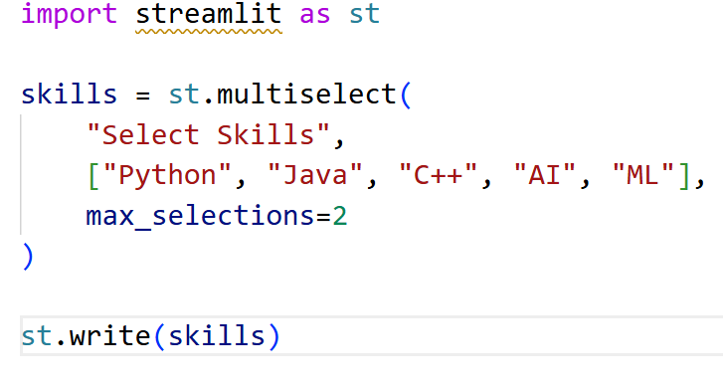
Multiselect
st.multiselect(
label,
options,
default=None,
key=None,
help=None,
max_selections=None,
placeholder=None
)

Slide 17
File Upload
st.file_uploader(
label,
type=None,
accept_multiple_files=False
)

Slide 18
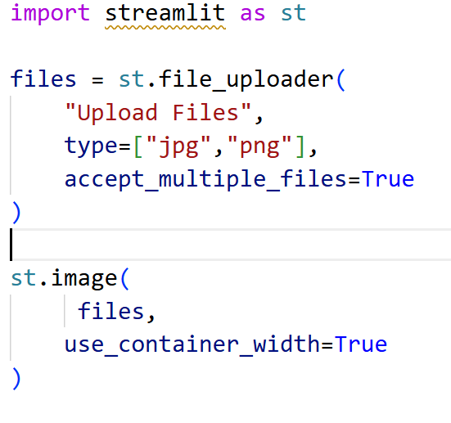
Image
st.image(
image,
caption=None,
width=None,
use_container_width=True/False,
clamp=False/True,
channels="RGB/BGR",
output_format="auto"
)

Slide 19
Audio
import streamlit as st audio_file = open("song.mp3", "rb") audio_bytes = audio_file.read() st.audio(audio_bytes, format="audio/mp3", start_time=0)

Slide 20
Example Audio
import streamlit as st
uploaded_file = st.file_uploader(
"Upload Audio",
type=["mp3", "wav"]
)
if uploaded_file is not None:
st.audio(uploaded_file)

Slide 21
Play .Wav
import streamlit as st audio_file = open("voice.wav", "rb") audio_bytes = audio_file.read() st.audio(audio_bytes, format="audio/wav")

Slide 22
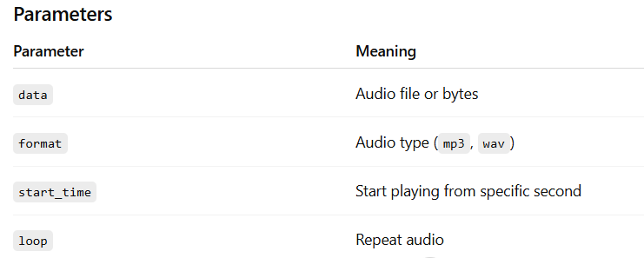

Slide 23
Play Video
import streamlit as st video_file = open("movie.mp4", "rb") video_bytes = video_file.read() st.video(video_bytes)

Slide 24
Example
import streamlit as st uploaded_video = st.file_uploader( "Upload Video", type=["mp4", "mov", "avi"] ) if uploaded_video is not None: st.video(uploaded_video)

Slide 25
Play URL
import streamlit as st st.video("https://www.youtube.com/watch?v=dQw4w9WgXcQ")

Slide 26
Columns
import streamlit as st
col1, col2,col3,col4 = st.columns(4)
with col1:
st.image("https://picsum.photos/200", width=200)
with col2:
st.image("https://picsum.photos/201", width=200)
with col3:
st.image("https://picsum.photos/200", width=200)
with col4:
st.image("https://picsum.photos/201", width=200)

Slide 27
Dialog
import streamlit as st
@st.dialog("Login Form")
def login_dialog():
st.text_input("Username")
st.text_input("Password", type="password")
if st.button("Login"):
st.success("Login Successful")
if st.button("Open Dialog"):
login_dialog()

Slide 28
Dialog
import streamlit as st
@st.dialog("Delete Confirmation")
def confirm_delete():
st.warning("Are you sure you want to delete?")
col1, col2 = st.columns(2)
with col1:
if st.button("Yes"):
st.success("Deleted")
with col2:
if st.button("No"):
st.info("Cancelled")
if st.button("Delete File"):
confirm_delete()

Slide 29
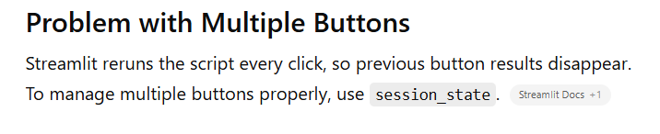
Session(Button Without Session)
import streamlit as st
if st.button("Button 1"):
st.write("Button 1 clicked")
if st.button("Button 2"):
st.write("Button 2 clicked")
if st.button("Button 3"):
st.write("Button 3 clicked")

Slide 30
Button Using Session
import streamlit as st
# Initialize state
if "btn1" not in st.session_state:
st.session_state.btn1 = False
if "btn2" not in st.session_state:
st.session_state.btn2 = False
# Functions
def click_btn1():
st.session_state.btn1 = True
def click_btn2():
st.session_state.btn2 = True
# Buttons
st.button("Show Python", on_click=click_btn1)
st.button("Show Java", on_click=click_btn2)
# Output
if st.session_state.btn1:
st.success("Python Selected")
if st.session_state.btn2:
st.success("Java Selected")

Slide 31
Sidebar Navigation
import streamlit as st
st.sidebar.title("Navigation")
page = st.sidebar.radio(
"Go To",
["Home", "Courses", "Students", "About"]
)
if page == "Home":
st.title("Home Page")
elif page == "Courses":
st.title("Courses Page")
elif page == "Students":
st.title("Students Page")
elif page == "About":
st.title("About Us")

Slide 32
Horizontal Navigation Bar
import streamlit as st
tab1, tab2, tab3 = st.tabs(
["Home", "Employee", "Product"]
)
with tab1:
st.header("Home")
with tab2:
st.header("Employee")
with tab3:
st.header("Product")

Slide 33
Option Menu
import streamlit as st
from streamlit_option_menu import option_menu
# pip install streamlit_option_menu
selected = option_menu(
menu_title=None,
options=["Home", "Employee", "Product", "Contact"],
icons=["house", "people", "box", "telephone"],
orientation="horizontal"
)
if selected == "Home":
st.title("Home Page")
elif selected == "Employee":
st.title("Employee Page")
elif selected == "Product":
st.title("Product Page")
elif selected == "Contact":
st.title("Contact Page")

Slide 34
Pill
import streamlit as st
page = st.pills(
"Select Page",
["Home", "Employee", "Student", "Reports"]
)
st.write(page)

Slide 35
Switch Page
import streamlit as st
# create pages folder first if st.button("Go to About"):
st.switch_page(r"pages/ex.py")

Slide 36
Page Link
import streamlit as st
st.title("Navigation Example")
st.page_link("pages/AddRecord.py", label=“Add New")
st.page_link("pages/ShowRecord.py", label=“Show All")

