Slide 1
SAGAR SETU
An agentic, evidence-grounded marine advisory system
for Indian small-craft fishermen
GO
CAUTION
DO NOT SAIL
Harshvardhan Singh · Supervisor: Ms. Anusha Chhabra · Mid-term review, 13 October 2026
ISRO / INCOIS agentic marine intelligence problem statement · Smart India Hackathon 2026
Notes:
Sagar Setu: 'bridge to the sea'. One sentence — a fisherman asks in his own language and gets a safety decision built from official data, where the AI explains the decision but never makes it. Today's structure follows the review criteria: problem, literature survey, research gap, objectives, methodology.

Slide 2
Introduction and problem definition
PROBLEM DEFINITION
Context
Problem statement
About 4 million people depend on marine fishing in India; most work boats under 12 m — no radar, little offshore signal.
One decision a day, made before dawn: go, or stay. Wrong one way costs a day's income; wrong the other way can cost the boat and crew.
Three questions arrive together: Is it safe? Where are the fish? Where is the maritime border?
India already publishes the answer to each — in three separate products, as maps and bulletins.
Given a free-form question in any of India's scheduled languages, produce a single, trustworthy operational answer — safety verdict, fishing guidance and boundary warning together — derived verifiably from official marine data, fast enough to use before a boat leaves, and degrading honestly when sources fail.
Constraint: the language model must never be the component that decides whether it is safe to go to sea.
The gap is not data. It is the last step between a government portal and a fisherman on a beach at 4 a.m.
Notes:
Context on the left, the formal problem statement on the right. Read the constraint aloud — it shapes every design decision that follows.

Slide 3
Literature survey I — the fisherman's needs
LITERATURE 1 / 2
Study | Contribution | Method / data | Key finding | Limitation for our problem
Kurup et al., 2024 Weather 79(7) [1] | Localised coastal wind forecasts for artisan fishers, Kerala | WRF model downscaled to a 5 km grid; forecasts issued per 25 × 25 km zone | Localised forecasts complement official ones issued for large ocean areas | Forecasts wind only; turning it into a go / no-go call is left to the fisher
Sarangi et al., 2024 Environ. Monit. Assess. 196 [2] | Multi-parameter fishing-zone generation, western Bay of Bengal | Chlorophyll, SST fronts, winds, currents, Ekman transport, eddies; FSI catch data 2016–18 | Chlorophyll correlates most with catch, then fronts and eddies | A zone map only — not linked to safety, the boat or the border
Saka et al., 2021 MTS Journal 55(3) [3] · Thoondil | Fisher safety app run by Tamil Nadu Fisheries | Android app: offline maps to nearest port, weather, PFZ, incident reports; web-GIS boat tracking | Operational, local language, 15,000+ downloads in months | Menu screens; no free-form questions; no go / no-go verdict described
Anabel et al., 2018 CSI Trans. ICT 6(3–4) [4] · Fisher Friend | Decision-support app for small-scale fishers (MSSRF, INCOIS) | PFZ with GPS, ocean-state forecasts, danger-zone and disaster alerts, market prices | Multilingual one-stop delivery works in practice | The fisher reads and combines each screen himself; no source shown per number
The data and the delivery channels exist. Every system still leaves the fisherman to combine the pieces and make the call himself.
Notes:
Four studies on what the fisherman needs. Kurup: better local wind forecasts, but the decision is still his. Sarangi: fishing zones done properly need six satellite parameters and catch validation — which is why we consume INCOIS's PFZ product. Thoondil and Fisher Friend are the closest existing systems: real, operational, local-language — but menu screens, no question answering, no verdict. Read the red column.

Slide 4
Literature survey II — the border and the AI
LITERATURE 2 / 2
Study | Contribution | Method / data | Key finding | Limitation for our problem
Vincent, 2020 Maritime Affairs 16(2) [5] | Analysis of the Palk Bay fishing conflict | Governance analysis of fishing across the India–Sri Lanka IMBL | The problem is recurring; argues for joint Indo–Sri Lankan governance | No aid to the fisherman — the boundary stays invisible at sea
Lewis et al., 2020 NeurIPS 33 [6] · RAG | Retrieval-augmented generation | Language model combined with a dense retriever over Wikipedia | Retrieved evidence improves factual answers and provenance | Grounds in text, not live numbers; no guarantee every claim is supported
Niu et al., 2024 ACL 2024 [7] · RAGTruth | Hallucination corpus for retrieval-augmented models | ~18,000 responses from many LLMs, annotated word by word | Unsupported content persists even with the right evidence retrieved | Retrieval is not enough — the safety call must stay out of the model
Gala et al., 2023 TMLR [8] · IndicTrans2 | Open translation for all 22 scheduled languages | BPCC corpus of 230 M sentence pairs; IN22 benchmark | First model to cover all 22 languages | Translation is solved; no fisher system offers conversation in it
Retrieval makes a trustworthy assistant possible; RAGTruth shows it is not sufficient. So our model never makes the safety call.
Notes:
Vincent establishes the border problem is structural — we do not solve the politics, only the fisherman's need to see the line. RAG is the principle: tomorrow's waves must be fetched, not remembered. RAGTruth is the key paper: even with the right data retrieved, models still produce unsupported content. That single finding justifies both research choices — fixed rules for the verdict, and a mechanical number checker.

Slide 5
Research gap — comparative analysis
RESEARCH GAP
Work | Small-boat safety info | Fishing zones | Border awareness | Indian languages | Answers a question | Go / no-go by fixed rules | Every number verified
Kurup et al. [1] | ✓ (wind) | ✗ | ✗ | — | ✗ | ✗ | ✗
Sarangi et al. [2] | ✗ | ✓ | ✗ | ✗ | ✗ | ✗ | ✗
Thoondil — Saka et al. [3] | ✓ | ✓ | — | ✓ | ✗ | ✗ | ✗
Fisher Friend — Anabel et al. [4] | ✓ | ✓ | partial | ✓ | ✗ | ✗ | ✗
RAG systems [6] [7] | ✗ | ✗ | ✗ | partial | ✓ | ✗ | ✗
IndicTrans2 [8] | ✗ | ✗ | ✗ | ✓ | ✗ | ✗ | ✗
Sagar Setu (proposed) | ✓ | ✓ | ✓ | ✓ | ✓ | ✓ | ✓
✓ addressed · ✗ not addressed · — not described in the source. Vincent [5] analyses the boundary problem but proposes no tool.
We found no published system that lets a fisherman ask one question in his own language and receive a single operational decision — safety, fishing and border together — derived verifiably from official data rather than generated by a model.
Notes:
Every row is a study from the two survey slides. Each covers one or two columns. Thoondil and Fisher Friend come closest — safety information, fishing zones, local language — but neither answers a question, issues a verdict from fixed rules, or verifies its numbers. RAG systems answer questions, but RAGTruth shows they cannot be trusted with the numbers. Nobody has the bottom row.

Slide 6
Research gaps and objectives
GAP → OBJECTIVES
Gap identified in the literature | Evidence | Objective
G1 Fragmentation — weather, fishing zones and the border are separate studies and separate screens | [1]–[5] | O1 Integrate all three behind one conversational interface that accepts a question
G2 Menu-driven apps — no system accepts a free-form question | [3] [4]
G3 Local-language content exists, but not conversation | [3] [4] [8] | O4 End-to-end question answering in Indian languages, Tamil and Hindi first
G4 Retrieval grounds answers, yet hallucination persists | [6] [7] | O3 Evidence ledger per observation; a verifier that deletes any unsupported number
G5 No system keeps the safety call out of the model | [6] [7] | O2 Deterministic, unit-tested safety verdict, structurally outside the model
G6 Validation stops at the forecast or the zone, never the decision | [1] [2] | O6 Evaluate the verdict itself with POD, FAR and CSI [10]
C Connectivity at sea is unreliable — Thoondil ships offline maps for this reason | [3] | O5 Cache → live → stale cache → snapshot, always declaring degradation
O2 and O3 are the research contribution. The rest is engineering that makes them usable.
Notes:
Each gap traces to evidence on the survey slides, and each maps to one objective. G4 and G5 come straight from RAGTruth: if retrieval cannot guarantee the numbers, the model must not make the safety call, and every number must be checked mechanically.

Slide 7
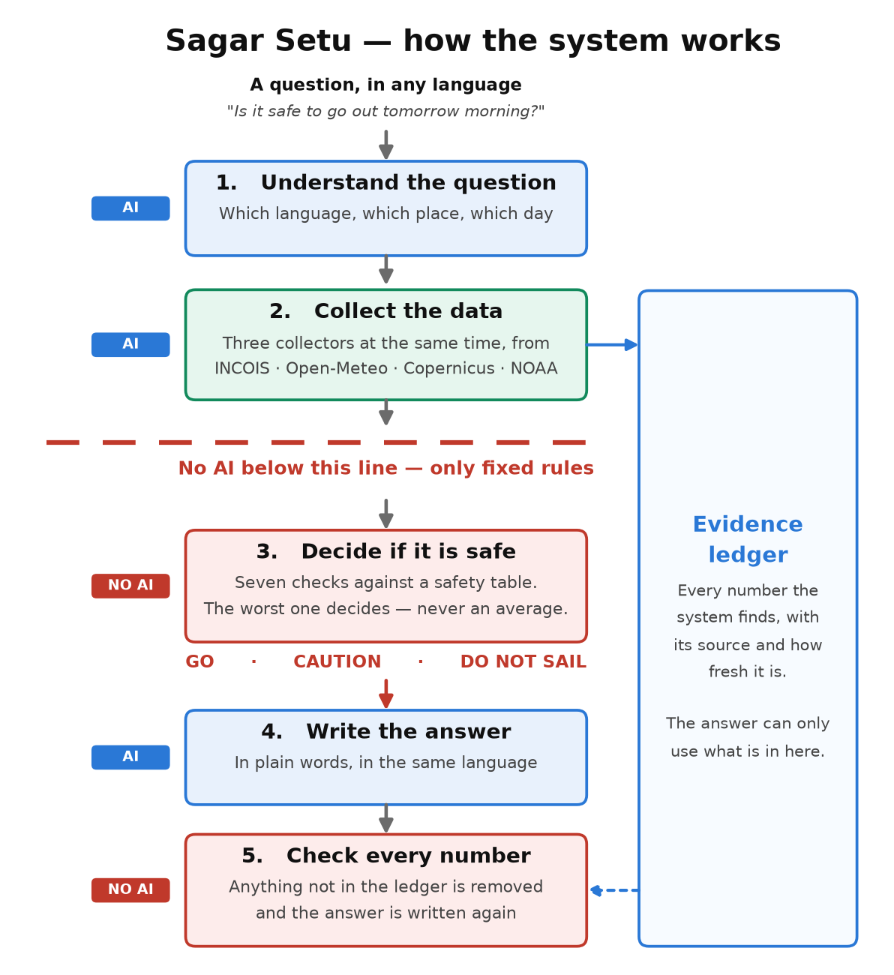
Methodology I — architecture and techniques
METHODOLOGY
Step | Technique | Model?
1 Understand | LLM planner emits a typed task DAG (Pydantic schema, validated, one retry) | AI
2 Collect | LangGraph parallel superstep: ocean & weather, geospatial & boundary, analytics. Async fetch; cache → live (2 s) → stale → snapshot | NO AI
3 Decide | Deterministic rule engine: 7 parameters × 3 vessel classes; worst parameter wins, never an average; < 50 ms | NO AI
4 Explain | LLM writes the answer in the user's language from a structured brief | AI
5 Verify | Every number extracted (Latin and Indic digits) and matched to the ledger; unsupported → stripped and regenerated | NO AI
Evidence ledger. No tool returns a bare number. Every value is an Observation — value, unit, source, valid time, fetch time, distance to the query point, confidence, note. About 130 per question, shown to the user beneath every answer.
Notes:
Left: the five steps and the technique used at each. Right: the same pipeline as a diagram — blue is AI, red is no AI. The red dashed line is the design: below it there is no model at all. The ledger is what makes step 5 possible.

Slide 8
Methodology II — dataset and tools
METHODOLOGY · DATASET
Source | Variables used | Format | Access | Status
Open-Meteo Marine | Wave height, period, direction; swell; currents; SST | JSON, hourly, 7 d past + 8 d ahead | Free, no key | ✓ Live — primary
Open-Meteo Weather | Wind, gusts, visibility, thunderstorm code, CAPE | JSON, hourly | Free, no key | ✓ Live
INCOIS PFZ (GeoServer WFS) | Daily Potential Fishing Zone advisory lines, by sector | GeoJSON, daily | Open | ✓ Live
INCOIS static layers | 14 PFZ sectors; 1,223 named landing centres | GeoJSON | Open | ✓ Committed
Marine Regions (VLIZ) | India EEZ polygon; boundary lines incl. IMBL | GeoJSON | Open | ✓ Committed
NOAA CoastWatch (VIIRS) | Chlorophyll-a | ERDDAP grid | Open | ✓ Live
Copernicus Marine | Chlorophyll-a (BGC_001_028); physics (PHY_001_024) | NetCDF | Free account | ✓ Account active
IMD API | Cyclone track, lightning, district warnings | — | API key | ✗ Blocked (401)
INCOIS ERDDAP | SST and chlorophyll archive | NetCDF | Open | ✗ Stale (SST ends 2011)
Derived datasets
Frozen 7-day snapshot × 5 harbours + Gulf of Mannar (offline fallback). Evaluation set: 92 days × 5 harbours of archived forecasts.
Tools
Python 3.11 · Pydantic · LangGraph · FastAPI + SSE · httpx (async) · xarray / netCDF4 · Shapely · pytest · React + Vite + MapLibre GL · Gemini (free tier)
Notes:
Every source was tested live from this laptop before any code was written against it — documented in docs/data-sources.md. Be upfront about the two red rows: IMD needs an API key (a letter on college letterhead), and INCOIS's open ERDDAP archive is stale. Total cost of every source: zero.

Slide 9
Evaluation method and preliminary results
PROGRESS
Method
93.9 %
3.1 %
0
Prediction: verdict from the forecast available the evening before.
Truth: verdict from the same model's analysis of that morning.
Sample: 92 mornings × 5 harbours = 460, 2026 monsoon.
Metrics: POD, FAR, CSI from the 2×2 contingency table [10].
hit rate (POD)
false-alarm ratio
misses graded GO
dangerous mornings that were warned, one day ahead
warnings that wasted a good day
both misses were graded CAUTION
Forecast lead | Warned (of 33) | Hit rate (POD) | False alarms | False-alarm ratio | CSI (overall skill)
1 day ahead | 31 of 33 | 93.9 % | 1 | 3.1 % | 91.2 %
2 days ahead | 32 of 33 | 97.0 % | 7 | 17.9 % | 80.0 %
3 days ahead | 30 of 33 | 90.9 % | 13 | 30.2 % | 65.2 %
Only 33 dangerous mornings: one morning ≈ 3 points of hit rate. The 2-day “rise” is one extra catch, bought with 6 more false alarms.
Limitation: truth is model analysis, not a buoy measurement — these figures are an upper bound on real skill.
Status: phases 1–4 of 6 complete · 115 unit tests · ₹0 cost. Needed: IMD API key (college letter) · INCOIS small-craft criteria · INCOIS/NIOT buoy data.
Notes:
The professor asked last time how often we are right — this is the answer. Stress the asymmetry: the misses fell to caution, never to go. The table shows skill falling with lead time, mainly through false alarms, which is why the day-ahead verdict is the decision. State the limitation before it is asked. Close on the three needs, leading with the IMD letter.

Slide 10
References
Literature reviewed
[1] P. H. Kurup, S. Abhilash, S. Mavath, V. K. Mini, N. Alamirew and M. Martin, “Validation of localised coastal wind forecasts for artisan fishers of southwestern India,” Weather, 79(7), 231–241, 2024.
[2] R. K. Sarangi, M. Jishad, R. Sharma et al., “Multiple ocean parameter-based potential fishing zone (PFZ) location generation and validation in the Western Bay of Bengal,” Environ. Monit. Assess., 196, 98, 2024.
[3] S. K. Saka, A. E. Mathew, V. Ganesh et al., “A Web-GIS and mobile-based application for a safe ocean for fishers,” Marine Technology Society Journal, 55(3), 50–57, 2021.
[4] N. J. Anabel, S. Velvizhi and D. Suvitha, “Fisher Friend Mobile Application: a decision support system for small scale fishers in India,” CSI Transactions on ICT, 6(3–4), 257–267, 2018.
[5] S. Vincent, “Palk Bay fishing problem requires Indo-Sri Lankan joint-governance,” Maritime Affairs, 16(2), 71–88, 2020.
[6] P. Lewis, E. Perez, A. Piktus et al., “Retrieval-augmented generation for knowledge-intensive NLP tasks,” NeurIPS 33, 9459–9474, 2020.
[7] C. Niu, Y. Wu, J. Zhu et al., “RAGTruth: A hallucination corpus for developing trustworthy retrieval-augmented language models,” ACL 2024, 10862–10878.
[8] J. Gala, P. A. Chitale, R. AK et al., “IndicTrans2: Towards high-quality and accessible machine translation models for all 22 scheduled Indian languages,” TMLR, 2023.
Methodology references
[9] INCOIS, “Small Vessel Advisory and Forecast Services (SVAS),” incois.gov.in/portal/osf/SVA_overview.jsp
[10] I. T. Jolliffe and D. B. Stephenson, Forecast Verification: A Practitioner's Guide in Atmospheric Science, 2nd ed., Wiley-Blackwell, 2012.
Notes:
Every reference was checked against its publisher or DOI record. Leave this slide on screen during questions.

