Slide 1


Army Institute of Technology Pune
Department of Information Technology
Course Name :Community Engagement Project
Course Code: BIT25437A0B
Project Title: Inclusive Crowdsourcing: A Multilingual, SMS/Voice-Based Framework for Bridging Accessibility Gaps in Disaster Data Collection
Submitted by: Raj Karshnia (4240), Harshwardhan (4223), Harmannat (4221), Himanshu (4224)
Guide: Prof. Priya Nerkar
Academic Year: 2026-2027
Class: Second Year B. Tech (Division: A)

Slide 2
Army Institute of Technology Pune
Department of Information Technology
Contents:
Introduction
Literature Survey & Findings
Project Title
Objectives
Proposed Methodology
Implementation
Result Analysis
Conclusion

Slide 3
Army Institute of Technology Pune
Department of Information Technology
Introduction:
Disaster response increasingly relies on crowdsourced data — citizen reports, social media and volunteered geographic information (VGI).
Most existing systems are built around English, Twitter-centric, smartphone inputs.
Yet many residents of flood-prone areas speak Marathi or Hindi, use basic phones, or have low digital literacy — so they go unheard.
The most vulnerable (elderly, rural, low-income) are often the least represented in the very data meant to help them.
Our project builds an inclusive, multilingual, SMS/voice-ready reporting framework, implemented as the working prototype AwaazSetu for Pune.

Slide 4
Army Institute of Technology Pune
Department of Information Technology
Literature Survey & Findings : (Survey 1 of 4)
Sr. No | Downloaded Paper title with link | Details of paper (year of publication /Journal name) | Findings of Paper (Min 4 in bullet points)
1. | Unpacking the role of volunteered geographic information in disaster management: focus on data quality https://www.tandfonline.com/doi/full/10.1080/19475705.2023.2300825 | Year: 2023 Taylor & Francis Review paper | VGI and citizen science are related but distinct concepts Combined bibliometric and text-mining methodology Five thematic clusters in data-quality literature VGI quality challenges mapped onto the PPRR disaster cycle
2. | A method for assessing the credibility of volunteered geographic information in case of flood crisis https://www.sciencedirect.com/science/article/pii/S1877050922011012 | Year: 2022 ScienceDirect Technology paper | Score-based credibility model for text- and map-based VGI Uses distance, flood hazard and spatial clustering Validated on Ushahidi reports from the 2013 Brisbane flood Reports classed high/low credibility against ground truth
3. | Analysis of Mumbai floods in recent years with crowdsourced data https://www.sciencedirect.com/science/article/abs/pii/S2212095524000117 | Year: 2024 ScienceDirect Technology paper | Urban flooding drivers and impacts Gaps in traditional flood monitoring Crowdsourced data as a solution Choice and challenges of Twitter as a source

Slide 5
Army Institute of Technology Pune
Department of Information Technology
Literature Survey & Findings : (Survey 2 of 4)
Sr. No | Downloaded Paper title with link | Details of paper (year of publication /Journal name) | Findings of Paper (Min 4 in bullet points)
1. | Opportunities for Crowdsourcing in Urban Flood Monitoring https://doi.org/10.1016/j.envsoft.2021.105124 | 2021 Environmental Modelling & Software (Elsevier) | Reviews crowdsourced flood-monitoring sources Examines webcams, social media and citizen science Shows potential for fine-scale flood monitoring Identifies data quality and integration challenges
2. | Integrating User-Generated Content to Track Urban Flooding Hotspots and Foster Emergency Management: A Case Study in Central China https://doi.org/10.1111/tgis.12836 | 2021 Transactions in GIS (Wiley) | Uses UGC to identify flood hotspots Applies crawlers, NLP and geographic visualisation Validates with water level, DEM and rainfall Supports flood emergency management
3. | Quality Assessment of Crowdsourced Social Media Data for Urban Flood Management https://doi.org/10.1016/j.compenvurbsys.2021.101690 | 2021 Computers, Environment and Urban Systems (Elsevier) | Assesses quality of crowdsourced data Uses flood-related Twitter data Applies logistic regression and fuzzy logic Estimates uncertainty in social media observations

Slide 6
Army Institute of Technology Pune
Department of Information Technology
Literature Survey & Findings : (Survey 3 of 4)
Sr. No | Downloaded Paper title with link | Details of paper (year of publication /Journal name) | Findings of Paper (Min 4 in bullet points)
1. | Deep Learning Methods for Flood Mapping https://hess.copernicus.org/articles/26/4345/2022/ | 26 Aug 2022 Hydrology and Earth System Sciences (Copernicus) | Reviewed 58 studies using CNNs and RNNs Faster detection of complex flood patterns Poor performance in new regions without retraining Transfer learning suggested for global use
2. | Machine Learning for Disaster Prediction and Preparedness https://www.frontiersin.org/journals/environmental-science/articles/10.3389/fenvs.2023.1194918/full | 2 Nov 2023 Frontiers in Environmental Science | Evaluated ML models for weather and flood prediction ML detects complex patterns in climate data Enables faster disaster early warnings Supports scalable real-time alerts
3. | Comparison of Deep Learning Techniques for River Streamflow Forecasting https://ieeexplore.ieee.org/document/9423961 | 5 May 2021 IEEE Access, Vol. 9 | Compared six deep learning models Daily discharge from seven Red River basin stations LSTM and GRU outperformed feed-forward and CNN Single-layer RNNs matched accuracy at lower cost

Slide 7
Army Institute of Technology Pune
Department of Information Technology
Literature Survey & Findings : (Survey 4 of 4)
Sr. No | Downloaded Paper title with link | Details of paper (year of publication /Journal name) | Findings of Paper (Min 4 in bullet points)
1. | A systematic review of social media-enabled flood disaster informatics: method, technology and application https://doi.org/10.1016/j.jag.2025.104935 | 2025 Int. J. of Applied Earth Observation and Geoinformation (Elsevier) | Social media fills gaps in traditional monitoring Multimodal data + AI boosts flood monitoring Authenticity checks and integration remain open Pipeline: analysis → detection → awareness → mapping → response
2. | Prototype citizen and community science app for urban heavy rainfall risk management in the Ahr Valley, Germany https://doi.org/10.5194/nhess-26-1795-2026 | 2026 Natural Hazards and Earth System Sciences (Copernicus) | Personal risk perception drives action Hybrid app → API → geo data warehouse Privacy by design with anonymous IDs Gaps: offline support, GNSS accuracy, validation
3. | Mobile and web-based application for flood data collection based on citizen science doi:10.1007/s12145-024-01664-1 | 2025 Earth Science Informatics (Springer) | Modified Design Thinking suits small teams App data + social images + satellite estimates Structured DB enables web-GIS queries CSV export; 97 users, 212 rows at prototype scale

Slide 8
Army Institute of Technology Pune
Department of Information Technology
Project Title:
Inclusive Crowdsourcing: A Multilingual, SMS/Voice-Based Framework for Bridging Accessibility Gaps in Disaster Data Collection
Working prototype: AwaazSetu (आवाज़ सेतु, “voice bridge”) — a multilingual flood-reporting and coordination system for Pune community drills.
Residents report by web, voice, SMS or Telegram in Marathi, Hindi or English.
Coordinators see a mapped, prioritised and explained incident queue.
A coverage dashboard shows which languages and areas are under-reported.

Slide 9
Army Institute of Technology Pune
Department of Information Technology
Objectives:
Accept flood reports in Marathi, Hindi and English through web, voice, SMS and Telegram, so basic-phone users are included.
Extract structured facts (incident type, people, water level, vulnerability) using AI with a rules fallback that works offline.
Resolve informal landmark names to locations, and ask instead of guessing when unclear.
Give each report a transparent, explained priority score and merge duplicates conservatively.
Keep reporters informed in their own language and support opt-in area alerts.
Measure inclusion: show which languages, channels and areas are under-represented.
Protect privacy with consent, encrypted contacts and human review of every decision.

Slide 10
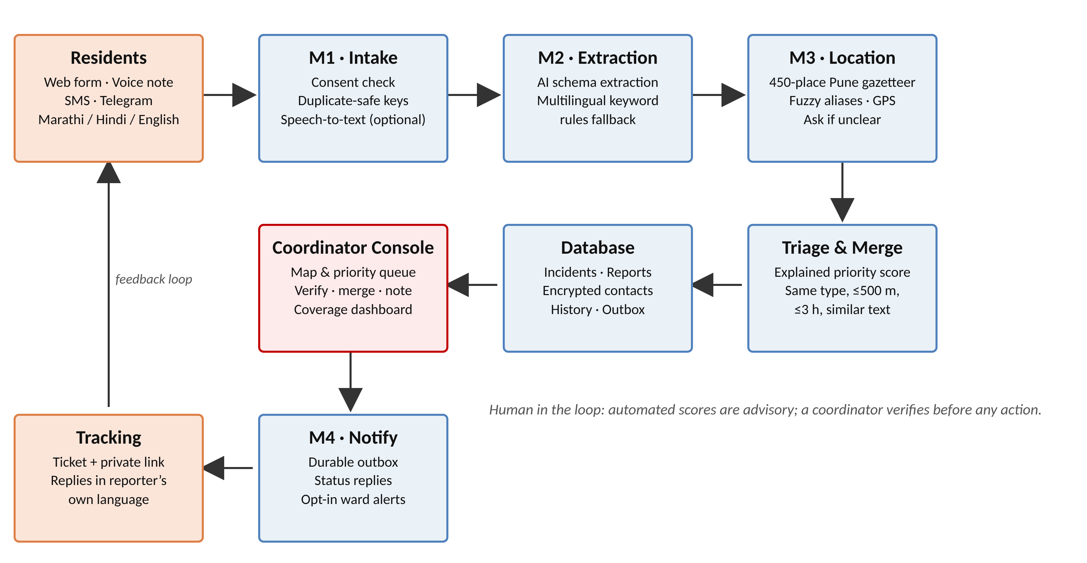
Army Institute of Technology Pune
Department of Information Technology
Proposed Methodology : (Block Diagram)

Slide 11
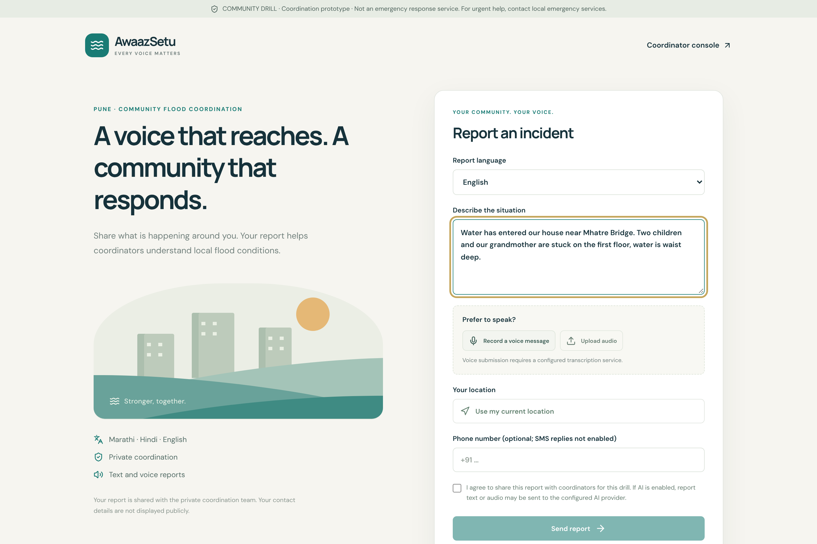
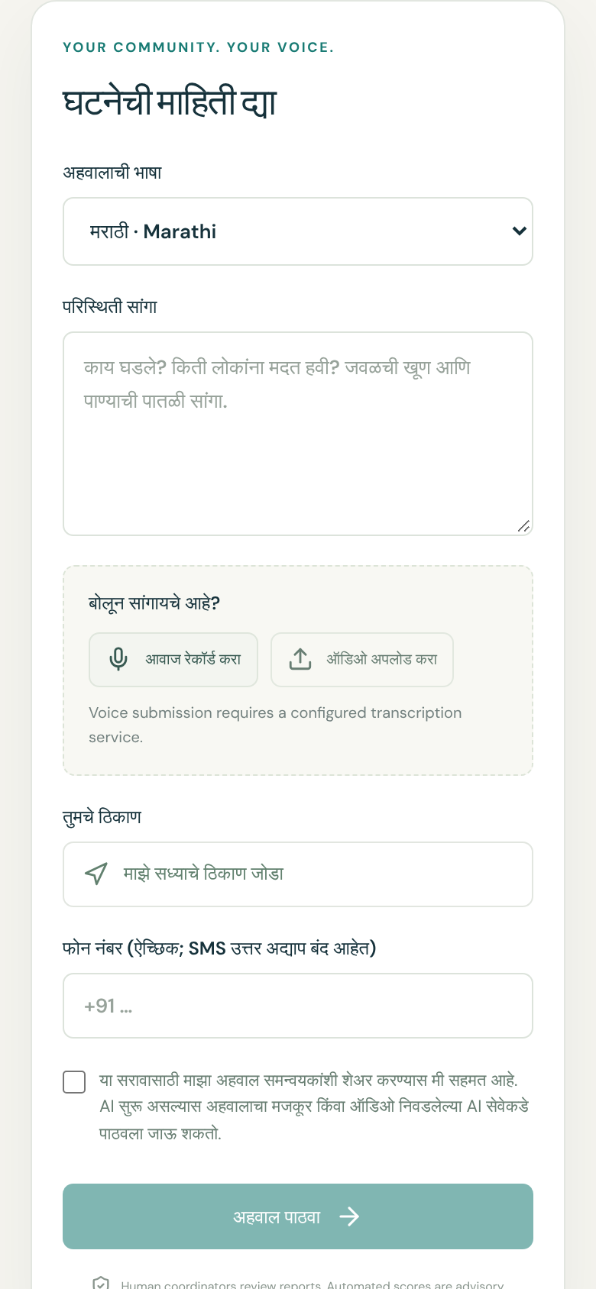
Army Institute of Technology Pune
Department of Information Technology
Implementation : Resident Interface
Features: three languages · voice with editable transcript · optional GPS · consent · ticket ID and private tracking link

Slide 12
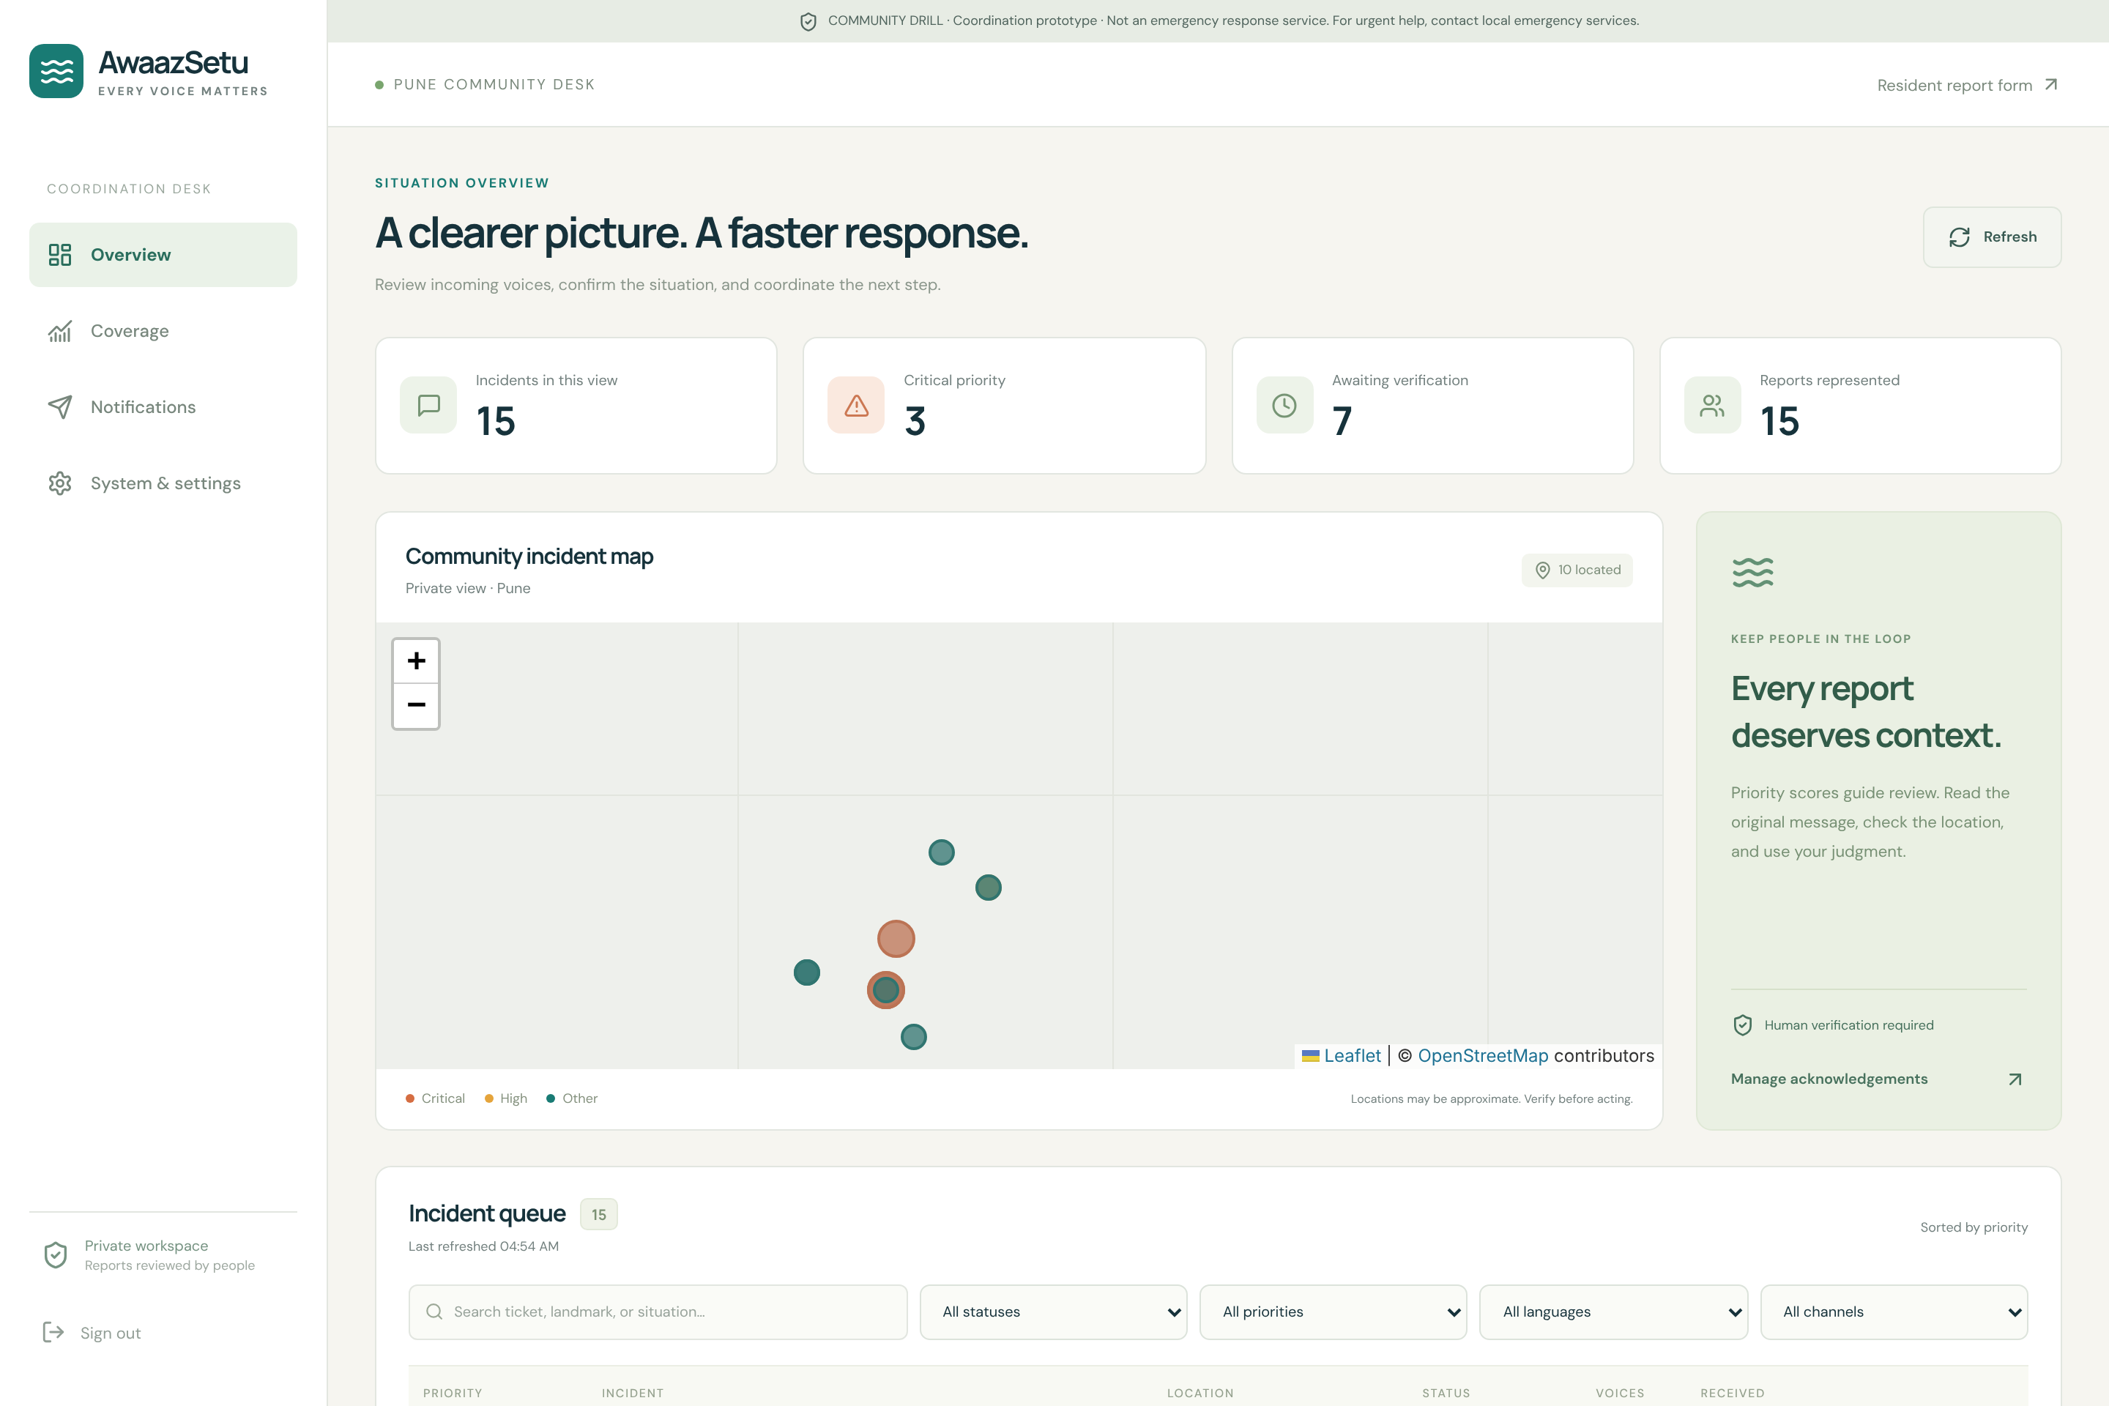
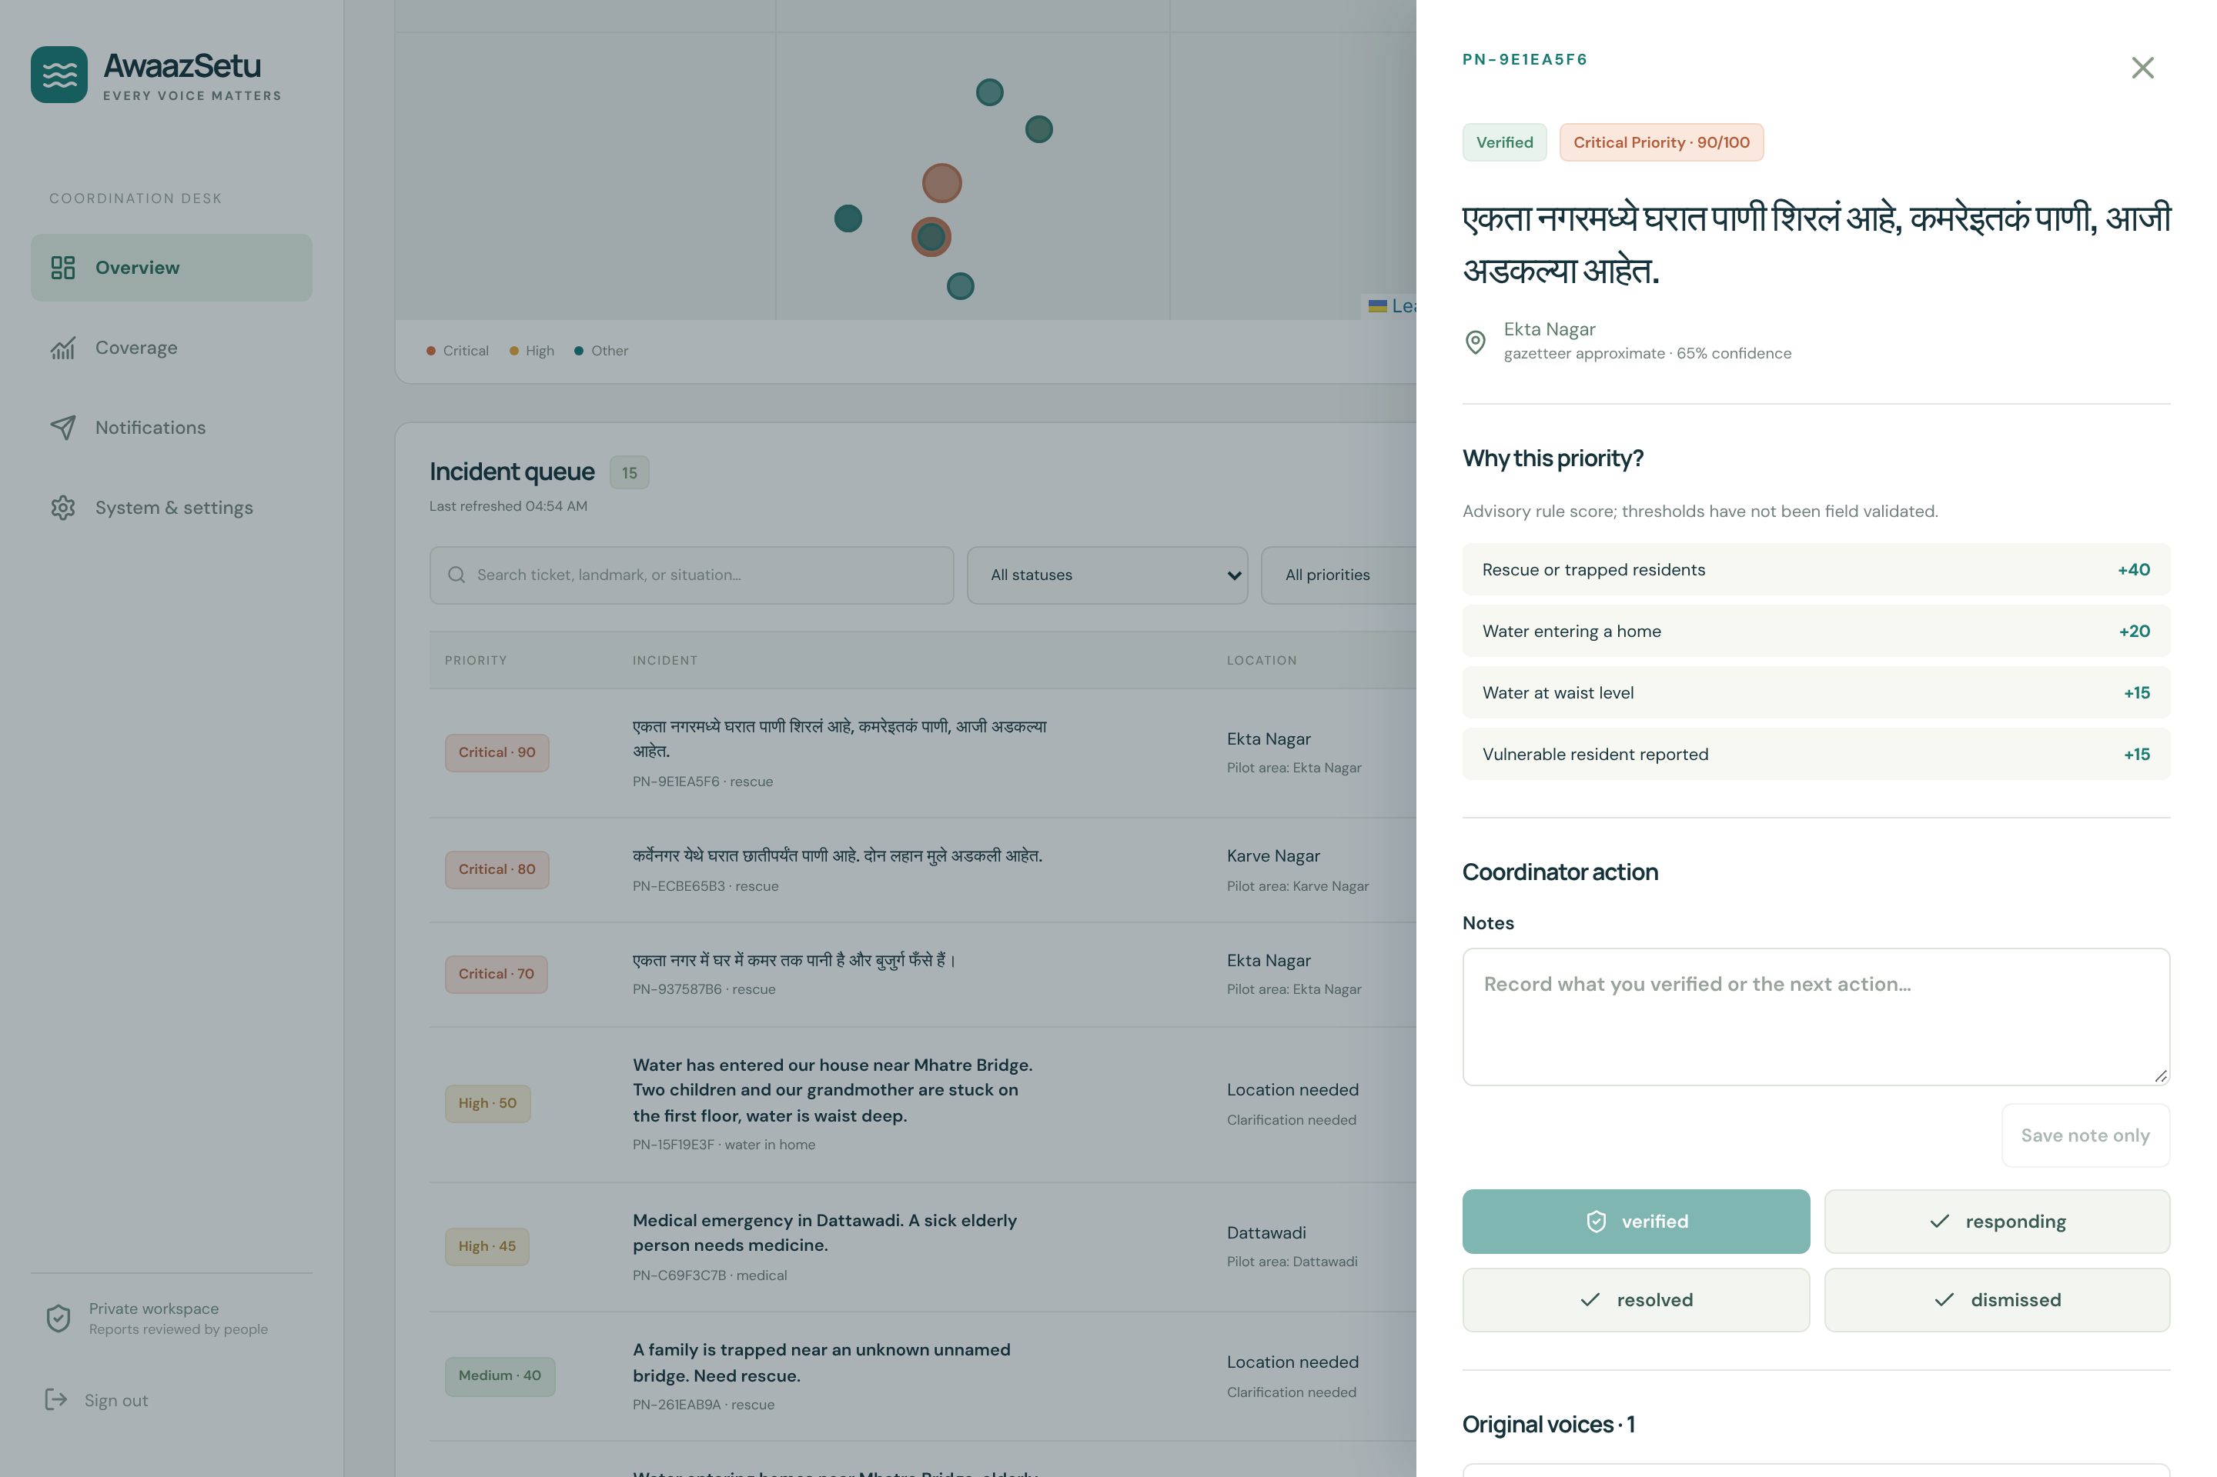
Army Institute of Technology Pune
Department of Information Technology
Implementation : Coordinator Console
Overview: live priority queue, private incident map, filters by status, priority, language and channel.
Incident detail: score reasons, original message, verify / respond / resolve / dismiss, notes and merge with a reason.
Stack: React + Vite, Leaflet, Recharts · FastAPI, SQLAlchemy, SQLite · optional OpenAI extraction and speech.

Slide 13
Army Institute of Technology Pune
Department of Information Technology
Result Analysis
Test / metric | Result | Notes
Backend automated tests | 88 / 88 passed | pytest; API, triage, location, delivery, voice
Browser UI tests | 10 / 10 passed | Playwright; resident and coordinator flows
Synthetic triage suite | 150 / 150 exact match | 50 cases each in EN, HI, MR; 7 fields
Report intake latency | median 7.4 ms, p95 9.8 ms | 200 local reports, offline rules mode
Location lookup | 0.24 ms per query | 450-place Pune gazetteer
Field validation | Pending | Marathi speech accuracy, duplicate F1, landmark accuracy, SMS latency
Analysis: the rules engine handles all three languages consistently and responds in milliseconds, so it works offline and without AI cost. The synthetic suite is a regression check, not field accuracy; real accuracy needs a supervised community drill.

Slide 14
Army Institute of Technology Pune
Department of Information Technology
Conclusion:
AwaazSetu shows that an inclusive, multilingual, SMS- and voice-ready channel can turn scattered flood reports into a reviewed, located and prioritised picture.
Explained scores, conservative merging and ask-don’t-guess locations keep coordinators in control.
The coverage dashboard makes visible who is still missing from the data — the core gap found in the literature.
Future work: connect the Android SMS gateway and Telegram bot, run a supervised drill, measure Marathi speech accuracy and duplicate F1, and add phone-ownership verification.

Slide 15
Army Institute of Technology Pune
Department of Information Technology
Thank You

