Slide 1

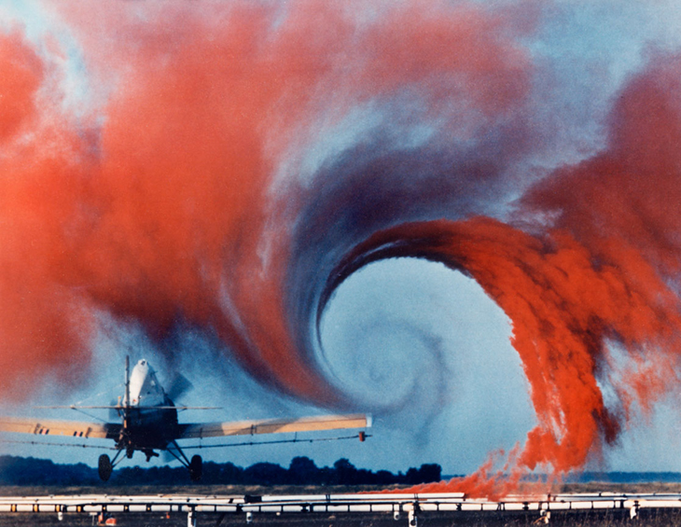
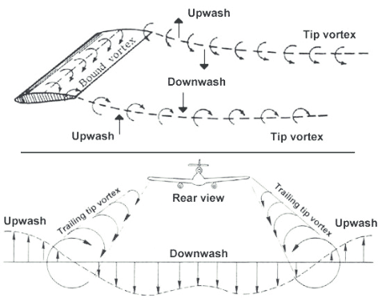
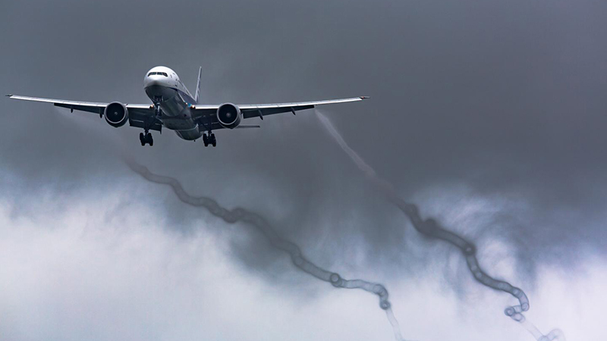
AE 211: Incompressible Aerodynamics
Wing-tip / Trailing Vortices
Induced Drag
Downwash
Wake Turbulence
Courtesy: NASA Langley
Courtesy: Ryoh Isihara

Slide 2
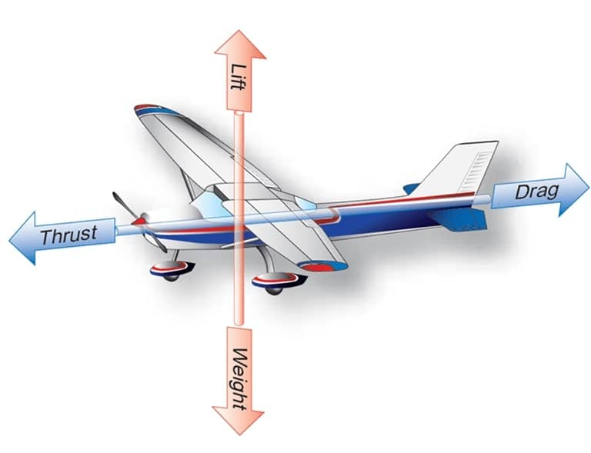
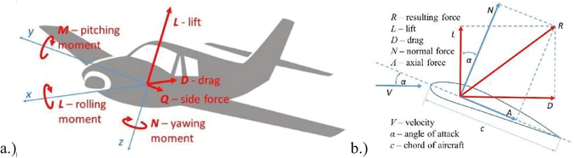
AE 211: Incompressible Aerodynamics
Aerodynamic Forces
Lift ^ flow
Drag || flow
Moments, Side Force
Rotating wings
3D case
2D Model

Slide 3
AE 211: Incompressible Aerodynamics
Things can go wrong...
Flow-induced Oscillations
Unintended Lift
Not enough Drag
Not enough Thrust??

