Slide 1

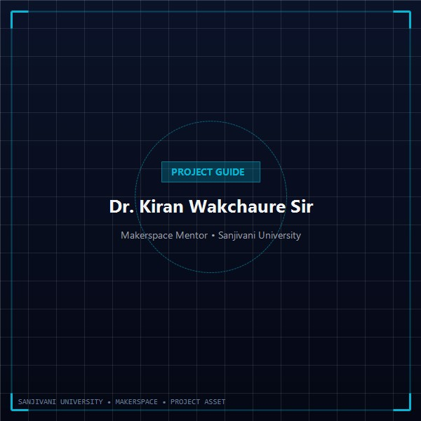




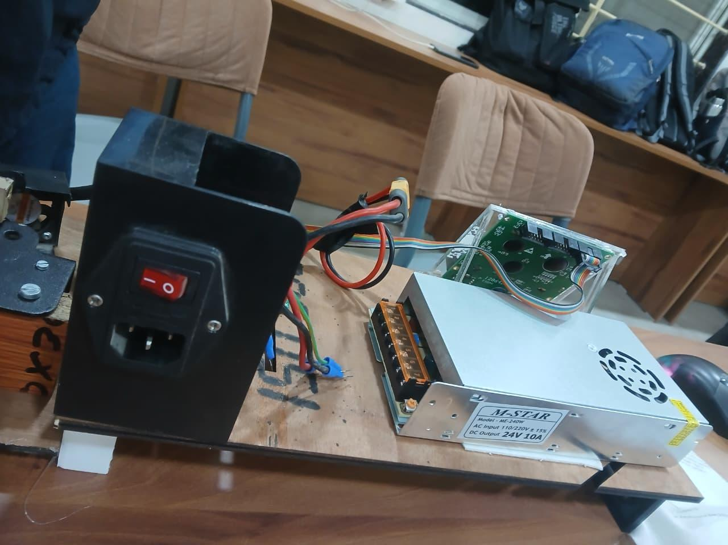
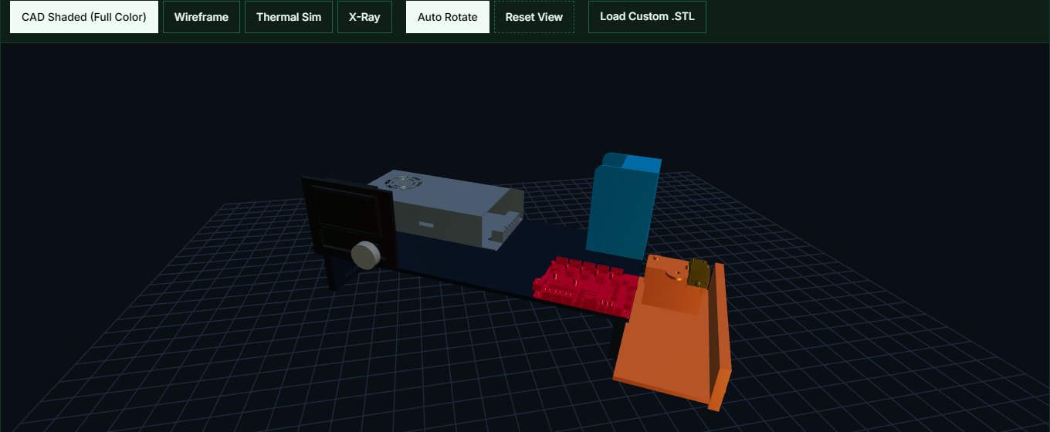

SANJIVANI UNIVERSITY, KOPARGAON
School of Engineering and Technology · Department of Mechanical Engineering · Makerspace Innovation Lab
GROUP NO. 10 · ACADEMIC YEAR 2026–2027
DESIGN AND DEVELOPMENT OF 3D PRINTING FILAMENT FROM PET BOTTLES
An Open-Hardware Pultrusion Recycling System Converting Waste PETG/PET Plastic into 1.75 mm 3D Printing Filament
PROJECT GUIDE
Dr. Kiran Wakchaure Sir
Associate Professor
Dept. of Mechanical Engineering
Sanjivani University
Harshwardhan Shewale
PRN: 2126UMEM1016
Role: Lead & CAD Modeling
F.Y. B.Tech Mechanical
Shraddha Chavanke
PRN: 2126UMEF1073
Role: PPT & Documentation
F.Y. B.Tech Mechanical
Yugant Pawar
PRN: 2126UMEM1058
Role: Assembly & Testing
F.Y. B.Tech Mechanical
Prem Gangurde
PRN: 2126UMEM1014
Role: Fabrication & Hardware
F.Y. B.Tech Mechanical
[01] 1. PROBLEM STATEMENT & MOTIVATION
[04] 4. WORKING PRINCIPLE & PROCESS PIPELINE
[06] 6. PHYSICAL PROTOTYPE & HARDWARE ASSEMBLY
[08] 8. TECHNICAL SPECIFICATIONS & BENCHMARKS
• Global Plastic Pollution Challenge:
Over 380 million tonnes of synthetic polymers are produced annually. Polyethylene Terephthalate (PET) beverage bottles represent one of the single largest components of post-consumer municipal solid waste.
• High Cost of 3D Printing Filament:
Commercial virgin filaments (PLA/PETG) retail between ₹1,400 to ₹2,500/kg. This recurring material expense severely limits rapid prototyping in engineering colleges, school makerspaces, and maker communities.
• The Open-Hardware Upcycling Solution:
This project engineers a benchtop pultrusion machine that transforms discarded bottles directly into continuous 1.75 mm 3D printing filament at zero raw-material cost, bypassing energy-intensive industrial recycling pipelines.
Stage 01: Bottle Collection & Preparation
Select clean, smooth 1.0L–2.0L carbonated drink bottles. Wash thoroughly with mild detergent to remove sugar residue. Remove labels and adhesives. Slice off the base cleanly with a hot wire or razor.
Stage 02: Continuous Spiral Slitting
Mount bottle onto rotating mandrel. Bearing-guided carbon steel blade cuts a continuous, uninterrupted 9.0 mm wide ribbon from bottom to shoulder, yielding 18–22 meters of feedstock per 2L bottle.
Stage 03: Thermal Pultrusion Forming
Feed ribbon lead-in into 250°C heated aluminum block. The 1.75 mm conical brass nozzle forces the flat ribbon into a closed circular cylindrical rod through progressive radial plastic deformation.
Stage 04: Active Air Quenching
A 40 mm cooling fan directs focused ambient air immediately onto the emerging filament at the die exit, rapidly dropping polymer temperature below Tg and freezing the cylindrical geometry.
Stage 05: Traction Drive & Spool Winding
A high-torque planetary geared NEMA17 stepper motor pulls the filament with steady linear velocity, eliminating tensile necking, and winds it onto a master 3D-printed spool.
Parameter | Virgin PLA | Virgin PETG | Recycled Bottle PET
Raw Material Cost | ₹1,200 – ₹1,800/kg | ₹1,400 – ₹2,200/kg | ₹0.00 / kg (Free Waste)
Filament Diameter | 1.75 mm ± 0.03 mm | 1.75 mm ± 0.03 mm | 1.75 mm ± 0.05 mm
Extrusion Temp | 190°C – 210°C | 230°C – 250°C | 245°C – 260°C
Glass Transition (Tg) | 55°C – 60°C | 75°C – 80°C | 78°C – 82°C
Tensile Strength | 45 – 55 MPa | 50 – 60 MPa | 55 – 65 MPa
Operating Power | N/A (Factory) | N/A (Factory) | 65 W (Running Avg)
• Dimensional Accuracy & Tolerance Analysis:
Micrometer sampling across a continuous 15-meter extrusion run demonstrated a mean diameter of 1.748 mm with standard deviation σ = 0.038 mm. Circularity error was under 3.5%, meeting standard FDM extruder feed specifications without jamming.
• Integrated Benchtop Workstation:
The hardware prototype is mounted onto a precision CNC-machined rigid wooden baseboard, organizing the high-voltage AC power distribution, low-voltage 24V electronics, controller motherboard, and high-temp extrusion hotend into dedicated safe operational zones.
• Interactive Telemetry & Control Interface:
The front control panel features a 12864 Graphical LCD display with rotary encoder interface, allowing the operator to set target extrusion temperatures, monitor real-time hotend thermistor readings, adjust puller RPM, and track total filament length produced.
• Thermal Forming Hotend Assembly:
Comprises a precision-machined 20×20×12 mm aluminum block, high-output 40W ceramic cartridge heater, silicone insulation sock, and custom conical brass nozzle.
[02] 2. PROJECT OBJECTIVES
1. Precision Ribbon Slitter:
Develop a mechanical slicing rig utilizing ball bearing rollers and carbon utility blades to strip bottle sidewalls into calibrated 9.0 mm wide ribbons.
2. Conical Thermal Forming Die:
Engineer a 24V heated aluminum block with a 1.75 mm conical brass nozzle maintaining stable forming temperatures (245°C–260°C).
3. Closed-Loop PID Temperature Control:
Implement an electronic controller with real-time thermistor feedback maintaining ±1.5°C thermal stability under cooling draft.
4. Geared Stepper Traction Puller:
Build a high-torque NEMA17 puller mechanism to draw filament at steady velocity (300–450 mm/min) without cross-sectional necking.
5. Dimensional Verification & Print Validation:
Achieve standard 1.75 mm ± 0.05 mm diameter with verified circularity for direct use on open-source FDM 3D printers.
[09] 9. SUSTAINABILITY & CIRCULAR ECONOMY
• UN SDG 12: Responsible Consumption & Production
Enables local decentralized circular polymer recycling. Eliminates transport carbon footprint and avoids extraction of non-renewable fossil hydrocarbons.
• UN SDG 13: Climate Action & Carbon Reduction
Recycling 1.0 kg of post-consumer PET bottles prevents ~2.3 kg of CO2 equivalent greenhouse emissions compared to producing virgin petroleum-derived PLA or PETG.
• Practical Yield Metric:
One standard 2.0-liter soft drink bottle (weight ~42 grams) yields ~18 to 22 meters of printable 1.75 mm filament, sufficient to print 2 functional brackets or test specimens.
[05] 5. SOLIDWORKS 3D CAD DIGITAL TWIN
[07] 7. ELECTRICAL CIRCUITS & THERMAL CONTROL
• Power Distribution (M-STAR 24V 10A SMPS):
An industrial switch-mode power supply delivers up to 240W of clean DC power. High current capacity ensures fast preheat (<180 seconds from cold to 250°C). AC mains input is secured via fused IEC socket and illuminated master rocker switch.
• Microcontroller & Stepper Driver Architecture:
Arduino/RAMPS 1.4 controller running custom Marlin-derived firmware coordinates PWM hotend drive via low-Rds(on) MOSFET and stepper pulses via A4988 microstepping driver with active heatsinking.
• Closed-Loop PID Thermal Regulation:
Real-time NTC 100K 3950 thermistor feedback sampled at 10 Hz executes a tuned PID control loop (Kp=22.2, Ki=1.08, Kd=114), maintaining die temperature within ±1.5°C of 250°C setpoint during continuous extrusion.
[10] 10. CONCLUSIONS & FUTURE WORK
[03] 3. MATERIAL SCIENCE: PET vs. PETG
• Project Milestones Achieved:
Successfully designed, fabricated, and validated an open-hardware bottle-to-filament recycling pultruder producing reliable 1.75 mm filament for sustainable additive manufacturing.
• Future Enhancements:
Integrating an inline optical laser micrometer for dynamic closed-loop puller speed regulation, and an automated heated spooling system for continuous industrial production.
• Molecular Chain Orientation & Strength:
Commercial PET bottles undergo biaxial stretch-blow molding, which aligns polymer chains and yields high tensile strength (55–65 MPa). Thermal pultrusion preserves molecular alignment while reforming the shape.
• Glycol Modification & Crystallization:
PETG contains cyclohexanedimethanol (CHDM) to inhibit crystallization. Pure bottle PET is semi-crystalline; it requires forming at 245°C–260°C and thorough pre-drying (<0.02% moisture) to prevent hydrolytic degradation.
• High Thermal Resistance (Glass Transition Tg):
With a glass transition temperature of 78°C–82°C (significantly higher than PLA at 55°C–60°C), recycled PET filament yields functional parts suitable for automotive, outdoor, and high-temp enclosures.
• Digital Twin Assembly (makerspace_A.SLDASM):
The full machine was modeled and simulated in SolidWorks before physical fabrication. The digital twin encompasses 8 modular subsystems comprising 47,944 mesh facets across an overall assembly envelope of 486.3 × 177.2 × 418.0 mm.
• Key Mechanical Subassemblies:
1. Precision Bearing Slitter: Dual bearing guides with micrometer adjustment for accurate ribbon width control.
2. Thermal Isolation Barrier: Phenolic spacers isolate 260°C heater block from structural chassis.
3. Puller Traction Rig: Geared NEMA17 stepper with knurled dual-drive gears to prevent slip.
4. Ergonomic Enclosure: Acrylic front fascia housing 12864 LCD screen and master emergency power switch.
[11] 11. REFERENCES & LIVE PROJECT PORTAL
SCAN FOR INTERACTIVE 3D WEB PORTAL
https://harshwardhanshewale02-bit.github.io/
petg-filament-makerspace/
Academic References:
1. Groover, M. P. (2020). Fundamentals of Modern Manufacturing: Materials, Processes, and Systems.
2. ASTM D638: Standard Test Method for Tensile Properties of Plastics.
3. RepRap Open-Hardware Polymer Recycling Projects.

