Slide 1
Vishing Scams
Exploring the impact and prevention of voice phishing fraud

Slide 2
Introduction
Voice phishing, commonly known as vishing, is an increasingly prevalent scam method that utilizes technology to deceive victims. The integration of AI-generated voices makes these scams more convincing, leveraging human trust to manipulate and extract sensitive information. This presentation delves into the mechanics of vishing scams, their definition, the tactics employed, and the essential steps toward developing prevention tools to protect users from falling prey to such fraudulent activities.

Slide 3
01
Vishing

Slide 4
Definition of vishing
Vishing is a form of phishing that specifically utilizes voice communication, often through phone calls, to defraud individuals or organizations. It involves scammers impersonating legitimate entities to gain the trust of their targets and obtain confidential information like passwords or bank details. With advancements in technology, vishing scams have evolved to utilize realistic AI-generated voices, making them more challenging to identify and defend against.

Slide 5
Mechanisms used in vishing scams
Vishing scams typically employ a variety of tactics to deceive victims. Commonly, fraudsters use caller ID spoofing to display a legitimate number, enhancing credibility. They might create urgency, pressuring victims to act quickly without thinking. The use of deepfake voice technology allows scamsters to closely mimic the voices of trusted individuals or organizations, leading to increased trust and likelihood of compliance from their targets. Overall, the combination of technology and psychological manipulation makes vishing a dangerous threat.

Slide 6

Impact on victims
Vishing scams can have devastating effects on victims, both financially and psychologically. Individuals may suffer significant financial losses due to unauthorized transactions or identity theft. Beyond financial impact, victims often experience anxiety, fear, and a pervasive sense of violation, leading to a long-lasting mistrust of phone communications. Organizations targeted by vishing can suffer reputational damage, loss of customer trust, and potential legal ramifications resulting from data breaches. The holistic impact stretches from immediate financial implications to wider societal trust in digital communications.

Slide 7
02
AI Detection Tool

Slide 8
AI speech analysis functionalities
The AI detection tool incorporates advanced speech analysis techniques designed to identify patterns commonly associated with vishing. By analyzing tonal variations, speech rate, and specific linguistic markers, the tool can discern malicious intent in vocal communications. The model is trained on vast datasets that include examples of known scams, enabling it to differentiate between legitimate calls and potential threats effectively. This proactive approach allows users to be alerted to suspicious activities before any damage occurs.

Slide 9
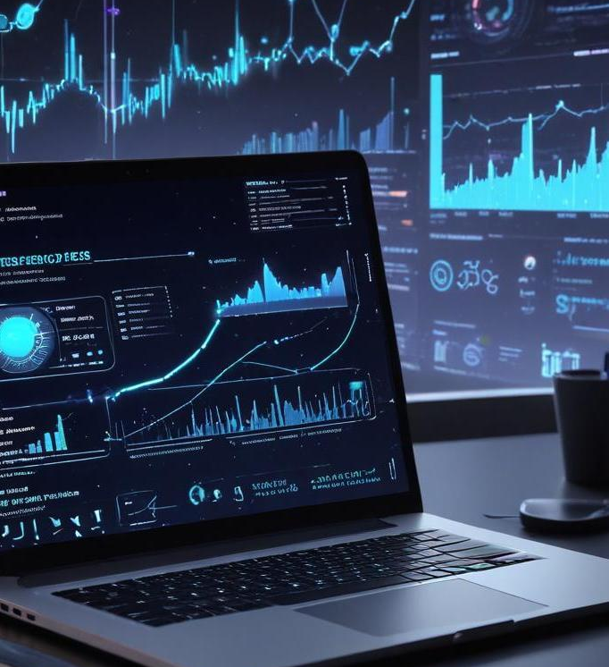
Real-time transcription and risk scoring
An integral feature of the AI detection tool is its ability to provide real-time transcription of phone calls. As conversations unfold, the tool generates text transcripts that are analyzed for risk assessment. Each transcript is scored based on the likelihood of containing fraudulent information, combining linguistic analysis with contextual understanding. This scoring mechanism empowers users by providing them with immediate feedback on the perceived risk level, allowing them to make informed decisions during a call.

Slide 10
Multi-language detection capabilities
To accommodate a global user base, the AI detection tool is equipped with multi-language detection capabilities. This feature allows the system to analyze and assess calls in various languages, increasing its accessibility and effectiveness across different regions. By expanding its linguistic framework, the tool ensures that users, regardless of their language preference, have access to robust protection against vishing scams. The system continuously adapts to different dialects and cultural nuances to improve its accuracy in identifying fraud.

Slide 11
Conclusions
In conclusion, the rise of vishing scams poses a significant challenge that requires innovative solutions. The AI detection tool presents a comprehensive approach to combating these threats through speech analysis, real-time transcription, and multi-language support. By harnessing technology to enhance user awareness and safety, we can significantly reduce the risk of falling victim to these sophisticated scams. Continued development and training of AI systems will be crucial in staying ahead of evolving tactics used by fraudsters.

