Slide 1
Microsoft PowerPoint
Example Presentation
for Beginners
(Click the left mouse button or press <Return> to move on)
Notes:
This presentation is designed to be an introduction to Microsoft PowerPoint, showing those new to the software some of the things it can do.
Get those on the training session to open up this example file and run through the slides in their own time.

Slide 2
Microsoft PowerPoint is an easy-to-use program for producing professional-quality presentations. It can produce:
On-screen slide shows (which can be projected onto a larger screen)
Colour or black/white overheads
35mm slides
Speaker’s notes
Audience hand-outs

Slide 3
For on-screen presentations, it has animation effects, which allow you to introduce points one at a time in various ways. For example:
On any given slide, points can ‘fly in’ from the left, right, top, bottom or a corner
They can ‘materialise’ (and ‘disappear’)
They can appear a word at a time or as a single unit
They can be timed to appear after a set number of seconds

Slide 4
This next slide gives a random selection of animation effects, each point being timed to appear after a couple of seconds
This is the first example
Here’s the second
And another
Everyone running this demonstration should be getting their own random set of effects
This is the final example

Slide 5

Slides can appear in a variety of layouts and can include pictures, graphs and charts. Here are some useful sources of pictures:
Microsoft’s own Clip Art Gallery
The WWW
Scanners (pictures from books/paper)
Digital Cameras
Draw them yourself

Slide 6
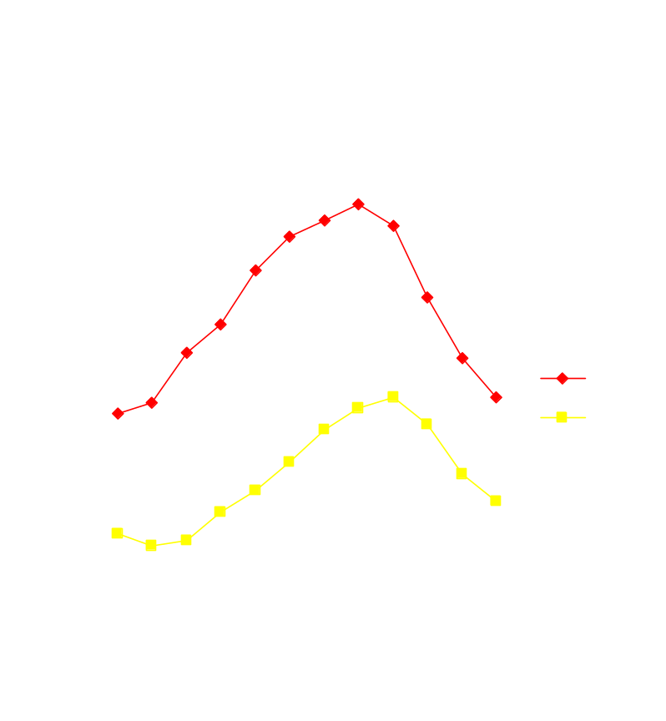
Here’s an example of some data and a graph:
The maximum values peak in August
The minimum values peak in September
The lowest maximum value is in January
The lowest minimum value is in February
There is a one-month lag effect

Slide 7
Here is an Organisation Chart:
IT Training at the University of Reading
Microsoft
Office XP
Access
Excel
PowerPoint
Word
Beginners
Intermediate
Beginners
Intermediate
Advanced
Beginners
Advanced
Beginners
Intermediate
Advanced

Slide 8
You can have a wide variety of backgrounds, ranging from plain (with shading, as here) to pictures and patterns.

Slide 9
Templates
A template is the overall design of your presentation - the layout, colour scheme and text formats used for your slides. Microsoft provide various pre-defined templates (or you can design your own).
The template used here has a plain blue background with yellow titles (the font is Times 44 point) and the rest of the text white (Times 28 point).

Slide 10
The End!
This is the final slide in this presentation - it’s now your turn to have a go and create a new presentation.
Wait while the others in the class reach this point.
Notes:
Once the attendees have finished the slide show, talk about PowerPoint Views before getting them to start their own blank presentation.

