Slide 1
Banking Customer Churn Prediction
Objective: Predict and prevent customer churn using machine learning.
Goal: Retain valuable clients by identifying churn risk early.
Method: Data mining + predictive modeling (Random Forest, KNN).

Slide 2
Key Business Questions Answered
❓ Who is most likely to churn?
❓ Why are customers churning?
❓ Can we predict churn before it happens?
❓ Which customers should we retain first?
❓ How accurate is the model?
❓ What actions can the bank take?

Slide 3
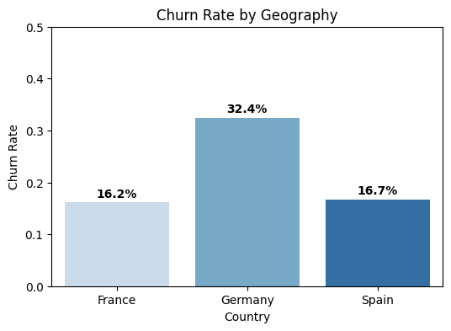
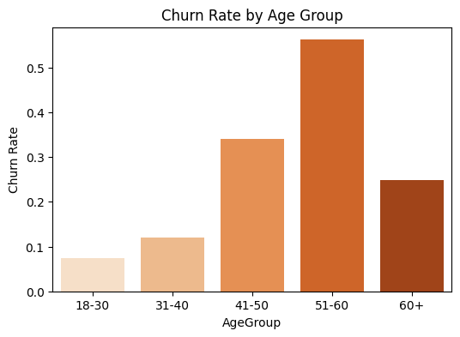
Who is Most Likely to Churn?
Older customers (age 40+) are at significantly higher risk of churn.
High-balance customers who show low activity are prone to leaving.
Customers from Germany show the highest churn rate among regions.
Users with 3 or more products have an unexpected churn spike.
Inactive account holders are consistently flagged as high risk.

Slide 4
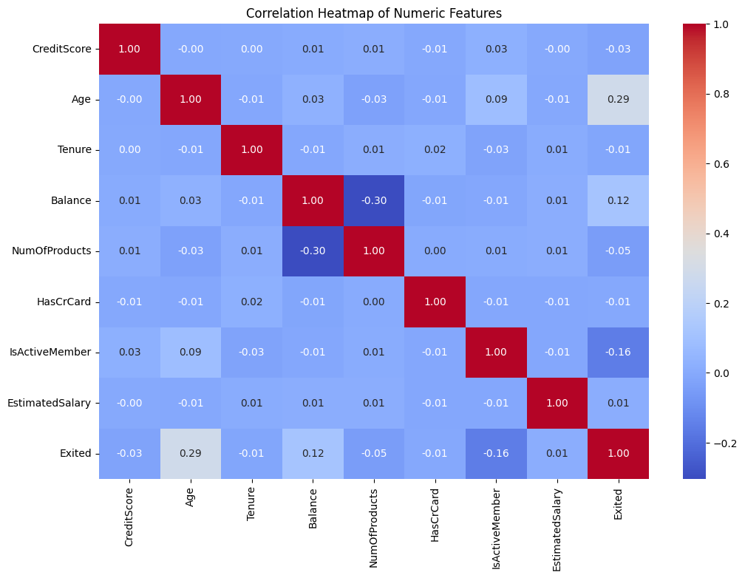
Why are Customers Churning?
Older and less active customers are significantly more likely to churn, with age showing a positive correlation of +0.29 and activity level showing a negative correlation of -0.16 with churn.
Having a high account balance does not ensure customer retention, as balance has a mild positive correlation of +0.12 with churn.
Customers with more products tend to be slightly more loyal, indicated by a weak negative correlation of -0.05 between number of products and churn.
Credit score and estimated salary have minimal influence on churn, with near-zero correlations of -0.03 and +0.01, respectively.

Slide 5
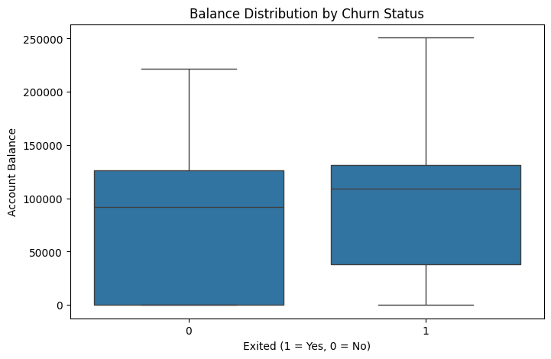
Churned customers tend to have higher and more variable account balances, as indicated by a higher median, wider interquartile range, and elevated minimum balance in the boxplot.
This supports the positive correlation (+0.12) between balance and churn, suggesting that high-balance customers may be more targeted by competitors or more likely to leave for better financial offers.

Slide 6
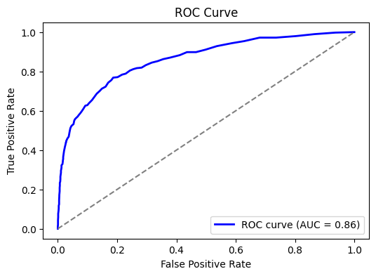
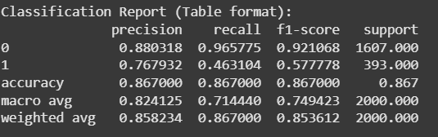
Can We Predict Churn Early?
Yes, we can predict churn early using our machine learning model.
Our model achieved an accuracy of 87% — which means it correctly classifies most customers.
The ROC AUC score is 0.86, showing the model can clearly distinguish between churners and non-churners.
We’re catching nearly half of the churners with a recall of 47% — that’s a strong base for action.
This level of performance is promising, especially for early detection and proactive outreach.

Slide 7
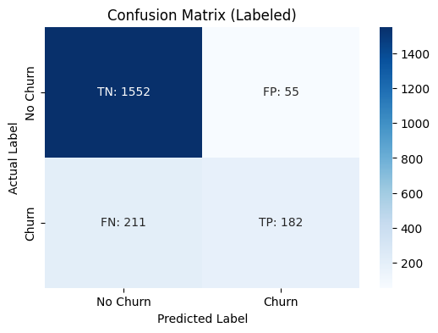
How Accurate is the Model?
Metric | Random Forest | KNN (k=5)
Accuracy | 86.7% | 82.75%
Precision (Churn) | 77% | 59%
Recall (Churn) | 46% | 41%
F1 Score (Churn) | 58% | 48%
AUC (ROC) | 0.86 | Not computed
Notes:
We evaluated two models — Random Forest and KNN. Random Forest delivers the best balance of accuracy and interpretability. Its AUC score of 0.86 shows strong performance in separating churners from loyal customers.

Slide 8
Model Optimization & Evaluation
Hyperparameter | Value
max_depth | 11
min_samples_leaf | 4
min_samples_split | 5
n_estimators | 70
Prevent overfitting and improve model generalization
Identify the best hyperparameters for optimal performance
Ensure consistent accuracy across different data splits
Best parameters control tree complexity and enhance accuracy
Cross-validation scores are consistent, indicating stable performance
Mean CV score ~86%, confirming strong and reliable model results
Fold | Score
1 | 0.855
2 | 0.8665
3 | 0.8595
4 | 0.867
5 | 0.8595

Slide 9
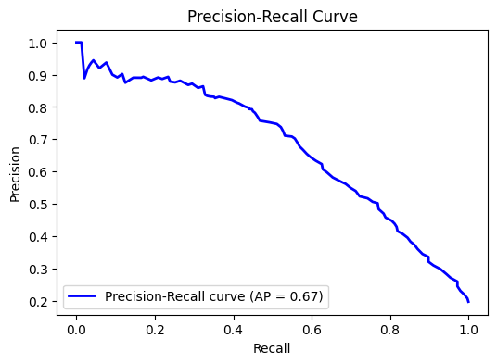
AP = 0.67 indicates moderate ability to detect churners.
Highlights the trade-off between precision and recall.
Useful for choosing the right threshold based on business goals.
Especially relevant for imbalanced data like churn predictio

Slide 10
Other Noteworthy Findings
IsActiveMember contributes moderately (~6%) to churn prediction, aligning with its negative correlation of -0.16 — showing that engagement still matters, but less than age or income.
Tenure, though traditionally assumed important, contributes less than 9%, suggesting that how long a customer has been with the bank is less predictive than current behavior and demographics.
Geography plays a subtle role — customers from Germany and Spain show slight differences in churn behavior, indicating that regional factors or localized services may influence retention.
Gender and HasCrCard are relatively weak predictors, contributing under 3% to the model's decisions, which means they are not major drivers of customer churn.
Balance Range categories (Low/Medium/High/Very High) add minimal predictive value, reinforcing the earlier insight that raw balance value is more useful than binned ranges in this dataset

Slide 11
What Actions Can the Bank Take?
Focus retention efforts on high-risk segments identified by the model.
Offer personalized perks to inactive, high-balance customers.
Use model alerts to detect and engage potential churners early.
Re-engage low-activity customers through targeted outreach (email, call, app push).
Monitor churn-prone regions (e.g., Germany) with tailored campaigns.

