Slide 1
E-Commerce Data Analysis
Prepared by Harsh Yadav
Institute: analyticxlabs

Slide 2
Agenda
This slide presents detailed information about agenda in the e-commerce data analysis project using Excel, SQL, and Power BI.

Slide 3
Problem Statement
This slide presents detailed information about problem statement in the e-commerce data analysis project using Excel, SQL, and Power BI.

Slide 4
Business Objective
This slide presents detailed information about business objective in the e-commerce data analysis project using Excel, SQL, and Power BI.

Slide 5
Tools Used
This slide presents detailed information about tools used in the e-commerce data analysis project using Excel, SQL, and Power BI.

Slide 6
Workflow
This slide presents detailed information about workflow in the e-commerce data analysis project using Excel, SQL, and Power BI.

Slide 7
Dataset Overview
This slide presents detailed information about dataset overview in the e-commerce data analysis project using Excel, SQL, and Power BI.

Slide 8
Product Dataset
This slide presents detailed information about product dataset in the e-commerce data analysis project using Excel, SQL, and Power BI.

Slide 9
Sales Dataset
This slide presents detailed information about sales dataset in the e-commerce data analysis project using Excel, SQL, and Power BI.

Slide 10
Pricing Dataset
This slide presents detailed information about pricing dataset in the e-commerce data analysis project using Excel, SQL, and Power BI.

Slide 11
Hierarchy Dataset
This slide presents detailed information about hierarchy dataset in the e-commerce data analysis project using Excel, SQL, and Power BI.

Slide 12
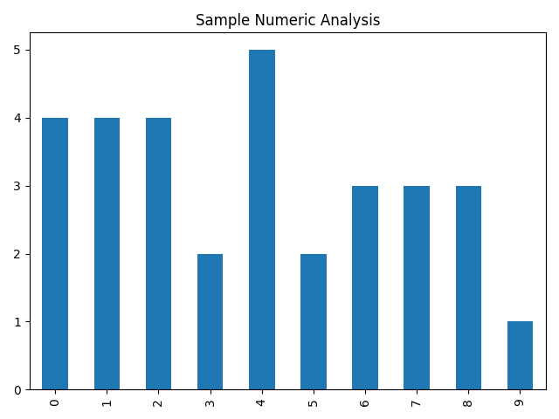
Data Cleaning
This slide presents detailed information about data cleaning in the e-commerce data analysis project using Excel, SQL, and Power BI.

Slide 13
Excel Analysis
This slide presents detailed information about excel analysis in the e-commerce data analysis project using Excel, SQL, and Power BI.

Slide 14
Pivot Tables
This slide presents detailed information about pivot tables in the e-commerce data analysis project using Excel, SQL, and Power BI.

Slide 15
Revenue Analysis
This slide presents detailed information about revenue analysis in the e-commerce data analysis project using Excel, SQL, and Power BI.

Slide 16
Trend Analysis
This slide presents detailed information about trend analysis in the e-commerce data analysis project using Excel, SQL, and Power BI.

Slide 17
Top Products
This slide presents detailed information about top products in the e-commerce data analysis project using Excel, SQL, and Power BI.

Slide 18
Regional Analysis
This slide presents detailed information about regional analysis in the e-commerce data analysis project using Excel, SQL, and Power BI.

Slide 19
SQL Introduction
This slide presents detailed information about sql introduction in the e-commerce data analysis project using Excel, SQL, and Power BI.

Slide 20
Database Creation
This slide presents detailed information about database creation in the e-commerce data analysis project using Excel, SQL, and Power BI.

Slide 21
Table Structure
This slide presents detailed information about table structure in the e-commerce data analysis project using Excel, SQL, and Power BI.

Slide 22
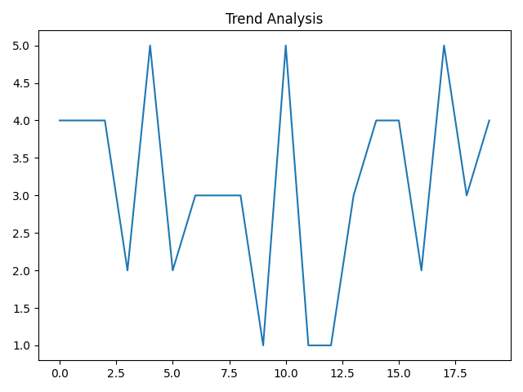
Primary Keys
This slide presents detailed information about primary keys in the e-commerce data analysis project using Excel, SQL, and Power BI.

Slide 23
Foreign Keys
This slide presents detailed information about foreign keys in the e-commerce data analysis project using Excel, SQL, and Power BI.

Slide 24
SQL Joins
This slide presents detailed information about sql joins in the e-commerce data analysis project using Excel, SQL, and Power BI.

Slide 25
Aggregate Functions
This slide presents detailed information about aggregate functions in the e-commerce data analysis project using Excel, SQL, and Power BI.

Slide 26
Subqueries
This slide presents detailed information about subqueries in the e-commerce data analysis project using Excel, SQL, and Power BI.

Slide 27
Window Functions
This slide presents detailed information about window functions in the e-commerce data analysis project using Excel, SQL, and Power BI.

Slide 28
SQL Insights
This slide presents detailed information about sql insights in the e-commerce data analysis project using Excel, SQL, and Power BI.

Slide 29
Power BI Introduction
This slide presents detailed information about power bi introduction in the e-commerce data analysis project using Excel, SQL, and Power BI.

Slide 30
Data Import
This slide presents detailed information about data import in the e-commerce data analysis project using Excel, SQL, and Power BI.

Slide 31
Power Query
This slide presents detailed information about power query in the e-commerce data analysis project using Excel, SQL, and Power BI.

Slide 32
Data Modeling
This slide presents detailed information about data modeling in the e-commerce data analysis project using Excel, SQL, and Power BI.

Slide 33
DAX Measures
This slide presents detailed information about dax measures in the e-commerce data analysis project using Excel, SQL, and Power BI.

Slide 34
KPI Cards
This slide presents detailed information about kpi cards in the e-commerce data analysis project using Excel, SQL, and Power BI.

Slide 35
Sales Dashboard
This slide presents detailed information about sales dashboard in the e-commerce data analysis project using Excel, SQL, and Power BI.

Slide 36
Customer Dashboard
This slide presents detailed information about customer dashboard in the e-commerce data analysis project using Excel, SQL, and Power BI.

Slide 37
Product Dashboard
This slide presents detailed information about product dashboard in the e-commerce data analysis project using Excel, SQL, and Power BI.

Slide 38
Regional Dashboard
This slide presents detailed information about regional dashboard in the e-commerce data analysis project using Excel, SQL, and Power BI.

Slide 39
Filters and Slicers
This slide presents detailed information about filters and slicers in the e-commerce data analysis project using Excel, SQL, and Power BI.

Slide 40
Business Insights
This slide presents detailed information about business insights in the e-commerce data analysis project using Excel, SQL, and Power BI.

Slide 41
Recommendations
This slide presents detailed information about recommendations in the e-commerce data analysis project using Excel, SQL, and Power BI.

Slide 42
Conclusion
This slide presents detailed information about conclusion in the e-commerce data analysis project using Excel, SQL, and Power BI.

Slide 43
Additional Analysis 42
This slide presents detailed information about additional analysis 42 in the e-commerce data analysis project using Excel, SQL, and Power BI.

Slide 44
Additional Analysis 43
This slide presents detailed information about additional analysis 43 in the e-commerce data analysis project using Excel, SQL, and Power BI.

Slide 45
Additional Analysis 44
This slide presents detailed information about additional analysis 44 in the e-commerce data analysis project using Excel, SQL, and Power BI.

Slide 46
Additional Analysis 45
This slide presents detailed information about additional analysis 45 in the e-commerce data analysis project using Excel, SQL, and Power BI.

Slide 47
Additional Analysis 46
This slide presents detailed information about additional analysis 46 in the e-commerce data analysis project using Excel, SQL, and Power BI.

Slide 48
Additional Analysis 47
This slide presents detailed information about additional analysis 47 in the e-commerce data analysis project using Excel, SQL, and Power BI.

Slide 49
Additional Analysis 48
This slide presents detailed information about additional analysis 48 in the e-commerce data analysis project using Excel, SQL, and Power BI.

Slide 50
Additional Analysis 49
This slide presents detailed information about additional analysis 49 in the e-commerce data analysis project using Excel, SQL, and Power BI.

Slide 51
Additional Analysis 50
This slide presents detailed information about additional analysis 50 in the e-commerce data analysis project using Excel, SQL, and Power BI.

Slide 52
Additional Analysis 51
This slide presents detailed information about additional analysis 51 in the e-commerce data analysis project using Excel, SQL, and Power BI.

Slide 53
Additional Analysis 52
This slide presents detailed information about additional analysis 52 in the e-commerce data analysis project using Excel, SQL, and Power BI.

Slide 54
Additional Analysis 53
This slide presents detailed information about additional analysis 53 in the e-commerce data analysis project using Excel, SQL, and Power BI.

Slide 55
Additional Analysis 54
This slide presents detailed information about additional analysis 54 in the e-commerce data analysis project using Excel, SQL, and Power BI.

Slide 56
Additional Analysis 55
This slide presents detailed information about additional analysis 55 in the e-commerce data analysis project using Excel, SQL, and Power BI.

Slide 57
Additional Analysis 56
This slide presents detailed information about additional analysis 56 in the e-commerce data analysis project using Excel, SQL, and Power BI.

Slide 58
Additional Analysis 57
This slide presents detailed information about additional analysis 57 in the e-commerce data analysis project using Excel, SQL, and Power BI.

Slide 59
Additional Analysis 58
This slide presents detailed information about additional analysis 58 in the e-commerce data analysis project using Excel, SQL, and Power BI.

Slide 60
Additional Analysis 59
This slide presents detailed information about additional analysis 59 in the e-commerce data analysis project using Excel, SQL, and Power BI.

Slide 61
Additional Analysis 60
This slide presents detailed information about additional analysis 60 in the e-commerce data analysis project using Excel, SQL, and Power BI.

Slide 62
Additional Analysis 61
This slide presents detailed information about additional analysis 61 in the e-commerce data analysis project using Excel, SQL, and Power BI.

Slide 63
Additional Analysis 62
This slide presents detailed information about additional analysis 62 in the e-commerce data analysis project using Excel, SQL, and Power BI.

Slide 64
Additional Analysis 63
This slide presents detailed information about additional analysis 63 in the e-commerce data analysis project using Excel, SQL, and Power BI.

Slide 65
Additional Analysis 64
This slide presents detailed information about additional analysis 64 in the e-commerce data analysis project using Excel, SQL, and Power BI.

Slide 66
Additional Analysis 65
This slide presents detailed information about additional analysis 65 in the e-commerce data analysis project using Excel, SQL, and Power BI.

Slide 67
Additional Analysis 66
This slide presents detailed information about additional analysis 66 in the e-commerce data analysis project using Excel, SQL, and Power BI.

