Slide 1
Network Security Analysis of DoS/DDoS Attacks using Wireshark
NAME : - HARSIMRANPREET KAUR
STUDENT ID : - B00942933

Slide 2
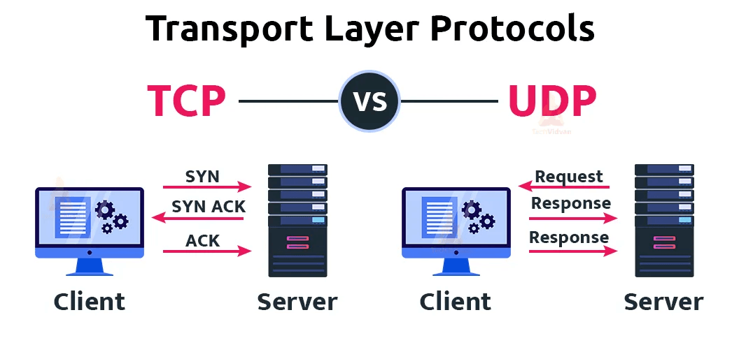
TCP /UDP protocol
The Transmission control protocol is a communication standard that ensures reliable message exchange between devices and application across networks. It is connection-oriented protocol, meaning it establishes a secure link before data is sent.. By using a three-way handshake , Tcp ensures reliable communication, making it essential for transferring data accurately across the internet and other networks[1].
UDP User diagram protocol is a network communication protocol primarily used for time-sensitive data transfers, such as DNS queries and video streaming . Unlike other protocols does not require establishing a formal connection before transmitting data, which results in faster communication. However, the lack of connection setup can lead to packet loss and increase risk of vulnerabilities, such as being exploited by Distributed Denial-Of-service(DDOS) attacks.[2]
.
[3]

Slide 3
Internet protocol (IP)
“Internet protocol is a network-layer protocol that enables data packets to be addressed, routed, delivered correctly across interconnected networks .Using IP addressing like IPv4 and IPv6”.[4], it ensures data reaches its correct destination by breaking into smaller packets. Each packet carries IP information to guide routers along the way. Every device connected to the Internet is assigned a unique IP address, ensuring efficient communication across the global network.
TCP/IP differences
TCP is responsible for establishing and maintaining reliable, end-to-end connections between devices. It ensures that data is delivered in the correct order and without errors
TCP manages flow control to ensure that a sender does not overwhelm a receiver by sending data too quickly. It adjusts the rate of data transmission based on the receiver's capacity to process the data.
IP focuses on addressing and routing data packets across the network, determining the best path for each packet to reach its destination.
IP is responsible for fragmenting large data packets into smaller ones to fit the network's maximum transmission unit (MTU). It also reassembles these packets at the destination.

Slide 4
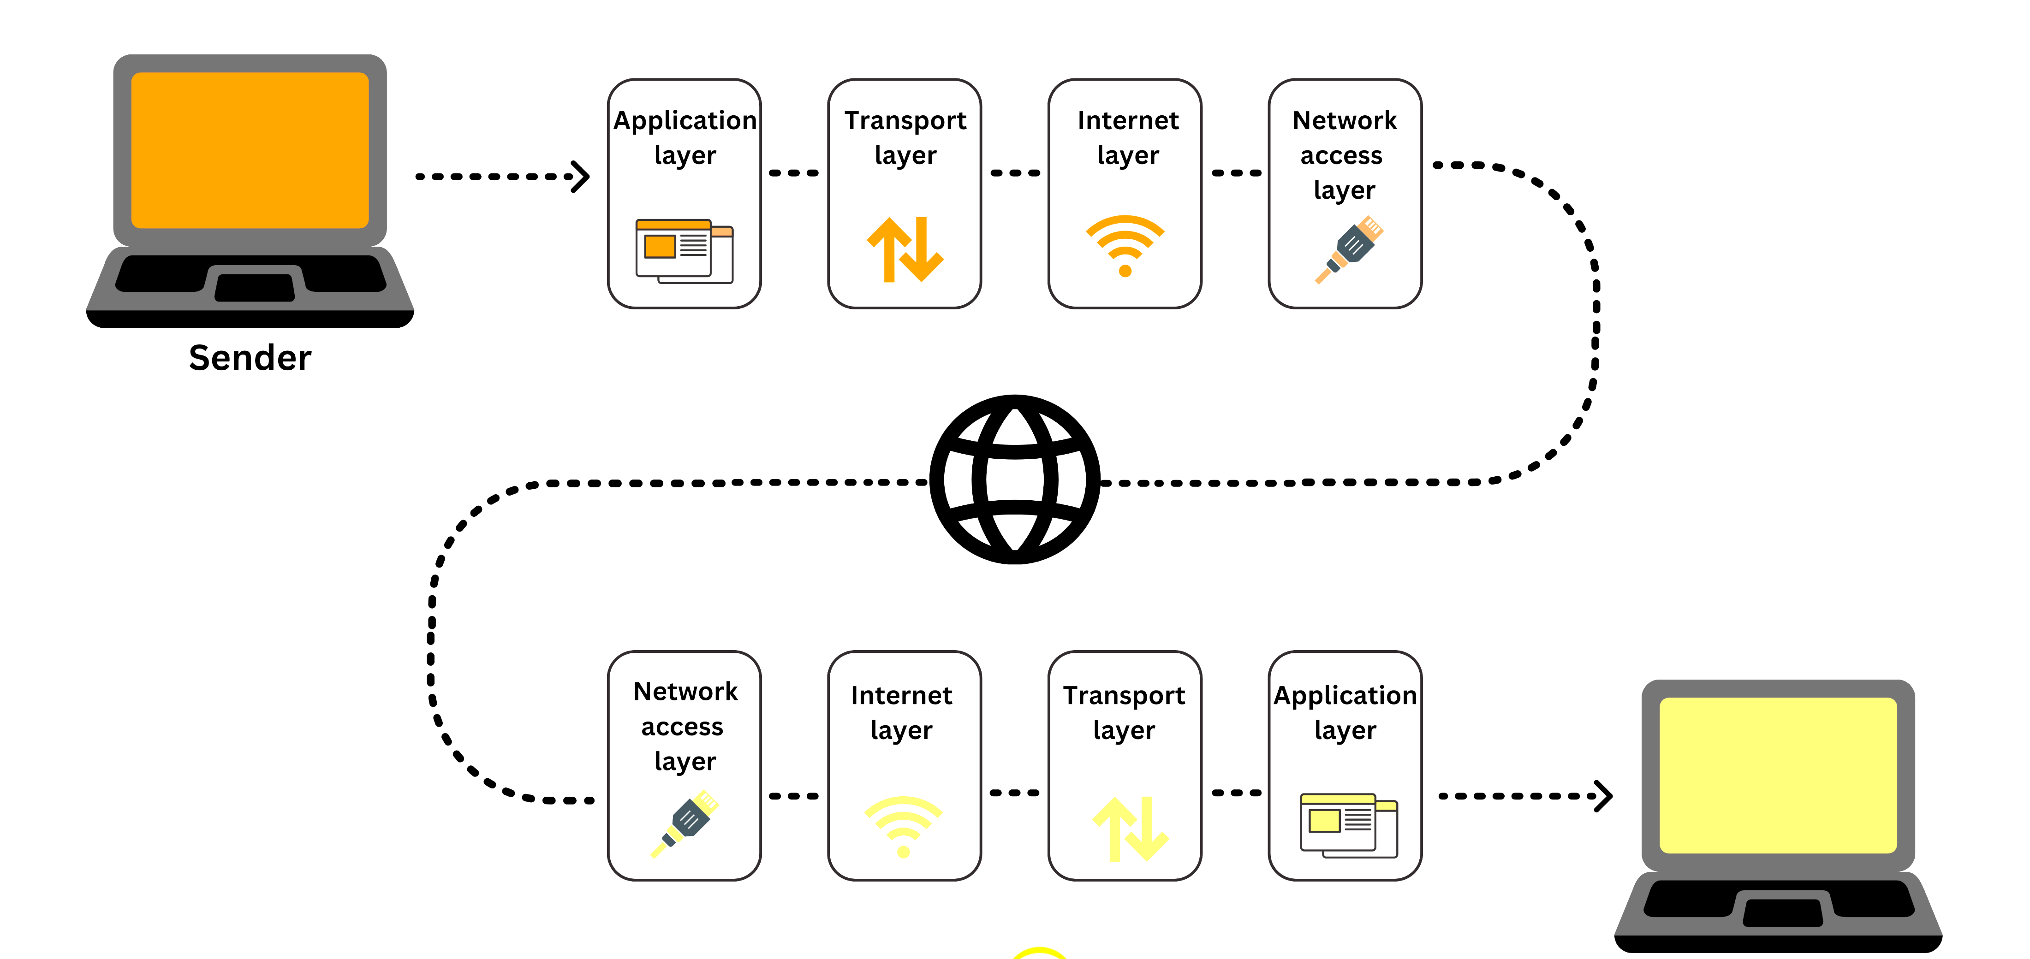
IP/TCP protocol
Application layer
Transport layer
Internet layer
Network access layer
How does TCP/IP[5]

Slide 5
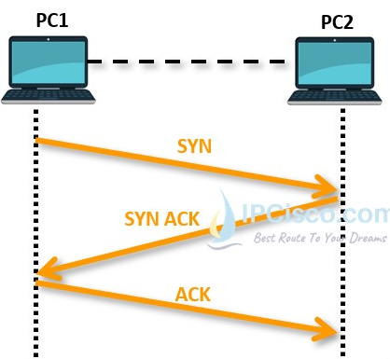
TCP 3-WAY HANDSHAKE PROCESS
The TCP 3-Way Handshake is a crucial mechanism for establishing a dependable connection between two devices within a TCP/IP network. This process consists of three key steps: SYN (Synchronize), SYN-ACK (Synchronize-Acknowledge), and ACK (Acknowledge). Throughout the handshake, the client and server share their initial sequence numbers and verify the establishment of the connection.[7]
Three-way handshake[6]

Slide 6

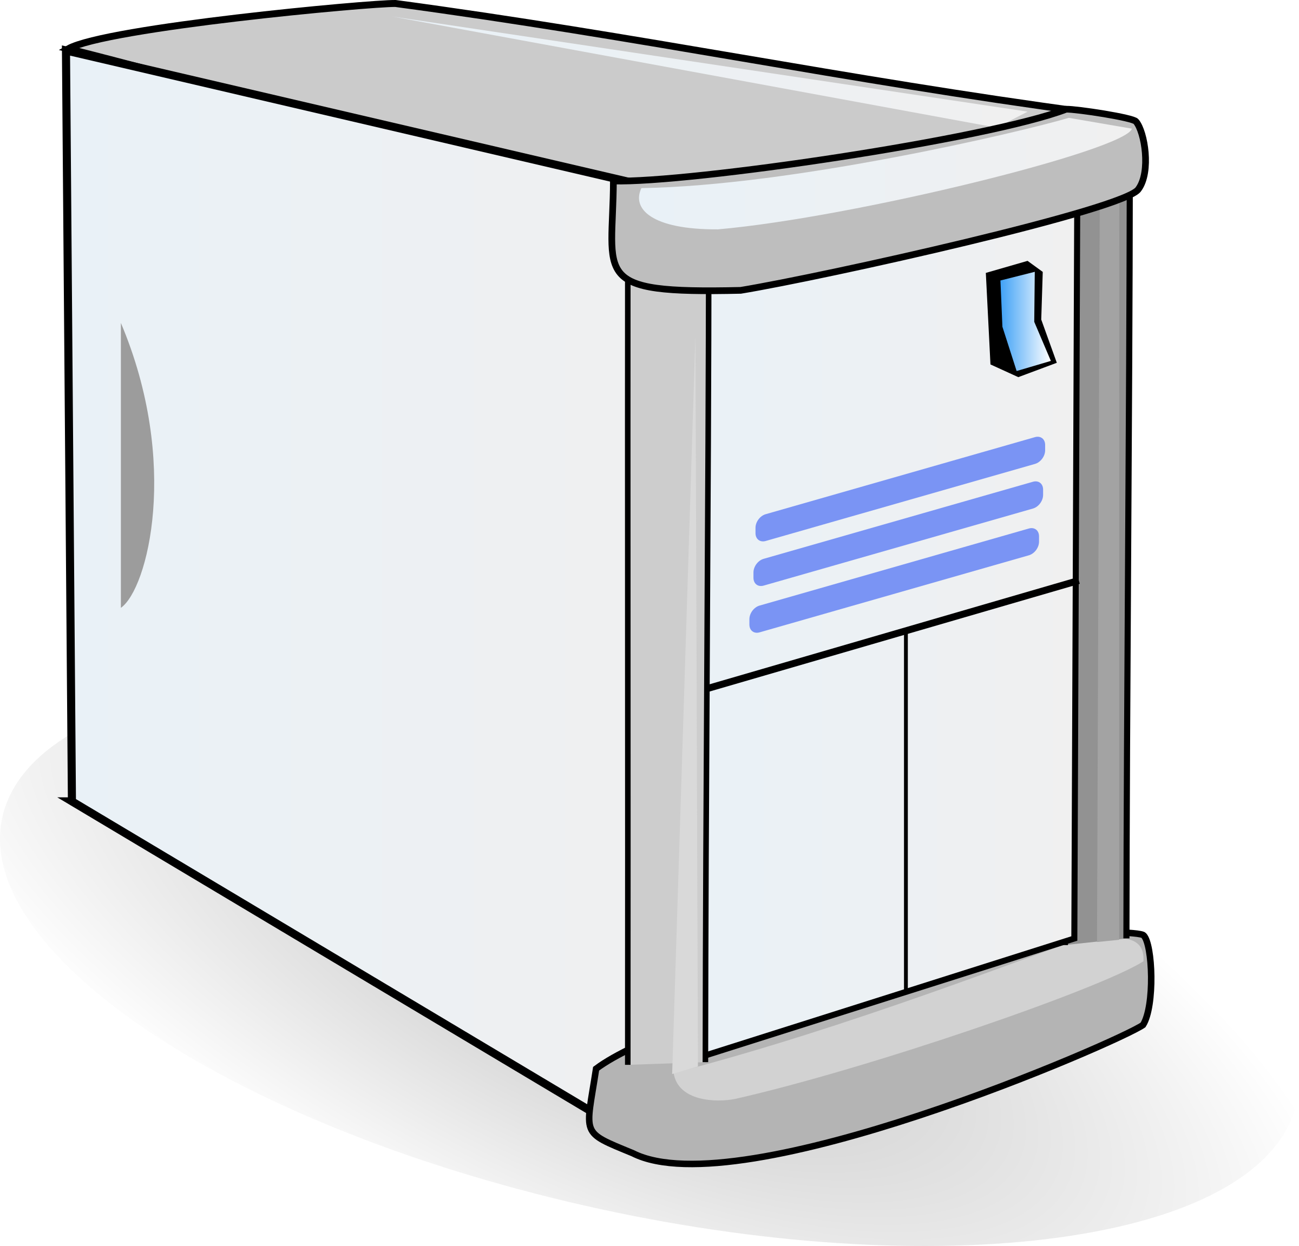
Denial-Of-Service Attack
a Denial of Service (DoS) attack is described as an intentional effort to disrupt the normal operation of a system, service, or network by flooding it with excessive traffic. This overload prevents legitimate users from accessing the targeted service. [8]
Denial of attack

Slide 7
Types of DoS attacks[11]
ICMP/Ping and
UDP Flood can be DoS or DDoS attack .
Syn flood can be DoS or DDoS ; if a single sources sends SYN packets, its DoS or if multiple sources(botnets) sends packets its DDoS.
Buffer overflow overloads memory by sending more data than the system can handle, causing crashes.
Teardrop attack sends malformed packets to crash the target system’s network stack.

Slide 8
Distributed Denial-Of-Service
A Distributed Denial-of-Service (DDoS) attack is a coordinated assault using numerous compromised hosts infected with malware.The attacker controls these hosts remotely to send excessive traffic to a target system or network. This overwhelms the target, often causing disruption to services or servers. The severity depends on the number of compromised devices and the intensity of the attack.[9]
DDOS attack[10]

Slide 9
Types of DDoS attacks[12]
Application Layer DDoS Attack: Aims to exhaust server resources by targeting the web application's core functionality, such as database queries or script execution. Measured in requests per second (RPS), it can be more difficult to detect and often requires fewer requests to cause significant damage.
Volumetric DDoS Attack: This attack overwhelms a target's server with massive traffic, often utilizing amplification techniques like DNS amplification. It’s the most common type, measured in bits or gigabits per second (Gbps), and floods the network to disrupt service.
Protocol DDoS Attack: Targets weaknesses in network protocols such as TCP/IP, often aiming to disrupt routers and firewalls. Measured in packets per second (pps), this attack type includes methods like SYN floods and UDP floods, leading to system unresponsiveness..

Slide 10
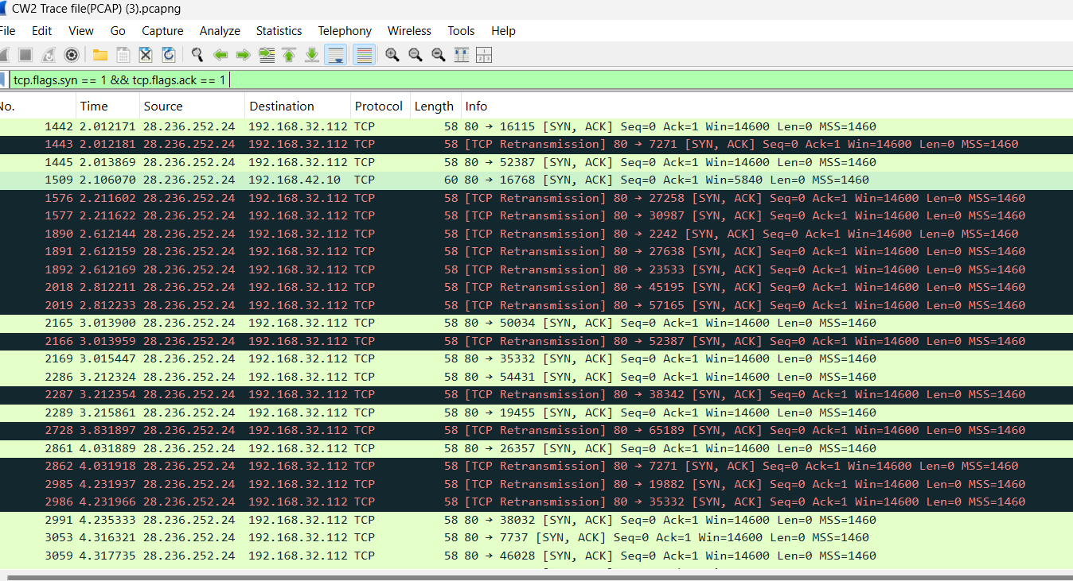
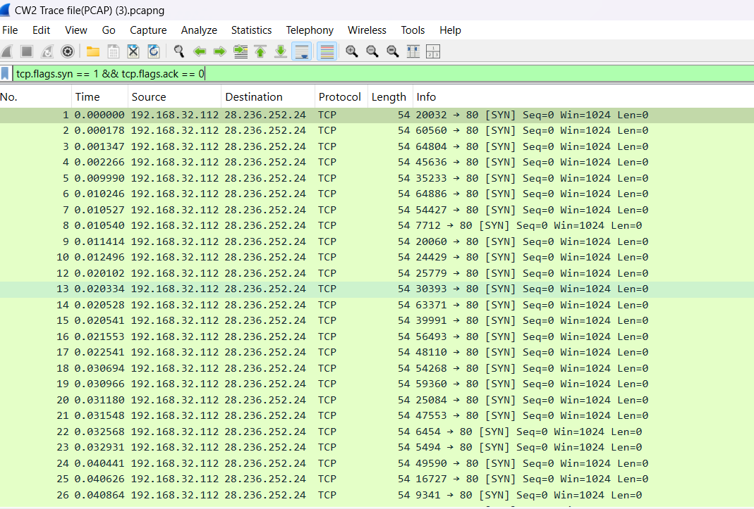
PCAP File represents DoS attack
OBSERVATION:- The PCAP file shows only two IPs, suggesting that a single attacker (or two systems) is initiating the attack. The absence of ACK responses after SYN and SYN-ACK packets indicates an incomplete TCP handshake, typical of a SYN flood DoS attack, which overwhelms the server and causes a Denial of Service..
Filter used: tcp.flags.syn == 1 && tcp.flags.ack == 0(requests)
Filter used: tcp.flags.syn == 1 && tcp.flags.ack == 1(Reponses)

Slide 11
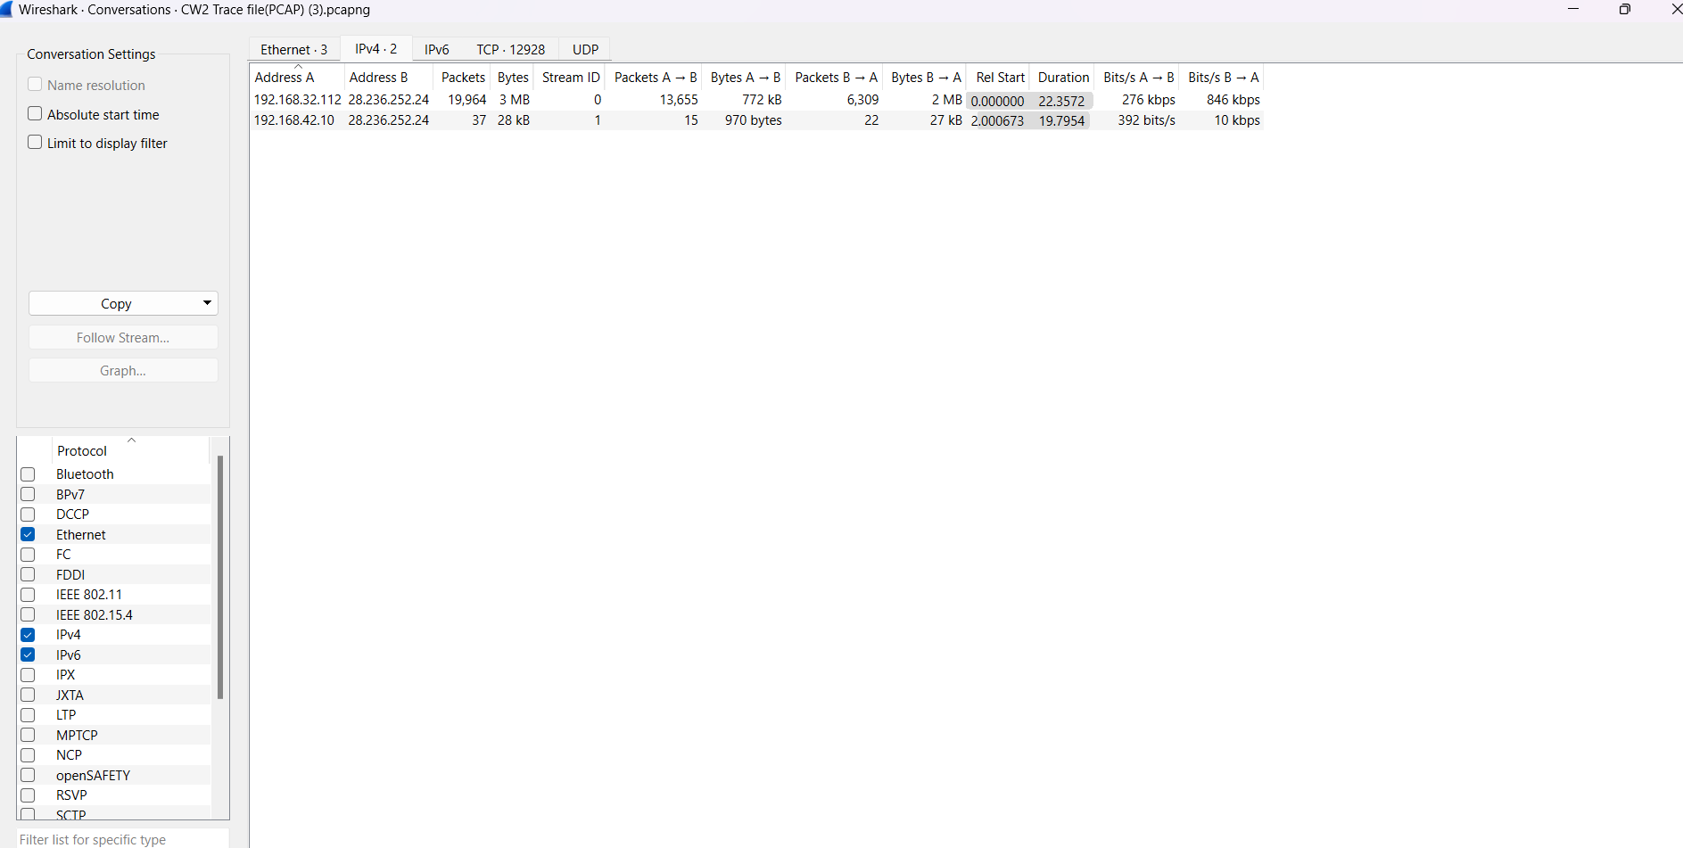
In this screenshot, the majority of traffic is coming from 192.168.32.112 to the destination(28.236.252.24),with high outgoing data from server shows potential response to a flood of requests. Another connection(192.168.42.10) represents minimal traffic which means its inactive or just testing the server. The victim sends syn-ack relies to each syn but the attacker does not finalize the handshake. This indicates DoS attack.
IP address(attacker): 192.168.32.112; victim id: 28.236.252.24
Given the high volume of traffic, the SYN flood pattern, and the server’s substantial responses to 192.168.32.112, this IP address is likely the attacker of the DoS or SYN flood attack.

Slide 12
causes
Weak network defenses: the network didn’t have tools like intrusion detection systems(IDS) or firewalls that could block harmful traffic This made it easier for attacks like SYN floods and port scans to go unnoticed.
Security settings/ mis configured firewall: The firewall wasn’t set up properly to block dangerous traffic, like too many connection requests or traffic from unknown sources. This made it easy for the attacker to carry out their attack without being stopped.
Unprotected Services: Some services were left open on the network, using ports that shouldn’t have been exposed. These services were either unnecessary or not properly secured, making it easy for attackers to scan and attack them.

Slide 13
countermeasures
Use syn cookies , rate limiting
Improve intrusion detection system
Fix firewall settings
Use web application firewalls to block malicious web traffic
Harden services
To conclude, The PCAP analysis showed SYN flood and port scanning attacks due to weak defenses and misconfigured firewalls. To prevent this, use SYN flood protection, improve IDS/IPS, and configure firewalls properly. Regular monitoring and patching are essential to enhance security. These steps will reduce future attack risks.

Slide 14
REFERENCES
[1] Forouzan, B. A. (2021). TCP/IP Protocol Suite (4th ed.). McGraw-Hill.
[2] Cloudflare, "User Datagram Protocol (UDP)," Cloudflare, 2024. [Online]. Available: https://www.cloudflare.com/learning/ddos/glossary/user-datagram-protocol-udp/. [Accessed: Nov. 19, 2024].
[3] Almabetter, “what is Transport protocol layer”, almabetter 2024,[online]. Available: https://www.almabetter.com/bytes/articles/transport-layer-protocols
[4] Johnson, Peter. Internet Protocols: Concepts and Architectures. HiTeX Press, 2024.
[5] ClouDNS, "TCP (Transmission Control Protocol): What is it and how does it work?," ClouDNS Blog, 2024. [Online]. Available: https://www.cloudns.net/blog/tcp-transmission-control-protocol-what-is-it-and-how-does-it-work/.
[6] IPCisco, "TCP Handshake," IPCisco, 2024. [Online]. Available: https://ipcisco.com/lesson/tcp-handshake/. [Accessed: Dec. 3, 2024].
[7] geeksforgeeks, “TCP 3-Way Handshake Process,” geeksforgeeks,2024. [online]. Available:
https://www.geeksforgeeks.org/tcp-3-way-handshake-process/. [ Accessed: Nov. 27,2024].
[8] Ortega-Fernandez and F. Liberati, "A review of Denial of Service attack and mitigation in the smart grid using reinforcement learning," Energies, vol. 16, no. 23, 2023.
.[9] D. K. Bhattacharyya and J. K. Kalita, DDoS Attacks: Evolution, Detection, Prevention, Reaction, and Tolerance. Boca Raton, FL: CRC Press, 2016
[10] SystemWeakness, "DDoS Attacks: When Thousands Show Up Uninvited to Crash Your Website Party," SystemWeakness, 2024. [Online]. Available: https://systemweakness.com/ddos-attacks-when-thousands-show-up-uninvited-to-crash-your-website-party-c134d4faaf66. [Accessed: Dec. 4, 2024].
[11] Wikipedia contributors. (2024, December 4). Denial-of-service attack. Wikipedia. https://en.wikipedia.org/wiki/Denial-of-service_attack
[12] Imperva. (2024). DDoS attacks. Imperva. Available at: https://www.imperva.com/learn/ddos/ddos-attacks/

