Slide 1
Amazon Product Review Sentiment Analysis
Project by Harsimran Kaur

Slide 2
Problem Statement
Amazon receives a huge number of customer reviews every day, making manual analysis slow and difficult.
Businesses need a fast way to understand whether reviews are positive, neutral, or negative.
This project automates review sentiment classification using Machine Learning and a Streamlit dashboard.

Slide 3
Project Objectives
Perform data cleaning and preprocessing on Amazon review data
Handle missing values and duplicate records
Apply feature engineering techniques for text reviews
Convert text into numerical features using TF-IDF
Train and compare machine learning models for sentiment classification
Deploy the best model using a Streamlit web app

Slide 4
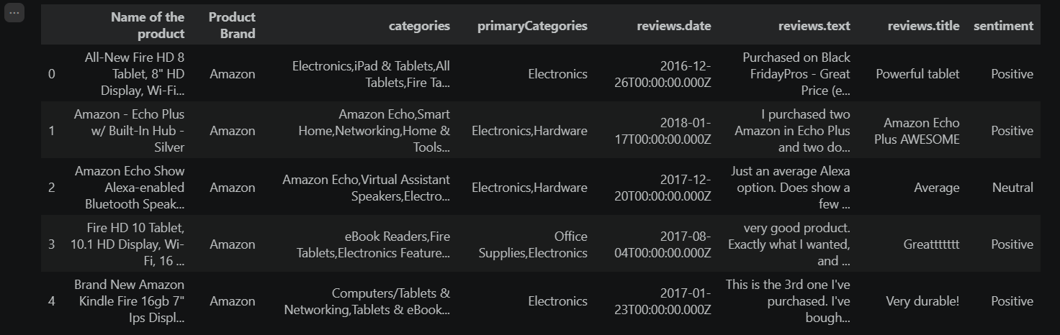
Dataset Overview
Dataset contains Amazon product reviews along with product information, review title, review text, date, and sentiment label.
Target variable: sentiment (Positive / Neutral / Negative).
Total dataset size used in EDA: 4000 records and 8 columns.

Slide 5
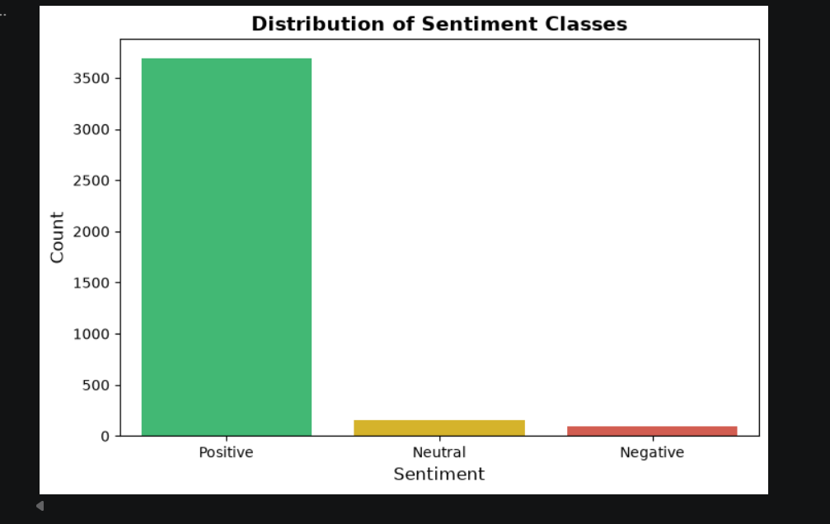
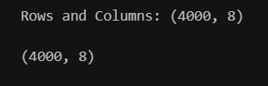
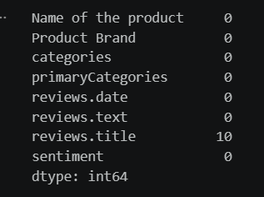
Exploratory Data Analysis (EDA) - Key Findings
The dataset contains 4000 rows and 8 columns, suitable for sentiment classification.
Only the reviews. title column had missing values (10 records); all other columns were complete.
The sentiment distribution was highly imbalanced, with Positive reviews dominating the dataset.
Frequent words such as great, love, and product gave useful signals about customer opinion.

Slide 6
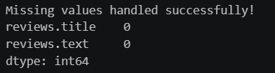
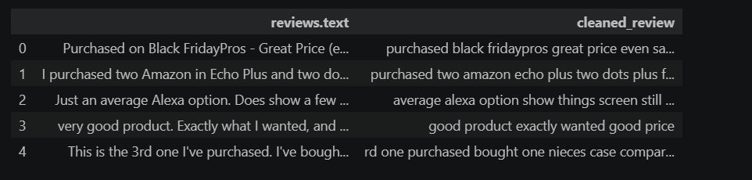

Data Preprocessing
Missing review titles were handled during preprocessing.
Review text was cleaned by converting to lowercase, removing URLs, punctuation, stopwords, and extra spaces.
Text data was transformed into numerical form using TF-IDF vectorization.
These steps prepared the review text for machine learning model training.

Slide 7
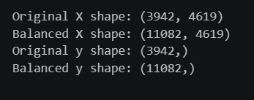
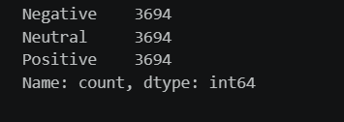
Class Balancing
The original dataset was imbalanced, which could bias the model toward the majority class.
RandomOverSampler was applied to balance all sentiment classes.
After balancing, each class had equal representation:
Negative = 3694, Neutral = 3694, Positive = 3694

Slide 8
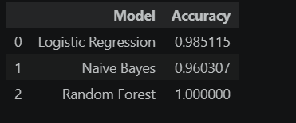
Models Trained and Compared
Logistic Regression — Accuracy: 98.51%
Naive Bayes — Accuracy: 96.03%
Random Forest — Accuracy: 100.00%
Multiple models were evaluated to choose the most suitable model for deployment.

Slide 9

Best Model Selected for Deployment
Final deployed model: Logistic Regression
Deployment accuracy: 98.51%
Although Random Forest achieved 100% accuracy during evaluation, Logistic Regression was selected because it is simpler, faster, and highly effective for text classification.

Slide 10
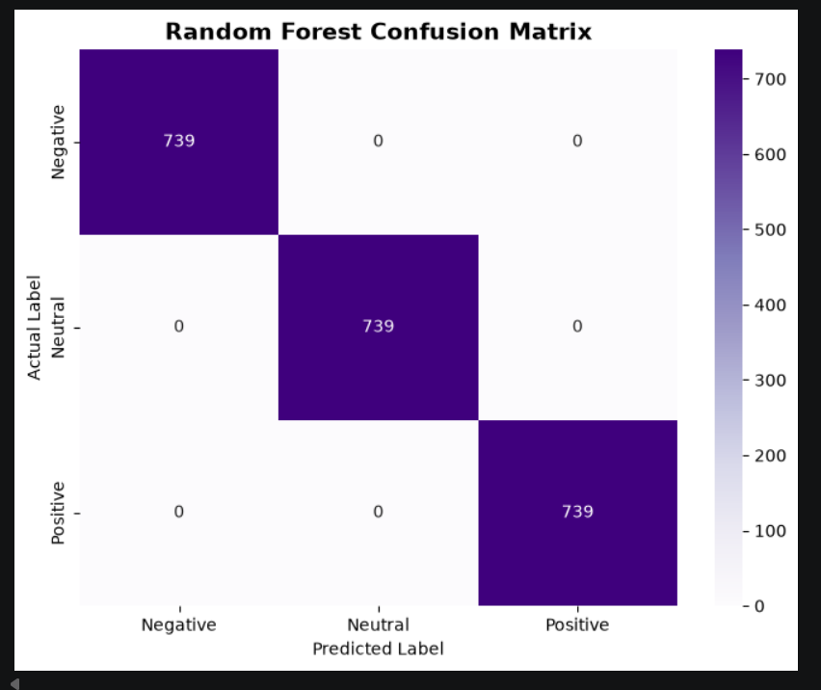
Model Performance - Confusion Matrix
The confusion matrix shows class-wise
prediction performance. The evaluated model
correctly classified Negative, Neutral, and
Positive reviews with very high accuracy.
This indicates strong performance of the trained
sentiment classification pipeline.

Slide 11
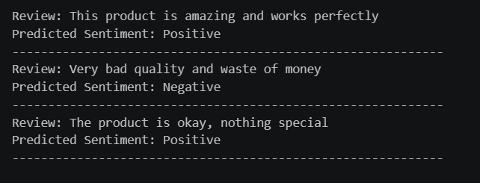
Sample Deployment Predictions
“This product is amazing and works perfectly” → Positive
“Very bad quality and waste of money” → Negative
“The product is okay, nothing special” → Neutral
The model correctly classified custom unseen review examples.

Slide 12
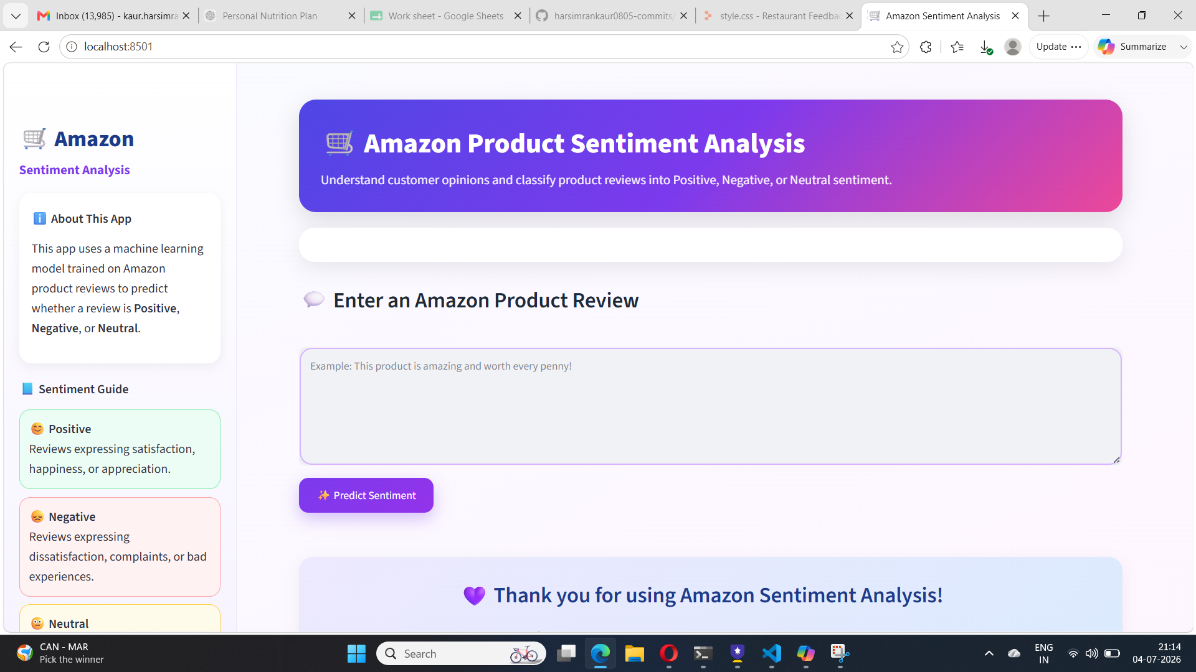
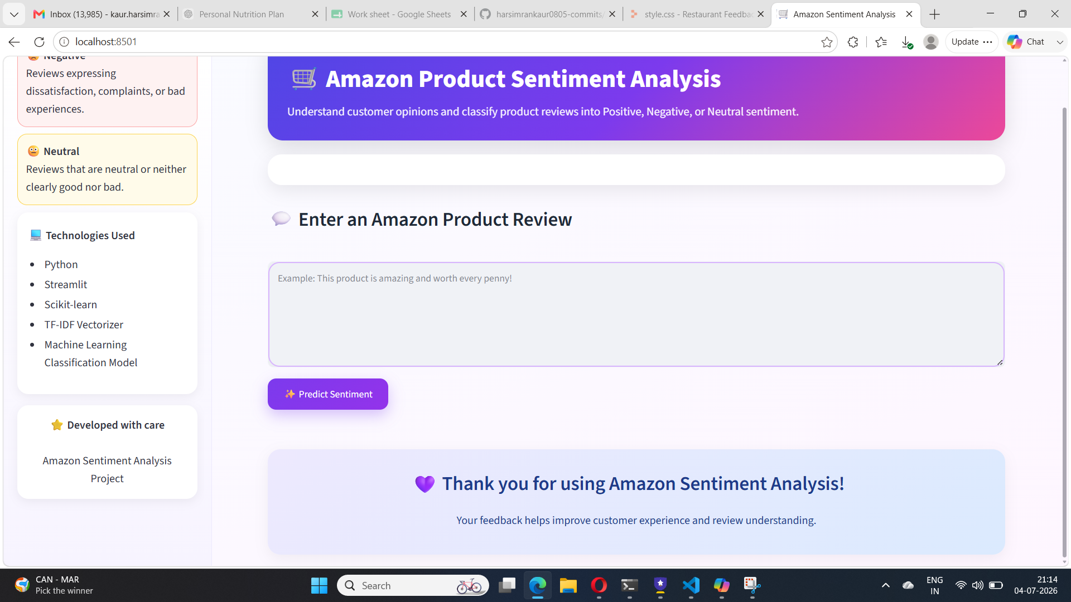
Streamlit Dashboard - Final Output
A Streamlit dashboard was created for real-time
sentiment prediction. Users can enter an Amazon product
review and click Predict Sentiment.
The app classifies the review as Positive, Negative, or Neutral
using the trained model and saved TF-IDF vectorizer.

Slide 13
Project Workflow
Data Collection
Exploratory Data Analysis (EDA)
Missing Value Handling & Text Cleaning
TF-IDF Feature Extraction
Class Balancing
Model Training & Evaluation
Best Model Selection
Streamlit Dashboard Deployment

Slide 14
Conclusion
Built an end-to-end sentiment analysis system for Amazon product reviews.
Performed EDA, preprocessing, class balancing, and model comparison.
Selected Logistic Regression as the final deployment model with strong performance.
Created a Streamlit dashboard for user-friendly real-time sentiment prediction.

Slide 15
Future Scope
Use a larger real-world dataset for better generalization.
Experiment with advanced NLP models such as LSTM, GRU, or BERT.
Deploy the dashboard online for public access and live predictions.
Add product-wise review analytics and sentiment trend visualizations.

Slide 16
Thank You

