Slide 1
R based Shiny App for interactive stock analysis
By M.S.Arjun
And
Harsimrat Kaur

Slide 2
Problem statement
To develop a system which can analyze and predict the stocks of users interest .
Must be easy to use
Should be interactive
Should produce effective analysis
Should be able to predict the stock values

Slide 3


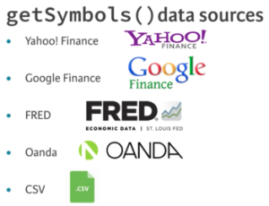
Proposed Solution

Slide 4
Proposed solution
Shiny-highly interactive, easy to use and easy to plot
Quantmod- Easily pull down stock data from internet
Astsa, Fpp2, Forecast- Easy to analyze predict and stock values
Xts ,Zoo - Used for data manipulation and plotting
All these combined to get the simple yet a powerful solution for stock analysis

Slide 5
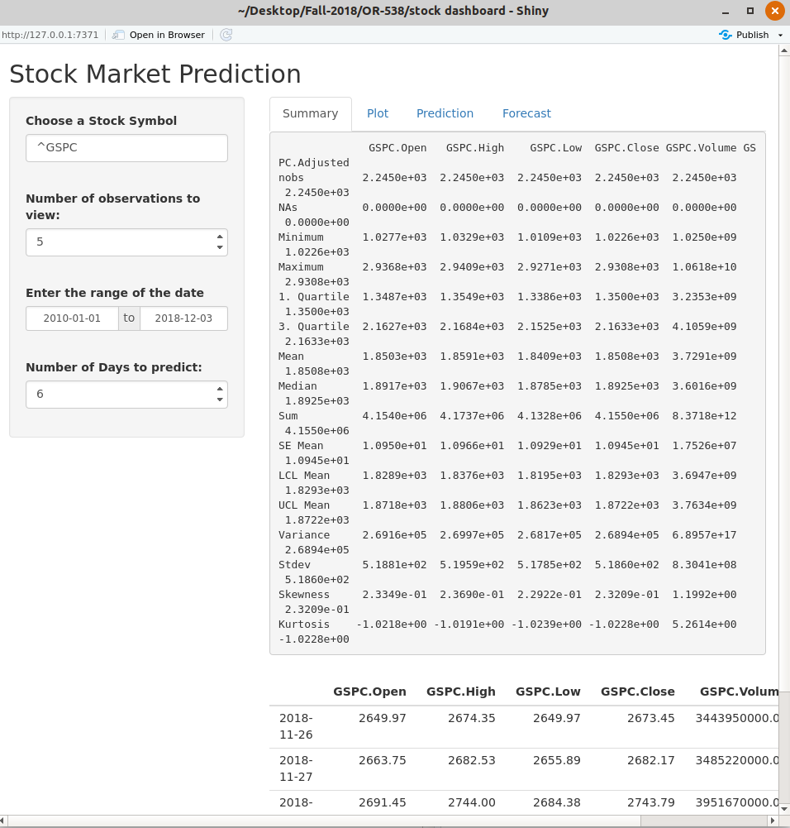
Initial Development

Slide 6
Data Downloading
We provided a field box for the user to enter the stock Symbol of his interest .
The getSymbol.yahoo function was used for downloading
User must provide Yahoo’s stock Symbols for downloading

Slide 7
Stock Plots
The Xts and zoo frameworks was used for data manipulation
They also provided good plotting functions
Plot.xts , acf.plot were used for ploting

Slide 8
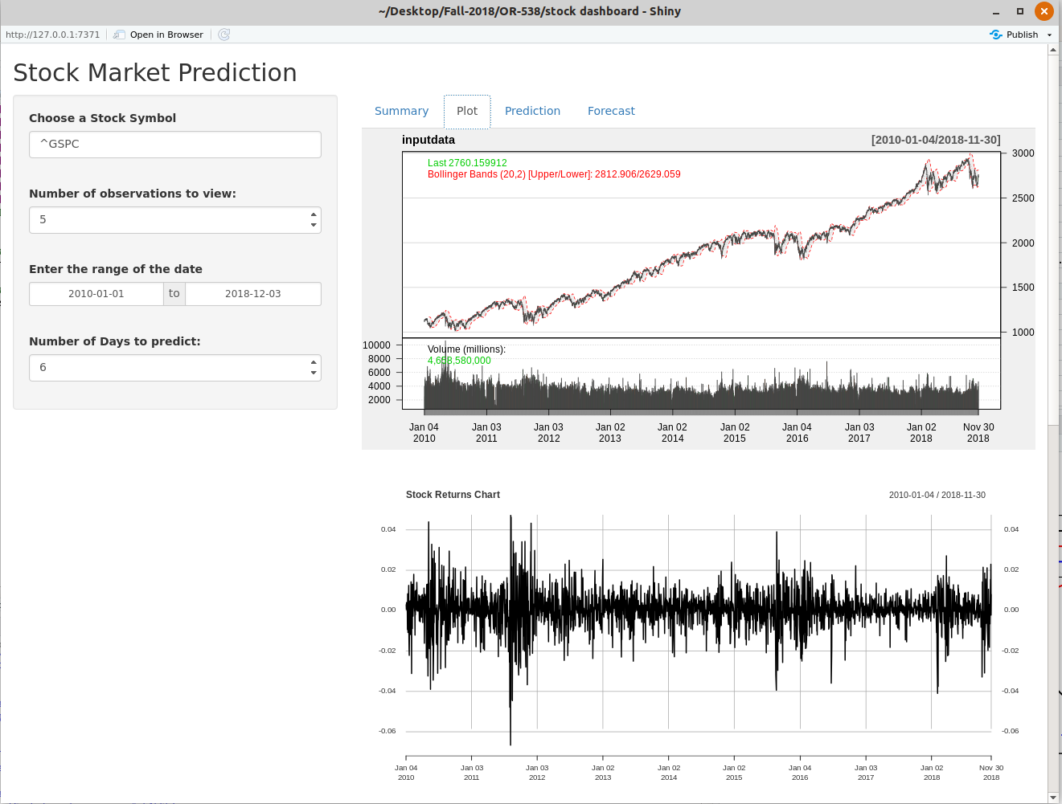

Slide 9
Stock prediction and forecast
We used the FPP2 ,astsa and forecast packages to predict and forecast the stocks
Auto.arima function returned the best fitting ARIMA values to the stock
Forecast takes in the arima and gives the upcoming stock values
Autoplot is used to plot the future stock values

Slide 10
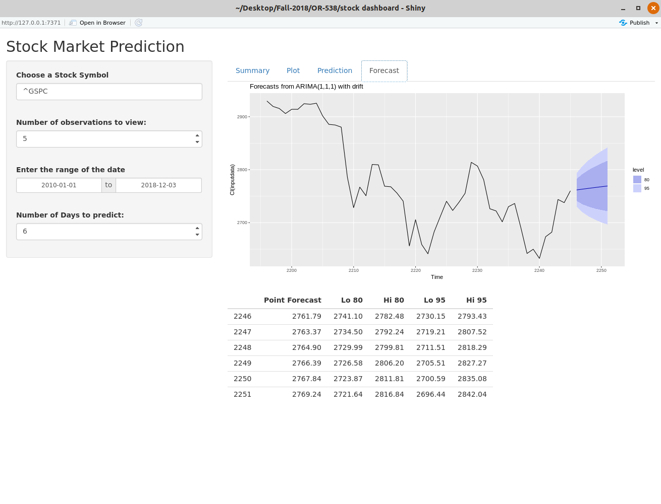

Slide 11
Validation
We used to AIC and BIC score from the model to estimate how well the model fits
For the stock values predicted we had to manually cross verify the next day stock values

Slide 12
Further Works
Improve the Efficiency of the model (Use neural networks and deep learning to predict the stock values for better result prediction)
Better charting techniques (using dygraphs and advanced plotting functions)
Better predictors ( Implement residual analysis and MSE scores)
Less sophisticated (???)

Slide 13


Slide 14


