Slide 1
Kerberos
Harsimrat Singh

Slide 2
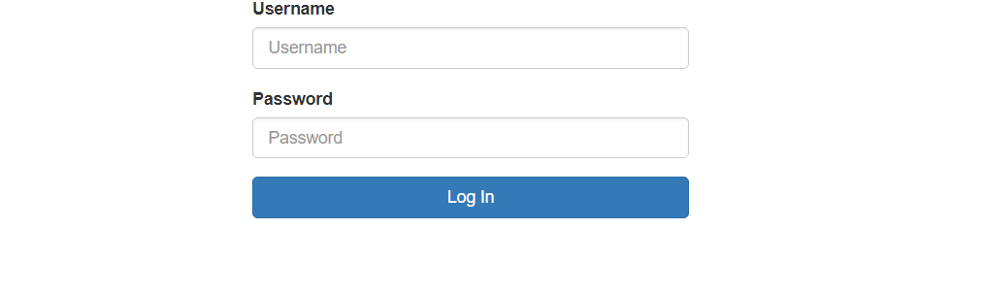
Implementation
Created a local web server where user enters credentials

Slide 3
Implementation
Then AS verifies whether credentials are correct
If yes, then it generates a ticket and key and sends it to user
User ask for session key from TGS and send the ticket from AS
TGS gives another ticket to user for server and generates a session key

Slide 4
Implementation
User sends ticket generated by TGS to server
Server verifies the ticket and give access to data of user

Slide 5
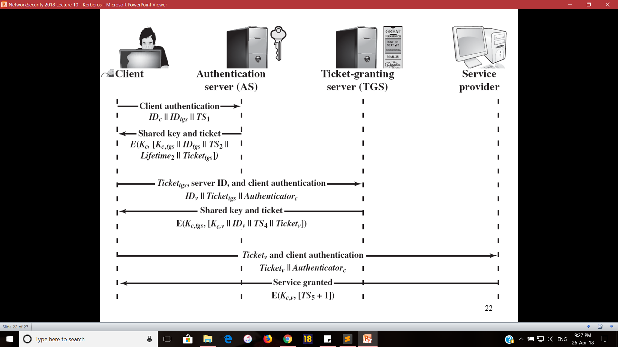

Slide 6
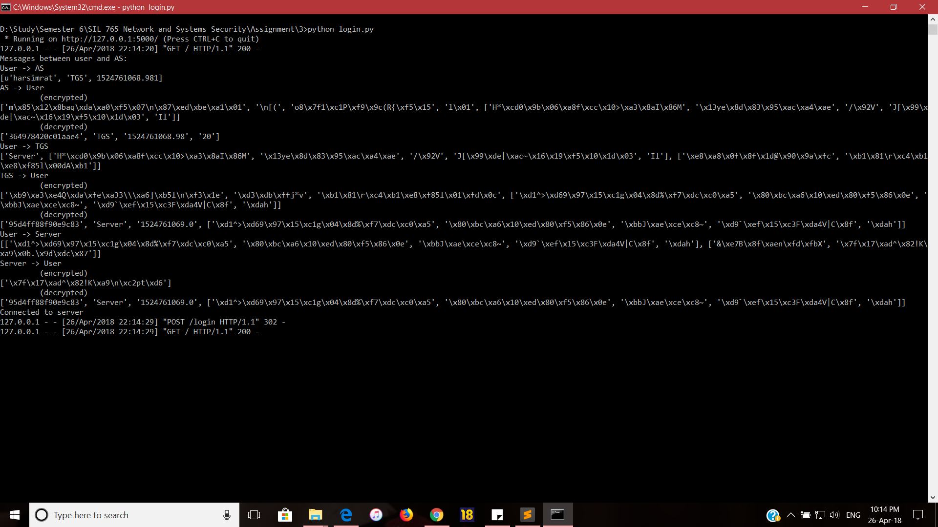
Demonstration

Slide 7
Demonstration

Slide 8
Demonstration

