Slide 1

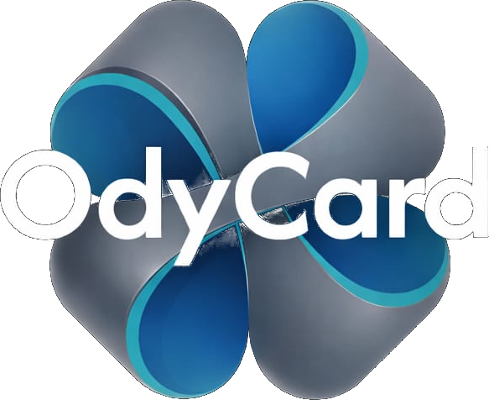


PREPARED FOR
ODYSRA · ODYCARD PRESENTS
An AI Waiter,
built only for Annapoorna.
A custom AI dining assistant on a simple table QR — it recommends, answers every question, and helps each guest order better.
Scan. Ask. Order.
Odysra — an era of good fortune

Slide 2





WHO WE ARE
One company. One product. One assistant for you.
ODYSRA
ODYCARD
AI WAITER
The parent company
The product
A custom AI chatbot · this project
Our venture — “an era of good fortune.”
A modern, smart menu card — your menu, reimagined.
Built only for Sree Annapoorna — the smart dining assistant inside OdyCard.
This is the assistant we're presenting to you today.
OdyCard · An Odysra product
2

Slide 3

LET'S START WITH A QUESTION
Picture your busiest Sunday lunch…
?
When every table fills at once, who tells each guest about today's specials?
How many dishes go unnoticed — simply because no one described them?
How tired is your waiter by the hundredth “what's good here?”
How many guests order less than they'd love to, just because they didn't know?
Let's answer that →

Slide 4




THE PROBLEM
A great waiter simply can't be everywhere at once.
The rush bottleneck
Hidden dishes
At peak hours, staff can't describe every dish to every table. Guests wait, or just guess.
Your specials and best dishes stay invisible when there's no one to pitch them.
Under-ordering
Tiring & untracked
Guests order less than they'd enjoy — only because they didn't know the options.
Waiters repeat the same answers all day, and you capture none of what guests actually wanted.
OdyCard · An Odysra product
4

Slide 5

OUR OBJECTIVE
Give every table a tireless AI waiter.
Know the menu perfectly
Every dish, price, and detail — always at hand.
Recommend & upsell honestly
Lift the bill by being genuinely helpful, never pushy.
One that knows your entire menu, recommends like your best server, and helps guests order more — while easing the load on your staff.
Lighten the staff workload
The chatbot answers; your team focuses on service.
Built only for Annapoorna
A bespoke assistant, tuned to your restaurant.
OdyCard · An Odysra product
5

Slide 6
YOU MIGHT BE WONDERING
“Isn't this just ChatGPT or a QR-code menu?”
?
Can a normal QR menu actually recommend dishes like a seasoned waiter?
Does a generic chatbot know Annapoorna's real menu, prices, and what's sold out right now?
Can it talk to your guests in Tamil?
Can it get smarter every single day — without costing a fortune?
Here's what makes it different →

Slide 7




WHAT MAKES IT DIFFERENT
Not a generic bot. Your bot.
Grounded on YOUR menu
AI Waiter
It speaks only from Annapoorna's real dishes and prices — it never invents.
Speaks your guests' language
“Something light & not too spicy?”
Tamil & English to start — built to scale to Hindi, Malayalam, Telugu & Kannada.
Honestly margin-aware
Try our Ghee Pongal — a guest favourite, mild and comforting. Pairs perfectly with hot filter coffee.
Gently favours your profitable dishes — framed by taste, never price. Guests never feel pushed.
Learns every day
Gets smarter from each chat and from your existing Google reviews.
Built only for you
Grounded · in Tamil too · always available
A custom assistant for Sree Annapoorna — not an off-the-shelf app.
OdyCard · An Odysra product
7

Slide 8
THE BIG WORRY WITH AI
“Smart AI is expensive. So how do we keep it cheap?”
?
How can it answer instantly without running up huge AI bills?
How does it always know what's sold out — in real time?
How does it get smarter over time without costly retraining?
The secret: two brains →

Slide 9


HOW IT WORKS
Two brains — one fast, one smart.
Guest asks
ALPHA
BETA
price · spice · what's good?
fast brain · answers free
AI brain · only when needed
ALPHA — the quick brain
BETA — the AI brain
Handles the common questions: prices, availability, timings, restaurant info.
Answers instantly, at zero AI cost.
Reads availability live — so it's never wrong about what's sold out.
Handles real conversations and recommendations using top AI (Gemini).
Only the tricky questions ever reach it — keeping costs low.
Teaches Alpha as it goes, so the chatbot keeps getting smarter.
Grounded on your live menu. Most questions are answered free by Alpha — only the tricky ones reach Beta.
OdyCard · An Odysra product
9

Slide 10
NOW THE FUN PART
So… what can the AI chatbot actually do at the table?
?
Can it recommend the perfect dish for a guest's mood and budget?
Can it answer “is this Jain?” or “how spicy is it?” in a second?
Can it handle a banquet-hall enquiry while you're busy serving?
Can it remember what guests loved — and tell you?
Here's the full skill set →

Slide 11



WHAT THE CHATBOT DOES
Your AI waiter's full skill set.
Smart recommendations
Answers any question
Live availability
Banquet enquiries
Suggests dishes by taste, mood & budget — like your best server.
Ingredients, spice, Jain / no onion-garlic — instantly.
Never recommends a dish that's sold out.
Answers hall questions & captures booking leads, 24/7.
Restaurant info
Up to 6 languages
Customer feedback
Dish photos
Timings, location, parking, seating — all covered.
Tamil & English now; Hindi, Malayalam, Telugu, Kannada ready.
Collects feedback and flags problems to your manager fast.
Shows tempting photos so guests order with their eyes.
OdyCard · An Odysra product
11

Slide 12



MORE THAN A CHATBOT
One assistant. The power of two systems.
CRM
TMS
Customer Relationship Management
Table & Menu Management
Remembers guest preferences & feedback
Surfaces what guests love — and what's missing
Turns every chat into real customer data
Live menu, prices & availability
Captures banquet & booking enquiries
Recommends to lift each order, eases staff load
CRM + TMS, combined into one simple QR chat. Speaks up to 6 languages — English · Tamil · Hindi · Malayalam · Telugu · Kannada (Tamil & English first).
OdyCard · An Odysra product
12

Slide 13




WHAT ANNAPOORNA GAINS
More orders, lighter load, zero missed leads.
Higher bills, naturally
Lighter load on staff
Guest: “Something light.” → AI: “Our Ghee Pongal is a favourite — lovely with filter coffee.” A gentle nudge lifts the average bill, and the guest still feels cared for.
The chatbot fields the endless “what's good?” and “is it spicy?” questions, so your team focuses on serving, not explaining.
Never miss a banquet lead
Know your guests
A wedding enquiry at 11 pm? The chatbot answers and captures their number — even when you're closed.
See what guests ask for, what's in demand, and what's missing — real data you never had before.
OdyCard · An Odysra product
13

Slide 14


EXPECTED OUTCOMES
What success looks like.
Average bill
Wait for answers
Banquet leads
Guest delight & repeats
Gentle, honest upselling on every table.
Guests get help instantly, even at peak.
Round-the-clock enquiry capture.
A memorable, modern dining touch.
Directional, based on how guided menus and digital ordering perform — actuals firm up during the pilot.
OdyCard · An Odysra product
14

Slide 15






WHERE THIS GOES NEXT
We're starting with chat. We're not stopping there.
Dish videos
AR food view
Voice ordering
Short clips so guests see the sizzle, not just a photo.
Point the phone at the table and see the dish in 3D, life-size.
Guests simply talk to the chatbot, hands-free.
Personalised regulars
All branches, one brain
…and more
Signed-in guests get picks based on past visits.
Roll it out across every Annapoorna outlet.
We grow the assistant alongside your restaurant.
OdyCard · An Odysra product
15

Slide 16


Thank you.
Odysra — an era of good fortune
Custom-built for Sree Annapoorna
Harsith
+91 00000 00000
you@odysra.com

