Slide 1
INVESTMENT COMMITTEE · PRELIMINARY SCREENING
Project Aspen
Should we acquire a 20,000-hectare boreal timberland tract in north-central Alberta, and at what price?
HYPOTHETICAL TRANSACTION: the tract does not exist. Built to demonstrate method, not to recommend an investment.
Harsit Baral
Renewable Resources, timberland and farmland | all figures in real CAD
Notes:
Project Aspen is a hypothetical timberland acquisition I built end to end to show how I
would underwrite a real one: a 20,000-hectare boreal mixedwood tract in north-central
Alberta, offered at $92.0M, or
$4,600 a hectare.
Say clearly up front that the tract is invented. Everything about the property is an
illustrative assumption documented in a single YAML file with a source field. The market
data in the last section is real and cited.
The question the deck answers is not just "is this a good asset" but "what is the most we
should pay, and what could go wrong". Three deliverables sit behind it: a live-formula
Excel model, a Monte Carlo risk engine, and a market study testing the diversification
and inflation claims the asset class is usually sold on.

Slide 2
RECOMMENDATION
Buy, but only below $109.5M: at the $92.0M ask the tract returns 7.5% against a 6% hurdle
PROJECT IRR
NET PRESENT VALUE
BREAKEVEN PRICE
MONEY MULTIPLE
7.5%
$17.7M
$109.5M
2.91x
+152 bps above the 6% hurdle
discounted at 6.0% real
+19% vs the ask ($5,477/ha)
undiscounted, over 30 years
WHY
▪ We are buying standing inventory, not growth. The tract carries 3.58 million m³ today, 179 m³ a hectare, against 0.50 million for a fully regulated forest. That mature surplus is the return; the biology adds little over 30 years.
▪ The price, not the forecast, decides the outcome. Moving the offer ±30% swings the IRR by roughly six points; moving long-run real price growth across a full point moves it by two. Discipline on entry is the whole game, which is why the recommendation is a price, not a yes.
▪ The margin is real but thin. Stumpage can fall about 15% before the deal breaks, and 10% of simulated paths miss the hurdle. This clears, but it is not a bargain.
CONDITIONS
1. Cap the bid at $109.5M. Above that the deal destroys value at our cost of capital.
2. Verify the inventory with an independent timber cruise before confirming price. The whole case rests on the volume that is standing there today.
3. Negotiate harvest-timing latitude into any mill supply agreement. That flexibility alone is worth $3.5M.
Project Aspen · hypothetical tract, prepared for portfolio purposes only · not investment advice
2
Notes:
The recommendation is conditional and the condition is the price.
At the $92.0M ask the model returns 7.52% real and
unlevered against a 6.0% hurdle, an NPV of $17.7M. That
clears, so the answer is buy. But the number that matters is the breakeven,
$109.5M or $5,477 a hectare. That is
19% above the ask, and it is the ceiling I would take
into a negotiation.
On the first bullet: this is fundamentally a liquidation-of-surplus story. The tract holds
179 m³ a hectare against a
regulated level of about
25. We harvest the excess
down over thirty years and sell a normalised forest. If asked "where does the return come
from", the answer is the mature timber, not the growth.
Be honest about the weaknesses: the growth curve is illustrative, and
10% of paths miss the hurdle. I would not present this
as a high-conviction deal. It is a priced-about-right deal where execution and entry
discipline decide the result.

Slide 3
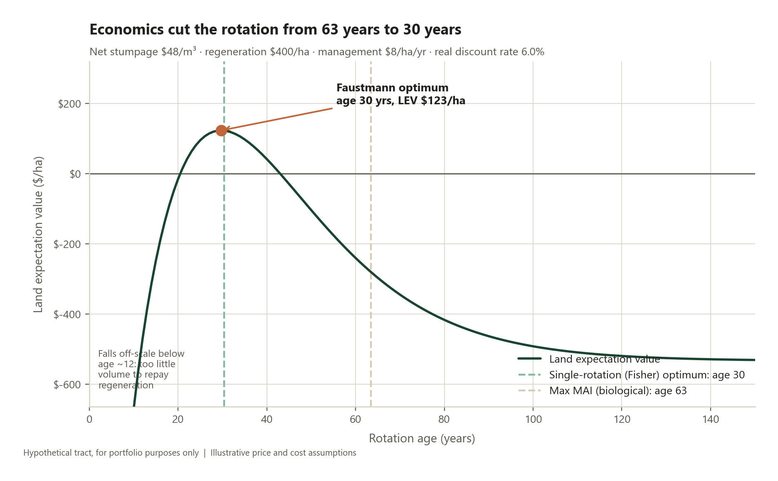
BIOLOGICAL GROWTH AND OPTIMAL ROTATION
Discounting cuts the optimal rotation from 63 years to 30, and that decision sets every cash flow that follows
THREE ANSWERS, ONE QUESTION
Maximum MAI
63.5 yrs
Peak 3.40 m³/ha/yr. Maximises wood, ignores money.
Single rotation (Fisher)
30.4 yrs
Counts interest on the standing timber, but not on the land under it.
Faustmann
29.7 yrs
LEV $123/ha. Also counts the delay to every future rotation, so it is the shortest. Rounded to 30 years for scheduling.
Caveat: a 30-year rotation is far shorter than the 70-100 years Alberta boreal stands are actually managed on. That gap is driven by the illustrative growth curve and the 6% real discount rate, and it is the first assumption I would replace with published growth-and-yield data.
Project Aspen · hypothetical tract, prepared for portfolio purposes only · not investment advice
3
Notes:
This slide is the forestry content, and it is where the model earns its keep.
Three rotation ages, all defensible, all different. Maximum mean annual increment says cut
at 63 years: that maximises wood per year and ignores money entirely.
Fisher's single-rotation NPV says 30 years: it discounts, so it cuts
earlier. Faustmann says 30 years, and it is the shortest because it counts
one thing the others miss: while you wait, the land itself is tied up, and so is every
rotation that would have followed. That opportunity cost is the land expectation value,
$123 a hectare here.
A good follow-up question is why the curve falls so steeply after the peak. Past the
optimum you are earning a biological growth rate below the discount rate on an
increasingly valuable asset, so you are destroying value every year you wait.
Another: a higher timber price actually *shortens* the Faustmann rotation, which surprises
people. Richer land raises the opportunity cost of waiting faster than the extra volume
repays it.
Do not oversell this. A 30-year rotation is not what anyone operates in the Alberta boreal.
That is a function of my illustrative parameters, and I say so on the slide rather than
hoping nobody notices.

Slide 4
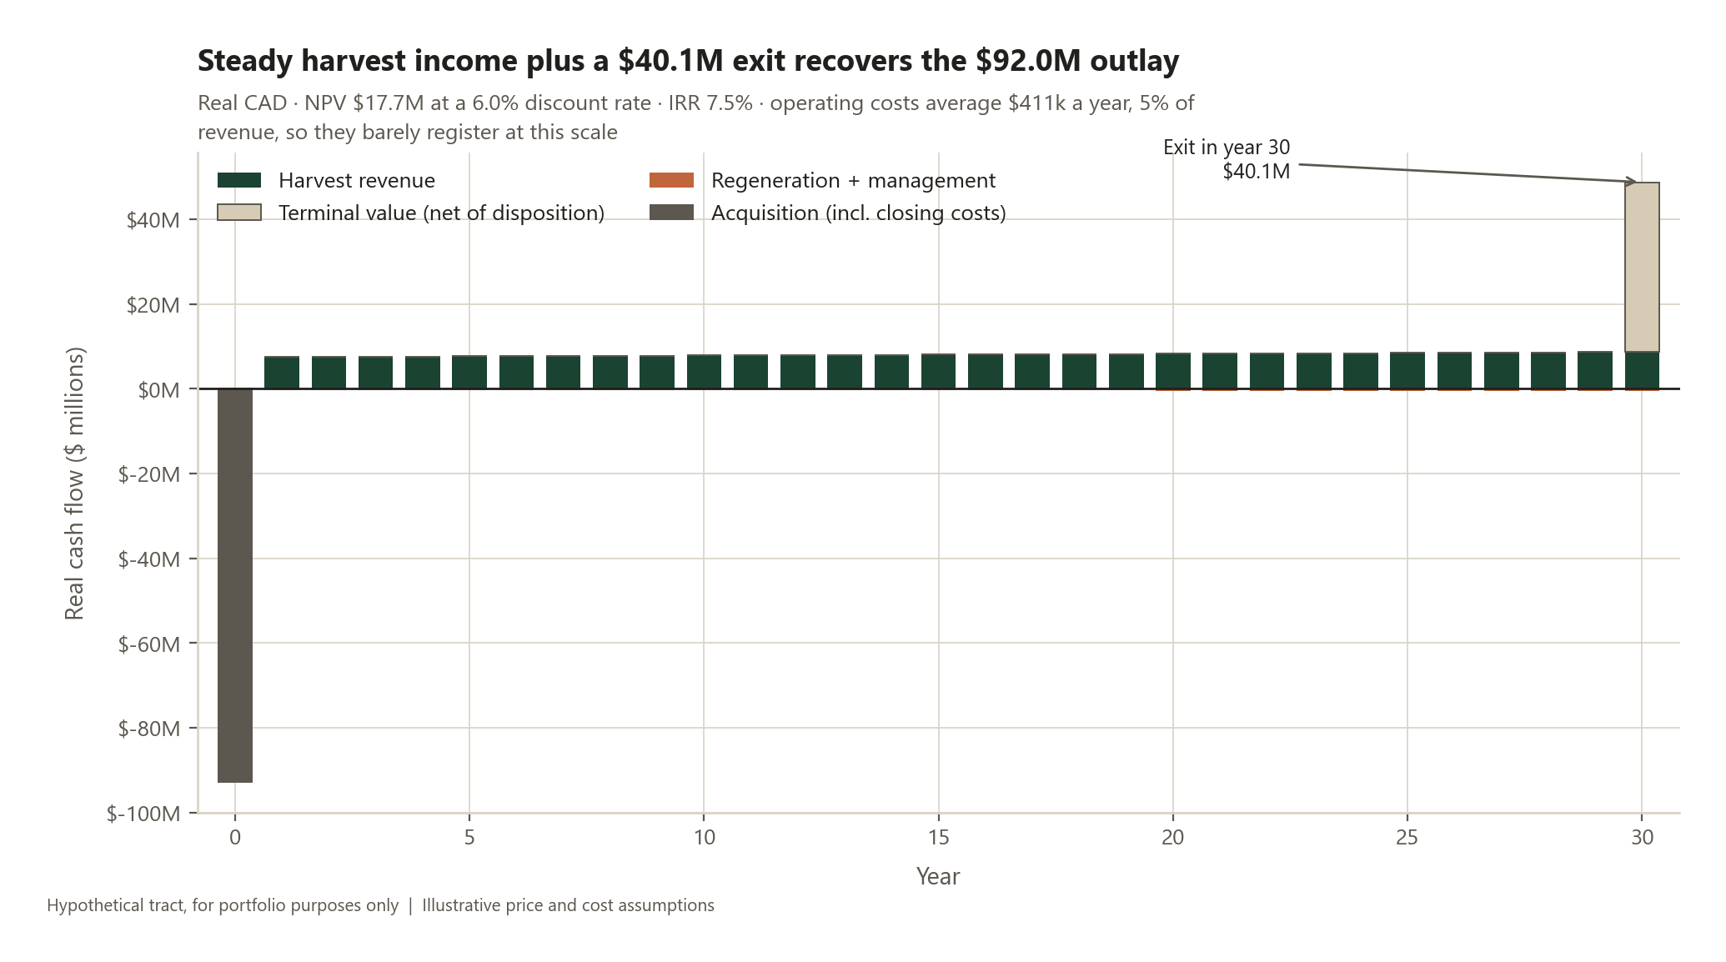
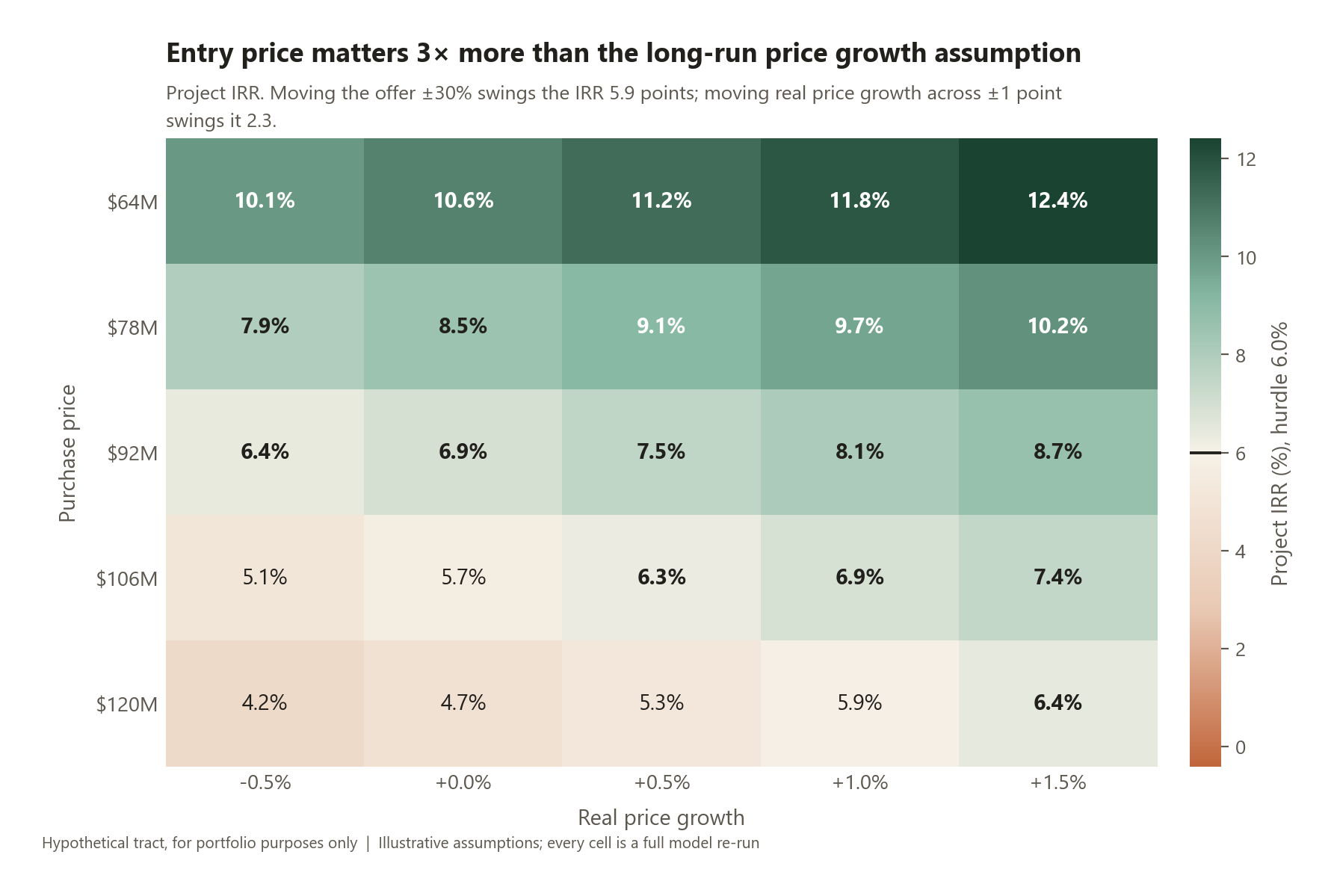
VALUATION AND SENSITIVITY
The return absorbs a 15% fall in stumpage, but not a 19% rise in the price we pay
SUSTAINABLE CUT
EXIT VALUE
BREAKEVEN STUMPAGE
BREAKEVEN PRICE
156k m³/yr
$40.1M
$41/m³
$5,477/ha
held within ±15% every year
$4.8M land + $35.3M standing timber
vs $48 assumed
vs $4,600/ha asked
Project Aspen · hypothetical tract, prepared for portfolio purposes only · not investment advice
4
Notes:
Left chart: the cash flow shape. One large outflow at close, thirty years of steady harvest
income of roughly $8.1M a year, and
an exit worth $40.1M. Operating costs are about 5% of revenue,
which is why they barely show.
The exit is not a hand-waved multiple. It is the bare land value in perpetuity,
$4.8M, plus the standing timber we leave behind,
$35.3M, priced stand by stand off the year-30 age
distribution. In the workbook that whole calculation is live formulas.
Right chart: the two-way grid. Read down for the entry price, across for the long-run real
price growth assumption. The vertical spread dwarfs the horizontal one, which is the point
- we control the price we pay and we do not control the commodity.
The single most useful number here is the breakeven stumpage of $41 a cubic
metre against $48 assumed. Prices would have
to sit 15% below assumption, on average, for thirty years, before this deal fails.
That is a real cushion, though not a large one by timberland standards.
If challenged on the discount rate: it barely moves the IRR, because it touches only the
rotation age and the exit price, not the operating cash flows. The grid in the workbook
shows that explicitly.

Slide 5
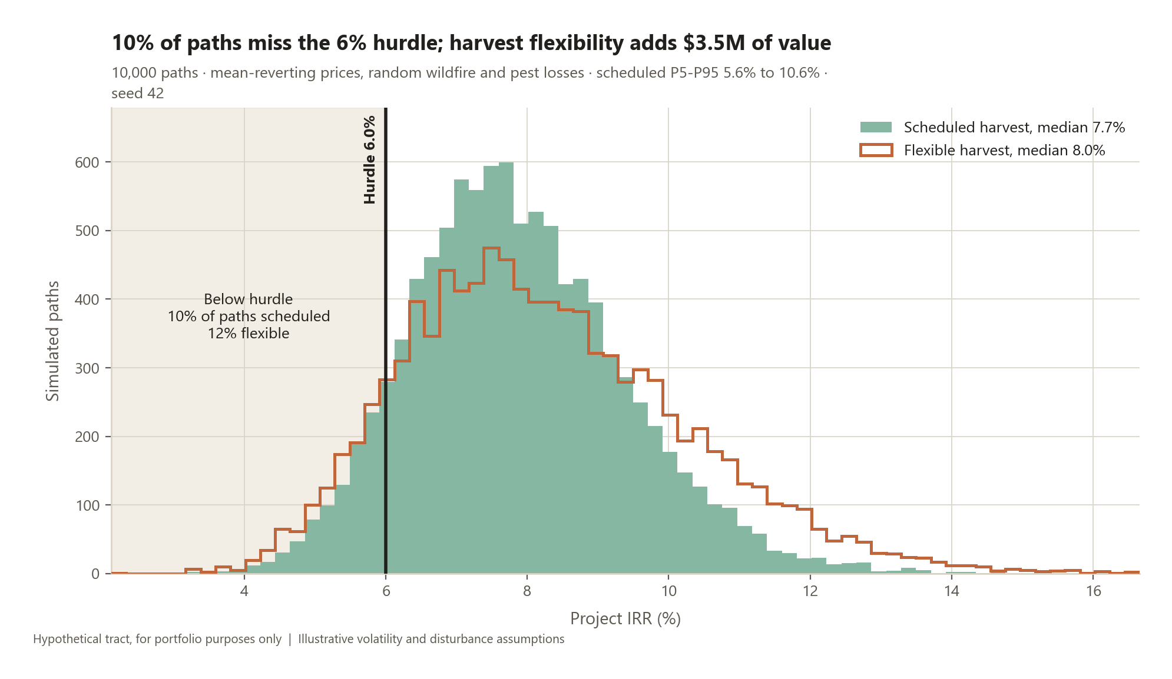
RISK
10% of 10,000 simulated paths miss the hurdle; harvest timing flexibility is worth $3.5M against that
KEY RISKS AND MITIGANTS
Wildfire
Costs $1.1M of expected NPV. Spread harvest across the tract, insure where priced sensibly, budget salvage capacity.
Mountain pine beetle
Modelled inside the same disturbance term. Mixedwood composition limits pure-pine exposure; monitor and accelerate harvest in infested stands.
Lumber and stumpage prices
The dominant driver. Prices can sit 15% below assumption for the whole hold before the deal breaks; keep the harvest band wide and stay unlevered.
Regulatory and Indigenous consultation
Not quantified here, and that is a genuine gap. Requires early engagement, consent-based planning and schedule contingency before any bid.
WHERE THE RISK SITS
IRR spans 5.6% at the 5th percentile to 10.6% at the 95th, median 7.7%. Fire and pests cost $1.1M of expected value - real, but second order next to price.
Flexibility has value only because prices mean revert: a weak price today signals a stronger one later, so shifting volume inside the ±15% band pays. Under a random walk it would be worth nothing.
Liquidity
Thirty-year hold with no interim market. Only appropriate for a long-dated liability pool; size the position accordingly.
Project Aspen · hypothetical tract, prepared for portfolio purposes only · not investment advice
5
Notes:
Ten thousand paths. Stumpage follows a mean-reverting Ornstein-Uhlenbeck process on the log
price: cyclical, not a random walk, because a sawlog price that doubles does not stay
doubled. Each year carries a 2% chance
of a fire or pest event destroying a random share of the tract.
The honest headline is 10% of paths below the hurdle.
Median 7.7%, 5th percentile 5.6%. This is not a
safe deal; it is an adequately priced one.
The flexibility number is the part I would most want to talk about. Two strategies run on
identical price and fire paths. One cuts the target every year regardless of price. The
other cuts at the bottom of the permitted band when prices are below their long-run mean
and at the top when above. The difference, $3.5M or
$176 a hectare, is a real option on harvest timing, and it
exists only because prices revert. I verified that with a control run: set volatility near
zero and the option value collapses.
One caveat worth volunteering: the flexible strategy raises mean value but also widens the
distribution, so its probability of missing the hurdle is slightly higher, at
12%. More value, more variance.
On regulatory and Indigenous consultation, I have not quantified it and I would not
pretend otherwise. On a real Alberta transaction that is front-and-centre due diligence,
not a footnote, and it would need legal and community work before a bid.

Slide 6
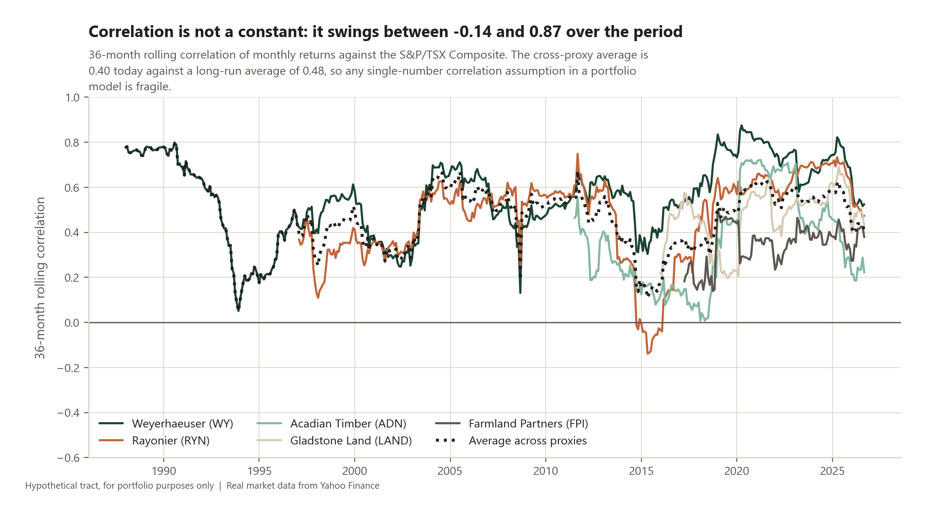
PORTFOLIO FIT
The diversification case is weaker than the pitch: listed proxies correlate 0.47 with the S&P/TSX Composite
WHAT THE DATA SAYS
▪ Correlation is moderate, not low. Timber proxies average 0.47 against the S&P/TSX Composite over 500 months, and the 36-month rolling figure has ranged from -0.14 to 0.87.
▪ Inflation hedging is unproven here. Regressing annual returns on annual CPI gives no statistically significant positive beta for any of the 8 series tested. With 12 to 41 annual observations the standard errors swamp the slopes.
▪ Farmland looks better than timber. Both farmland proxies earned materially more in above-median inflation years, but on barely a decade of data that is suggestive, not evidence.
THE CAVEAT THAT QUALIFIES ALL OF THIS
Listed timber and farmland REITs are equities first. They carry market beta, leverage and daily sentiment that a directly held tract does not, so these correlations are an upper bound and understate the diversification private timberland would deliver. Appraisal-based private indices have the opposite bias: smoothing suppresses measured correlation. The truth sits between them, and neither is available for one Alberta tract.
Project Aspen · hypothetical tract, prepared for portfolio purposes only · not investment advice
6
Notes:
This is the slide where I report a result that does not help the pitch.
The standard case for timberland is low correlation and inflation protection. Tested
against real data, using Yahoo Finance monthly returns and Statistics Canada CPI, neither
claim comes through cleanly. Timber proxies correlate
0.47 with the TSX, which is moderate, not low. And no
proxy shows a statistically significant inflation beta.
I want to be precise about why that is not the same as "the thesis is wrong". The proxies
are listed REITs, and they are equities before they are trees. They trade with the market
because they are traded. A directly held tract has no daily price and no equity beta, so
its true correlation is almost certainly lower than what I measured. The opposite bias
exists too: private appraisal-based indices update slowly and understate correlation.
Honest answer is that the truth is between them and I cannot observe it.
What I would do with more time and data: get NCREIF Timberland Index history and run the
same analysis on a de-smoothed series, which is the standard correction.
The farmland result is interesting: both proxies did much better in high-inflation years,
but it rests on twelve and thirteen annual observations, so I would present it as a
hypothesis worth testing, not a finding.
CPI source is Statistics Canada table 18-10-0004-01, Consumer Price Index, all-items, Canada, monthly (vector v41690973).

