Slide 1

Networked Programs
Chapter 12
Python for Everybody
www.py4e.com

Slide 2
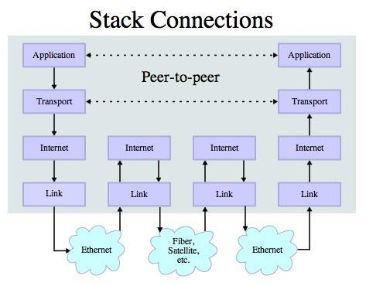
Transport Control Protocol (TCP)
Built on top of IP (Internet Protocol)
Assumes IP might lose some data - stores and retransmits data if it seems to be lost
Handles “flow control” using a transmit window
Provides a nice reliable pipe
Source: http://en.wikipedia.org/wiki/Internet_Protocol_Suite
Notes:
While many of the examples in this book have focused on reading files and looking for data in those files, there are many different sources of information when one considers the Internet. We will learn how to pretend to be a web browser in Python and retrieve web pages using the Hypertext Transfer Protocol (HTTP). Then we will read through the web page data and parse it.
Transport Control Protocol (TCP) is built on top of Internet Protocol (IP). It assumes IP might lose some data. Therefore, it has the objective of providing a nice reliable pipe to store and retransmit data. It handles flow control of data using a transmit window.

Slide 3
TCP Sockets & Port Numbers
A port is an application-specific or process-specific software communications endpoint
It allows multiple networked applications to coexist on the same server
http://en.wikipedia.org/wiki/TCP_and_UDP_port
Notes:
In computer networking, an Internet socket or network socket is an endpoint of a bidirectional inter-process communication flow across an Internet Protocol-based computer network, such as the Internet. A port, on the other hand, refers to an application (or process) specific software communications endpoint. A port allows multiple networked applications to coexist and communicate with each other on the same server.

Slide 4
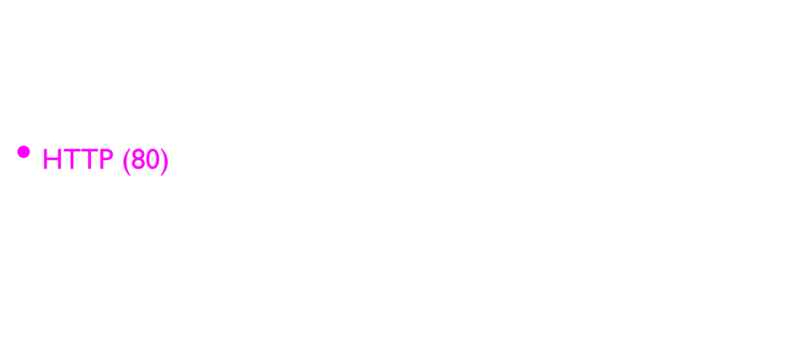
Common TCP Ports
http://en.wikipedia.org/wiki/List_of_TCP_and_UDP_port_numbers
Notes:
Here is a list of some commonly used TCP port numbers. For example, Port 80 is the port number assigned to commonly used internet communication protocol, HTTP (HyperText Transfer Protocol). At Port 80, a computer sends and receives web client-based communication and messages from a web server and uses to send and receive HTML pages and data.

Slide 5
Sockets in Python
Python has built-in support for TCP Sockets
import socket
mysock = socket.socket(socket.AF_INET, socket.SOCK_STREAM)
mysock.connect( ('data.pr4e.org', 80) )
Host
Port
http://docs.python.org/library/socket.html
Notes:
The network protocol that powers the web is actually quite simple and there is built-in support in Python called socket which makes it very easy to make network connections and retrieve data over those sockets in a Python program. A socket is much like a file, except that a single socket provides a two-way connection between two programs.
You can both read from and write to the same socket. If you write something to a socket, it is sent to the application at the other end of the socket. If you read from the socket, you are given the data which the other application has sent. But if you try to read a socket when the program on the other end of the socket has not sent any data, you just sit and wait. If the programs on both ends of the socket simply wait for some data without sending anything, they will wait for a very long time, so an important part of programs that communicate over the Internet is to have some sort of protocol.
A protocol is a set of precise rules that determine who is to go first, what they are to do, and then what the responses are to that message, and who sends next, and so on. In a sense the two applications at either end of the socket are doing a dance and making sure not to step on each other’s toes.

Slide 6

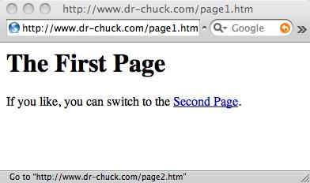
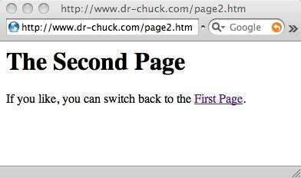
Request
Web Server
Response
80
<h1>The Second Page</h1><p>If you like, you can switch back to the <a href="page1.htm">First Page</a>.</p>
GET http://www.dr-chuck.com/page2.htm
Browser
Click
Parse/
Render
Notes:
How does a computer get the data from a server?
Each time the user clicks on an anchor tag with an href = value to switch to a new page, the browser makes a connection to the web server and issues a “GET” request - to GET the content of the page at the specified URL. The server returns the HTML document to the browser, which formats and displays the document to the user.

Slide 7
Let’s Write a Web Browser!

Slide 8
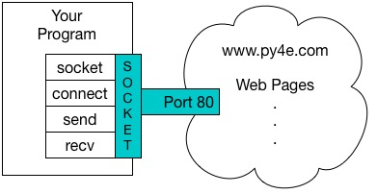
An HTTP Request in Python
import socket
mysock = socket.socket(socket.AF_INET, socket.SOCK_STREAM)
mysock.connect(('data.pr4e.org', 80))
cmd = 'GET http://data.pr4e.org/romeo.txt HTTP/1.0\r\n\r\n'.encode()
mysock.send(cmd)
while True:
data = mysock.recv(512)
if (len(data) < 1):
break
print(data.decode(),end='')
mysock.close()
Notes:
The easiest way to show how the HTTP protocol works is to write a very simple Python program that makes a connection to a web server and follows the rules of the HTTP protocol to request a document and display what the server sends back. For example,
import socket
mysock = socket.socket(socket.AF_INET, socket.SOCK_STREAM)
mysock.connect(('data.pr4e.org', 80))
cmd = 'GET http://data.pr4e.org/romeo.txt HTTP/1.0\r\n\r\n'.encode()
mysock.send(cmd)
while True:
data = mysock.recv(512)
if (len(data) < 1):
break
print(data.decode(),end='')
mysock.close()
First the program makes a connection to port 80 on the server www.py4e.com. Since our program is playing the role of the “web browser”, the HTTP protocol says we must send the GET command followed by a blank line. \r\n signifies an EOL (end of line), so \r\n\r\n signifies nothing between two EOL sequences. That is the equivalent of a blank line. Once we send that blank line, we write a loop that receives data in 512-character chunks from the socket and prints the data out until there is no more data to read (i.e., the recv() returns an empty string).

Slide 9
HTTP/1.1 200 OK
Date: Sun, 14 Mar 2010 23:52:41 GMT
Server: Apache
Last-Modified: Tue, 29 Dec 2009 01:31:22 GMT
ETag: "143c1b33-a7-4b395bea"
Accept-Ranges: bytes
Content-Length: 167
Connection: close
Content-Type: text/plain
But soft what light through yonder window breaks
It is the east and Juliet is the sun
Arise fair sun and kill the envious moon
Who is already sick and pale with grief
HTTP Header
while True:
data = mysock.recv(512)
if ( len(data) < 1 ) :
break
print(data.decode())
HTTP Body
Notes:
The HTTP request program in Python produces the following output:
HTTP/1.1 200 OK
Date: Sun, 14 Mar 2010 23:52:41 GMT
Server: Apache
Last-Modified: Tue, 29 Dec 2009 01:31:22 GMT
ETag: "143c1b33-a7-4b395bea"
Accept-Ranges: bytes
Content-Length: 167
Connection: close
Content-Type: text/plain
But soft what light through yonder window breaks
It is the east and Juliet is the sun
Arise fair sun and kill the envious moon
Who is already sick and pale with grief
The output starts with headers which the web server sends to describe the document. For example, the Content-Type: text/plain header indicates that the document is a plain text document. After the server sends us the headers, it adds a blank line to indicate the end of the headers, and then sends the actual data of the file romeo.txt.
This example shows how to make a low-level network connection with sockets in Python. Sockets can be used to communicate with a web server or with a mail server or many other kinds of servers. All that is needed is to find the document which describes the protocol and write the code to send and receive the data according to the protocol – the rules of the communication!

Slide 10
Python Strings to Bytes
When we talk to an external resource like a network socket we send bytes, so we need to encode Python 3 strings into a given character encoding
When we read data from an external resource, we must decode it based on the character set so it is properly represented in Python 3 as a string
while True:
data = mysock.recv(512)
if ( len(data) < 1 ) :
break
mystring = data.decode()
print(mystring)
Notes:
To represent the wide range of characters computers must handle, we represent characters with more than one byte. UTF-8 (8-bit Unicode Transformation Format) is a variable width character encoding mechanism using 1 to 4 8-bit bytes. UTF-8 is recommended practice for encoding data to be exchanged between systems in the Internet.
When we talk to an external resource like a network socket, we send bytes. Therefore, we need to encode Python 3 strings into a given character encoding (i.e., UTF-8 Unicode encoding). Similarly, when we read data from an external resource, we must decode it based on the character set so that it is properly represented in Python 3 as a string.

Slide 11
An HTTP Request in Python
import socket
mysock = socket.socket(socket.AF_INET, socket.SOCK_STREAM)
mysock.connect(('data.pr4e.org', 80))
cmd = 'GET http://data.pr4e.org/romeo.txt HTTP/1.0\n\n'.encode()
mysock.send(cmd)
while True:
data = mysock.recv(512)
if (len(data) < 1):
break
print(data.decode())
mysock.close()

Slide 12
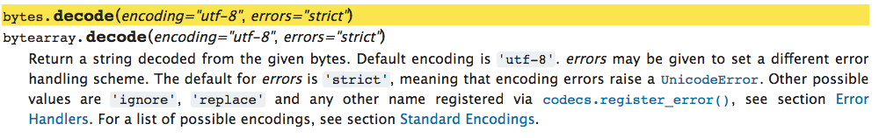
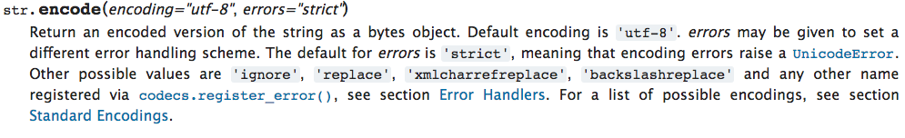
https://docs.python.org/3/library/stdtypes.html#bytes.decode
https://docs.python.org/3/library/stdtypes.html#str.encode
Notes:
Python has the following built-in methods: decode() and encode() for converting bytes into strings and vice versa. Specifically,
bytes.decode(): it is a method on bytes and byte array objects. It returns a string decoded from the given bytes. Default encoding is UTF-8.
str.encode(): it is a method on a string object. It returns an encoded version of the string as a bytes object. Default encoding is UTF-8.
You can get more information on Python documentation on these two methods:
https://docs.python.org/3/library/stdtypes.html#bytes.decode
https://docs.python.org/3/library/stdtypes.html#str.encode

Slide 13
Network
decode()
Bytes
UTF-8
recv()
Socket
String
Unicode
Bytes
UTF-8
encode()
send()
import socket
mysock = socket.socket(socket.AF_INET, socket.SOCK_STREAM)
mysock.connect(('data.pr4e.org', 80))
cmd = 'GET http://data.pr4e.org/romeo.txt HTTP/1.0\n\n'.encode()
mysock.send(cmd)
while True:
data = mysock.recv(512)
if (len(data) < 1):
break
print(data.decode())
mysock.close()
Notes:
A picture representation of how received bytes are decoded to turn into strings and how strings are encoded to bytes before sent.

Slide 14
Making HTTP Easier With urllib

Slide 15
Using urllib in Python
Since HTTP is so common, we have a library that does all the socket work for us and makes web pages look like a file
import urllib.request, urllib.parse, urllib.error
fhand = urllib.request.urlopen('http://data.pr4e.org/romeo.txt')
for line in fhand:
print(line.decode().strip())
Notes:
While we can manually send and receive data over HTTP using the socket library, there is a much simpler way to perform this common task in Python by using the urllib library.
Using urllib, you can treat a web page as if it is a file. You simply indicate which web page you would like to retrieve and urllib handles all of the HTTP protocol and header details. The equivalent code to read the romeo.txt file from the web using urllib is as follows:
import urllib.request, urllib.parse, urllib.error
fhand = urllib.request.urlopen('http://data.pr4e.org/romeo.txt')
for line in fhand:
print(line.decode().strip())
Once the web page has been opened with urllib.urlopen, we can treat it like a file and read through it using a for loop. The general idea is: once we have opened the web page, we can read it like a local file.

Slide 16
import urllib.request, urllib.parse, urllib.error
fhand = urllib.request.urlopen('http://data.pr4e.org/romeo.txt')
for line in fhand:
print(line.decode().strip())
But soft what light through yonder window breaks
It is the east and Juliet is the sun
Arise fair sun and kill the envious moon
Who is already sick and pale with grief
Notes:
After the program runs, we only see the output of the contents of the file. The headers are still sent, however, the urllib consumes the headers and only returns the data to us:
But soft what light through yonder window breaks
It is the east and Juliet is the sun
Arise fair sun and kill the envious moon
Who is already sick and pale with grief

Slide 17
Treat a Webpage Like a File...
import urllib.request, urllib.parse, urllib.error
fhand = urllib.request.urlopen('http://data.pr4e.org/romeo.txt')
counts = dict()
for line in fhand:
words = line.decode().split()
for word in words:
counts[word] = counts.get(word, 0) + 1
print(counts)
Notes:
Another example to show the use of urllib library would be to write a Python program to retrieve the data from romeo.txt and calculate the frequency of each word in the file and store the results in a dictionary with keys as the words and the corresponding frequencies as the values as follows:
import urllib.request, urllib.parse, urllib.error
fhand = urllib.request.urlopen('http://data.pr4e.org/romeo.txt')
counts = dict()
for line in fhand:
words = line.decode().split()
for word in words:
counts[word] = counts.get(word, 0) + 1
print(counts)

Slide 18
Reading Web Pages
import urllib.request, urllib.parse, urllib.error
fhand = urllib.request.urlopen('http://www.dr-chuck.com/page1.htm')
for line in fhand:
print(line.decode().strip())
<h1>The First Page</h1>
<p>If you like, you can switch to the <a href="http://www.dr-chuck.com/page2.htm">Second Page</a>.
</p>
Notes:
We can also read the contents of a web page that is in htm format. The received output will be in the form of html language. For example,
import urllib.request, urllib.parse, urllib.error
fhand = urllib.request.urlopen('http://www.dr-chuck.com/page1.htm')
for line in fhand:
print(line.decode().strip())
The corresponding output becomes:
<h1>The First Page</h1>
<p>If you like, you can switch to the <a href="http://www.dr-chuck.com/page2.htm">Second Page</a>.
</p>

Slide 19
Parsing HTML
(a.k.a. Web Scraping)

Slide 20
What is Web Scraping?
When a program or script pretends to be a browser and retrieves web pages, looks at those web pages, extracts information, and then looks at more web pages
Search engines scrape web pages - we call this “spidering the web” or “web crawling”
http://en.wikipedia.org/wiki/Web_scraping
http://en.wikipedia.org/wiki/Web_crawler
Notes:
One of the common uses of the urllib capability in Python is to scrape the web. Web scraping is when we write a program that pretends to be a web browser and retrieves pages, then examines the data in those pages looking for patterns.
As an example, a search engine such as Google will look at the source of one web page and extract the links to other pages and retrieve those pages, extracting links, and so on. Using this technique, Google spiders its way through nearly all of the pages on the web – web crawling. Google also uses the frequency of links from pages it finds to a particular page as one measure of how important a page is and how high the page should appear in its search results – page ranking method.

Slide 21
Scraping Web Pages
There is some controversy about web page scraping and some sites are a bit snippy about it.
Republishing copyrighted information is not allowed
Violating terms of service is not allowed
Notes:
We have to be careful about scraping web content. There is some controversy about web page scraping, whether it is illegal or not. Some web sites are a bit snippy about it. Als, republishing copyrighted information is not allowed. You should always look for terms of service on a website before scraping content from it.

Slide 22
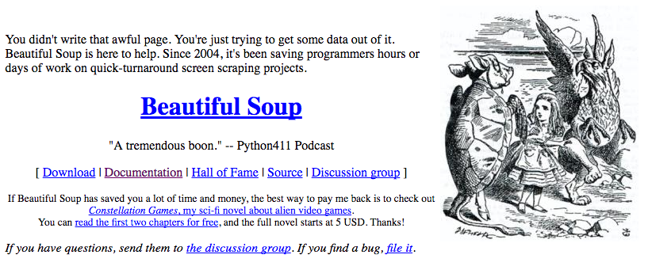
The Easy Way - Beautiful Soup
You could do string searches the hard way
Or use the free software library called BeautifulSoup from www.crummy.com
https://www.crummy.com/software/BeautifulSoup/
Notes:
There are a number of Python libraries which can help you parse HTML and extract data from the pages. Each of the libraries has its strengths and weaknesses and you can pick one based on your needs. Among them, we are going to focus on Beautiful Soup. Beautiful Soup is a robust HTML parsing library.
We will parse some HTML input and extract links using the BeautifulSoup library. BeautifulSoup tolerates highly flawed HTML and still lets you easily extract the data you need. For example,
we will use urllib to read the page and then use BeautifulSoup to extract the href attributes from the anchor (a) tags.

Slide 23
import urllib.request, urllib.parse, urllib.error
from bs4 import BeautifulSoup
url = input('Enter - ')
html = urllib.request.urlopen(url).read()
soup = BeautifulSoup(html, 'html.parser')
# Retrieve all of the anchor tags
tags = soup('a')
for tag in tags:
print(tag.get('href', None))
Enter - http://www.dr-chuck.com/page1.htm
http://www.dr-chuck.com/page2.htm
Notes:
The following Python program prompts for a web address from the user. It then opens the imputed web page. It reads the data as an html format and passes the data to the BeautifulSoup parser. We note that html.parser is the HTML parser included in the standard Python 3 library. It then retrieves all of the anchor tags and prints out the href attribute for each tag.
import urllib.request, urllib.parse, urllib.error
from bs4 import BeautifulSoup
url = input('Enter - ')
html = urllib.request.urlopen(url).read()
soup = BeautifulSoup(html, 'html.parser')
# Retrieve all of the anchor tags
tags = soup('a')
for tag in tags:
print(tag.get('href', None))
When the Python program runs, it produces the following output:
Enter - http://www.dr-chuck.com/page1.htm
http://www.dr-chuck.com/page2.htm

Slide 24
Summary
The TCP/IP gives us pipes / sockets between applications.
HyperText Transfer Protocol (HTTP) is a simple yet powerful protocol.
Python has good support for sockets, HTTP, and HTML parsing.
Beautiful Soup is a robust HTML parsing library.
We can use urllib to read the page and then use BeautifulSoup to parse and extract data.

Slide 25
Acknowledgements / Contributions
Thes slide are Copyright 2010- Charles R. Severance (www.dr-chuck.com) of the University of Michigan School of Information and open.umich.edu and made available under a Creative Commons Attribution 4.0 License. Please maintain this last slide in all copies of the document to comply with the attribution requirements of the license. If you make a change, feel free to add your name and organization to the list of contributors on this page as you republish the materials.
Initial Development: Charles Severance, University of Michigan School of Information
… Insert new Contributors here
...

