Slide 1

Using Web Services
Chapter 13
Python for Everybody
www.py4e.com

Slide 2
Data on the Web
With the HTTP Request/Response well understood and well supported, there was a natural move toward exchanging data between programs using these protocols
We needed to come up with an agreed way to represent data going between applications and across networks
There are two commonly used formats: XML and JSON
Notes:
In addition to retrieving and parsing documents over HTTP in HTML format using programming languages, an approach has been developed to producing documents that were specifically designed to be consumed by other programs. There are two common formats that are used when exchanging data across the web: XML (eXtensible Markup Language) and JSON (JavaScript Object Notation). XML has been in use for a very long time and is best suited for exchanging document-style data. When programs just want to exchange dictionaries, lists, or other internal information with each other, they use JavaScript Object Notation (JSON). We will look at both formats.

Slide 3
XML
Marking up data to send across the network...
http://en.wikipedia.org/wiki/XML

Slide 4
XML Basics
Start Tag
End Tag
Text Content
Attribute
Self Closing Tag
<person>
<name>Chuck</name>
<phone type="intl">
+1 734 303 4456
</phone>
<email hide="yes" />
</person>
Notes:
XML looks very similar to HTML, but more structured than HTML. Primary purpose of XML is to help information systems share structured data. Here is a sample of an XML document:
<person>
<name>Chuck</name>
<phone type="intl">
+1 734 303 4456
</phone>
<email hide="yes" />
</person>
Each pair of opening and closing tags represents a element or node with the same name as the tag (e.g., person). Each element can have some text, some attributes, and other nested elements. If an XML element is empty (i.e., has no content), then it may be depicted by a self-closing tag (e.g., <email />). Line ends do not matter. White space is generally discarded on text elements. We indent only to be readable.

Slide 5
XML as a Tree
a
<a>
<b>X</b>
<c>
<d>Y</d>
<e>Z</e>
</c>
</a>
b
c
X
d
e
Elements
Text
Y
Z
Notes:
It is helpful to think of an XML document as a tree structure where there is a top element (i.e., person), and other tags (e.g., phone) are drawn as children of their parent elements.

Slide 6
Parsing XML in Python
import xml.etree.ElementTree as ET
data = '''<person>
<name>Chuck</name>
<phone type="intl">
+1 734 303 4456
</phone>
<email hide="yes"/>
</person>'''
tree = ET.fromstring(data)
print('Name:',tree.find('name').text)
print('Attr:',tree.find('email').get('hide'))
Notes:
Parsing XML in Python:
Here is a simple Python program that parses some XML and extracts some data elements from the XML structure:
import xml.etree.ElementTree as ET
data = '''<person>
<name>Chuck</name>
<phone type="intl">
+1 734 303 4456
</phone>
<email hide="yes"/>
</person>'''
tree = ET.fromstring(data)
print('Name:',tree.find('name').text)
print('Attr:',tree.find('email').get('hide'))
This Python program outputs the following:
Name: Chuck
Attr: yes
We note that the triple single quote ('''), as well as the triple double quote ("""), allow for the creation of strings that span multiple lines in Python. Calling fromstring method converts the string representation of the XML into a tree of XML elements. When the XML is in a tree, we have a series of methods we can call to extract portions of data from the XML string. For example, the find function searches through the XML tree and retrieves the element that matches the specified tag. Using an XML parser such as ElementTree allows us to extract data from XML without worrying about the rules of XML syntax.

Slide 7
Parsing XML in Python
import xml.etree.ElementTree as ET
input = '''<stuff>
<users>
<user x="2">
<id>001</id>
<name>Chuck</name>
</user>
<user x="7">
<id>009</id>
<name>Brent</name>
</user>
</users>
</stuff>'''
stuff = ET.fromstring(input)
lst = stuff.findall('users/user')
print('User count:', len(lst))
for item in lst:
print('Name', item.find('name').text)
print('Id', item.find('id').text)
print('Attribute', item.get("x"))
Notes:
When the XML has multiple nodes, we need to write a loop to process all of the nodes. In the following Python program, we loop through all of the user nodes in the XML:
import xml.etree.ElementTree as ET
input = '''<stuff>
<users>
<user x="2">
<id>001</id>
<name>Chuck</name>
</user>
<user x="7">
<id>009</id>
<name>Brent</name>
</user>
</users>
</stuff>'''
stuff = ET.fromstring(input)
lst = stuff.findall('users/user')
print('User count:', len(lst))
for item in lst:
print('Name', item.find('name').text)
print('Id', item.find('id').text)
print('Attribute', item.get("x"))
This Python program outputs the following:
User count: 2
Name Chuck
Id 001
Attribute 2
Name Brent
Id 009
Attribute 7
The findall method retrieves a Python list of subtrees that represent the user structures in the XML tree. We can write a for loop that looks at each of the user nodes, and prints the name and id text elements as well as the x attribute from the user node. We note that we must include all parent level elements in the findall statement except for the top level element (e.g., users/user). Otherwise, Python will not find any desired nodes.

Slide 8
JSON
(JavaScript Object Notation)

Slide 9
JavaScript Object Notation
Object literal notation in JavaScript
{ "name" : "Chuck",
"phone" : { "type" : "intl",
"number" : "+1 734 303 4456”
},
"email" : { "hide" : "yes" }
}
Notes:
The JSON format was inspired by the object and array format used in the JavaScript language. Since Python was invented before JavaScript, Python’s syntax for dictionaries and lists influenced the syn tax of JSON. So the format of JSON is nearly identical to a combination of Python lists and dictionaries. Here is a JSON encoding that is roughly equivalent to the simple XML format that we have seen earlier:
{ "name" : "Chuck",
"phone" : { "type" : "intl",
"number" : "+1 734 303 4456”
},
"email" : { "hide" : "yes" }
}
We construct JSON structures by nesting dictionaries and lists as needed. Also, JSON structures are simpler than XML because JSON has fewer capabilities than XML. However,
JSON has the advantage that it maps directly to some combination of dictionaries and lists. Since nearly all programming languages have something equivalent to Python’s dictionaries and lists, JSON is a very natural format to have two cooperating programs exchange data. This is the main driver for the popularity of JSON structure in exchanging data across programs. JSON is quickly becoming the format of choice for nearly all data exchange between applications because of its relative simplicity compared to XML.

Slide 10
Parsing JSON in Python
import json
input = '''[
{ "id" : "001",
"x" : "2",
"name" : "Chuck"
} ,
{ "id" : "009",
"x" : "7",
"name" : ”Brent"
}
]'''
info = json.loads(input)
print('User count:', len(info))
for item in info:
print('Name', item['name'])
print('Id', item['id'])
print('Attribute', item['x'])
JSON represents data as nested “lists” and “dictionaries”
Notes:
In the following Python program, we use the built-in json library to parse the JSON and read through the data. As a JSON, we have a list and that the list is of users and each user is a set of key-value pairs.
import json
input = '''[
{ "id" : "001",
"x" : "2",
"name" : "Chuck"
} ,
{ "id" : "009",
"x" : "7",
"name" : ”Brent"
}
]'''
info = json.loads(input)
print('User count:', len(info))
for item in info:
print('Name', item['name'])
print('Id', item['id'])
print('Attribute', item['x'])
This program outputs the following:
User count: 2
Name Chuck
Id 001
Attribute 2
Name Brent
Id 009
Attribute 7
We get from json.loads() a Python list. We traverse this list with a for loop, and each item within that list is a Python dictionary. Once the JSON has been parsed, we can use the Python index operator to extract the various bits of data for each user. We don’t have to use the JSON library to dig through the parsed JSON, since the returned data is simply native Python structures. This close connection to Python is a tremendous advantage of JSON structure. There is an industry trend away from XML and towards JSON for web services. Since the JSON is simpler and more directly maps to native data structures we already have in programming languages such as Python, the parsing and data extraction code is usually simpler and more direct when using JSON.

Slide 11
Web Services
http://en.wikipedia.org/wiki/Web_services

Slide 12
Application Program Interface
The API itself is largely abstract in that it specifies an interface and controls the behavior of the objects specified in that interface. The software that provides the functionality described by an API is said to be an “implementation” of the API. An API is typically defined in terms of the programming language used to build an application.
Text
http://en.wikipedia.org/wiki/API
Notes:
Since we have the ability to exchange data between applications using HyperText Transport Protocol (HTTP) and a way to represent complex data that we are sending back and forth between these applications using eXtensible Markup Language (XML) or JavaScript Object Notation (JSON), the next step is to begin to define and document contracts between applications using these techniques. The general name for these application-to-application contracts is called: Application Program Interfaces (APIs).

Slide 13
API Security and Rate Limiting
The compute resources to run these APIs are not “free”
The data provided by these APIs is usually valuable
The data providers might limit the number of requests per day, demand an API “key”, or even charge for usage
They might change the rules as things progress...
Notes:
When we use an API, generally one program makes a set of services available for use by other applications and publishes the APIs (i.e., the contract rules) that must be followed to access the services provided by the program. When an application makes a set of services in its API available over the web, we call these web services. We note that It is quite common that you need an API key to make use of a vendor’s API. The general idea is that they want to know who is using their services as well as how much each user is using. Perhaps they have free and pay tiers of their services or have a policy that limits the number of requests that a single individual can make during a particular time period. Sometimes once you get your API key, you simply include the key as part of POST data or perhaps as a parameter on the URL when calling the API.

Slide 14
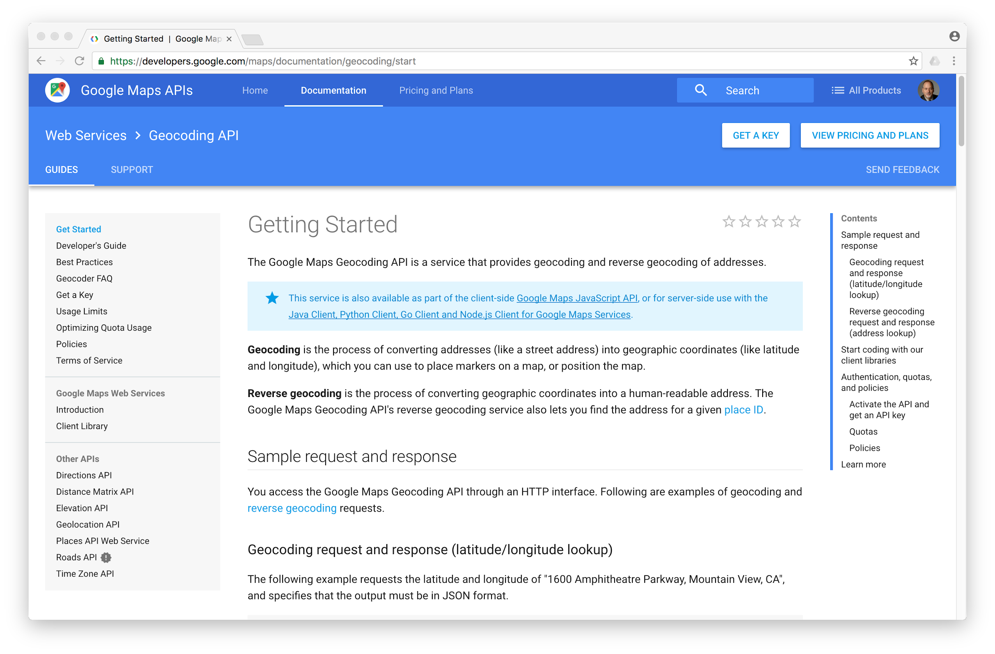
https://developers.google.com/maps/documentation/geocoding/
Notes:
Let us practice web services with an example from Google. Google has an excellent web service that allows us to make use of their large database of geographic information. We can submit a geographical search string like “Ann Arbor, MI” to their geocoding API and have Google return its best guess as to where on a map we might find our search string and tell us about the landmarks nearby.
This geocoding service provided by Google is free, but rate limit is applied. Therefore, you cannot make unlimited use of the API in a commercial application. However, if you have some survey data where an end user has entered a location in a free-format input box, you can use this API to clean up your data quite nicely. When you are using a free API like Google’s geocoding API, you need to be respectful in your use of these resources. If too many people abuse the service, Google might drop or significantly curtail its free service. You can read the online documentation for this service at https://developers.google.com/maps/documentation/geocoding/start

Slide 15
{
"status": "OK",
"results": [
{
"geometry": {
"location_type": "APPROXIMATE",
"location": {
"lat": 42.2808256,
"lng": -83.7430378
}
},
"address_components": [
{
"long_name": "Ann Arbor",
"types": [
"locality",
"political"
],
"short_name": "Ann Arbor"
}
],
"formatted_address": "Ann Arbor, MI, USA",
"types": [
"locality",
"political"
]
}
]
}
Google geocoding Web Service
http://maps.googleapis.com/maps/api/geocode/json?address=Ann+Arbor%2C+MI
Notes:
This web service is quite simple to use. You can even test it using a browser by typing the following URL into your browser:
https://maps.googleapis.com/maps/api/geocode/json?address=Ann+Arbor%2C+MI&key = YOUR_API_KEY
As you will observe, you must use an API key to authenticate each request to Google Maps Platform APIs before using this service. You can get an API key for yourself at
https://developers.google.com/maps/documentation/javascript/geocoding

Slide 16
Google geocoding Web Service
https://github.com/harslan/Notebooks/blob/master/google_geocoding_service.ipynb
Enter location: Ann Arbor, MI
Retrieving http://maps.googleapis.com/...
Retrieved 1669 characters
lat 42.2808256 lng -83.7430378
Ann Arbor, MI, USA
Enter location:
Notes:
The following is a simple Python program to prompt the user for a search string, call the Google geocoding API, and extract information from the returned JSON:
https://github.com/harslan/Notebooks/blob/master/google_geocoding_service.ipynb
This Python program takes the search string from the user and constructs a URL with the search string as a properly encoded parameter and then uses urllib library to retrieve the text from the Google geocoding API. Unlike a fixed web page, the data we get depends on the parameters we send in our API call to Google’ servers and the geographical data stored in Google’s servers. Once we retrieve the JSON data, we parse it with the json library and do a few checks to make sure that we received proper data. We then extract the information that we are looking for in the data.

Slide 17
Google Maps Platform
Geocoding API is part of Google Maps Platform. (https://developers.google.com/maps/documentation)
It converts addresses to geographic coordinates or the reverse.
$200 free monthly usage: the $200 monthly credit is enough to support our needs. You can also set daily quotas to protect against unexpected increases.
Notes:
We can sign up for Google Maps Platform to use provided APIs on Maps, Routes, and Places. The pricing mechanism is based on pay only what you use. Google provides $200 free monthly usage for API calls. This free credit line is enough for our needs to illustrate the use of Google web services. You may find these services valuable in your future projects.

Slide 18
Summary
An Application Program Interface (API) is a contract for interaction between applications
Web Services provide infrastructure for applications cooperating (an API) over a network
XML and JSON are two commonly used information exchange formats between applications

Slide 19
Acknowledgements / Contributions
Thes slide are Copyright 2010- Charles R. Severance (www.dr-chuck.com) of the University of Michigan School of Information and open.umich.edu and made available under a Creative Commons Attribution 4.0 License. Please maintain this last slide in all copies of the document to comply with the attribution requirements of the license. If you make a change, feel free to add your name and organization to the list of contributors on this page as you republish the materials.
Initial Development: Charles Severance, University of Michigan School of Information
… Insert new Contributors here
...

