Slide 1
Alternator

Slide 2
Alternator
Definition: The synchronous generator or alternator is an electrical machine that converts the mechanical power from a prime mover into an AC electrical power at a particular voltage and frequency.
Difference between DC Generator and Alternator:
It is seen that in the case of a DC generator, basically, the nature of the induced e.m.f in the armature conductors is of alternating type. By using commutator and brush assembly it is converted to DC and made available to the external circuit. If commutator is dropped from a DC generator and induced e.m.f is tapped from an armature directly outside, the nature of such emf will be alternating. Such a machine without a commutator, providing an AC emf to the external circuit is called an alternator.
Back

Slide 3
Construction of Synchronous generator or alternator
In Synchronous generator or alternators the stationary winding is called 'stator' while the rotating winding is called 'Rotor'.
Stator:
The stator in the synchronous generator is a stationary armature. This consists of a core and the slots to hold the armature winding similar to the armature of a DC generator. The stator core uses a laminated construction. It is built up of special steel stampings insulated from each other with varnish or paper. The laminated construction is basically to keep down eddy current losses. Generally choice of material is steel to keep down
hysteresis losses. The entire core is fabricated in a frame
made of steel plates. The core has slots on its periphery
for housing the armature conductors. The frame does not
carry any flux and serves as the support to the core.
Ventilation is maintained with the help of holes cast
in the frame.

Slide 4
Rotor:
There are two types of rotors used in the alternators: 1) Salient pole rotor
2)Smooth cylindrical rotor
Salient pole rotor:
This is also called projected pole type
as all the poles are projected out from the surface of the rotor. The poles are built up of thick steel laminations. The poles are bolted to the rotor as shown in the figure. The pole face has been given a specific shape. The field winding is provided on the pole shoe. These rotors have large diameters and small axial lengths. As the mechanical strength of salient pole type is less, this is preferred for low-speed alternators ranging from 125 r.p.m to 500 r.p.m. The prime movers used to drive such rotor are generally water turbines and I.C. engines.
Back

Slide 5
Rotor:
2)Smooth cylindrical rotor
This is also called non-salient type or non-projected pole type or round rotor. This rotor consists of a smooth solid steel cylinder, having a number of slots to accommodate the field coil. These slots are covered at the top with the help of steel or manganese wedges. The unslotted portions of the cylinder itself act as the poles. The poles are not projecting out and the surface of the rotor is smooth which maintains a uniform air gap between stator and rotor.
These rotors have small diameters and large axial lengths. The main advantage of this type is that these are mechanically very strong and thus preferred for high-speed alternators ranging between 1500 to 3000 r.p.m. Such high-speed alternators are called 'turbo-alternators'. The prime movers used to drive such type of rotors are generally steam turbines, electric motors.
Back

Slide 6
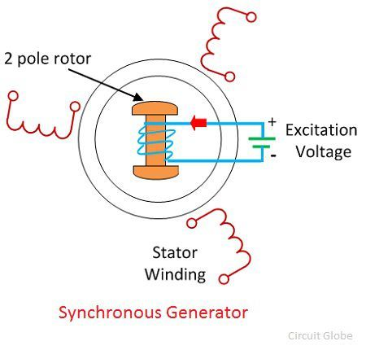
Working of Synchronous generator or alternator
The alternators work on the principle of electromagnetic induction. When there is a relative motion between the conductors and the flux, emf gets induced in the conductors. The dc generators also work on the same principle. The only difference in the practical synchronous generator and a dc generator is that in an alternator the conductors are stationary and field is rotating. But for understanding, the purpose we can always consider relative motion of conductors w.r.t the flux produced by the field winding.

Slide 7
EMF Equation of Alternator

Slide 9
THANK YOU

