Slide 1
THREE PHASE A.C. CIRCUITS

Slide 2
Content
Advantages of Three Phase System
Generation of Three Phase EMF
Star Connection
Delta Connection
Problems of Three Phase AC Circuits

Slide 3
Advantages of 3 Phase System
A three phase system has following advantages over single phase system:
The output of three phase machine is always greater than single phase machine of same size,
For a transmission and distribution, three phase system needs less copper or less conducting material than single phase system for given volt amperes and voltage rating so transmission becomes very much economical.
It is possible to produce rotating magnetic field with stationary coils by using three phase system. Hence three phase motors are self-starting.
The instantaneous power is symmetrical three phase system and the toque is uniform and hence produces no vibration.
Three phase system give steady output.
Single phase supply can be obtained from three phase but three phase cannot be obtained from single phase.
Power factor of single phase motors is poor than three phase motors of same rating.
For converting machines like rectifiers, with three phase the d.c. output voltage becomes smoother.
Back

Slide 4
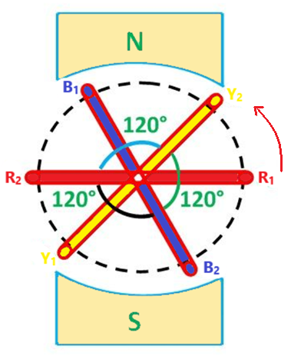
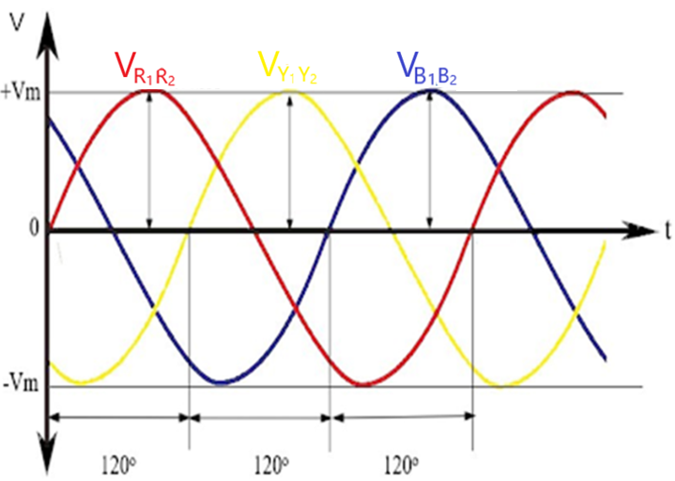
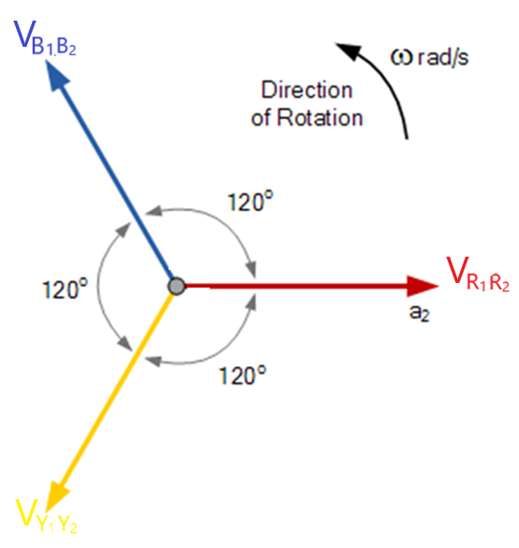
Generation of three Phase EMF
Consider three coils mounted on the same axis but displaced from each other by 120⁰ electrical.
Let the three coils be rotated in an anticlockwise direction in a bipolar magnetic field with an angular velocity of ω radians/sec, as shown in Fig. R₁, Y_{1,} B₁ are the starting terminals and R₂, B₂, C₂ are ending terminals of the coils.
When the coil R₁R₂ is in the position as shown in Fig. 1, the magnitude and direction of the e.m.f’s induced in the various coils are as shown in fig. 2 and the vector diagram is given in fig. 3
Fig. 1
Fig. 2
Fig. 3

Slide 5
Generation of Three Phase EMF

Slide 6
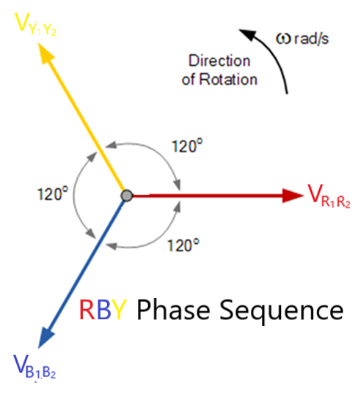
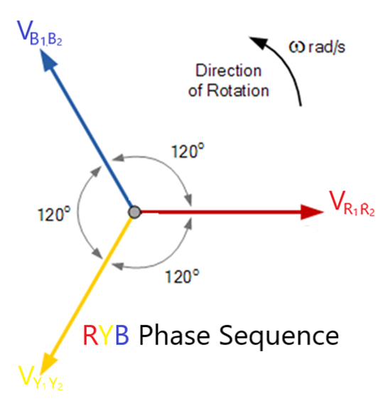
Phase Sequence
E_{R1R2} = E_{m}Sinωt
E_{B1B2} = E_{m}Sin(ωt – 120)
E_{Y1Y2} = E_{m}Sin(ωt – 240)
or
E_{Y1Y2} = E_{m}Sin(ωt + 120)
E_{R1R2} = E_{m}Sinωt
E_{Y1Y2} = E_{m}Sin(ωt – 120)
E_{B1B2} = E_{m}Sin(ωt – 240)
or
E_{B1B2} = E_{m}Sin(ωt + 120)

Slide 7
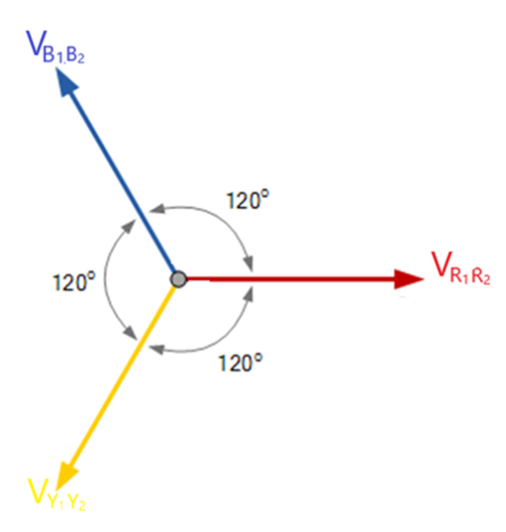
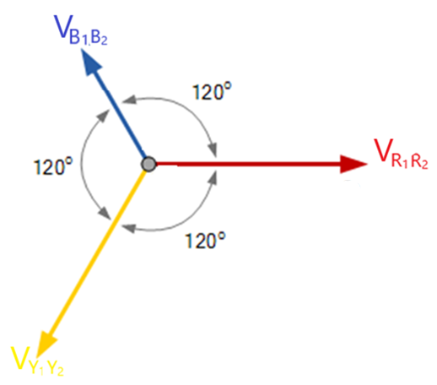
Balance and Unbalanced Supply and Load
When a balanced generating supply, where the three phase voltages are equal, and the phase difference is 120⁰ between one another, supplies balanced equipment load, where the impedance of the three phases or three circuit loads are equal, then the current flowing through these three phases will also be equal in magnitude, and will also have a phase difference of 120⁰ with one another. Such an arrangement is called a balanced load.
Balanced Supply
Unbalanced Supply
Back

Slide 8
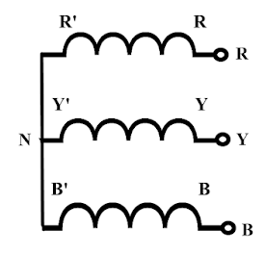
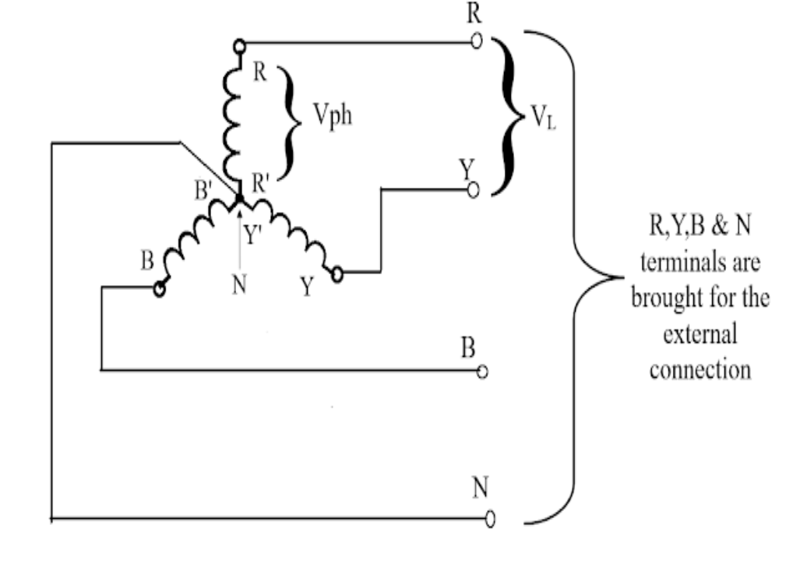
Star Connection

Slide 9
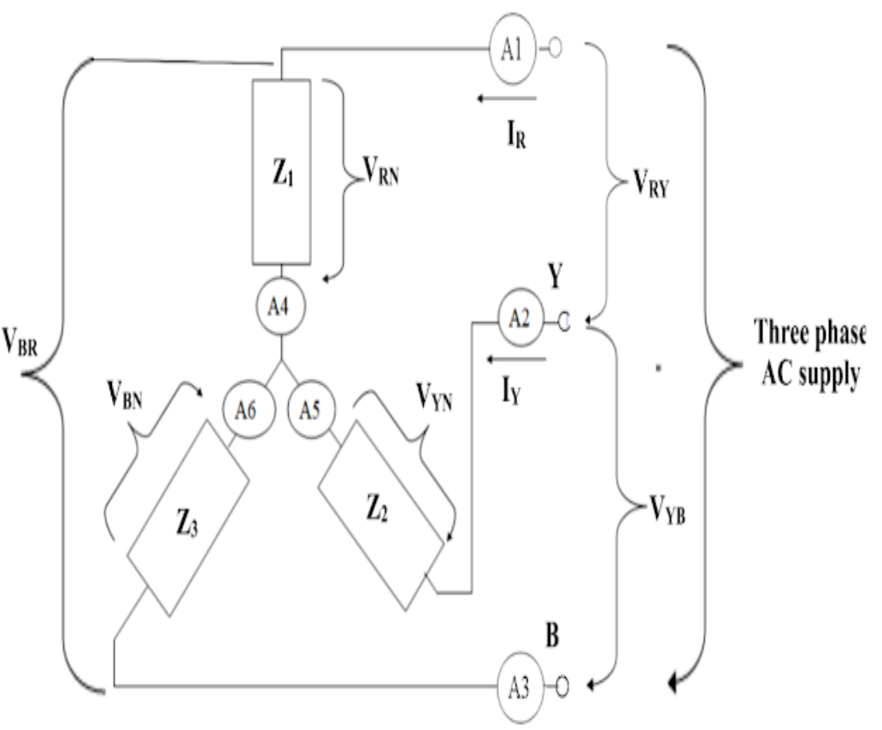
Relationship Between Phase and Line Values in a Balanced Star Connected System
From the Figure, it can be seen that the current flowing through the line conductors and the current through the impedances are same.
So we can conveniently say that the line current (ie., the current through the line conductor) and their respective phase current (ie., the current through the impedance) are same. ie., I_{R} = I_{Y} = I_{B} = I_{L} = I_{ph}
From the Figure, it can also be seen that, the line voltage V_{RY}, V_{YB} and V_{BR} across lines RY, YB and BR respectively and the phase voltages V_{RN}, V_{YN} and V_{BN} across Z_{1,} Z₂ and Z₃ respectively are not same
So by applying KVL between RY, YB and BR respectively, we get
V_{RY} = V_{RN} – V_{YN} = V_{R} – V_{Y}
V_{YB} = V_{YN} – V_{BN} = V_{Y} – V_{B}
V_{BR} = V_{BN} – V_{RN} = V_{B} – V_{R}

Slide 10
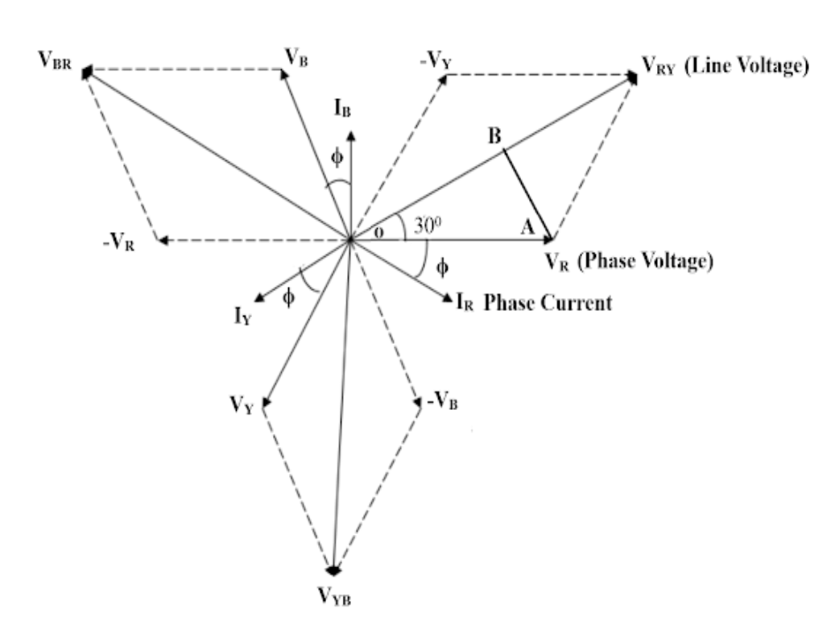
Relationship Between Phase and Line Values in a Balanced Star Connected System
Considering triangle OAB from the vector diagram
cos30 = (V_{RY}/2) / V_{R} and cos30 = (√3)/2
V_{RY} = √3 V_{R}
V_{L} = √3 V_{ph} and I_{L} = I_{ph}

Slide 11
Expression for Power in a Balanced Three Phase Star Connected System
Single Phase active power P = V_{ph} I_{ph} cosφ watts
Three phase active power = 3 * single phase active power
Three phase active power = 3 * (V_{ph} I_{ph} cosφ)
In a delta connected system V_{L} = √3 V_{ph} and I_{L} = I_{ph}
So three phase active power P = √3 V_{L} I_{L} cosφ W or kW (kilo Watts)
Similarly
Three phase reactive power = √3 V_{L} I_{L} sinφ VAR or kVAR (kilo Volt Ampere Reactive)
Three phase apparent power = √3 V_{L} I_{L} VA or kVA (kilo Volt Ampere)
Back

Slide 12
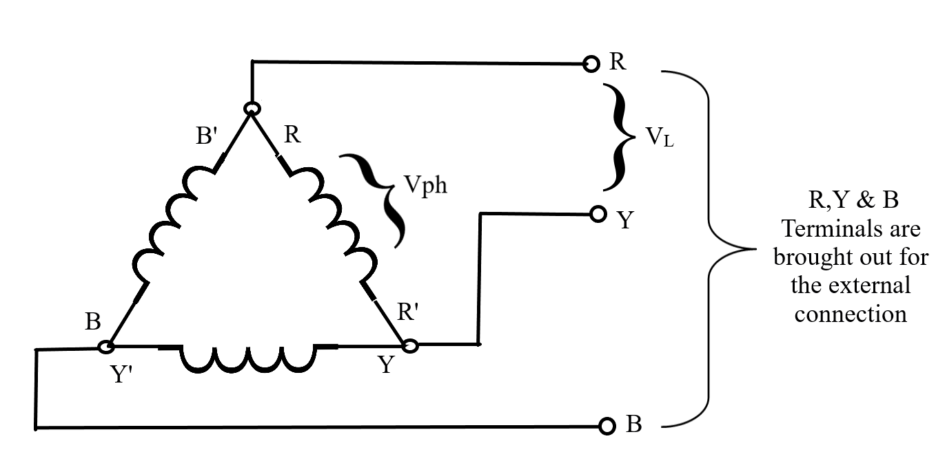
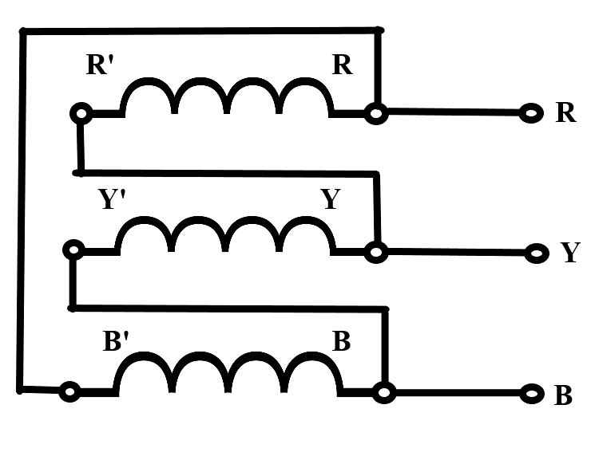
Delta Connection

Slide 13
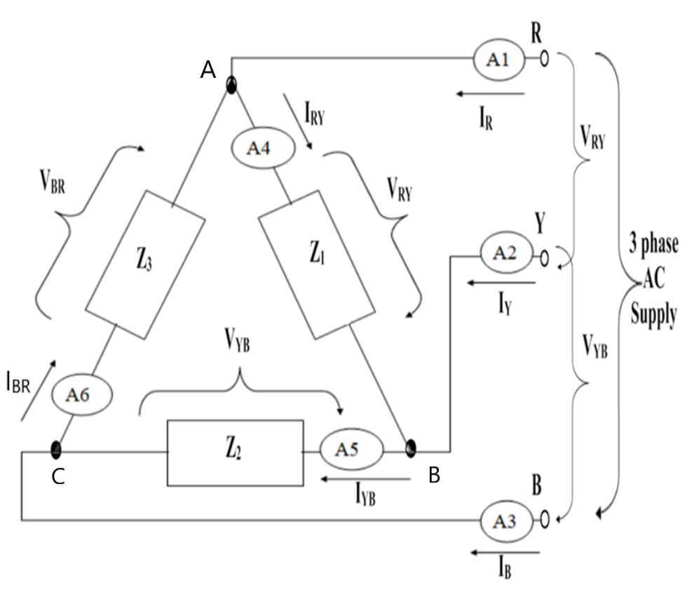
Relationship Between Phase and Line Values in a Balanced Delta Connected System
From the Figure, it can be seen that the voltage across impedance say Z₁ and voltage between the lines connecting this impedance Z₁ ie., R - Y are same.
So we can conveniently say that the line voltage (ie., the voltage across any two incoming lines) and their respective phase voltage (ie., the voltage across the impedance) are same. ie., V_{RY} = V_{YB} = V_{BR} = V_{L} = V_{ph}
From the Figure, it can also be seen that, the line current I_{R}, I_{Y} and I_{B} flowing through the line R, Y and B respectively and the phase currents I_{RY}, I_{YB} and I_{BR} flowing through Z_{1,} Z₂ and Z₃ respectively are not same
So by applying KCL to node A, B and C respectively, we get
I_{R} = I_{RY} – I_{BR}
I_{Y} = I_{YB} – I_{RY}
I_{B} = I_{BR} – I_{YB}

Slide 14
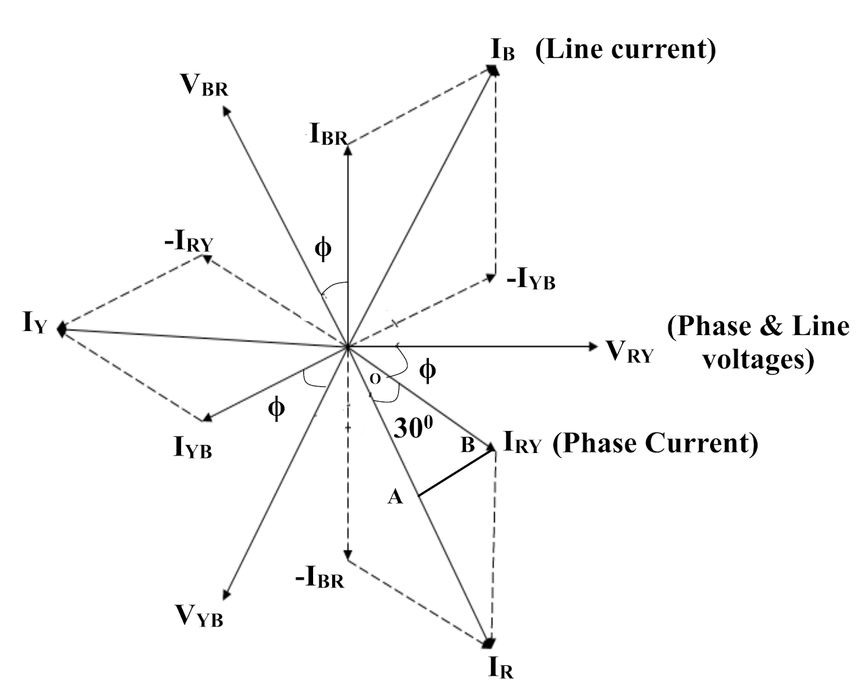
Relationship Between Phase and Line Values in a Balanced Delta Connected System
Considering triangle OAB from the vector diagram
cos30 = (I_{R}/2) / I_{RY} and cos30 = (√3)/2
I_{R} = √3 I_{RY}
I_{L} = √3 I_{ph} and V_{L} = V_{ph}

Slide 15
Expression for Power in a Balanced Three Phase Delta Connected System
Single Phase active power P = V_{ph} I_{ph} cosφ watts
Three phase active power = 3 * single phase active power
Three phase active power = 3 * (V_{ph} I_{ph} cosφ)
In a delta connected system V_{L} = V_{ph} and I_{L} = √3 I_{ph}
So three phase active power P = √3 V_{L} I_{L} cosφ W or kW (kilo Watts)
Similarly
Three phase reactive power = √3 V_{L} I_{L} sinφ VAR or kVAR (kilo Volt Ampere Reactive)
Three phase apparent power = √3 V_{L} I_{L} VA or kVA (kilo Volt Ampere)

Slide 16
Impedance and Power Factor in a Three Phase System
Impedance is always a per phase value in a three phase system
|Z_{ph}|∠ +φ = R_{ph} + jX_{ph} Ω (+^{ve} for inductive reactance and –^{ve} for capacitive reactance)
Also |Z_{ph}| = |V_{ph}|/ |I_{ph}| Ω and φ = tan⁻¹ (X_{ph} / R_{ph})
Power factor in a three phase circuit is the cosine of the angle between phase voltage and phase current
Back

Slide 17
PROBLEMS ON THREE PHASE A.C. CIRCUITS

Slide 18
Q. 1&2. A balanced load of (8+j6)Ω/ph is connected in star/delta across 3 phase, 400V, 50Hz supply. Find the line current, active power, reactive power, apparent power and power factor. Also find the ratio of I_{L_star} / I_{L_delta} and P_{star} / P_{delta}?
Solution for delta connected load:
Delta connection; Phase = 3; Z_{ph} = (8+j6)Ω; V_{L} = 400V; f = 50 Hz; I_{L} = ?; P = ?; Q = ?; S = ?; cosφ = ?
Z_{ph} = (8+j6)Ω = 10∠36.86 Ω
|V_{ph}| = |V_{L}| = 400 V
|I_{ph}| = |V_{ph}| / |Z_{ph}| = 40 A
|I_{L}| = √3 |I_{ph}| = 69.28 A
cosφ = cos (36.86) = 0.8 lag
P = √3 V_{L} I_{L} cosφ = 38.4 kW
Q = √3 V_{L} I_{L} sinφ = 28.79 kVAR
S = √3 V_{L} I_{L} = 47.99 kVA
|I_{L_star}| / |I_{L_delta}| = 0.3333
P_{star} / P_{delta} = 0.3333
Solution for Star Connected load:
Star connection; Phase = 3; Z_{ph} = (8+j6)Ω; V_{L} = 400V; f = 50 Hz; I_{L} = ?; P = ?; Q = ?; S = ?; cosφ = ?
Z_{ph} = (8+j6)Ω = 10∠36.86 Ω
|V_{ph}| = |V_{L}| / √3 = 230.94 V
|I_{ph}| = |V_{ph}| / |Z_{ph}| = 23.09 A
|I_{L}| = |I_{ph}| = 23.09 A
cosφ = cos (36.86) = 0.8 lag
P = √3 V_{L} I_{L} cosφ = 12.78 kW
Q = √3 V_{L} I_{L} sinφ = 9.598 kVAR
S = √3 V_{L} I_{L} = 15.99 kVA

Slide 19
Q. 3. Three identical impedances connected in star across a balanced three-phase supply consume 300W and take a current of 10A. Find the phase current, line current and power consumed if the same impedances were connected in delta across the same supply.
Solution:
Star connection; Phase = 3; P_{star} = 300W; I_{L_star} = 10A; I_{ph_delta} = ?; I_{L_delta} = ? P_{delta} = ?
The relation between P_{star} and P_{delta} is 0.3333 and I_{L_delta} and I_{L_star} is also 0.3333
So P_{delta} = P_{star} / 0.3333 = 900 W similarly |I_{L_delta}| = |I_{L_star}| / 0.333 = 30 A
|I_{ph_delta}| ₌ |I_{L_delta}| / √3 = 17.32 A

Slide 20
Q. 4&5. A star/delta connected load consists of 25Ω resistance in series with 15mH inductance in each phase. If the supply is 415V, 60Hz, find line current, power & pf.
Solution for Star Connected load:
Star connection; Phase = 3; R_{ph} = 25Ω; L = 15mH; V_{L} = 415V; f = 60 Hz; I_{L} = ?; P = ?; cosφ = ?
X_{L} = 2πfL = 5.65 Ω
Z_{ph} = (25+j5.65)Ω = 25.63∠12.73 Ω
|V_{ph}| = |V_{L}| / √3 = 239.60 V
|I_{ph}| = |V_{ph}| / |Z_{ph}| = 9.34 A
|I_{L}| = |I_{ph}| = 9.34 A
cosφ = cos (12.73) = 0.975 lag
P = √3 V_{L} I_{L} cosφ = 6.55 kW
Solution for delta connected load:
Star connection; Phase = 3; R_{ph} = 25Ω; L = 15mH; V_{L} = 415V; f = 60 Hz; I_{L} = ?; P = ?; cosφ = ?
X_{L} = 2πfL = 5.65 Ω
Z_{ph} = (25+j5.65)Ω = 25.63∠12.73 Ω
|V_{L}| = |V_{ph}| = 415 V
|I_{ph}| = |V_{ph}| / |Z_{ph}| = 16.19 A
|I_{L}| = √3 |I_{ph}| = 28.04 A
cosφ = cos (12.73) = 0.975 lag
P = √3 V_{L} I_{L} cosφ = 19.65 kW

Slide 21
Q. 6. Three coils each with impedance Z are star connected and takes 150kW with a leading line current of 100A at a line Voltage of 1100V, 50Hz supply. Find the circuit constants.
Solution:
Star connection; Phase = 3; P = 150 kW; I_{L} = 100 A and leading; V_{L} = 1100V; f = 50 Hz; R_{ph} = ?; X_{Ph}= ?
//Circuit constants means resistance, inductance and capacitance
|V_{ph}| = |V_{L}| / √3 = 635.08 V
|I_{L}| = |I_{ph}| = 100 A
|Z_{ph}| = |V_{ph}| / |I_{ph}| = 6.35 Ω
//If the line current is leading then it is an RC series circuit
P = √3 V_{L} I_{L} cosφ // Active power is a scalar quantity
Cosφ = 0.797 lead so φ = 38.06⁰ //where φ is the angle of Z_{ph}. So it is the angle between phase voltage and phase current
Z_{ph} = 6.35 ∠-38.06⁰ Ω
Converting Z_{ph} into rectangular form we get
Z_{ph} = 5.00 – j3.91 Ω // Z_{ph} = R – JX_{C} form at current is leading
R_{ph} = 5Ω and X_{c} = 3.91 Ω
C = 1/2πfx_{c} = 814 μF

Slide 22
Q. 7. A three-phase delta connected load consumes a power of 200kW taking a lagging current of 200A at a line Voltage of 1100V, 50Hz. Find the parameters of each phase. What would be the power consumed if the load were connected in star?
Solution:
Case A: Delta connection; Phase = 3; P = 200 kW; I_{L} = 200 A and lagging; V_{L} = 1100V; f = 50 Hz; R_{ph} = ?; X_{Ph}= ?
//Circuit constants means resistance, inductance and capacitance
|V_{ph}| = |V_{L}| = 1100 V
|I_{L}| = |I_{ph}| / √3 = 115.47 A
|Z_{ph}| = |V_{ph}| / |I_{ph}| = 9.526 Ω
//If the line current is lagging then it is an RL series circuit
P = √3 V_{L} I_{L} cosφ // Active power is a scalar quantity
Cosφ = 0.524 lag so φ = 58.54⁰ //where φ is the angle of Z_{ph}. So it is the angle between phase voltage and phase current
Z_{ph} = 9.526 ∠58.54⁰ Ω
Converting Z_{ph} into rectangular form we get
Z_{ph} = 4.97 + j8.12 Ω // Z_{ph} = R + JX_{L} form as current is lagging
R_{ph} = 4.97 Ω and X_{L} = 8.12 Ω
L = X_{L} /2πf = 25.8 mH
Case B: Star connection; Phase = 3; Z_{ph} = 9.526 ∠58.54⁰ Ω; P = 200 kW; V_{L} = 1100V; f = 50 Hz; Cosφ = 0.524 lag; P = ?
|V_{ph}| = |V_{L}|/ √3 = 635.08 V
|I_{ph}| = |V_{ph}| / |Z_{ph}| = 66.66 A
|I_{L}| = |I_{ph}| = 66.66 A
P = √3 V_{L} I_{L} cosφ
P = 66.28 kW

Slide 23
THANK YOU

Slide 24
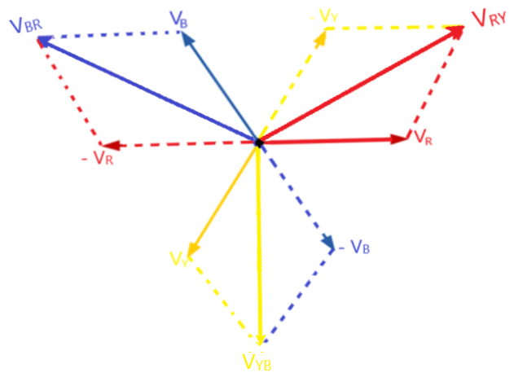
Star Connection

