Slide 1
JAG/US Courts Hackathon
Team Resources and Strategy

Slide 2
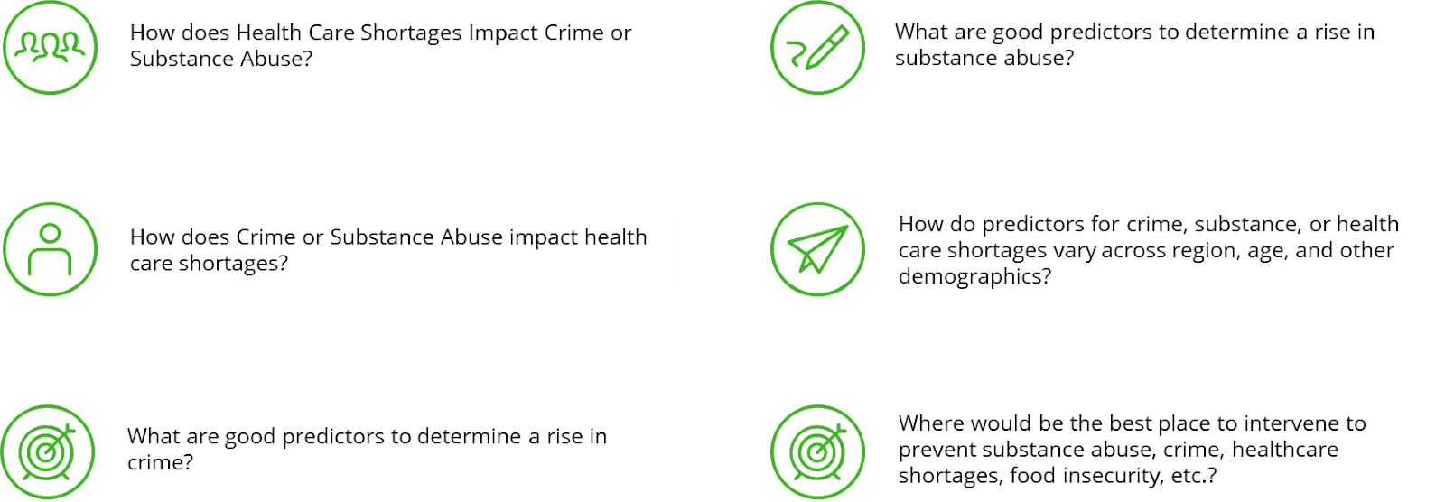
Example Solution Questions

Slide 3
Datasets (must use at least 2)
Violent Crime & LE Employee Data:
FBI’s NIBRS: A database containing information on crime in the US, including drug abuse. Data breakdowns include region, offense type, demographics, and more. NIBRS’s website includes the ability to download data as well as visualizations to support data exploration.
DJA’s LEARCAT: LEARCAT data offers count-based data by region, relationship to victim, crime category, year, victim characteristics, and more.
Overdose Death/Mortality & Public Health Data:
CDC’s NVSS: An extensive database with relation to drug mortality, and death counts for overdoses by state and drug.
CDC’s WONDER: A wide array of date-limited public health data.
Demographic Data:
US Census Data: The federal database of census information, with varying geographic-based demographics including food insecurity, poverty, summary statistics and the largest number of options for unique variable selection in this hackathon.
Prescription Drug Data
DEA’s ARCOS (through Washington Post): Data regarding purchase of pain pills, including area, drug, dosage, and pharmacy. Some data may require a free Washington Post account.
Healthcare Workforce
HRSA’s HPSA: A smaller database containing information on the shortage of medical personnel, substance abuse, and region-level specifics.
https://github.com/kanikasanduja/Machine-Learaning-HPSA/blob/master/strategic-identification-health.pdf
Other
Additional data you wish to incorporate.
All public federal datasets on crime – link
National Household Survey on Drug Abuse (NHSDA-1996) – link
FTE Law Enforcement Officers by County
500 Cities Project: 2016 to 2019 | PLACES: Local Data for Better Health | CDC
Strategies | County Health Rankings & Roadmaps

Slide 4
Proposed strategy
Join tables on regional data (city, state, or county)
Develop inferential model to determine factors that increase risk of drug-related crime (assuming drug-related crime increases the risk of all other drug-related incidents), as well as doctor/healthcare shortage
Determine target census groups that are most at-risk for BOTH physician shortages AND drug-related crime
Research additional studies that have proposed solutions for these problems. Ideal examples would be pilot programs that have shown a measurable impact on the community, reducing either drug-related incidents or reducing healthcare shortages.
Cite studies as a viable option for reducing risk factors moving forward

