Slide 1

BUILDOBJECTS · INFRASTRUCTURE MASTERPLAN
Sovereign by 2031
Indigenous Cloud · Indigenous Miniature Satellites
A five-year blueprint to own the compute, the network and the sky above our platform —
built only for Build Objects's one lakh customers, never for sale.
20-SLIDE BRIEF
FY 2027 – 2031
CONFIDENTIAL
August 2026
Notes:
Opening: Build Objects already owns the design spine. This deck is the case for owning the rails underneath it — cloud, data centers and a small captive satellite layer — sized only for our own use.

Slide 2







01 THE WHY
One platform. Three products. Zero rented rails.
WHAT WE ARE BUILDING
WHY OWN THE INFRASTRUCTURE
Build Objects Studio
Cost control
AI architect — sanction-grade designs, 3D + 4K renders
GPU rendering is our biggest recurring bill
Build Objects Store
Sovereignty
15,000+ SKUs — cement to chandeliers, BOQ to cart
Designs, payments, homes — data stays in India, with us
Build Objects Construct
Uptime
Contractors on escrow, milestone-tracked sites
10,000 concurrent designers; sites that can't go dark
One BIM spine — the design file drives every rupee spent after it.
Vertical integration is the moat competitors can't rent.
The thesis: whoever owns the design owns the transaction — whoever owns the rails owns the margin, the latency and the risk.
SERVE OURSELVES ONLY — NOTHING IS FOR RESALE
02
Notes:
Everything in this plan is captive infrastructure: our satellites, our servers, our network — sized for our own products only. No capacity resale business.

Slide 3




02 THE LOAD
The load we must never drop
1,00,000
10,000
10,000
99.95%
customers on platform
house designs / year
concurrent users at peak
uptime target
RENDER GPU FLEET (SUSTAINED CARDS)
WHAT 10,000 CONCURRENT MEANS
10–20k requests/sec at the edge
≥ 90% absorbed by CDN cache
~1–2k requests/sec at origin
30–40 stateless app pods, autoscaled
2,000+ renders / day
queue-scheduled; spikes = longer ETA, never a crash
150 TB → 1.5 PB objects
renders + 4K walkthroughs; DB stays < 2 TB
Sizing: internal scale model — spike headroom 5–10× is a permanent design rule. est.
03
Notes:
Design rule: systems die at spikes, not averages. Every layer sized with 5-10x headroom; renders queue instead of failing.

Slide 4





03 THE END-STATE
Own the stack, layer by layer
L3 — THE SKY
2026 → 2031
12 miniature satellites + leased LEO broadband
Rented cloud
Private cloud
L2 — THE CORE
Public internet
Own 1 MW data center + DR + edge cache
Private SD-WAN
Others' satellites
Our constellation
L1 — THE CLOUD
Build Objects private cloud — K8s, GPU farm, object store
Vendor SOC
Our 24×7 SOC
One control plane, one security operations center, one bill — ours.
04
Notes:
The three layers are one system: satellites feed sites, the core runs the platform, the cloud layer is the software that makes it all one machine.

Slide 5








04 PILLAR I — INDIGENOUS CLOUD
The Build Objects private cloud
Users → CDN edge
Two Indian regions
90%+ cache hit — renders, catalogs, galleries
Hyderabad primary + DR region · RPO 15 min, RTO 4 hr
Kubernetes app plane
Open-source core
Next.js · NestJS · design engines · edit-agent
K8s, Postgres, MinIO/Ceph — zero lock-in, export path always live
Data plane
Keys stay home
PostgreSQL + PostGIS · Redis · Meilisearch
Encryption keys in our HSMs — never a foreign cloud's custody
GPU render farm
L40S-class path tracing · priority queues
Burst valve
Public-cloud GPUs only for spikes — never for the baseline
Object store + archive
S3-compatible · lifecycle tiering · CDN-fronted
DESIGN LAW — cloud-neutral: any workload can leave any vendor in 90 days
05
Notes:
Private cloud = software sovereignty first. The same stack runs in colo, in our DC, or burst into public cloud — that portability is what makes every later decision reversible.

Slide 6



05 CLOUD ECONOMICS
Rent, partner or own the servers?
5-YEAR CUMULATIVE CASH OUT (₹ CRORE, EST.)
Own the GPUs — always
Payback < 2 years above 60% utilisation
Rent the building — for now
Colo until FY29; our IT racks inside it
Burst to cloud — forever
Festival spikes rent GPUs by the hour
+₹49 Cr 5-yr premium of full ownership —
bought back after FY31 at ~₹7 Cr/yr savings
VERDICT — hybrid: own compute, lease shells, burst up
est. — L40S-class cloud GPUs $0.4–1.6/hr; owned card ~$8–9k; India colo ₹8–25k/kW/mo. Sources on final slide.
06
Notes:
At our scale pure rent is cheapest inside 5 years, but ownership of the IT wins immediately at >60% GPU utilisation, and the building wins beyond FY31. Hence: hybrid, with a decision gate not a religion.

Slide 7
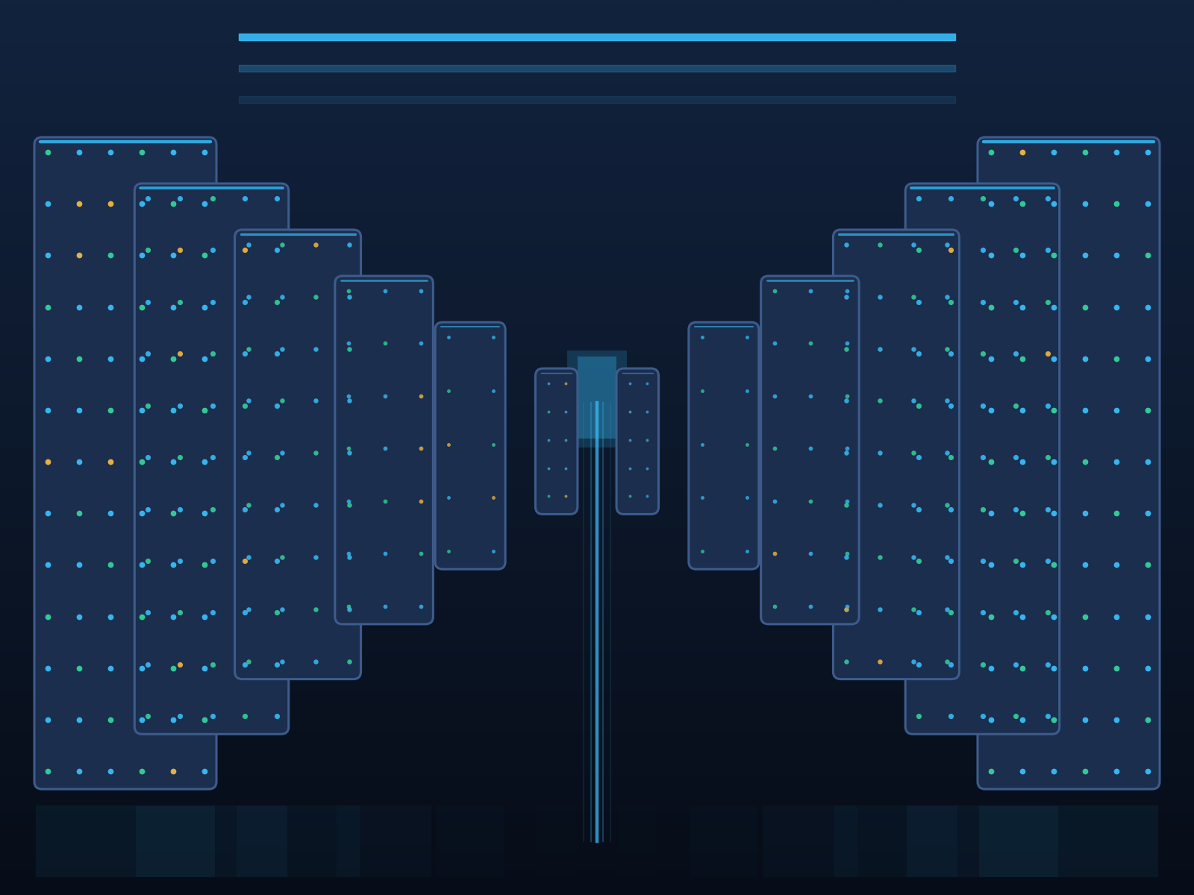
06 PILLAR II — DATA CENTERS · LAND
Land: our 1 MW sovereign core
WHAT IT COSTS (EST.)
Build — shell, power, cooling
₹50–70 Cr / MW
IT fit-out — servers, GPUs, network
₹40–55 Cr
Run — power, people, spares
₹8–12 Cr / yr
Timeline — design to live
18–24 months
Tier III
N+1
PUE ≤ 1.4
Liquid-ready
concurrently maintainable
power & cooling
with warm-water option
for next-gen GPUs
HYDERABAD
DUAL GRID
DUAL FIBRE
DECISION — site selection FY28 · ground-break FY29 · live FY30
India greenfield benchmarks ₹40–70 Cr per MW IT load (JLL / Blackridge, 2025). 1 MW covers FY31 fleet with headroom.
07
Notes:
1 MW sounds small — it's right-sized: 150 GPUs + CPU + storage is ~0.5-0.7 MW IT load; 1 MW leaves headroom. A DR pod (~0.2 MW) sits in a partner colo in another seismic zone.

Slide 8
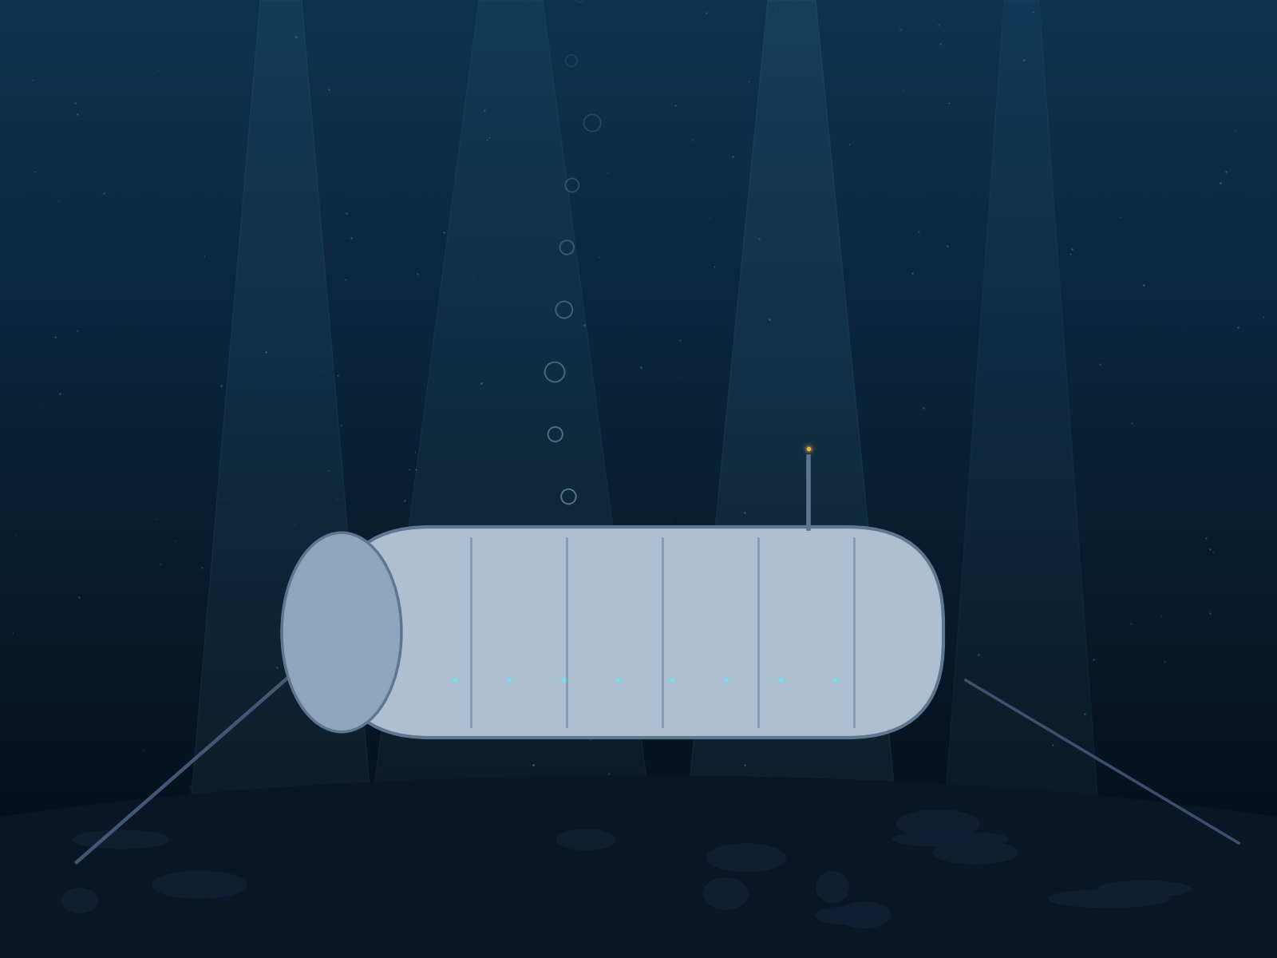




07 PILLAR II — DATA CENTERS · SEA
Sea: real technology, not yet our build
Proven reliable
Microsoft's subsea pods: 1/8th the failure rate of land — project still shelved in 2024
Now commercial — in China
First commercial subsea DC live off Shanghai, Oct 2025 — offshore-wind powered, ~90% cooling energy cut
India has no rulebook
No CRZ / marine framework for subsea compute; permits, cables, insurance all unmapped
Our economics
Prototype ≈ ₹80–150 Cr — beats land only at coastal scale, after the rules exist
PUE ~1.1 — SEA-COOLED
ZERO LAND, ZERO WATER
VERDICT — WATCH & PARTNER: joint feasibility study FY30, zero capex before rules
Microsoft Project Natick (ended 2024); Hailanyun / HiCloud commercial subsea DC, Shanghai, Oct 2025.
08
Notes:
Sea solves cooling and land — our two smallest problems at 1 MW scale. It becomes interesting for a 2030s coastal edge near Vizag/Chennai once India writes marine DC rules. We stay close via a study partnership, not capex.

Slide 9
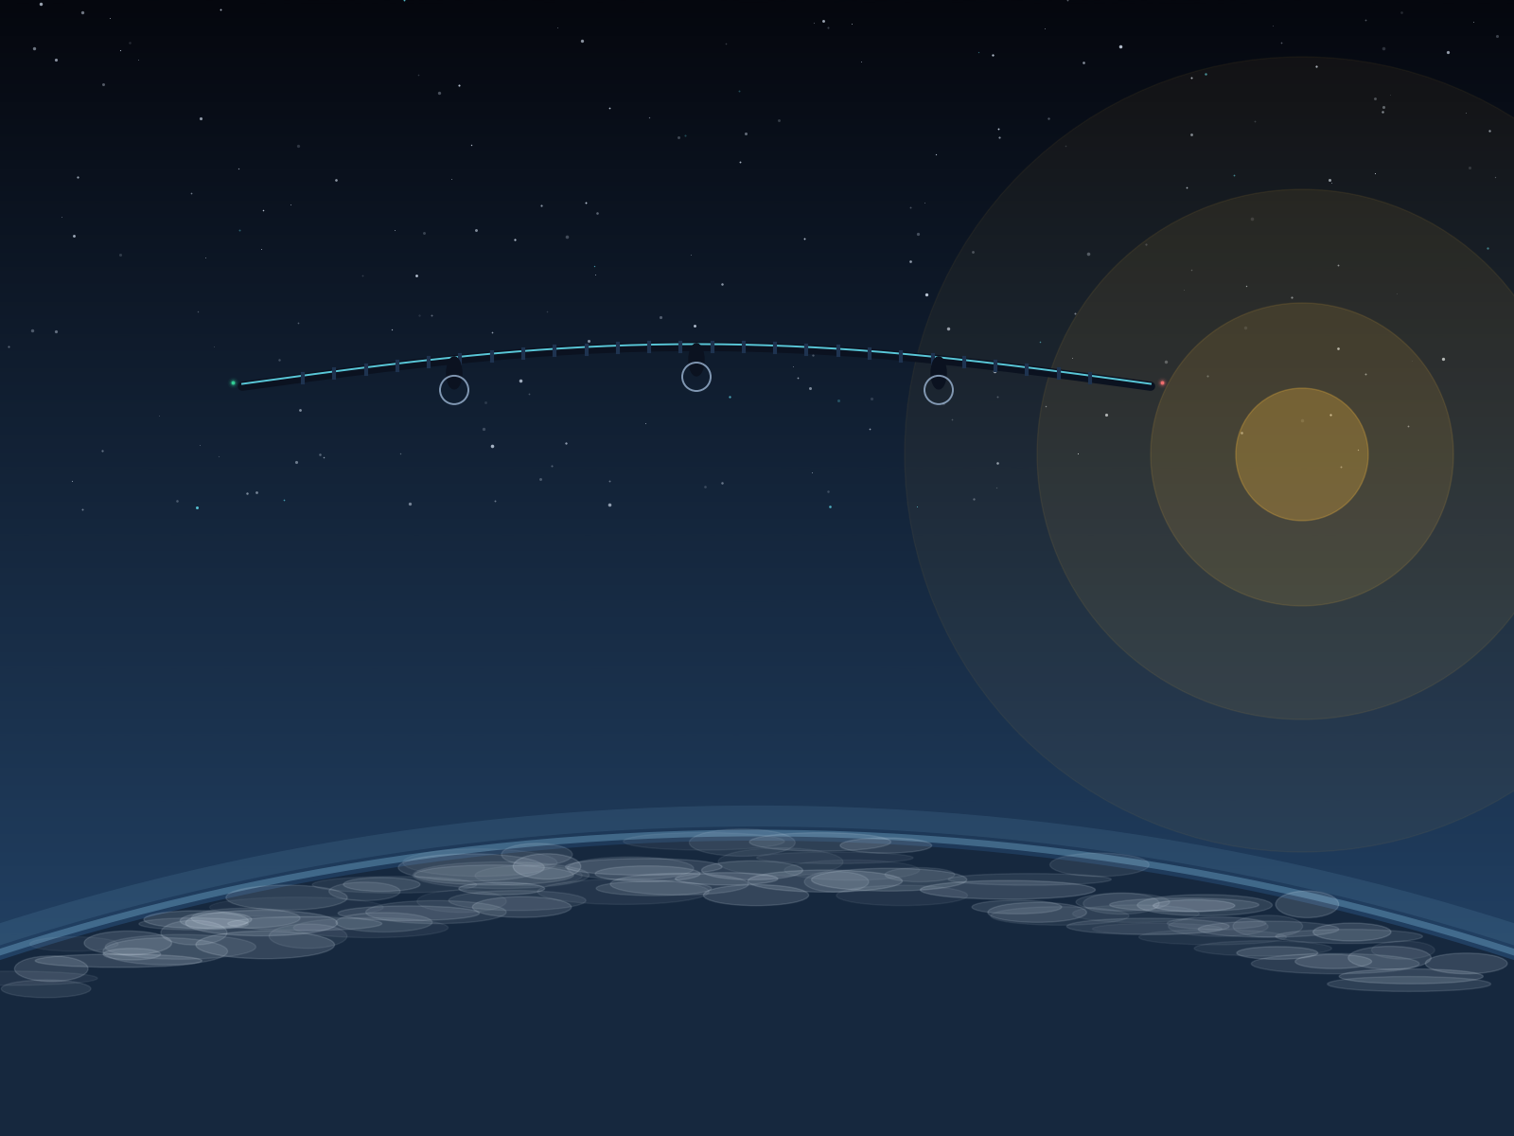




08 PILLAR II — DATA CENTERS · SKY
Sky: a relay layer, not a data center
The record is real
67-day continuous stratospheric flight (Zephyr, Apr 2025); first services target 2026
India is flying too
NAL's solar HAP prototype in test campaigns; HAL developing CATS warfighter ecosystem
Physics says no servers
A HAPS lifts kilowatts, not megawatts — compute payloads don't close; it's a flying cell tower
Our use case
Disaster-relay + temporary site backhaul over remote projects — rented by the week
20 KM · SOLAR HAPS
WEEKS ALOFT, KW POWER
VERDICT — NO COMPUTE ALOFT: rent HAPS relay trials FY30+, own nothing that flies in air
AALTO/Airbus Zephyr 67-day flight, Apr 2025; NAL HAP subscale trials, May 2025.
09
Notes:
Edge containers on the ground beat airborne compute on every axis. The sky layer that matters for us is orbital, not atmospheric — next slides.

Slide 10
09 DATA CENTERS — THE COMPARISON
Land wins this decade — and we'll watch the water
COST INDEX PER MW DEPLOYED (LAND 2026 = 100, EST.)
Maturity
Land TRL-9 · Sea first-commercial · Sky pre-commercial
Cooling & PUE
Sea best (~1.1) · Land 1.3–1.5 · Sky n/a
Rules in India
Land clear · Sea absent · Sky partial (DGCA)
Fix & maintain
Land hours · Sea weather-window · Sky landing cycles
BUILD on land · STUDY the sea · RENT the sky
Index: internal estimate from public build-cost anchors; sea projected to near-parity for coastal edge by early 2030s.
10
Notes:
The honest answer to 'which is cheapest': land today by a wide margin; sea could reach coastal parity by the 2030s as Chinese-style serial production matures; airborne compute never pencils at our scale.

Slide 11







10 PILLAR III — THE PRIVATE NETWORK
Every site online, three ways down
PRIVATE OVERLAY — ZERO-TRUST, ENCRYPTED, INDIA-ROUTED
Path 1 — Fibre
Primary at every fixed site; dual entry at DC
HQ + Data center
Experience centers
Path 2 — 4G/5G
Instant-on for new construction sites
Path 3 — Satellite
Leased LEO + our constellation; no-signal villages covered
SD-WAN CORE
One overlay
SD-WAN + zero-trust; site joins in a day, fails over in seconds
Construction sites
Vendors & engineers
TARGET — 200+ sites by FY31 · 99.9% each · zero dark days
11
Notes:
A construction site gets connectivity the day work starts: 5G router + LEO dish in a site box, absorbed into the SD-WAN overlay. Fibre follows if the site lives long enough.

Slide 12
11 PILLAR IV — SATELLITES · OPTIONS
Buy the sky first — then build our corner of it
GEO
MEO
LEO
36,000 km · ~600 ms
8,000 km · ~150 ms
550 km · 25–50 ms
Broadcast, rural VSAT
Trunk backhaul
Interactive apps — our fit
WHO CAN SELL US CAPACITY IN INDIA (STATUS AUG 2026)
Starlink
Jio-SES
Eutelsat OneWeb
Captive VSAT CUG
GMPCS + IN-SPACe cleared; ~₹3,000/mo expected, terminal ₹25–35k
GEO+MEO enterprise; Indian gateways live
LEO enterprise via Bharti; India gateways
Our own licensed hub — ₹10k/terminal/yr fee
STRATEGY — lease LEO broadband for sites & failover · reserve our own build for the one job leasing can't do: captive telemetry
Starlink licensing & pricing: press reports 2025–26; VSAT CUG fee: DoT guidelines 2022.
12
Notes:
Broadband is a solved, competitive market — we buy it. What we can't buy: a guaranteed, sovereign, always-ours telemetry layer for every site and product. That's what our miniature satellites are for.

Slide 13
12 PILLAR IV — SATELLITES · REALITY CHECK
What miniature satellites can honestly do
CAPABILITY — TRUTH TABLE
THE CLASSES (BUILD COST / SAT, EST.)
NB-IoT telemetry
Site sensors, trackers, meters — few bytes, everywhere
1U–3U CubeSat
₹1–4 Cr
1–5 kg · student & demo missions
Messaging & alerts
Milestone pings, SOS, fleet — store-and-forward
6U–12U nanosat
₹6–12 Cr
8–25 kg · our class — NB-IoT payloads
Scheduled data drops
Site photos, drone survey packets on each pass
50–100 kg microsat
₹15–35 Cr
50–100 kg · thin comms, EO
Thin broadband
Mbps-class only with large sats + big gateways
150–300 kg smallsat
₹40–90 Cr
Full broadband
150+ kg · broadband-lite constellations
Needs 100s of satellites & ₹8,000+ Cr — Starlink's game, not ours
Bus platforms now indigenous: Dhruva · Astrome · Azista (IN-SPACe programme, 2026)
Cost bands: NanoAvionics / industry references + Indian programme anchors. est.
13
Notes:
The honest line: miniature satellites are a telemetry and messaging machine, not a broadband machine. We design for the mission they can win.

Slide 14

13 PILLAR IV — SATELLITES · OUR BUILD
The Build Objects constellation — 12 birds by FY31
S1 · FY28–29 — Demonstrator
2× 6U NB-IoT sats · SSLV / rideshare · ground via GSaaS
S2 · FY30 — First ring
6 sats · own S-band gateway, Hyderabad · live site telemetry
S3 · FY31 — Full ring
12 sats · ~90-min revisit India · 2 gateways + mission NOC
550 KM SSO ORBIT
S-BAND NB-IoT (NTN)
STORE-AND-FORWARD
Built with, not from scratch: indigenous buses (Dhruva / Astrome / Azista), our payload spec, ISRO-ecosystem launch, Indian ground partners.
Coverage: 12 sats ≈ 90-min revisit (store-and-forward); continuous coverage stays hybrid with leased NB-IoT NTN roaming.
14
Notes:
12 satellites cannot hover over India — they pass. Store-and-forward + 3GPP NTN roaming onto partner constellations gives effective continuity while keeping the sovereign layer small and affordable.

Slide 15
14 PILLAR IV — SATELLITES · ECONOMICS
What the sky costs
LAUNCH PRICE PER KG TO ORBIT (USD, 2026)
Demonstrator (2 sats, FY28–29)
₹25–35 Cr
12-sat constellation, all-in
₹180–260 Cr
— build ₹96–144 · launch ₹20–35 · ground ₹25–35 · 3-yr ops ₹40–55
Leased-only alternative (per yr)
₹3–4 Cr
The honest math: owning never beats leasing on ₹/bit. We buy certainty: a layer nobody can price-hike, geo-block or switch off.
GATE IT — constellation go/no-go sits at FY29, after the demo flies
Launch: SpaceX rideshare $7k/kg (2026); SSLV ~$3.7M/500 kg; PSLV ₹130–200 Cr. Program bands: est., cross-checked vs Fleet (~$150–200M/100 sats) & Indian 12-sat EO PPP ($135M).
15
Notes:
Anchors keep us honest: a far more complex 12-sat EO constellation was priced at $135M under IN-SPACe PPP; our simpler comms birds at ₹180-260 Cr all-in is conservative-feasible.

Slide 16





15 THE RULEBOOK — WHAT WE MUST OBTAIN
The regulatory runway — start filing now
1
2
3
4
5
IN-SPACe
DoT licence
WPC spectrum
ITU filing
Launch & ops
Authorisation for satellites, payloads & ground stations
Captive VSAT CUG now · GMPCS via UL if user-links later
Administrative assignment · 4% AGR + ₹3,500/MHz min/yr
Frequency coordination via DoT — longest pole
NSIL / SSLV contract · insurance · deorbit plan (≤5 yr)
6–9 mo
~6 mo
with licence
12–24 mo
FY28–29
WHAT WE ACTUALLY BUY
S-band NB-IoT payload spectrum (NTN)
S/UHF TT&C command links
Ku/Ka gateway feeder links
WPC ETA for every terminal type
FEES ARE SMALL, TIME IS NOT — file IN-SPACe + ITU paperwork in FY27, fly in FY29
TRAI reco May 2025 (4% AGR, may rise to 5%); DoT Captive VSAT CUG guidelines 2022 (₹10k/terminal/yr); FDI: 74% automatic in sat manufacturing.
16
Notes:
Nothing here is a blocker — Starlink cleared the same wall. The killer is sequencing: ITU coordination and IN-SPACe authorisation must start ~2 years before first launch.

Slide 17

16 THE RULEBOOK — WHAT SHOULD CHANGE
Six rules we'll push to change
Captive-constellation licence
120-day single window
10-year spectrum terms
A simple own-use class for private constellations — like captive VSAT, not full GMPCS
IN-SPACe + DoT + WPC as one time-bound approval, not three queues
5-year assignments can't finance 7-year satellite capex
Guaranteed SSLV cadence
Marine DC framework
PLI for space + DC gear
Published rideshare calendar so Indian constellations plan launches like freight
CRZ / offshore rules for subsea & floating data centers — today there are none
Extend production incentives to satellite buses, gateways, HSMs, cooling
Route: IN-SPACe consultations · TRAI open houses · industry bodies (ISpA) — as a builder with skin in the game, not a lobbyist.
17
Notes:
India's space reform direction is already with us — SBaaS grants, PPP constellations, administrative spectrum. These six asks accelerate what's moving, not fight what's fixed.

Slide 18




17 SECURITY & SOVEREIGNTY
Sovereign means secure — or it means nothing
Data residency
Key custody
Zero-trust
Every byte — designs, payments, homes — stored and processed in India
Encryption keys in our HSMs; no foreign cloud ever holds them
MFA everywhere, least privilege, segmented networks, signed firmware
24×7 SOC + NOC
Unkillable backups
Compliance built-in
One pane for cloud, DC, network and satellites; forensic-ready logging
Immutable + offline copies; ransomware drills twice a year
DPDP Act 2023 · CERT-In 6-hour incident reporting · audit evidence on tap
Satellite terminals, gateways and telecommand links live inside the same zero-trust perimeter — a hacked dish must be worth nothing.
18
Notes:
Sovereignty argument only holds if our own estate is harder to breach than the hyperscalers we left. Budget includes red-teaming and DR drills from year one.

Slide 19
18 THE ECOSYSTEM
Partners, not dependencies
SPACE
CONNECTIVITY
COMPUTE
RESEARCH
IN-SPACe · NSIL / ISRO
Jio-SES · OneWeb
Colo host (interim)
IIST · IITs
authorisation · launch
leased GEO/LEO capacity
racks till our DC lives
payload & RF talent
Dhruva Space
Starlink
EPC + cooling partner
NAL
bus · ground stations
site broadband (as available)
DC design & build
HAPS relay trials
Astrome
BSNL · BharatNet
NVIDIA OEMs
C-DOT
payload · mmWave links
fibre to deep districts
GPU supply & service
telecom standards
Skyroot · Agnikul
Skylo / NTN roaming
HSM / security vendors
Marine institutes
future launch options
NB-IoT continuity
keys, SOC tooling
subsea DC study
The precedent that de-risks us: IN-SPACe already funded a private 12-satellite national constellation as a ₹1,150 Cr ($135M) PPP — the collaborate path is real and priced.
Pixxel-led consortium (with Dhruva, PierSight, SatSure), IN-SPACe EO constellation PPP, Feb 2026.
19
Notes:
Every box has two names behind it in our vendor file. Rule: one partner per layer, one fallback per partner, no partner owning two adjacent layers.

Slide 20
19 THE PLAN & THE BILL
Five years, three cheques, one spine
FY27
FY28
FY29
FY30
FY31
Cloud
Private cloud, rented iron
Own GPUs in colo
Own 1 MW DC live
Network
SD-WAN + leased LEO
Captive VSAT CUG hub
200+ sites, 3-path
Satellites
File IN-SPACe + ITU
Demo build + launch
12-sat constellation
THE 5-YEAR BILL — THREE PATHS (₹ CRORE, EST.)
DECISION GATES — SPEND UNLOCKS ONLY ON PROOF
₹405 Cr
FY28
GPU utilisation > 60% for a quarter → buy the fleet
FY29
Demo sat healthy + licences in hand → constellation go
₹210 Cr
FY30
Colo bill vs DC model crossover → building go
₹130 Cr
RECOMMENDED — HYBRID PATH: ₹210 Cr over 5 years
All figures order-of-magnitude estimates for planning; sources: JLL/Blackridge (DC), SpaceX/ISRO (launch), TRAI/DoT (fees), IN-SPACe PPP (constellation anchor).
20
Notes:
Close: the plan spends like an operator — every big cheque sits behind a gate that reality must open. Partnered keeps us renting forever; full-own overpays for pride; hybrid buys sovereignty exactly where it compounds.

