Slide 1
Ruppert’s Algorithm = Delaunay Refinement
Notes:
How do you say.

Slide 2
Background
Different triangulations
Matlab uses Delaunay triangulation with very simple refinement algorithm
Notes:
Triangulations
The ‘goodness’ of a mesh is determined by the error constant that depends on the proportion of the longest edge and the shortest altitude. Meaning: long skinny triangles are bad for calculations.
On lecture the error constant dependent of the mesh was defined to be proportional to the smallest circle enclosing given triangle and the largest circle that fits in the triangle.
Different triangulations
Triangulations are needed to solve fem and other numerical analysis problems.
Algorithms differ in performance. Many times algorithms are selected due to simplicity of implementation or speed rather than optimal or even close to optimal output.
Matlab uses Delaunay
Simple, generic and fast.
The triangulation tool provided by Matlab is meant for generic purposes and doesn’t take different kinds of requirements in to account very well.

Slide 3
Ruppert’s Algorithm = Delaunay Refinement
Bounded minimum angle
Bounded number of vertices
Size optimality
Notes:
Introduced by Ruppert at Nasa
Bounded minimum angles: user can choose a bound for the minimum angle. The bound is limited by the smallest angle present in the input data. 0-20 degrees
Delaunay refinement bounds the number of vertices.
The user can define suitable number of triangles according to computational resources and the needed accuracy. Selecting a larger number of vertices will obviously lead to longer execution times.
Size optimality: the number of triangles is within a constant factor of the minimum number possible.

Slide 4
Delaunay Refine
Inputs: Planar straight line graph, angle bound
Steps:
Initialize
while there are encroached segments or too small angles:
Split segments that are encroached upon
while there are skinny triangles:
Pick skinny triangle tri
If circumcenter of tri encroaches upon any segment seg:
Split seg
else:
Split tri
endwhile
endwhile
Notes:
Planar straight line graph
Encroach = A point is inside the diametral circle of an edge. A point is inside the circumcentral circle of a triangle.
Splitting a segment: Divide the segment in to two new segments, put the new segments in to list of all segments, remove old segment, add centerpoint to vertices.
Splitting a triangle: add circumcenter to points.
What’s the difficulty? <<KRISTIAN, WHAT’s THE DIFFICULTY>><><><
triangulation DelaunayRefine(pslg X, angleBound alpha) {
add a bounding square B to X
segments S = edges X
vertices V = vertices X
Delaunay(V)
while (no segments encroached upon, no angles < alpha) {
while (any segment s is encroached upon) {
SplitSeg(s)
}
t = pick skinny triangle
p = circumcenter of t
if (p encroaches upon any segment) {
for (i = 1 to size(segments)) {
SplitSeg(s);
}
} else {
SplitTri(t);
}
}
return Delaunay(V);
}

Slide 5
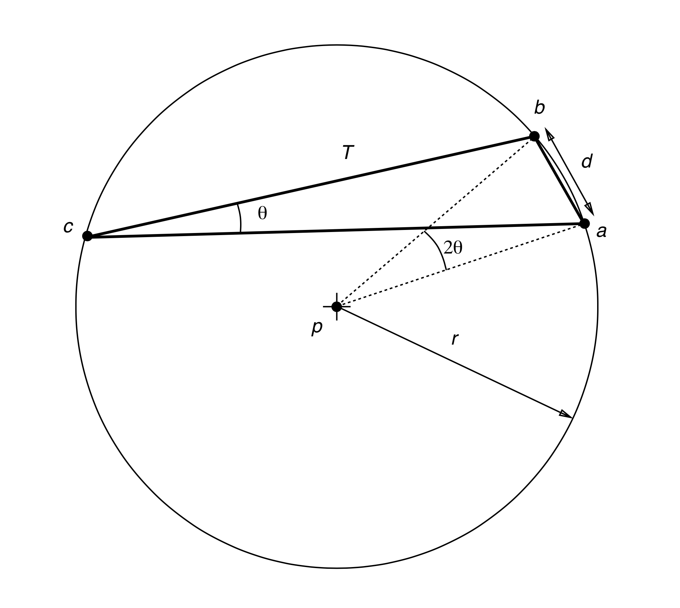
Minimum angle bound

