Slide 1
Shortest Path
Dijkstra’s Algorithm

Slide 2
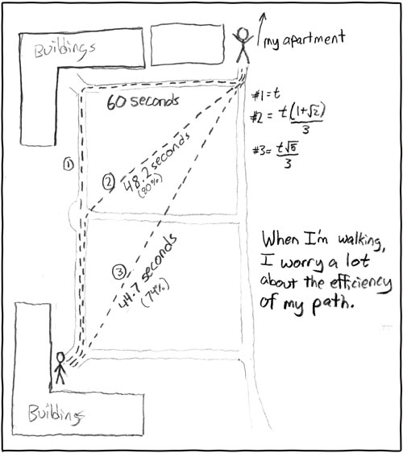
Today
Shortest Path Problem
http://xkcd.com/85/

Slide 3
Shortest Path problem
s
100
Input: Directed graph G=(V,E)
Edge lengths, l_{e} for e in E
“start” vertex s in V
w
5
15
u
s
s
w
5
5
15
u
u
Output: All shortest paths from s to all nodes in V

Slide 4
Naïve Algorithm
Ω(n!) time

Slide 5
Shortest Path Problem
3
y
u
1
1
3
s
4
x
2
2
2
w
z
3
Input: Directed G=(V,E), l_{e} ≥ 0, s in V

Slide 6
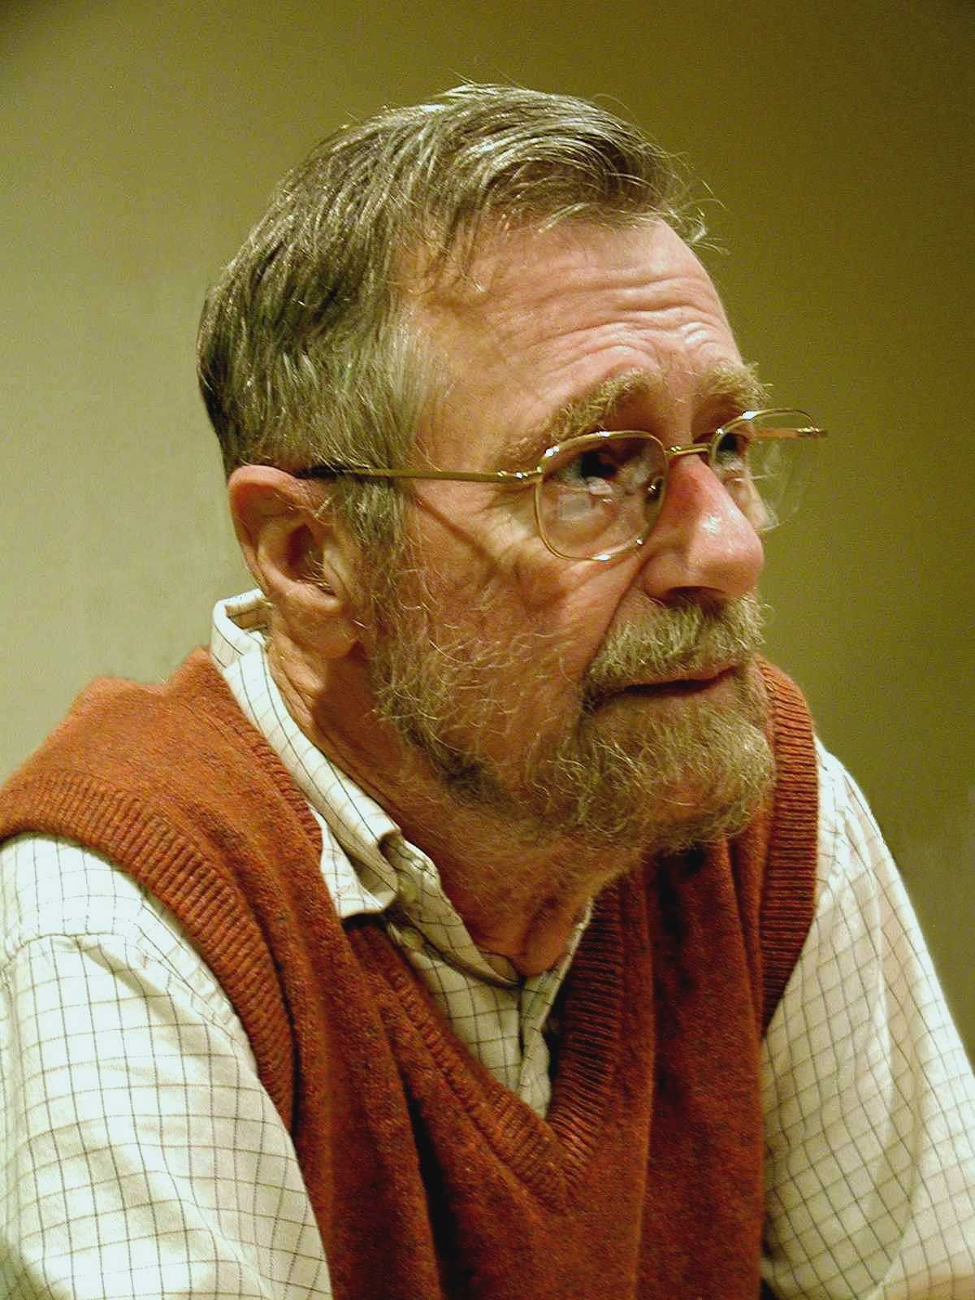
Dijkstra’s shortest path algorithm
E. W. Dijkstra (1930-2002)

Slide 7
Dijkstra’s shortest path algorithm
1
d’(w) = min _{e=(u,w) in E, u in R} d(u)+l_{e}
3
y
3
u
4
1
1
1
d(s) = 0
d(u) = 1
s
4
x
4
2
d(w) = 2
d(x) = 2
2
2
2
d(y) = 3
d(z) = 4
w
z
5
3
4
2
s
Input: Directed G=(V,E), l_{e} ≥ 0, s in V
u
w
R = {s}, d(s) =0
Shortest paths
While there is a x not in R with (u,x) in E, u in R
x
Pick w that minimizes d’(w)
Add w to R
y
z
d(w) = d’(w)

Slide 8
Couple of remarks
The Dijkstra’s algo does not explicitly compute the shortest paths
Can maintain “shortest path tree” separately
Dijkstra’s algorithm does not work with negative weights
…foreshadow

Slide 9
Dijkstra’s shortest path algorithm (runtime)
d’(v) = min _{e=(u,v) in E, u in S} d(u)+l_{e}
Input: Directed G=(V,E), l_{e} ≥ 0, s in V
S = {s}, d(s) =0
While there is a v not in S with (u,v) in E, u in S
At most n iterations
Pick w that minimizes d’(w)
Add w to S
d(w) = d’(w)
O(m) time
O(mn) time bound is trivial
O(m log n) time implementation is possible

Slide 10
Next Time
Runtime analysis of Dijkstra’s Algorithm
Prove the correctness of Dijkstra’s Algorithm

