Slide 1
Dynamic Programming
Weighted Interval Scheduling

Slide 2
High level view of CSE 331
Problem Statement
Problem Definition
Three general techniques
Algorithm
“Implementation”
Data Structures
Analysis
Correctness+Runtime Analysis

Slide 3

Greedy Algorithms
Natural algorithms
Reduced exponential running time to polynomial

Slide 4
A new algorithmic technique
Dynamic Programming

Slide 5
Using Memory to be smarter
Pow (a,n)
Pow (a,n)
// n is even and ≥ 2
// n is even and ≥ 2
t= Pow(a,n/2)
return Pow(a,n/2) * Pow(a, n/2)
return t * t
O(n) as we recompute!
O(log n) as we compute only once

Slide 6

End of Semester blues
Can only do one thing at any day: what is the optimal schedule to obtain maximum value?
Write up a term paper
(25)
Party!
(15)
Exam study
(2)
331 HW
(10)
Project
(30)
Monday
Tuesday
Wednesday
Thursday
Friday

Slide 7
Previous Greedy algorithm
Order by end time
Greedy value = 2+15+10= 27
Write up a term paper
(25)
Party!
(15)
Exam study
(2)
331 HW
(10)
Project
(30)
Monday
Tuesday
Wednesday
Thursday
Friday

Slide 8
New Greedy algorithm
Order by decreasing weight
OPT = 35
Write up a term paper
(25)
Greedy = 30
Party!
(15)
Exam study
(2)
331 HW
(10)
Project
(30)
Monday
Tuesday
Wednesday
Thursday
Friday

Slide 9
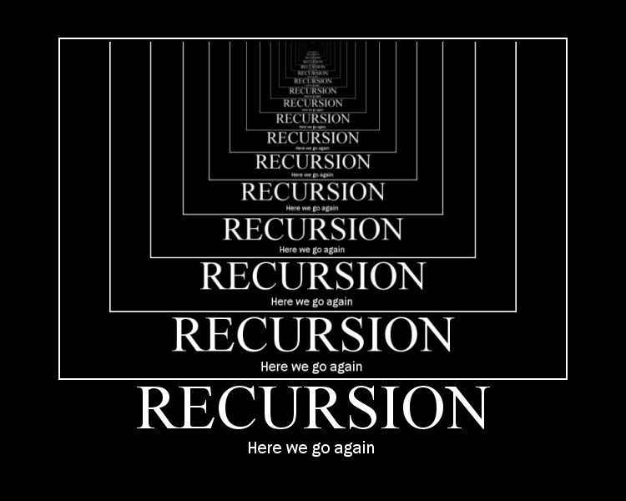
Today’s agenda
Formal definition of the problem
Start designing a recursive algorithm for the problem

Slide 10
Weighted Interval Scheduling
Input: n jobs (s_{i},t_{i},v_{i})
Output: A schedule S s.t. no two jobs in S have a conflict
Goal: max Σ_{i in S} v_{j}
Assume: jobs are sorted by their finish time

Slide 11
Couple more definitions
p(j) = largest i<j s.t. i does not conflict with j
p(j) < j
= 0 if no such i exists
OPT(j) = optimal value on instance 1,..,j

Slide 12
Property of OPT
j not in OPT(j)
j in OPT(j)
OPT(j) = max { v_{j} + OPT( p(j) ), OPT(j-1) }
Given OPT(1),…., OPT(j-1), how can one figure out if j in optimal solution or not?

Slide 13
A recursive algorithm
Proof of correctness by induction on j
Correct for j=0
Compute-Opt(j)
If j = 0 then return 0
return max { v_{j} + Compute-Opt( p(j) ), Compute-Opt( j-1 ) }
= OPT( p(j) )
= OPT( j-1 )
OPT(j) = max { v_{j} + OPT( p(j) ), OPT(j-1) }

Slide 14
Exponential Running Time
1
p(j) = j-2
2
3
Only 5 OPT values!
4
5
OPT(5)
OPT(3)
OPT(4)
OPT(3)
OPT(1)
OPT(2)
OPT(2)
OPT(1)
OPT(2)
OPT(1)
OPT(1)
OPT(1)

Slide 15
How many distinct OPT values?

Slide 16
A recursive algorithm
M-Compute-Opt(j) = OPT(j)
M-Compute-Opt(j)
If j = 0 then return 0
If M[j] is not null then return M[j]
M[j] = max { v_{j} + M-Compute-Opt( p(j) ), M-Compute-Opt( j-1 ) }
return M[j]
Run time = O(# recursive calls)

Slide 17
Bounding # recursions
M-Compute-Opt(j)
O(n) overall
If j = 0 then return 0
If M[j] is not null then return M[j]
M[j] = max { v_{j} + M-Compute-Opt( p(j) ), M-Compute-Opt( j-1 ) }
return M[j]
Whenever a recursive call is made an M value of assigned
At most n values of M can be assigned

Slide 18
Property of OPT
OPT(j) = max { v_{j} + OPT( p(j) ), OPT(j-1) }
Given OPT(1), …, OPT(j-1),
one can compute OPT(j)

Slide 19
Recursion+ memory = Iteration
Iteratively compute the OPT(j) values
Iterative-Compute-Opt
M[0] = 0
For j=1,…,n
M[j] = max { v_{j} + M[p(j)], M[j-1] }
M[j] = OPT(j)
O(n) run time

