Slide 1
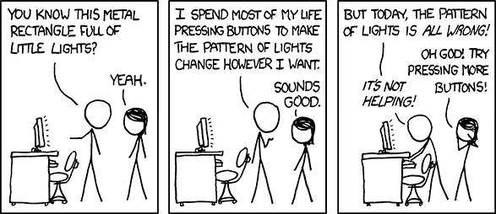
Software Errors

Slide 2
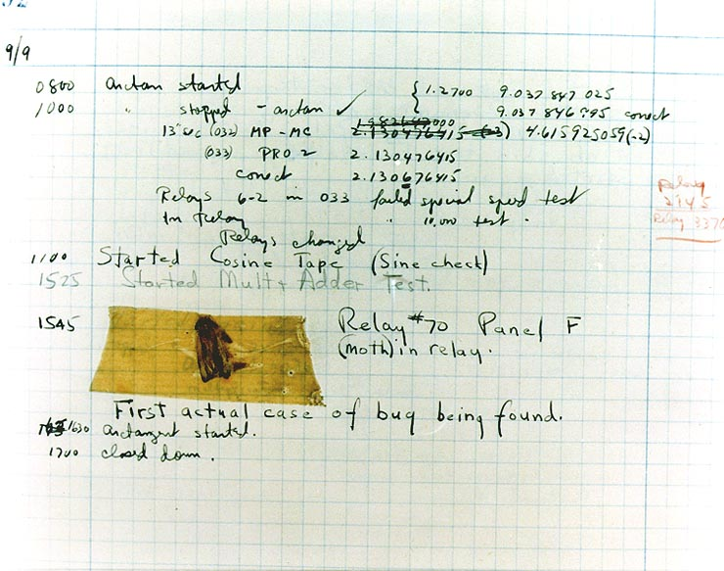
There’s a bug in our code

Slide 3
There’s a bug in our code
[Probably] The first software bug
Harvard Mark II
Electromechanical machine
Moth found in relay
Found by Grace Hopper

Slide 4
Type of Errors
3 that we’ll mention today
Compiler errors
Linking errors
Logic errors

Slide 5
Compiler Errors
Can be frustrating
Not a big issue
The errors are never released
The compiler is your first round of testing
Preventing compiler errors
Practice coding
You should be experts at solving these by now

Slide 6
Linking errors
Can be frustrating
Especially on large projects
The errors are usually not released
Issues if the software is environment dependent
Preventing linking errors
Have protocols to organize dependencies
Build tools
Coordinate the project build
Link necessary libraries

Slide 7
Logic Errors
Scary!
Today’s focus
When everything looks fine and runs fine
but it’s terribly terribly broken
Can be very difficult to detect
Often released
Preventing logic errors
Extensive testing

Slide 8
Rest of Today
Stories of logic errors

Slide 9
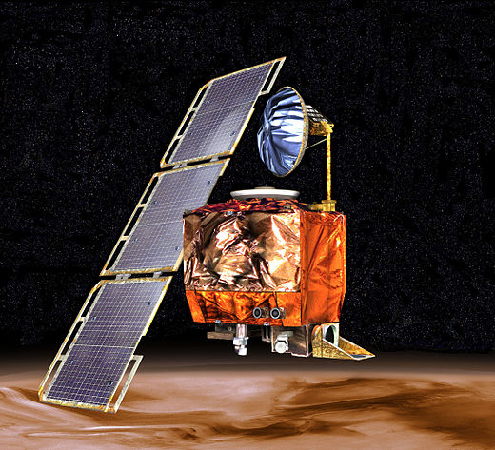
Mars Climate Orbiter
Launched
December 11, 1998
Lost communication
September 23, 1999
Never studied Martian climate
Large teams and contractors
Some used N s (Newton-second)
Others used lbf s (Pound-foot-second)
Conversions were never made
Total cost: $327.6 million

Slide 10
On the Lighter Side
int n = 5;
int k = 7;
System.out.println(“The sum is: “ + n + k);
The sum is: 57

Slide 11
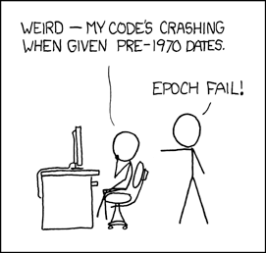
Representing Time
Y2K
2 digit year instead of 4
What happens when it’s 1900 again? -nothing
Many 32-bit UNIX-like systems
The epoch
January 1, 1970 @ 0:00:00 UTC
Current time represent in seconds
32-bit signed int + epoch
What happens after 2³¹ seconds?
January 19, 2038 @ 3:14:07am UTC

Slide 12
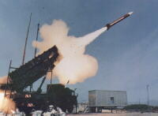
Patriot Missile
Needs to track time
24-bit floating point variable
Store time to the tenth of a second
1/10 is truncated in binary
Truncations were accumulated over time
Tested on short time intervals
Deployed with bug
100 hours of continuous operation
System failure
Missiles were off by ~1/2 km

Slide 13
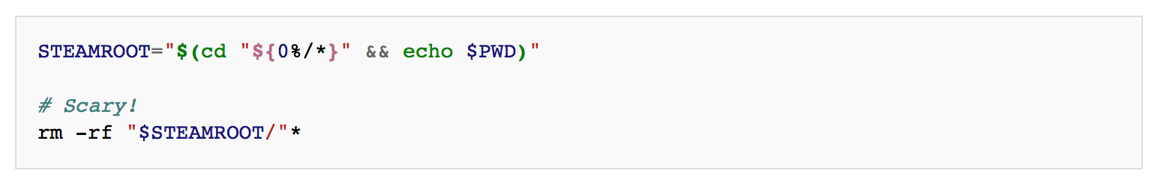
Steam Bug
Don’t move your install directory

Slide 14
DRM and Malware
DRM (Digital Rights Management)
Ensure copyright protection for digital media
Takes many forms (always-on, activation codes, restrictive file formats)
Sony BMG’s DRM Solution
Install rootkit alongside legitimate software
Don’t inform the user
Spy on them to look for illegal copying
If this wasn’t bad enough
The rootkit had a bug
Contained a backdoor that allowed anyone to control it
Any attacker had access to your machine

Slide 15
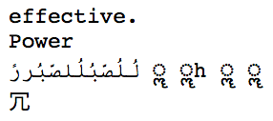
Apple Error
Send as a text to iPhone
Causes seg fault
Crashes current app
Crashes entire phone if opened from the notification center

Slide 16

Stock Market
Quants of Wall Street (quantitative analyst)
Significant algorithmic trading
Chicago-NYC arbitration
Different prices for the same commodity
Free money if you win the race
Spread Networks
$300 million laying 827 miles of fiber
Cut round trip communication
From 14.5ms to 13ms

Slide 17
Stock Trading Errors
The Flash Crash
May 6, 2010
$1 trillion of market value vanished
Prices recovered quickly
Lasted about 36 minutes
Knight
August 1, 2012
Software made erratic trades
Loses of $440 million in ½ hour

Slide 18
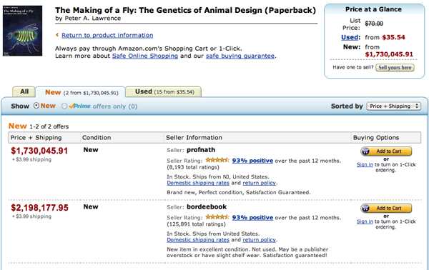
Similar algorithms on Amazon

