Slide 1
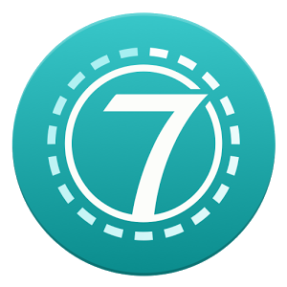
Seven Things Recent Graduates Don’t Know
Alan Hunt – March 1st, 2017

Slide 2

teamwork
In almost every case, you will be working with other people to get a job done, and your success will be measured by total outcomes more that by individual contribution.
You don’t have to like or agree with everyone you work with, but you do need to work with them productively.
Establishing relationships will be just as important to you as developing and maintaining technical skills.
Notes:
Group Projects, Open Source projects, Phone app on the 115 message board
Interview for personality

Slide 3

teamwork
Group Projects
Open Source Contributions
Personal Projects
Hackathons
Notes:
Group Projects, Open Source projects, Phone app on the 115 message board
Interview for personality

Slide 4
If you build it, they will break it
While malicious attempts on applications are an increasing concern in ALL industry, many of the same principles applied for secure development are also best practice for prevention of errors and unexpected behavior
Notes:
OWASP security
Secure coding practices
Input and output validation
Edge cases, negative tests
Error handling
Test Driven Development

Slide 5

If you build it, they will break it
OWASP Security Project
Defense in Depth
Input and Output Validation
Edge Cases
Negative Testing
Error Handling
Test Driven Development
Notes:
OWASP security
Secure coding practices
Input and output validation
Edge cases, negative tests
Error handling
Test Driven Development

Slide 6

User experience is as important as functionality
User requirements documents almost never specify that something needs to be easy to use, but it is always a requirement.
Without user adoption, no solution will provide the intended value, and awkward or frustrating experiences erode trust.
Notes:
Colorblind users
Mobile first principles/Adaptive Design
Search vs. Sort for menus/actions

Slide 7

User experience is as important as functionality
Colorblind users
Mobile First/Adaptive Design
Gamification
Cross Browser Compatibility
Search vs. Sort
Bad Error Messages
Failure to provide feedback
Notes:
Colorblind users
Mobile first principles/Adaptive Design
Search vs. Sort for menus/actions

Slide 8

Most source isn’t open
Unless you work for a university or an unusually enlightened employer, the code you write will be closed source, and key intellectual property.
Using open source libraries, widgets, GUI components, or other code sources could require that you compromise the nature of that IP (copyleft).
Each industry also has regulations that govern it, and these can be unintentionally breached unless they are part of your thought process.
Notes:
GPL = Bad, Apache v2 = Good
PII, HIPAA, SOX
FedEx country list, Nuvectra PHI, SOX Control

Slide 9

Most source isn’t open
GPL vs. Apache v2 vs. MIT…
PII and data classification
HIPAA
SOX
Embargoed Countries
Notes:
GPL = Bad, Apache v2 = Good
PII, HIPAA, SOX
FedEx country list, Nuvectra PHI, SOX Control

Slide 10
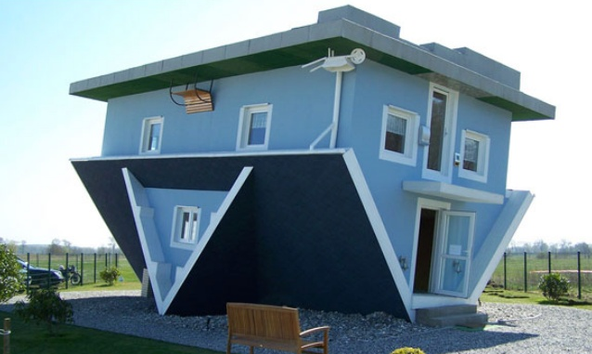
Who Built this junk?
After four years of writing projects from scratch, the first thing that a new programmer is usually given to do is fix something that someone else did a bad job building, or that they don’t understand well. Knowing how to decipher, re-architect, repair, and refactor are critical skills.
Notes:
Knowing when it makes sense to fix vs. rebuild
Sometimes code is awkward for good reasons

Slide 11
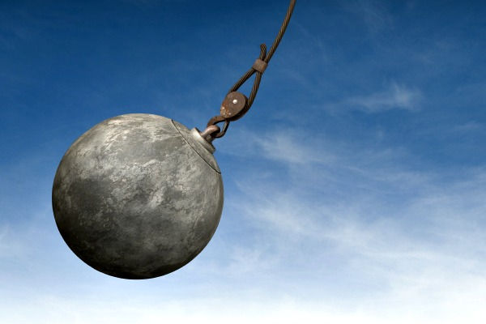
Who Built this junk?
No code is an island
Confusing != wrong
Cost is a factor
Best idea at the time
Project Shuffling
Modular architectures
Notes:
Knowing when it makes sense to fix vs. rebuild
Sometimes code is awkward for good reasons

Slide 12

That’s easy! That’s easy! That’s… late.
While individual tasks seem simple, enough simple tasks are the equivalent of a hard one. There are limits to the amount of effective multitasking you can do.
Delivering a program is more than just coding – don’t forget requirements, testing, training, documentation, and support!

Slide 13
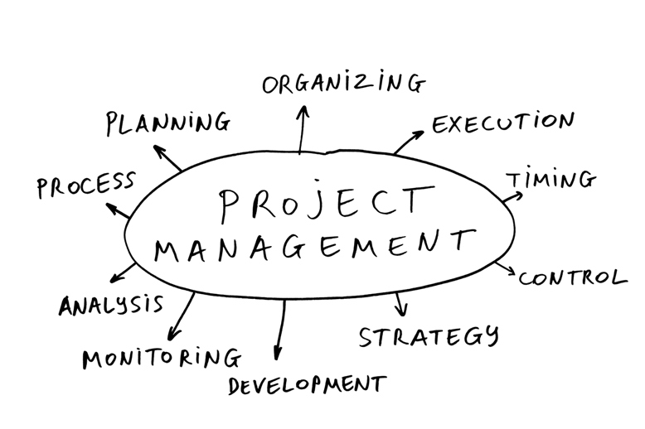
That’s easy! That’s easy! That’s… late.
Time Management
Task Prioritization
Coordination
Milestones
Change Management

Slide 14
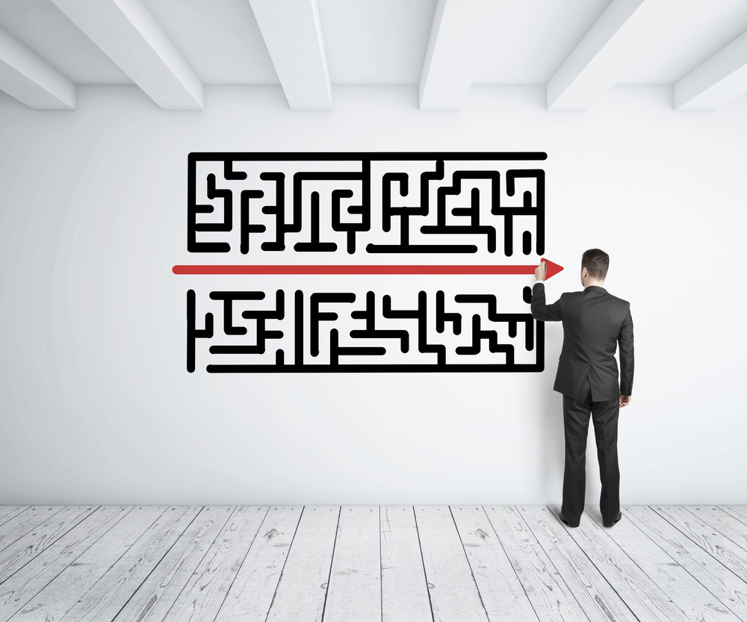
Communicate, and Make the complex Simple
Communications of all kinds are as important as technical skill. Understanding the need from the users point of view, and being able to explain how your solution meets that need can be the difference between success and failure.
If you can’t communicate technical issues in simple to understand ways, you won’t be able to sell your ideas.
Notes:
“message cleansing” vs spam – example of AD move
Show passion – javascript desk example

Slide 15

Communicate, and Make the complex Simple
Avoid Technical Jargon
Show Passion
Diversity Breeds Better Ideas
Walk A Mile in Their Shoes
Notes:
“message cleansing” vs spam – example of AD move
Show passion – javascript desk example

Slide 16

Questions?

