Slide 1
Design Patterns

Slide 2
OO-Concepts
Don’t rewrite code
Encapsulation
Inheritance
Write flexible code

Slide 3
Design Patterns
Time to level up!
Necessary when the projects are large
Course projects (possibly including CSE442)
Small projects
Requirements don’t change
No design patterns needed
Can get away without proper OO usage
Large projects with poor design
Do you want to refactor 10,000 lines of code?
100,000 lines?

Slide 4
Caution
Design patterns should be used in moderation
This is a hammer
Not all problems are nails

Slide 5
Let’s learn these
Singleton
Observer pattern
Decorator Pattern
Factory Pattern
//Command pattern
Adapter Pattern
State pattern
MVC

Slide 6
Singleton
There can be only one!
When your codebase needs to share a single object (not a single class)
Private constructor
What?
Controversial
Introduces global state

Slide 7
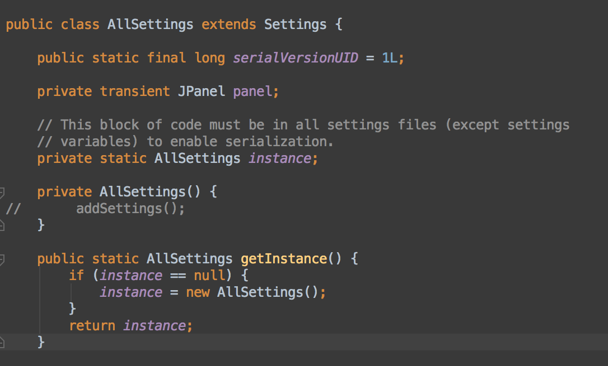
Singleton

Slide 8
Singleton
No need to pass the settings in every constructor and function call
Can cause issues
What if I want multiple sets of settings concurrently?
Panic
Then run multiple instances of the program and let the OS take care of it

Slide 9
Lazy Initialization
Don’t create an object until it’s about to be used
If an object is never used, it’s never created
Can prevent multiple instantiations
Can greatly improve efficiency
At least spreads out the computation
If that’s what you’re into

Slide 10
Observer Pattern
A single object has many other objects that need to know when it updates
On an update, broadcast to all concerned objects
But how?
Thermostat temp sensor
Furnace
AC
Mobile app

Slide 11
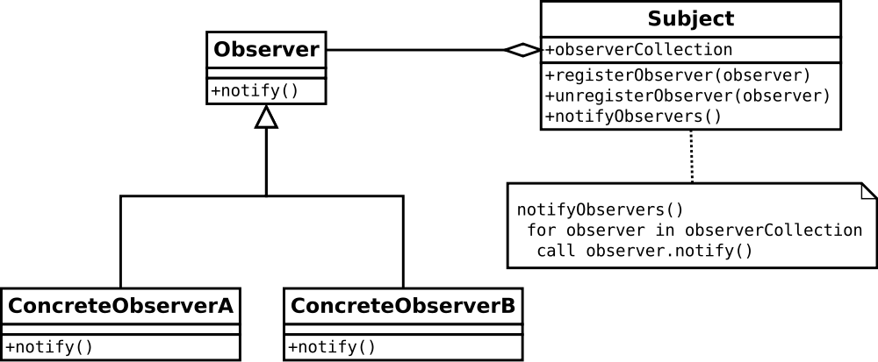
Observer Pattern

Slide 12
Observer Pattern
Loose coupling
Observers can be registered and unregistered during runtime
Flexible
Dynamic
No need to hardcode and notify every possible object that might ever be concerned
Subject is only coded once
This is a big deal!

Slide 13
Scenario
Inspired from Head First Design Patterns
Need to compute the cost of a burger
Condiments cost extra
Burger | $1.50
Ketchup | $0.05
Relish | $0.10
Cheese | $0.50

Slide 14
Scenario
How do we adjust to added requirement?
Burger | $1.50
Ketchup | $0.05
Relish | $0.10
Cheese | $0.25
Bacon | $0.50

Slide 15
Scenario
Customer orders double cheese and triple bacon

Slide 16
Decorator Pattern
Wrapper classes
Add features by adding wrapper classes
Outer object interacts with the world
Original/inner object is hidden
Especially useful when original class is in a library and lacks needed funtionality

Slide 17
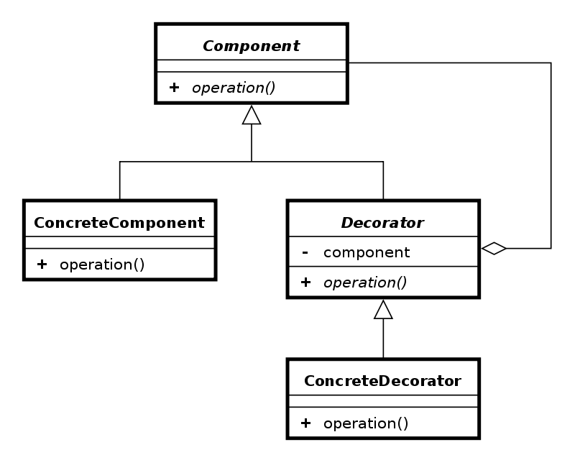
Decorator Pattern

Slide 18
Decorator Pattern
Food Item
cost()
Burger
cost()
Condiment
-Food Item
cost()
Ketchup
cost()
Relish
cost()
Cheese
cost()
Bacon
cost()

Slide 19
Scenario
Need to create an enemy (abstract class)
Type of enemy (concrete class) depends on:
Player’s level
Player’s location
Some randomness
Enemies are created throughout the codebase
What do you do?

Slide 20
Factory Pattern
A class that makes objects
Don’t all classes do that?
Factory pattern
Create objects of an abstract type
No concern about the concrete class that’s instantiated

Slide 21
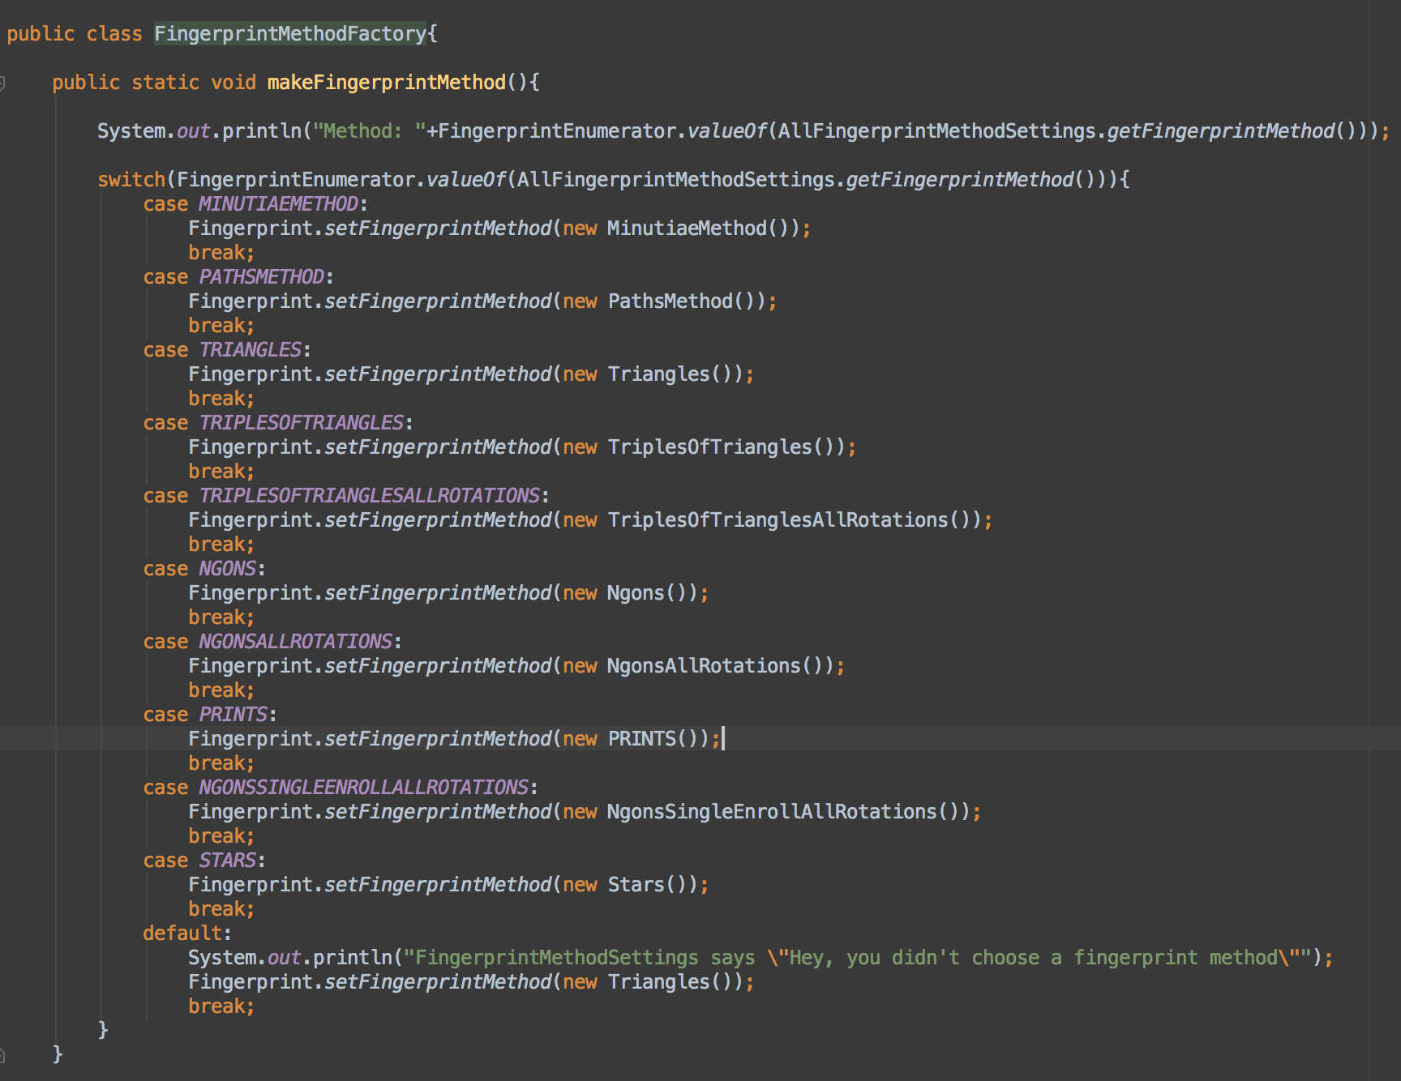

Slide 22
Command pattern
AI doesn’t push the a button
AI and human mixed games

Slide 23
Command pattern
AI doesn’t push the a button
AI and human mixed games

Slide 24
Command pattern
AI doesn’t push the a button
AI and human mixed games

Slide 25
Adapter Pattern
Interface between 2 different protocols
Don’t modify the source code of either
Often needed when combining code bases
Libraries
Your code uses a single interface
Adapters extend the interface and make external function calls

Slide 26
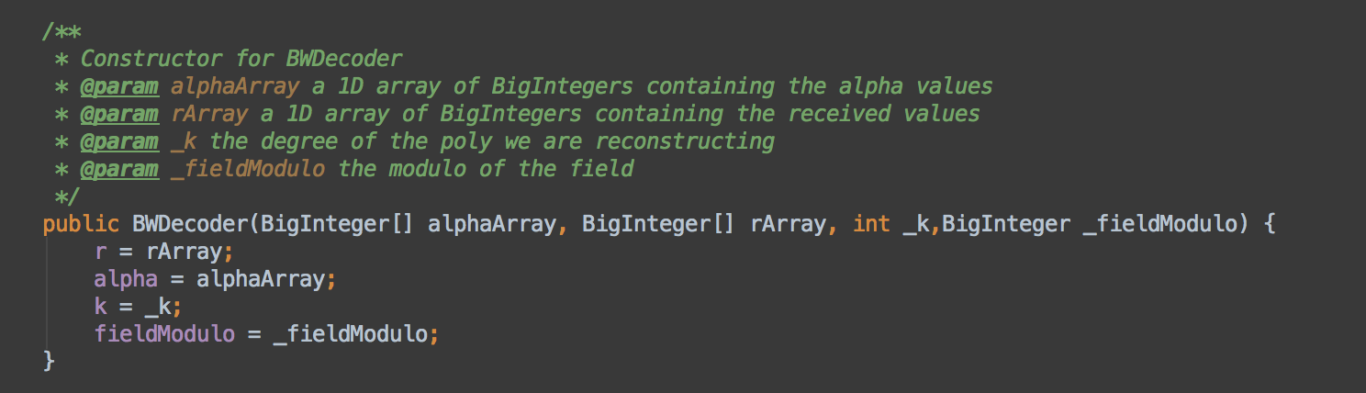
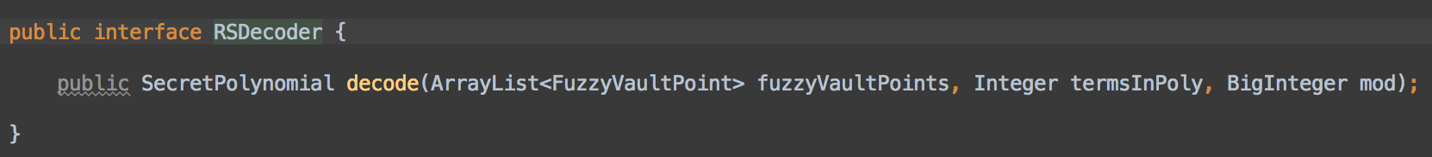
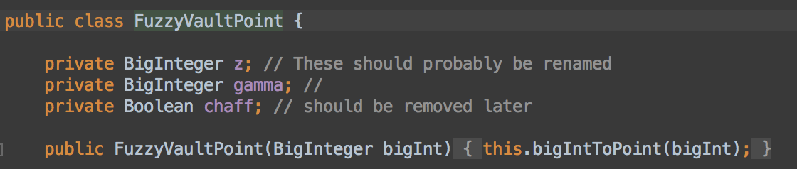
Library we need expects this:
Our code is built around this:

Slide 27
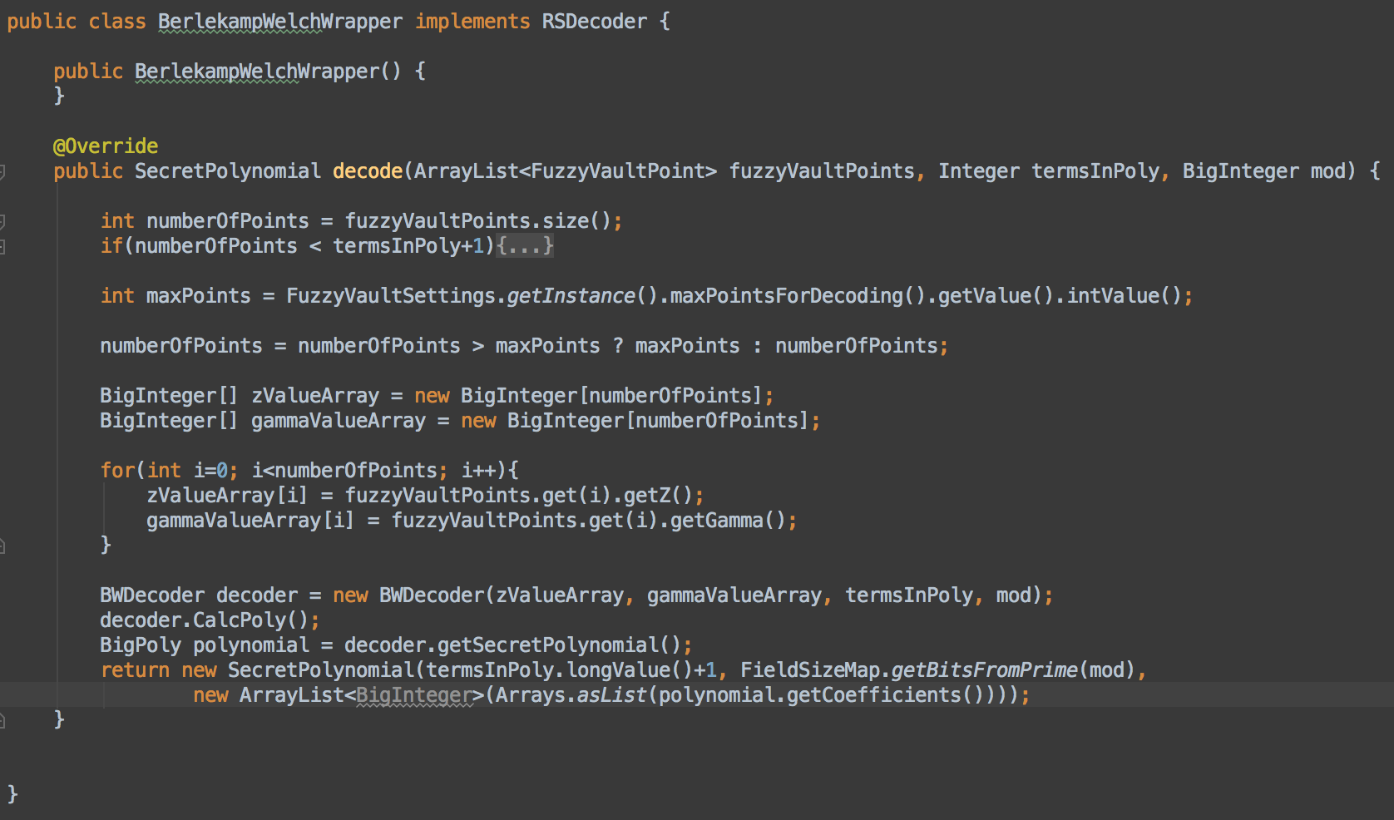
Adapter Pattern

Slide 28
State Pattern
CSE116
Make a program without using “if”
CSE396
DFA’s
Delegate functionality to a state object
Functionality changes as state chnges

Slide 29
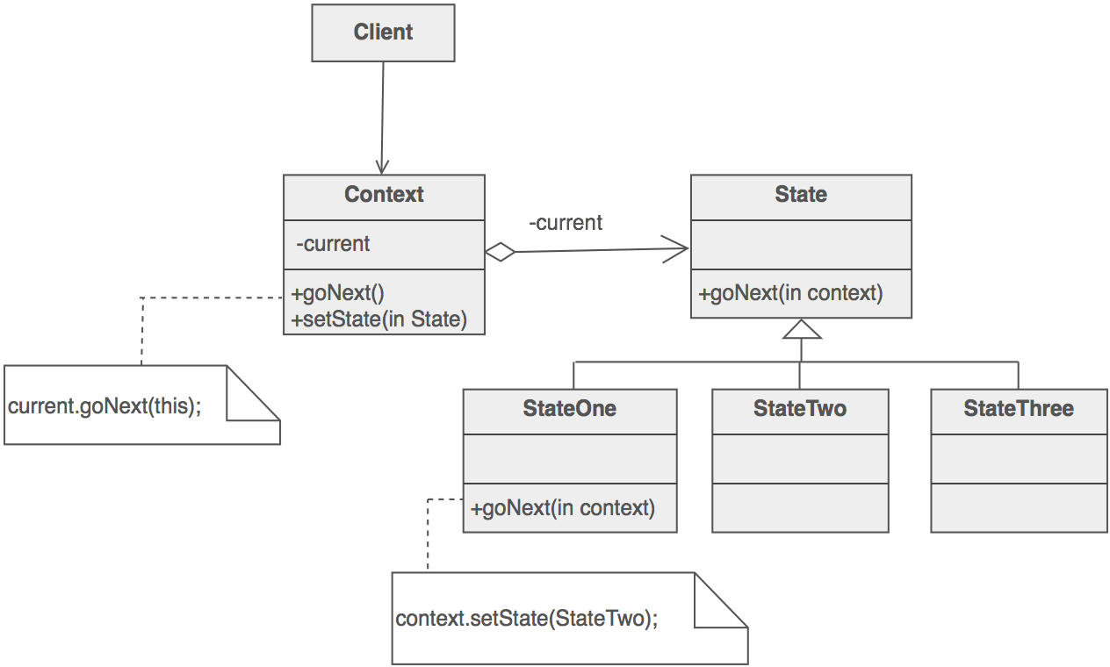
State Pattern

Slide 30
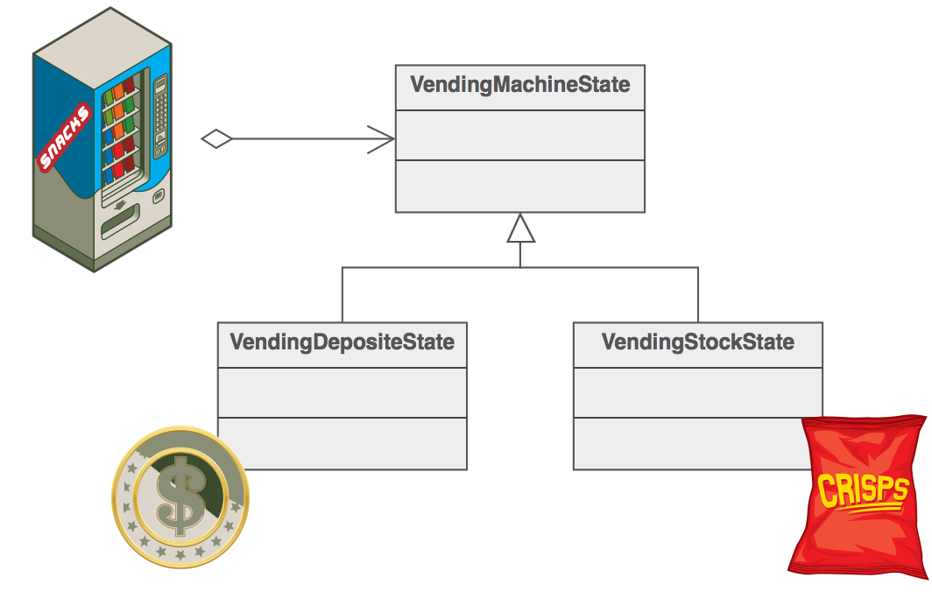
State Pattern

Slide 31
MVC
Model
Where all the action
View
What the user sees
Outputs
Controller
How the user interacts
Inputs

Slide 32


