Slide 1
Resumes

Slide 2
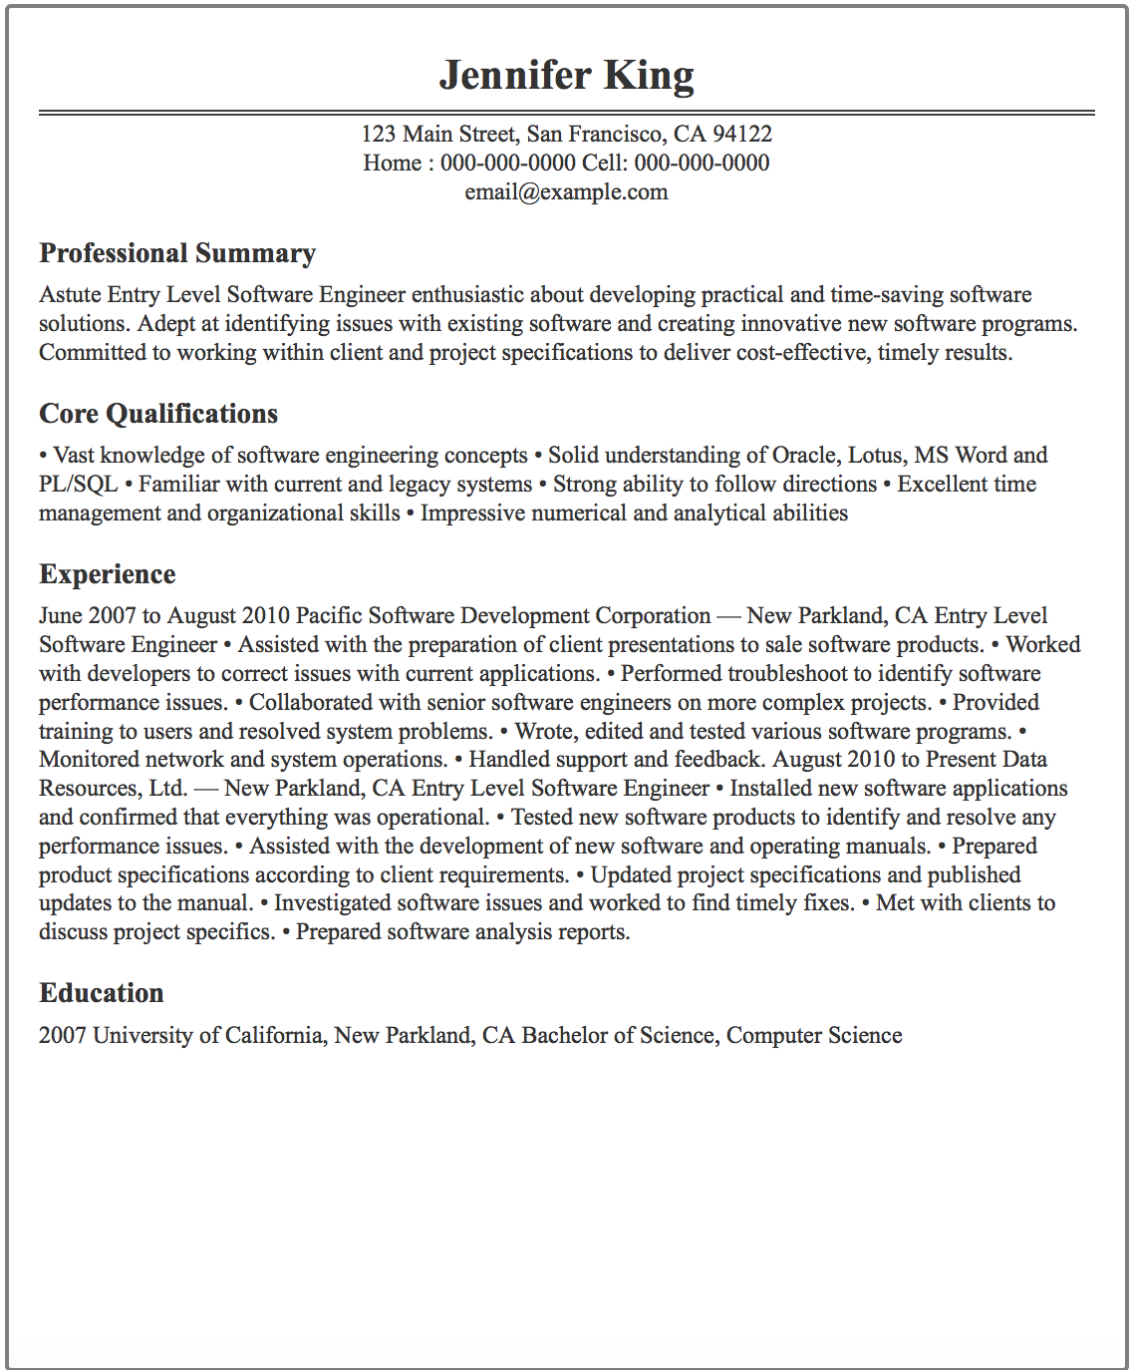

Slide 5
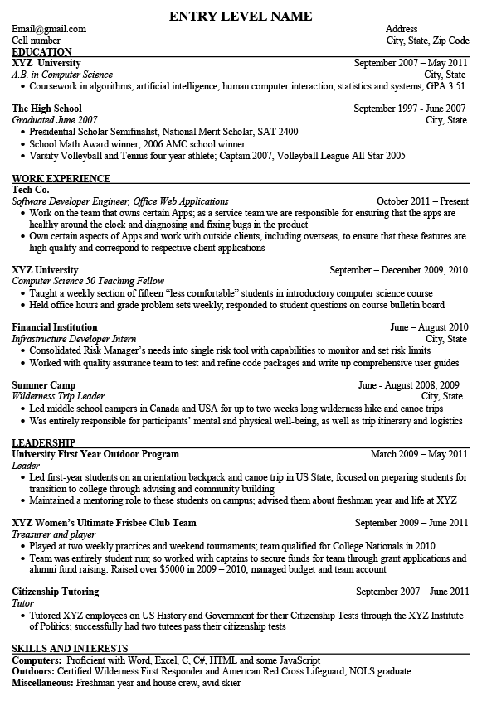

Slide 6
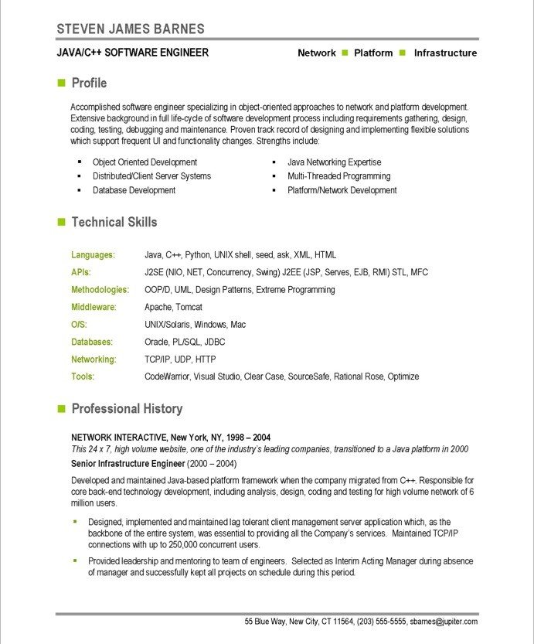

Slide 7
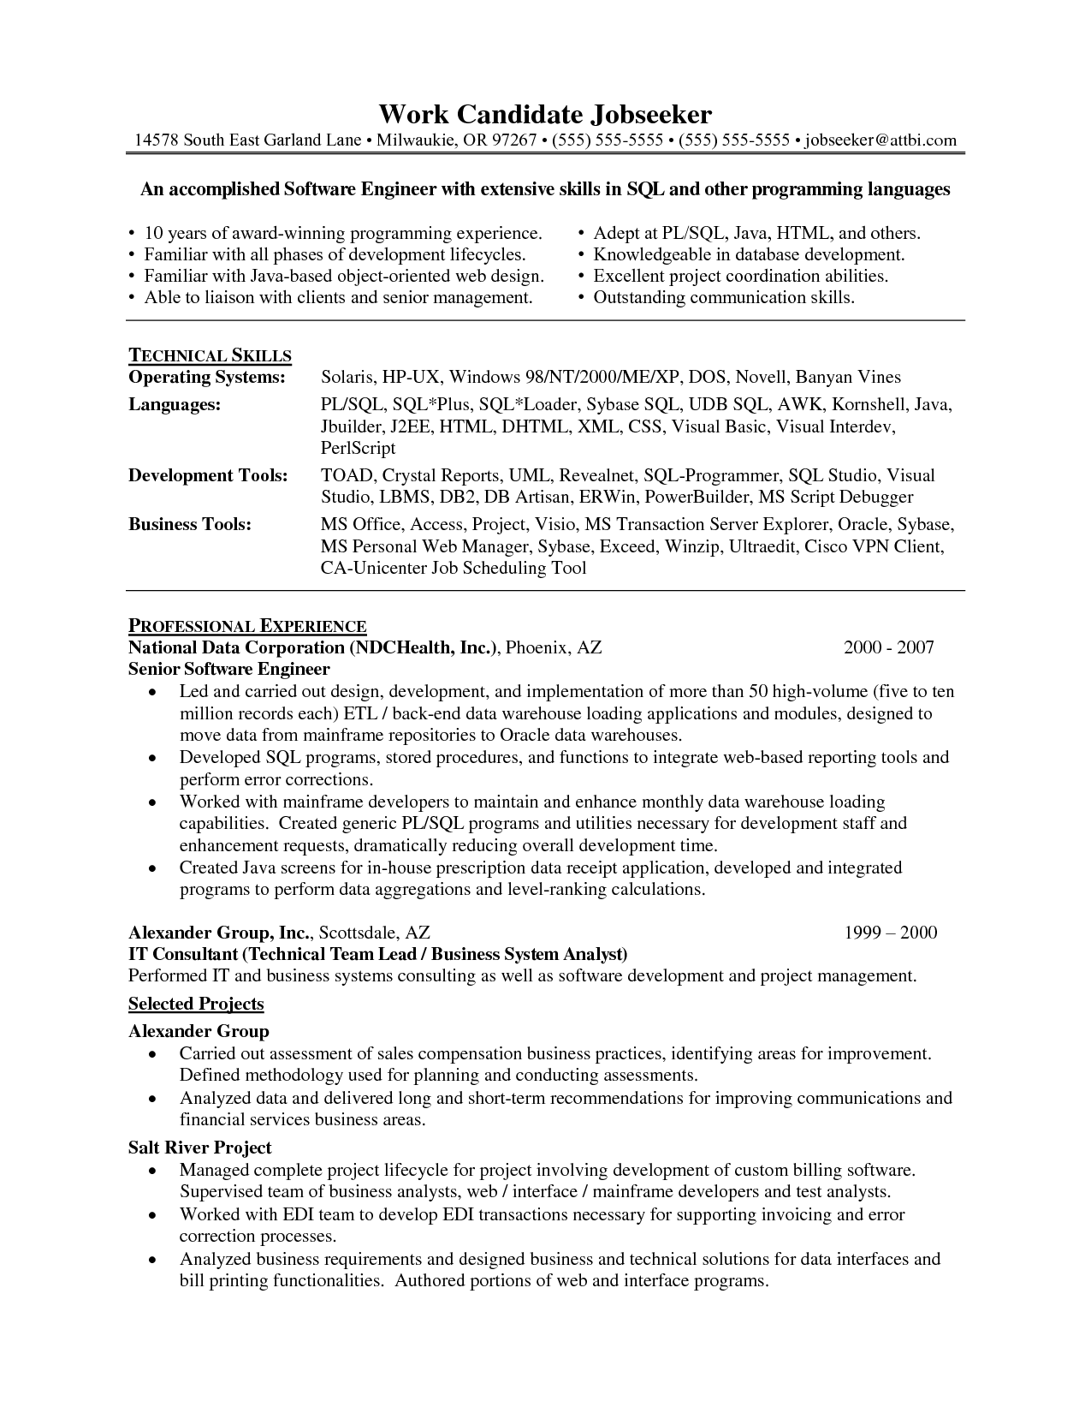

Slide 8
More Samples
https://www.resumedrop.co/
Real resumes
Site developed by UB alum Pat Jameson ('15)

Slide 9
Disclaimer
These are my opinions!
I’ve done my research and know a thing or two
Educated guesses
The nature of resume writing
Ask n people
Get n different answers
I’ll mostly stick with common strategies
Warn when I’m giving more controversial advice

Slide 10
Why write a resume?
To get an interview
A great resume can make the interview easier
Don’t lie on your resume. They can tell in the interview
Learning the claimed skills before the interview
You’re expected to
Even if you have the job through a contact
HR requires a resume to be on file

Slide 11
Resume Content
Is what you’ve been working on for years
We’ll focus mostly on presentation today

Slide 12
Presentation Matters
Make this document look great!
Especially if you’re applying for any web/app design or any other front-end design
Your resume is a document that represents you (professionally at least)
This is how you choose to present yourself
If you sloppily present yourself on a document that you’ve had years to prepare:
How much do you really care about your career?
How are you going to represent the company?

Slide 13
As opposed to:
Make this document look great! Especially if you’re applying for any web/app design or any other front-end design. Your resume is a document that represents you (professionally at least). This is how you choose to present yourself. If you sloppily present yourself on a document that you’ve had years to prepare:
-How much do you really care about your career?
-How are you going to represent the company?

Slide 14
Bullet Points
Makes resume easier to skim
Short sentences with buzzwords
Without bullets and buzz
I worked at this company doing web development and implemented a database to efficiently store and retrieve user data in real time.
With
Implemented a SQL server to manage 1000’s of customers’ data
Developed web apps using PHP, JavaScript, HTML, CSS
Monitored system performance in real time

Slide 15
Action words
Start each description with a strong action word
managed, originated, conducted, coordinated

Slide 16
Job Descriptions – With Action Words
Without
Worked at McDonalds as a cashier and cook
With
McDonalds
Responsible for 100’s of financial transactions each day
Ensure safety and health standards are met
Don’t lie or embellish
Remind and inform

Slide 17
Job Descriptions – From Samples
Summer Camp – Wilderness Trip Leader
“Led middle school campers in Canada and USA for up to two weeks long wilderness hike and canoe trips”
“Was entirely responsible for participants’ mental and physical well-being, as well as trip itinerary and logistics”
Barista
“Excelled within service-oriented (concurrent with college studies), delivering premium customer service and attracting repeat customers

Slide 18
Typical CSE Senior Resume
Content includes:
A degree in computer science
Multiple programing languages
Experience with software (IDE’s, Linux, MS Office)
Course projects
At least 1 past job (technical or not)
These should all be on your resume
Probably won’t set you apart though

Slide 19
Projects Section
If you have any projects
Make a projects section
Shows that you want to write software!
You’re not just taking CS cause it will make a good career
Can add course projects
Everyone has these so it’s not strong
Except this course project since it’s open-ended

Slide 20
Objective
Optional
I like having one
Brief (one sentence) description of your career goals

Slide 21
Skills Section
Skills should be scattered throughout your resume
Mention the software and languages used in each job/project description
Can also have a separate skills section to reinforce that experience and mention anything not covered elsewhere

Slide 22
Who reads resumes?
Most common cases
Software Engineers
Managers
Human resources
An algorithm
This depends a lot on where you apply
A resume can be tailored to the department that will be reading it
Add some non-technical flourish for HR
Talk technical details of projects for SE’s

Slide 23
Example Resume Flow
Software Engineers submit a job description to HR
“We need someone who can work on our website and knows HTML, CSS, PHP, SQL, JavaScript”
Resumes are submitted to HR
HR filters resumes not fitting the criteria
Remember, they might not know what SQL is
Keywords!
Qualified applicants go to the Software Engineers
Typically to the project managers or senior developers
The engineers decide who they will interview

Slide 24
Scenario
You are working as a software engineer
You are busy writing code and tracking down bugs
You are given a stack of resumes and you’re told to pick a few to interview
What would you look for?

Slide 25
Scenario
The person reading your resume is like you
A few years further in their career
*Potentially controversial suggestion:
“Write your resume for you”
If a company doesn’t like it, it might not have been the best match anyway
Bad advice if you just want a job
Better advice if you want your dream job

Slide 26
If you don’t know where you want to work
Target an audience that you would like to work for.
Try presenting yourself as a person you would hire
Not what you think the hiring manager will be looking for.
This way you have the companies self-select as the ones that you want to work for.
Some things you must tune to the hiring manager (if you know where you want to go).
I tailored to the CSE department.

Slide 27
Curriculum Vitae
“The course of my life”
What you call a resume when you fancy
Typically longer than a resume
I have done this:
Had one document
Rename the file “cv.pdf” or “resume.pdf” depending on what was asked for

Slide 28
Summary
Work Experience / Projects section
Bullet points
Action words
Mention tool/languages
Education is straight forward
Just make the formatting look good
A lot of choices depend on how much you have to say
Keep it to 1 page as a college grad

Slide 29
LinkedIn
Not much to say about this
Just make a profile
Some companies look for employees on here

Slide 30
Cover Letter
Not sure if anyone reads these
Some companies don’t require one
Aim for 3 paragraphs
1: Briefly, why you are qualified for this specific position
2: Summary of the highlights on your resume
Don’t be afraid to repeat content from your resume
3: Invitation to contact and looking forward to meeting

