Slide 1
Software Engineering Careers

Slide 2
Careers
Who uses software
Everyone
You can get a job in any industry
If an industry doesn’t utilize software
Enter it as an entrepreneur!

Slide 3
Grad school
Get a job, or stay in school
If you can get the job you want right now
Take it
Few exceptions to this
Master’s degree
Extend you bachelors degree
PhD
Research

Slide 4
Different types of industry
Startups
Large corporations
Research
Academia

Slide 5
Internships
Sample an organization
Great if you’re not sure where you want to go
Shift to hiring through internships
Hire lots of interns
Poor performance
Gone in a few months
Not a big loss financially (opposed to hiring full-time)
Good performance
Full time offer (usually)

Slide 6
Expected Pay
Lots of data online
I wont give numbers
You can make a lot
Academia is more freedom and less chasing someone else’s bottom line
Makes bigger difference from any level

Slide 7
The Money is Good
No matter what you do
Do something you WANT to do!
You chose whatever you wanted for your project
Seek a career doing that!

Slide 8
Choosing
Industry
Grad school
Master’s
PhD
research
Academia
Industry

Slide 9
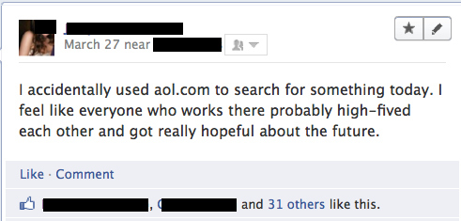
Company Culture
My opinion
More important than most other factors
Work somewhere that fits you
Might not get this right out of college

Slide 10
Professionalism
You have responsibilities
Take care of them
On time!
Communicate!
Clear
Concise
Often
Bring up issues / don’t over promise
Honesty
Don’t be a burden

Slide 11
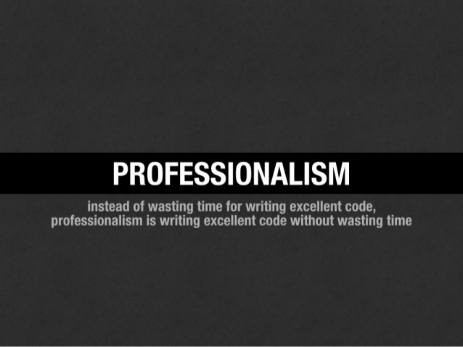

Slide 12
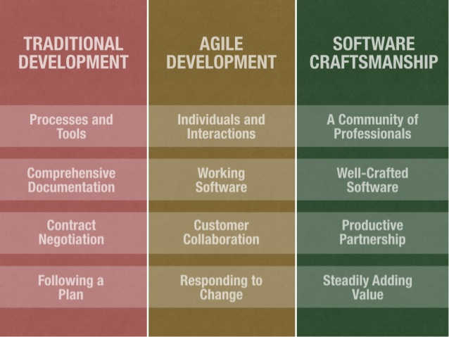
Side Note:

Slide 13
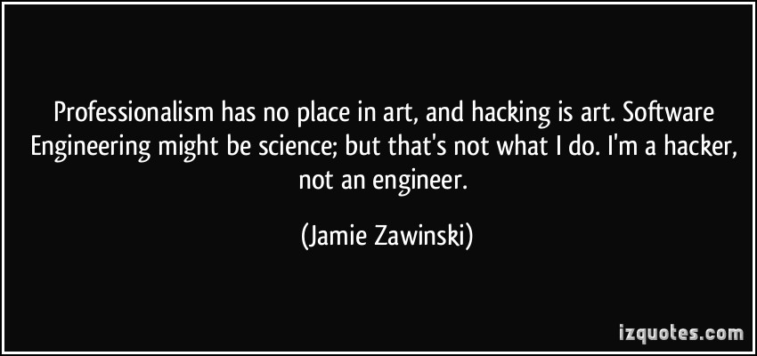

Slide 14

Professionalism
Not to be confused with acting professional

Slide 15
Acting Professional
You’ve heard the tips before
You should fit into your companies culture
If your company acts professional
You should act professional
If you don’t like acting professional
Seek employment where you’re not expected to
How many CS professors wear suits?

Slide 16
Entrepreneur
Better be comfortable with failure
Lots of ideas fail before the winner is found
Know when to abandon a project
Know when to go all-in with a winner
Resources at UB
Panasci
Student Entrepreneurship Programs
Hackathons

Slide 17
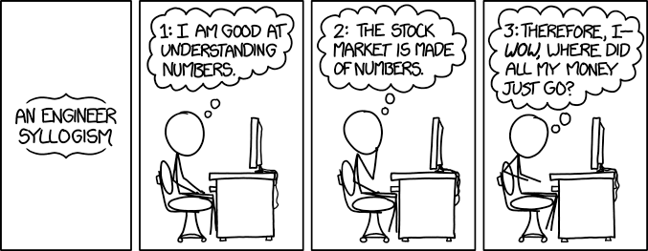

Slide 18
Software Engineering Jobs
Wall Street
Silicon Valley
Everywhere

Slide 19
Helpful Exercise
List your priorities in order
Use this to assess job listings and career directions
Mine
Location (WNY)
Freedom / Flexibility
Challenge
Meaning
Atmosphere / Culture

Slide 20
What does career mean to me?
I didn’t know what to do
Well, I didn’t know what job fit what I wanted to do
I know now
What I want to do:
Everything
What job lets me do that?
This one!
In industry
Work on your companies projects
Work with your companies employees
In academia
Work on anything
Work with anyone

