Slide 1
Shortest Path with Negative Edge Weights
Bellman-Ford

Slide 2
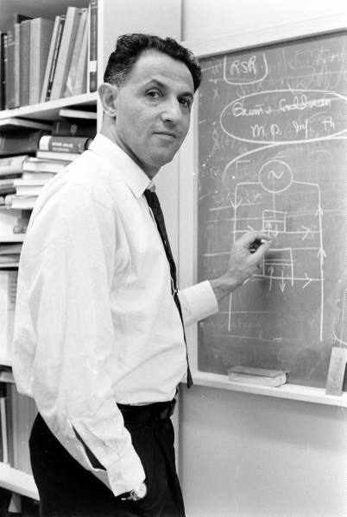
When to use Dynamic Programming
There are polynomially many sub-problems
Richard Bellman
Optimal solution can be computed from solutions to sub-problems
There is an ordering among sub-problems that allows for iterative solution

Slide 3
Shortest Path Problem
Input: (Directed) Graph G=(V,E) and for every edge e has a cost c_{e} (can be <0)
and no negative cycles in G
t in V
Output: Shortest path from every s to t
(Can also reverse the problem and find Shortest path from s to every node t)
1
1
s
t
Assume that G has no negative cycle
Shortest path has cost negative infinity
899
100
-1000

Slide 4
Rest of today’s agenda
Dynamic Program for shortest path

Slide 5
Bellman to the rescue

Slide 6
Recurrence Relation
OPT(i,u) = cost of shortest path from u to t with at most i edges
OPT(i,u) = min { OPT(i-1,u), min_{(u,w) in E} { c_{u,w} + OPT(i-1, w)} }
Path uses ≤ i-1 edges
Best path through all neighbors

Slide 7
Today’s agenda
Finish Bellman-Ford algorithm
Analyze the run time

Slide 8
Some consequences
OPT(i,u) = shortest path from u to t with at most i edges
OPT(i,u) = min { OPT(i-1,u), min_{(u,w) in E} { c_{u,w} + OPT(i-1, w)} }
OPT(n-1,u) is shortest path cost between u and t
Group talk time:
How to compute the shortest path between s and t given all OPT(i,u) values

Slide 9
