Slide 1

Version Control: Branching
CSE 442 – Software Engineering

Slide 2
Bersoff’s “First Law”
No matter where you are in
developing a system
the system will change
& you will find
continued desire to change it

Slide 3
Version Control Benefits
Reduces effort managing & implementing change
All changes can be placed in context
Easier to see logic behind changes
Software integrity and security increased
Improves quality and reliability
Fired worker cannot hold project hostage
Generate information about process
Improved process & team management
Software development database automated
Better finger pointing and/or saying “I told you so”
But, it’s easy to get in each others way
Merge Conflict

Slide 4
git Branching
Useful if adding feature, refactoring code, debugging
Want all benefits of version control as you develop code
Once changes complete, need to push changes back
Want any updates & limit conflicts for later push
You half-completed code should not pollute colleagues
git includes branching options for these cases
(As with most of this work, also true for other systems)

Slide 5
Without Branching
Susan busy fixing backend of system
Overhaul optimizes code & improves performance…
… or it will once Susan completes this work
May first make system unstable (or worse) until done
Major task takes weeks, so pushes to avoid losing work
John tinkering on frontend making cosmetic changes
But gets Susan's code in pull & sees new side effects
Assumes he caused changes and starts looking for bugs
Experience is of bugs which appear & get fixed randomly

Slide 6

Without Branching
Susan busy fixing backend of system
Improves performance, but only once complete
John tinkering on frontend making cosmetic changes
Sees system and tries to associate his changes with bugs

Slide 7
Without Branching
Huge argument about pushing incomplete code
Most tempting & easiest solution reached: JUST WAIT
Keep code local until complete so nobody else sees errors
Works great in short term; John and Susan both happy
Final work pushed & everyone is more productive

Slide 8

Without Branching
Huge argument about pushing incomplete code
Most tempting & easiest solution reached: JUST WAIT
Keep code local until complete so nobody else sees errors
Works great in short term; John and Susan both happy
Final work pushed & everyone is more productive

Slide 9
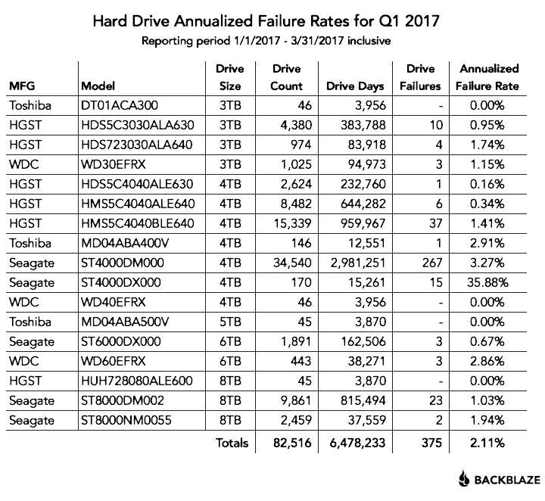
Without Branching
Huge argument about pushing incomplete code
Most tempting & easiest solution reached: JUST WAIT
Bad scenario: lose weeks of work with disk failure

Slide 10
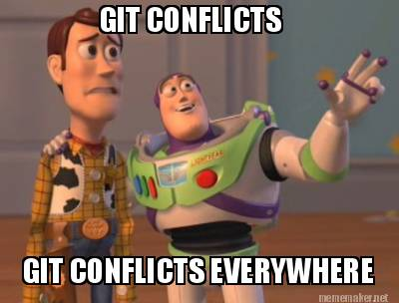
Without Branching
Huge argument about pushing incomplete code
Most tempting & easiest solution reached: JUST WAIT
Worse scenario: everyone pushes week of deadline

Slide 11
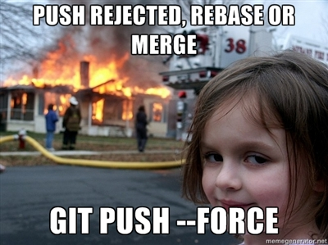
Without Branching
Huge argument about pushing incomplete code
Most tempting & easiest solution reached: JUST WAIT
Worst scenario: everyone pushes day of deadline

Slide 12
Benefits of Branching
Allows developers to work independently
Changes and updates saved in version control
Total independence not needed; others can join branch
Always able to prune branch and rejoin rest of team
Not everything is success, simplify if/when backing out
Merge branch into develop when work is complete
Should not interfere with others; you got it working!

Slide 13
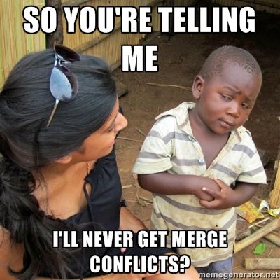
Benefits of Branching
Allows developers to work independently
Changes and updates saved in version control
Total independence not needed; others can join branch
Always able to prune branch and rejoin rest of team
Not everything is success, simplify if/when backing out
Merge branch into master when work is complete
Should not interfere with others; you got it working!

Slide 14

Benefits of Branching
Allows developers to work independently
Changes and updates saved in version control
Total independence not needed; others can join branch
Always able to prune branch and rejoin rest of team
Not everything is success, simplify if/when backing out
Merge branch into master when work is complete
Should not interfere with others; you got it working!
Limits time solving conflicts (for most developers)

Slide 15
Branching in git
git checkout –b <newBranchName>
Creates new branch in repo named <newBranchName>
Local system will now use branch (until merged back)
Could instead use two separate commands:
git branch <newBranchName>
git checkout <newBranchName>

Slide 16
master and develop
Two standard branches commonly used in git
Default that & one initially used is master branch
Often create develop branch for experimental code
Only store code for stable releases in master
Every version tagged so can always find where you were
In worst case, always have solid, stable code available
Never used directly; merges added after thorough testing
Team keeps completed features in develop
Code being readied for inclusion in next product release
Gauge completion by testing develop for stability

Slide 17

master and develop
When time to release new version draws near….
Commits stored in develop merged into master
master subjected to final tests for any latent bugs
Once ready, add tag to identify version used in release
…& repeat: continue work in develop for next pass

Slide 18
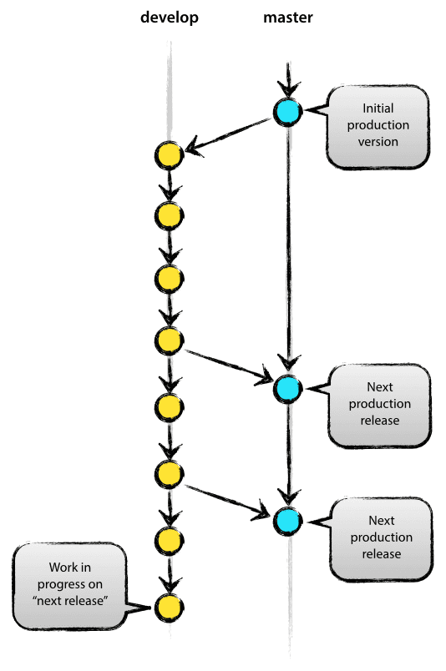
Standard Model for git

Slide 19
Developing Each Feature
Between releases branch off develop not master
Defines unit of code added back to project
Selectively merging part of branch impossible
Fine having many branches developed in parallel
With branching cheap, often create one for each feature

Slide 20
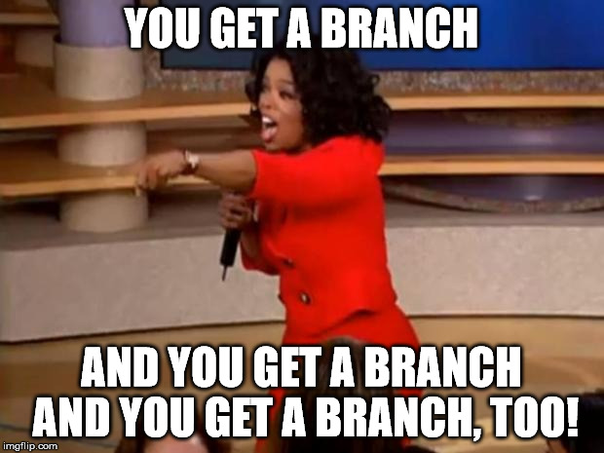
Feature Key Point
Between releases branch off develop not master
Defines unit of code added back to project
Selectively merging part of branch impossible
Fine having many branches developed in parallel
With branching cheap, often create one for each feature

Slide 21

Developing Each Feature
Some, but not all, features work as expected
Avoid confusion: delete branches where ideas failed
Review code before merging into develop
Or, & often done, just hope develop does not break
master remains safe so still better than nothing

Slide 22
Merging: A Comparison
Merging With fast-forwarding
Merging Without fast-forwarding
Command to be used: git merge
Changes merged & branch existence lost
git history complex from lack of data
Demands good commit messages & useful tags
Command to be used: git merge --no-ff
Changes merged, but branch existence kept
Branch development process can be seen
Helped by good commit messages & useful tags

Slide 23
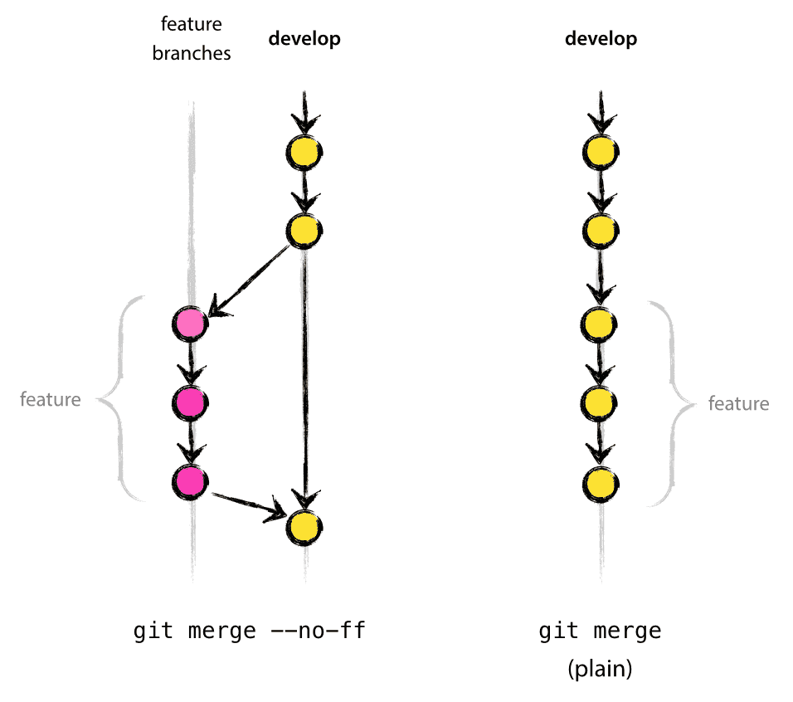
Merge History Comparison

Slide 24
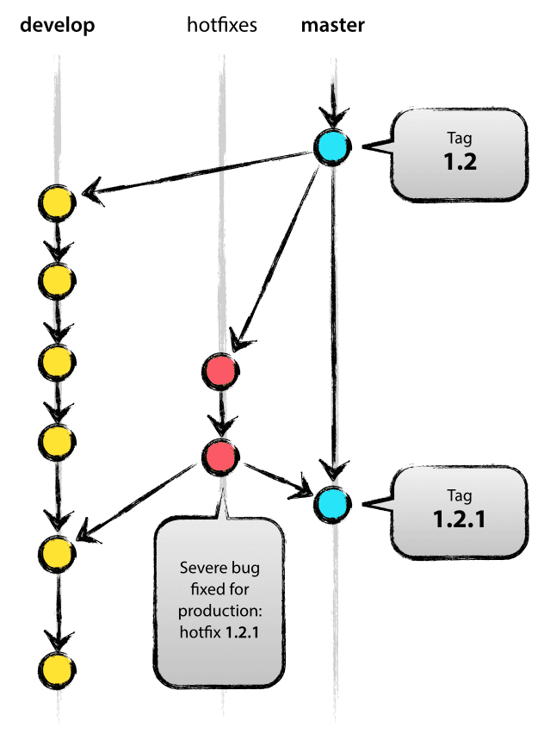
Bugs (& Hotfixes) Happen
Notes:
Hotfix merged to both branches

Slide 25

Picture of Good git Repo

Slide 26
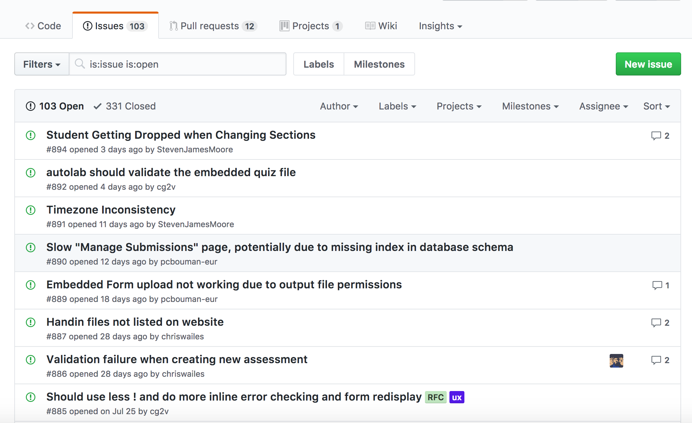
GitHub
Every feature branch should be associated with an issue in GitHub

Slide 27

Pull Request
Don’t push directly into develop or master
EVER! (At least in this course and on most teams)
Merge your feature branch with a pull request
Add a reviewer to your pull request
Add the issue being resolved to the request

Slide 28
Code Reviews
Review the pull request to ensure the code is ready to be added to the project
Check
For errors (clone the pull request code and test)
Code conventions
Readability
Anything else important to the team or project

Slide 29
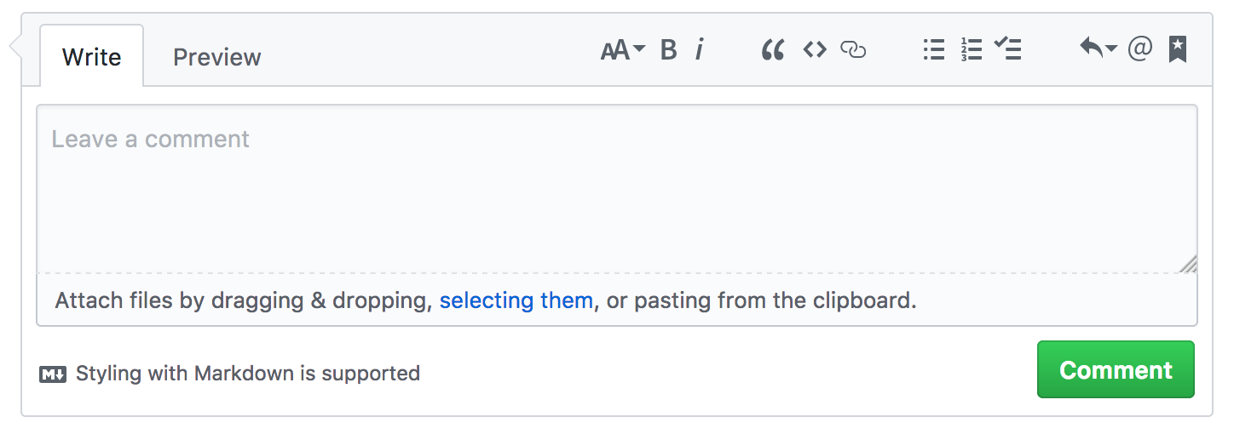
Code Reviews
Communication is critical!
Talk to the requester about the code
Discuss the code if it is missing an important aspect
Respond to messages on your requests and correct any issues

Slide 30
Development Workflow
Create an issue for a task
Create a feature branch off of develop for that issue
Commit and push code to the feature branch throughout development
When complete, create a pull request to merge the feature branch into develop
Add a reviewer(s) and issue to the pull request
Reviewer approves (or rejects) pull request
Once all reviewers approve, merge the code into the develop branch

